Slide 1



Nitrate-N Solute Transport Model of Yigo-Tumon Basin, Northern Guam Lens Aquifer
Atasha Bautista, Jovic Cassi, Todd Wood, and Dr. Nathan Habana
Notes:
Good morning! My name is Atasha Bautista, and I’m an undergraduate research assistant at WERI. I work under Dr. Nathan Habana as part of his modeling team, alongside Jovic Cassi and Todd Wood. Today, I’m sharing our recent work on developing a nitrate-nitrogen solute transport model for the Yigo-Tumon Basin.

Slide 2
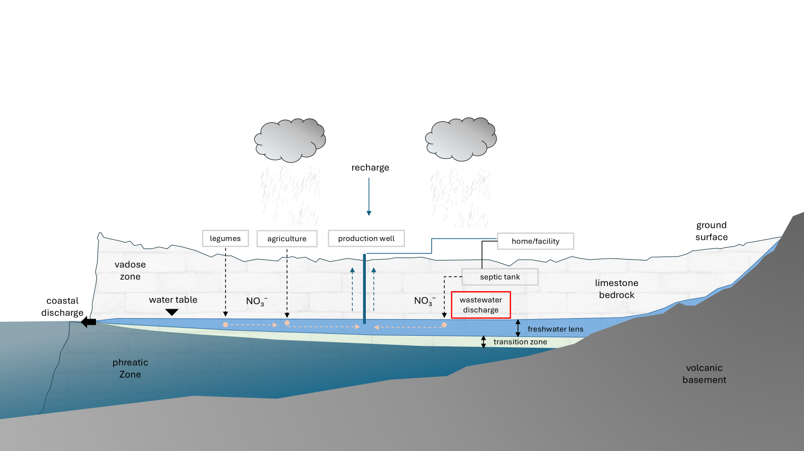
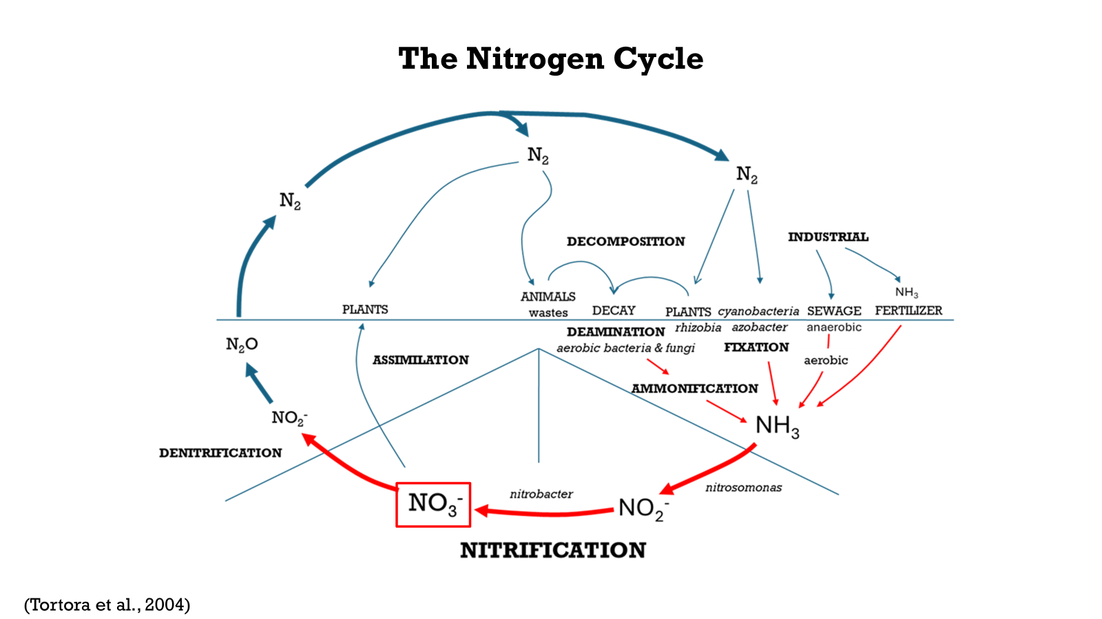
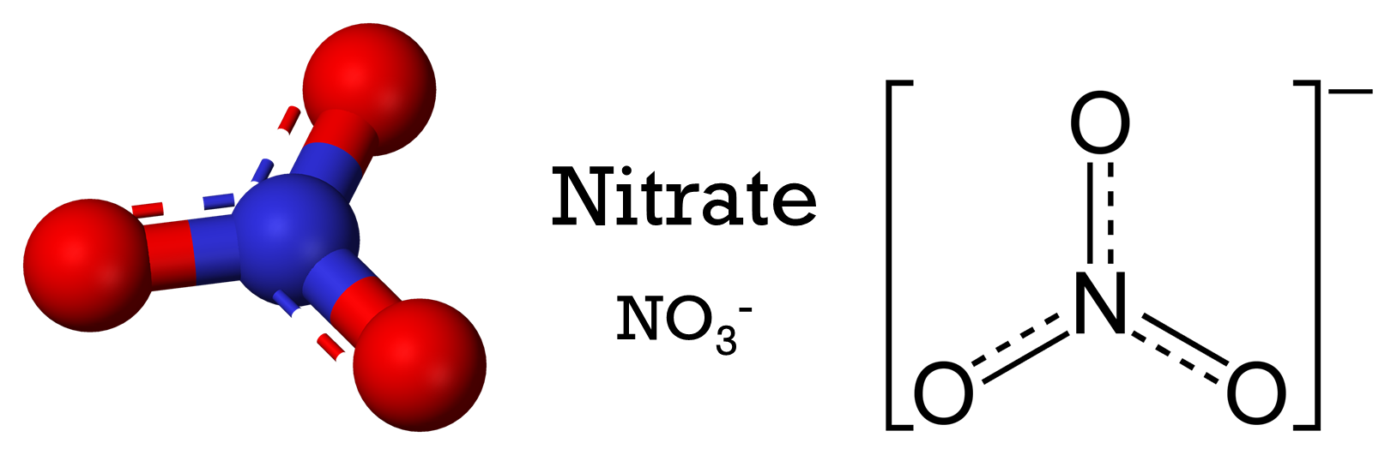
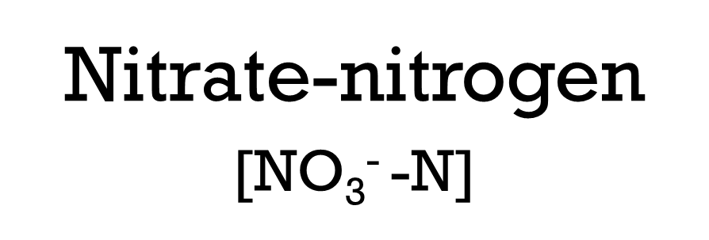
Background
Notes:
Nitrate (NO₃⁻) is a widely recognized indicator of groundwater contamination. (Click) Its concentration is commonly reported as nitrate-nitrogen (NO₃⁻-N), which measures only the nitrogen component of the nitrate ion.
(Click) To understand how nitrate occurs, we can look at the nitrogen cycle. Nitrogen from sewage, fertilizers, legumes, and animal or plant waste undergoes processes that eventually lead to nitrification, producing nitrate.
Natural sources like legumes and animal waste usually contribute background levels of about 1–2 mg/L of nitrate-N in groundwater. When concentrations rise above this range, it often signals anthropogenic sources, particularly from agriculture/farms and residential areas that rely on septic tanks. (CLICK) So when we overload nitrate in our environment, it bypasses natural uptake. It moves past the root zone and leaches into the aquifer, as this diagram shows.

Slide 3
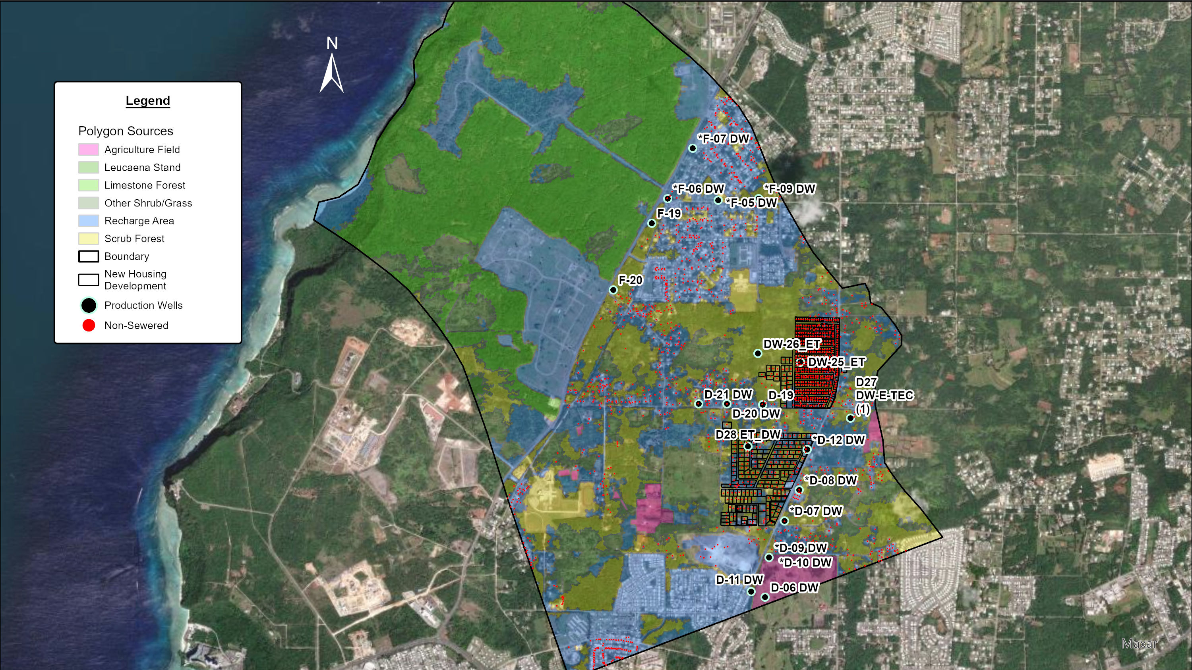
GIS Files
Polygon sources adapted from vegetation landcover (Wen, 2006)
Non-sewered data adapted from GWA and Habana & Heitz (2006)
New housing development (Parcel Map, DLM, 2005)
Notes:
In the last workshop, we introduced a pilot solute-transport model of the Swamp Road area to show how nitrates move into production wells. This map highlights potential nitrate sources and emphasizes a scenario where new housing developments would rely on septic tanks.

Slide 4
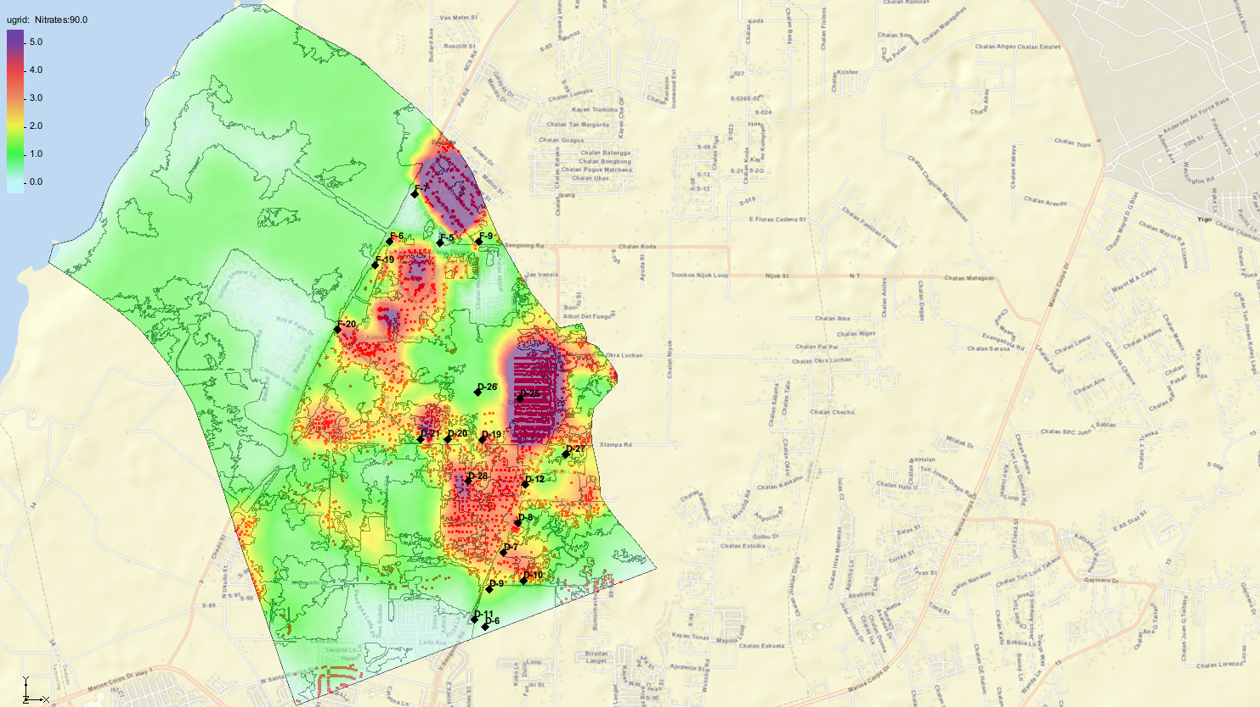
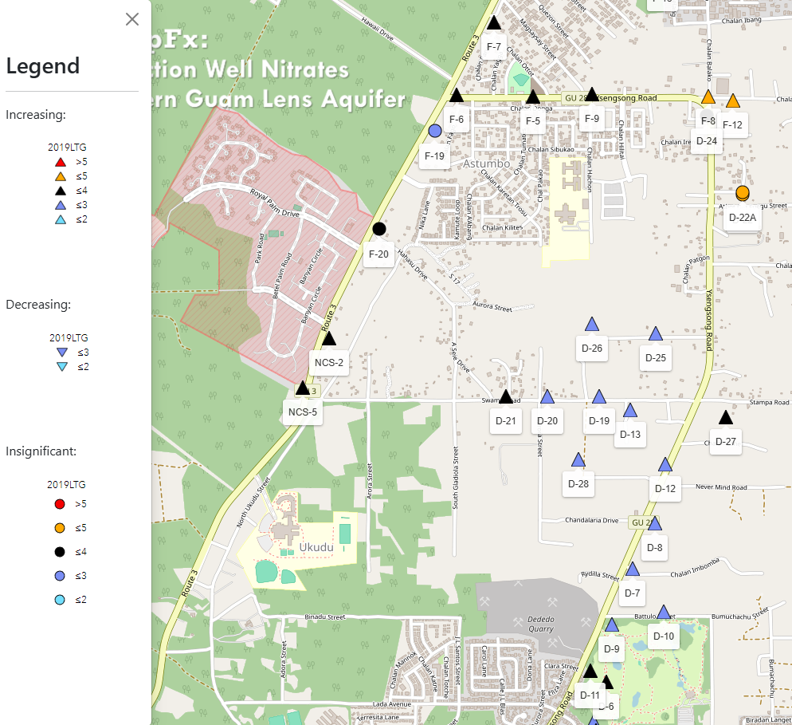
Source: Valerio et al., 2023, MAppFx – Guam Hydrologic Survey
https://guam-hydrologic-survey.github.io/well-nitrates-app/
Notes:
From the result of this scenario, we see that a cluster of houses that are 1/8th acre (outlined in black) could pose a threat to nearby production wells. This shows why housing of this size must be sewered. A full technical report with all the details will be released soon.

Slide 5
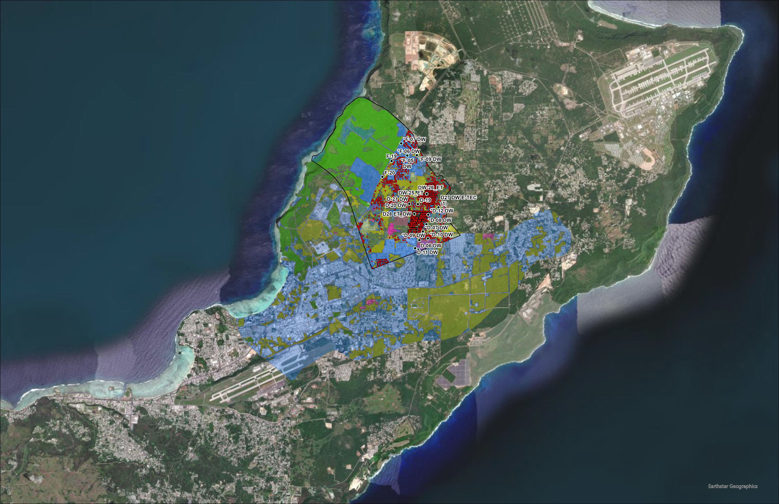
Notes:
Building on our pilot study, we expanded the analysis to a larger area.

Slide 6
Notes:
This area is the Yigo-Tumon Basin, the most productive basin of the NGLA.

Slide 7
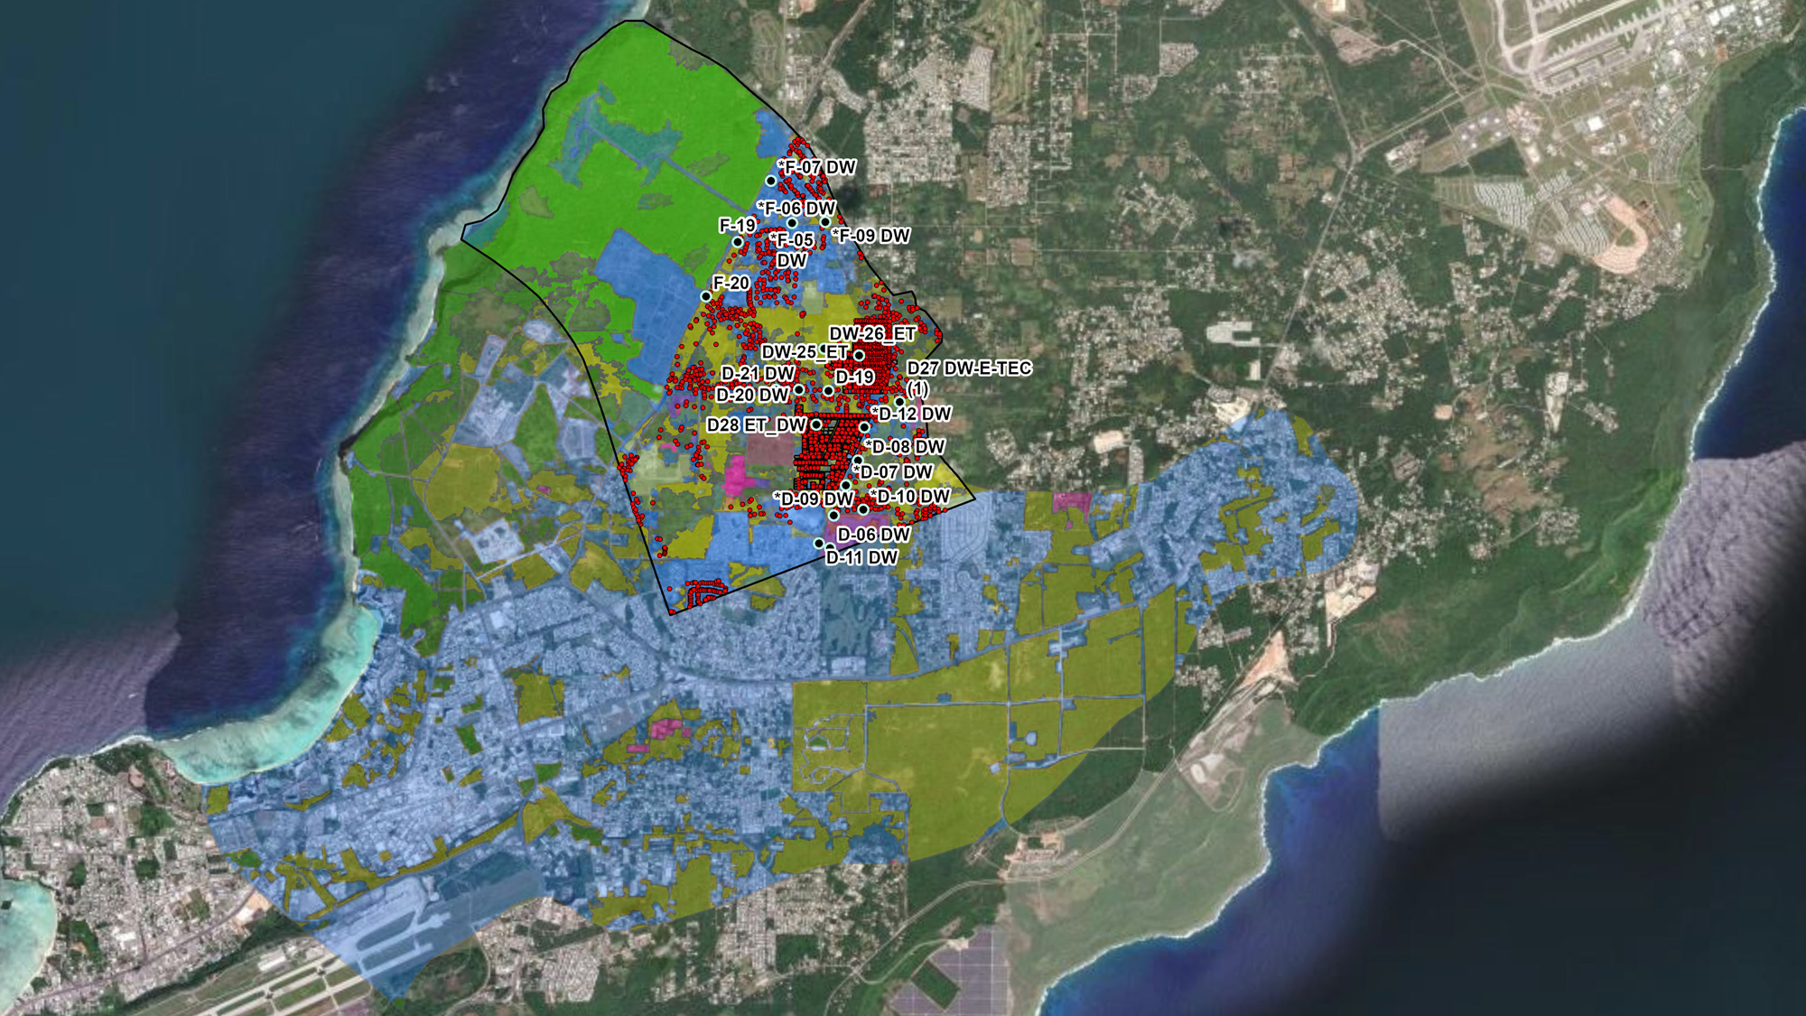
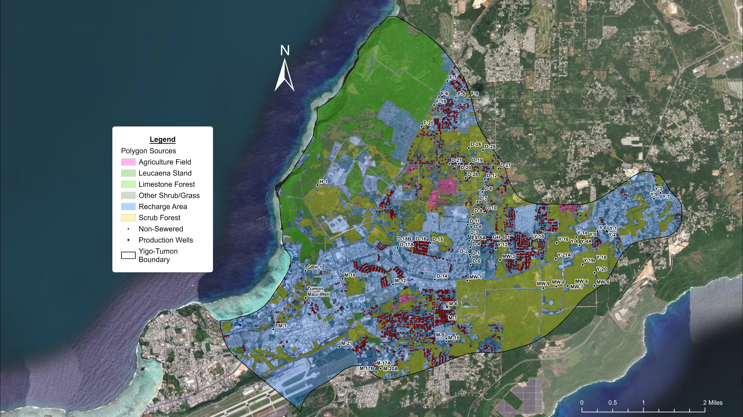
GIS Files
Polygon sources adapted from vegetation landcover (Wen, 2006)
Non-sewered data adapted from GWA and Habana & Heitz (2006)
Notes:
Similarly to the Swamp Road model, the legend here outlines the GIS files used for this analysis, including production wells, non-sewered housings, and color-coded land cover for agriculture, legumes, and recharge areas.

Slide 8
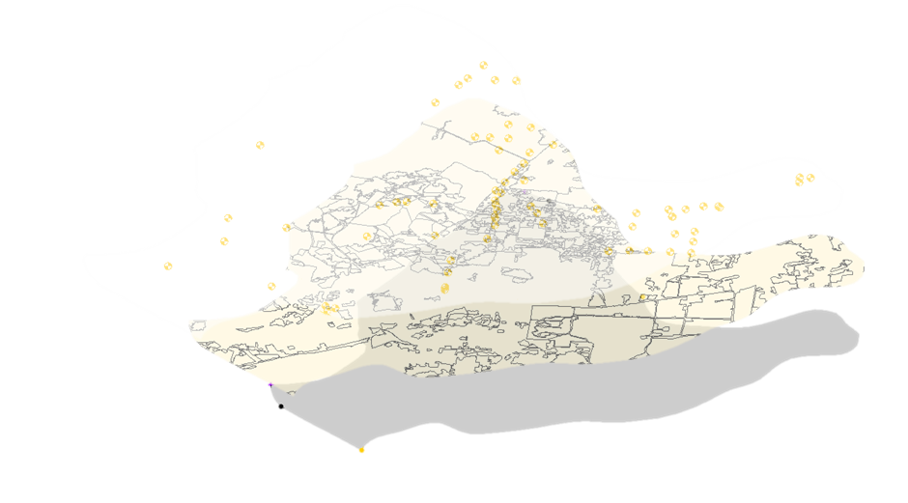

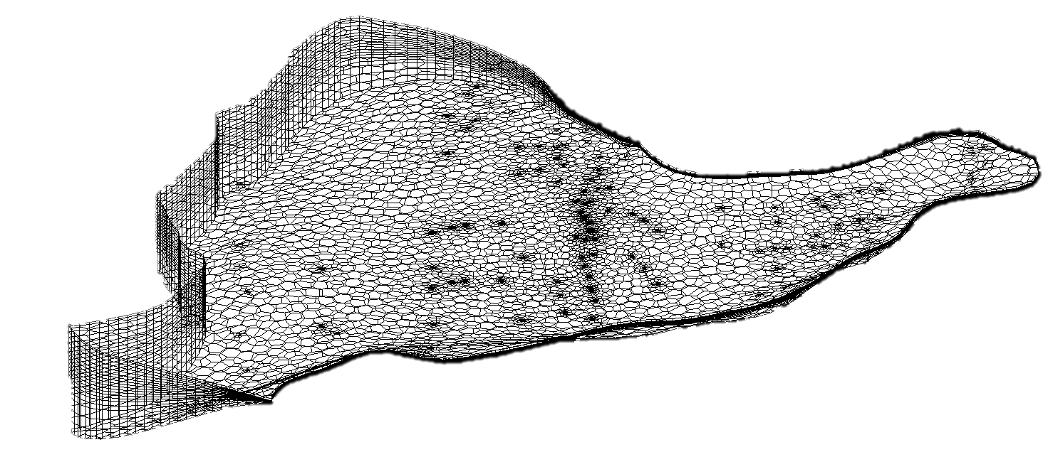
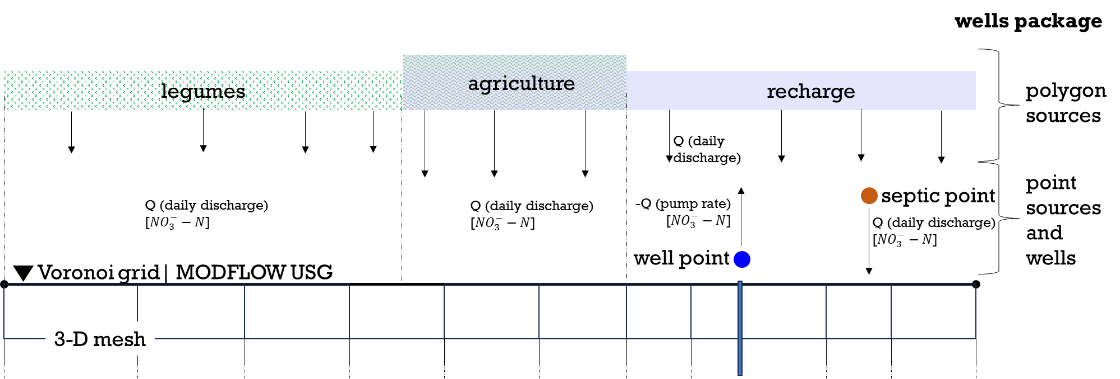
Esri ArcGIS Pro
Aquaveo GMS
② Create Conceptual Model Coverages
③ Generate UGrid
① GIS Shapefiles
boundary
wells
polygon source
point source
Import
④ Configure MODFLOW Packages
Notes:
First, we used ArcGIS to collect, process, and prepare shapefiles. These were imported into GMS, where we created coverages to define boundary conditions, production wells, and nitrate inputs. The coverages were then mapped onto a UGrid, which uses a 3-D Voronoi mesh grid.
Next, we configured MODFLOW packages to simulate groundwater flow and contaminant transport. Using the Wells package, we assigned flow rates and nitrate-N concentrations to polygon sources and septic points, and applied the same setup to production wells, which pump at average real-world rates. Hydraulic properties were specified from regional aquifer studies, and dispersivity values were set to represent nitrate migration in limestone.
We bring in hydrologic values and boundaries from the real world (such as pump rate, well depth, and recharge). Where data was unavailable, we used reasonable assumptions—for example, a household of six using 60 gallons per person per day, discharged through a septic system.

Slide 9
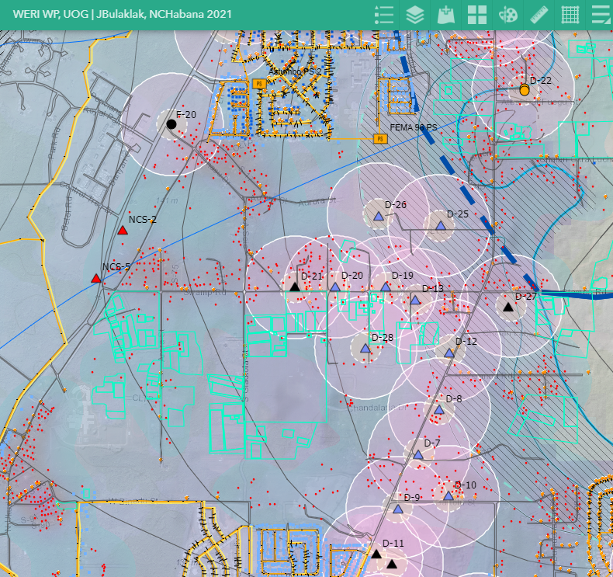
Results and Discussions
Scenario 1 – Natural and Agriculture + Wells off
Scenario 2 – Natural and Agriculture + Wells on
Scenario 3 – Natural and Agriculture + Septic + Wells on
Notes:
So, for the results, we ran 3 model objectives, as 3 scenarios with varying conditions.
Scenario 1 – Natural (meaning legumes, tangantangan) and Agriculture + Wells off
Scenario 2 – Natural and Agriculture + Wells on
Scenario 3 – Natural and Agriculture + Septic + Wells on
I'll briefly summarize the key takeaways from each model results.
Let’s check it out!

Slide 10
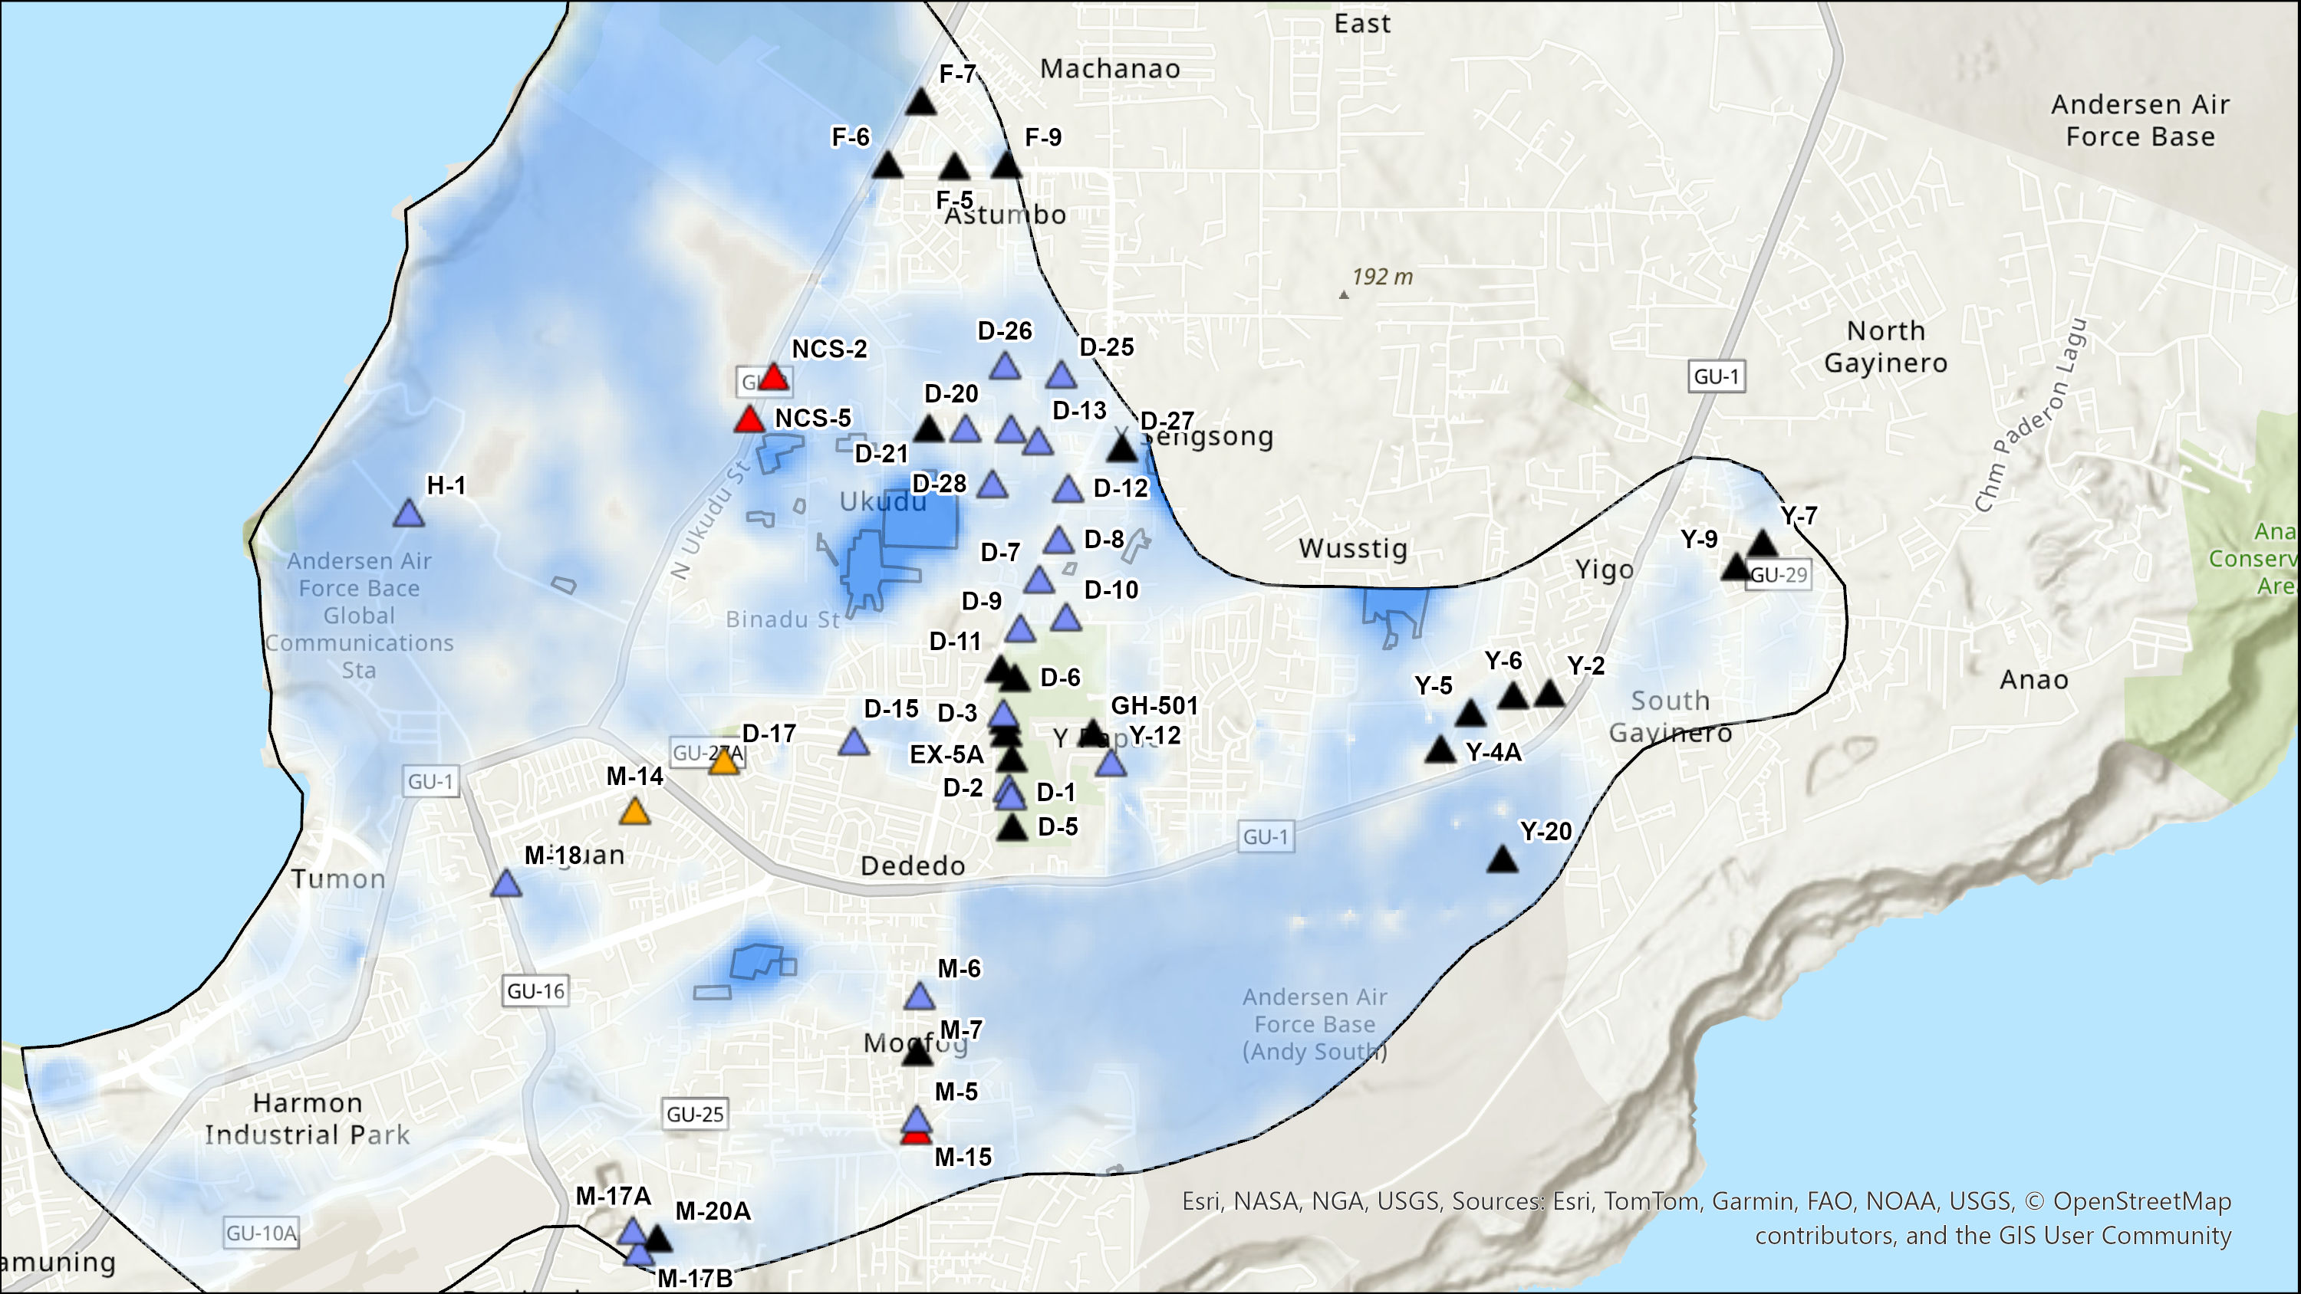
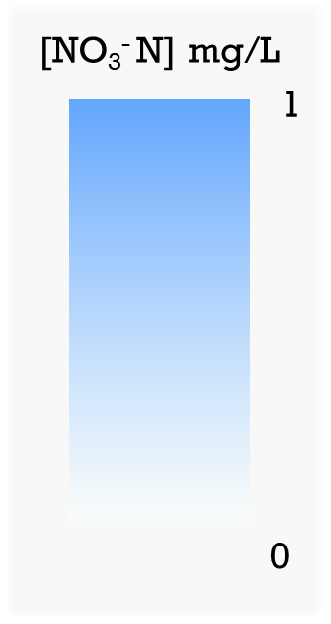
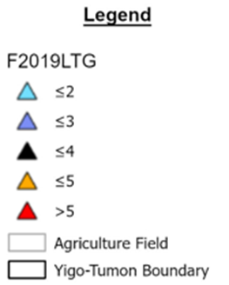
Scenario 1
Polygons: legumes, agriculture, recharge
No pumping
No septic tanks and no pumping scenario
Notes:
In Scenario 1, we focused on nitrate from natural and agricultural sources, with no pumping.
The scale on the left represents nitrate-N concentrations in mg/l from 0 in white to 1 in blue.
The legend on the right shows Ms. Bulaklak's nitrate analysis, which maps increasing nitrate-nitrogen concentration across wells. This allows us to compare real-world nitrate-N concentrations to our own model results and better understand how contaminants from various sources reach specific wells and receive those concentrations.
In this case, the model reveals an ambient concentration of 1 mg/L, with 0 concentration in areas with no legumes and agricultural sources, just natural recharge zones. This highlights the potential state of Guam's groundwater prior to extensive development.

Slide 11
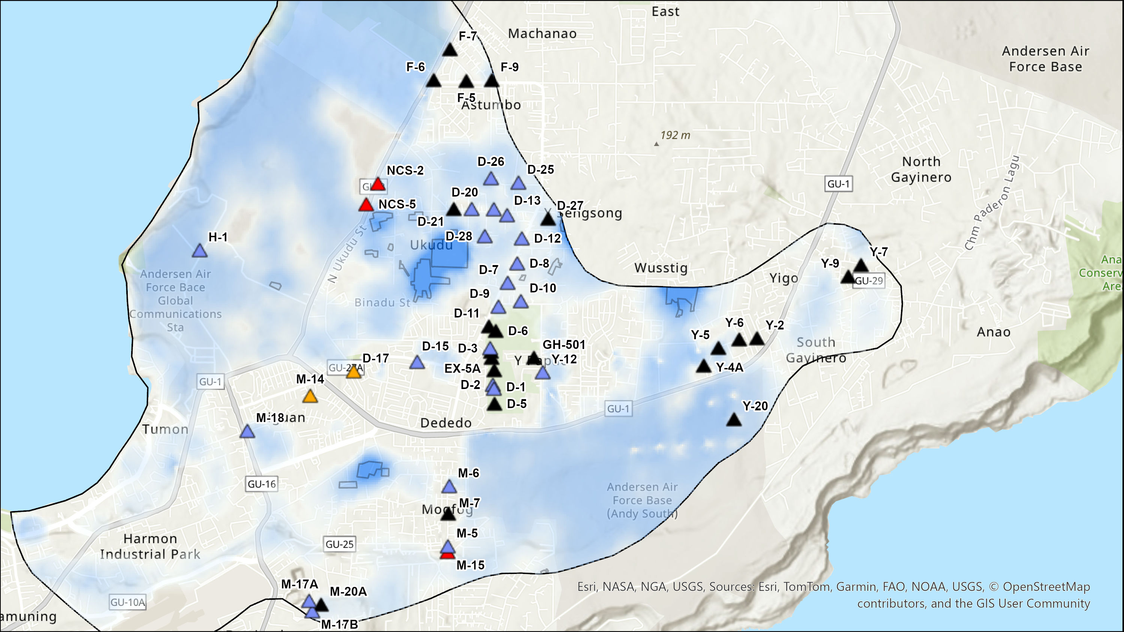
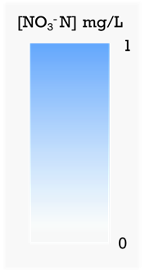
Scenario 2
Polygons: legumes, agriculture, recharge
Pumping on
No septic tanks and pumping scenario
Notes:
Here's scenario 2, similar to scenario 1 but with the wells activated.
Overall, there isn’t a major difference, though we do see stronger nitrate concentration around the farm areas in both scenarios.

Slide 12
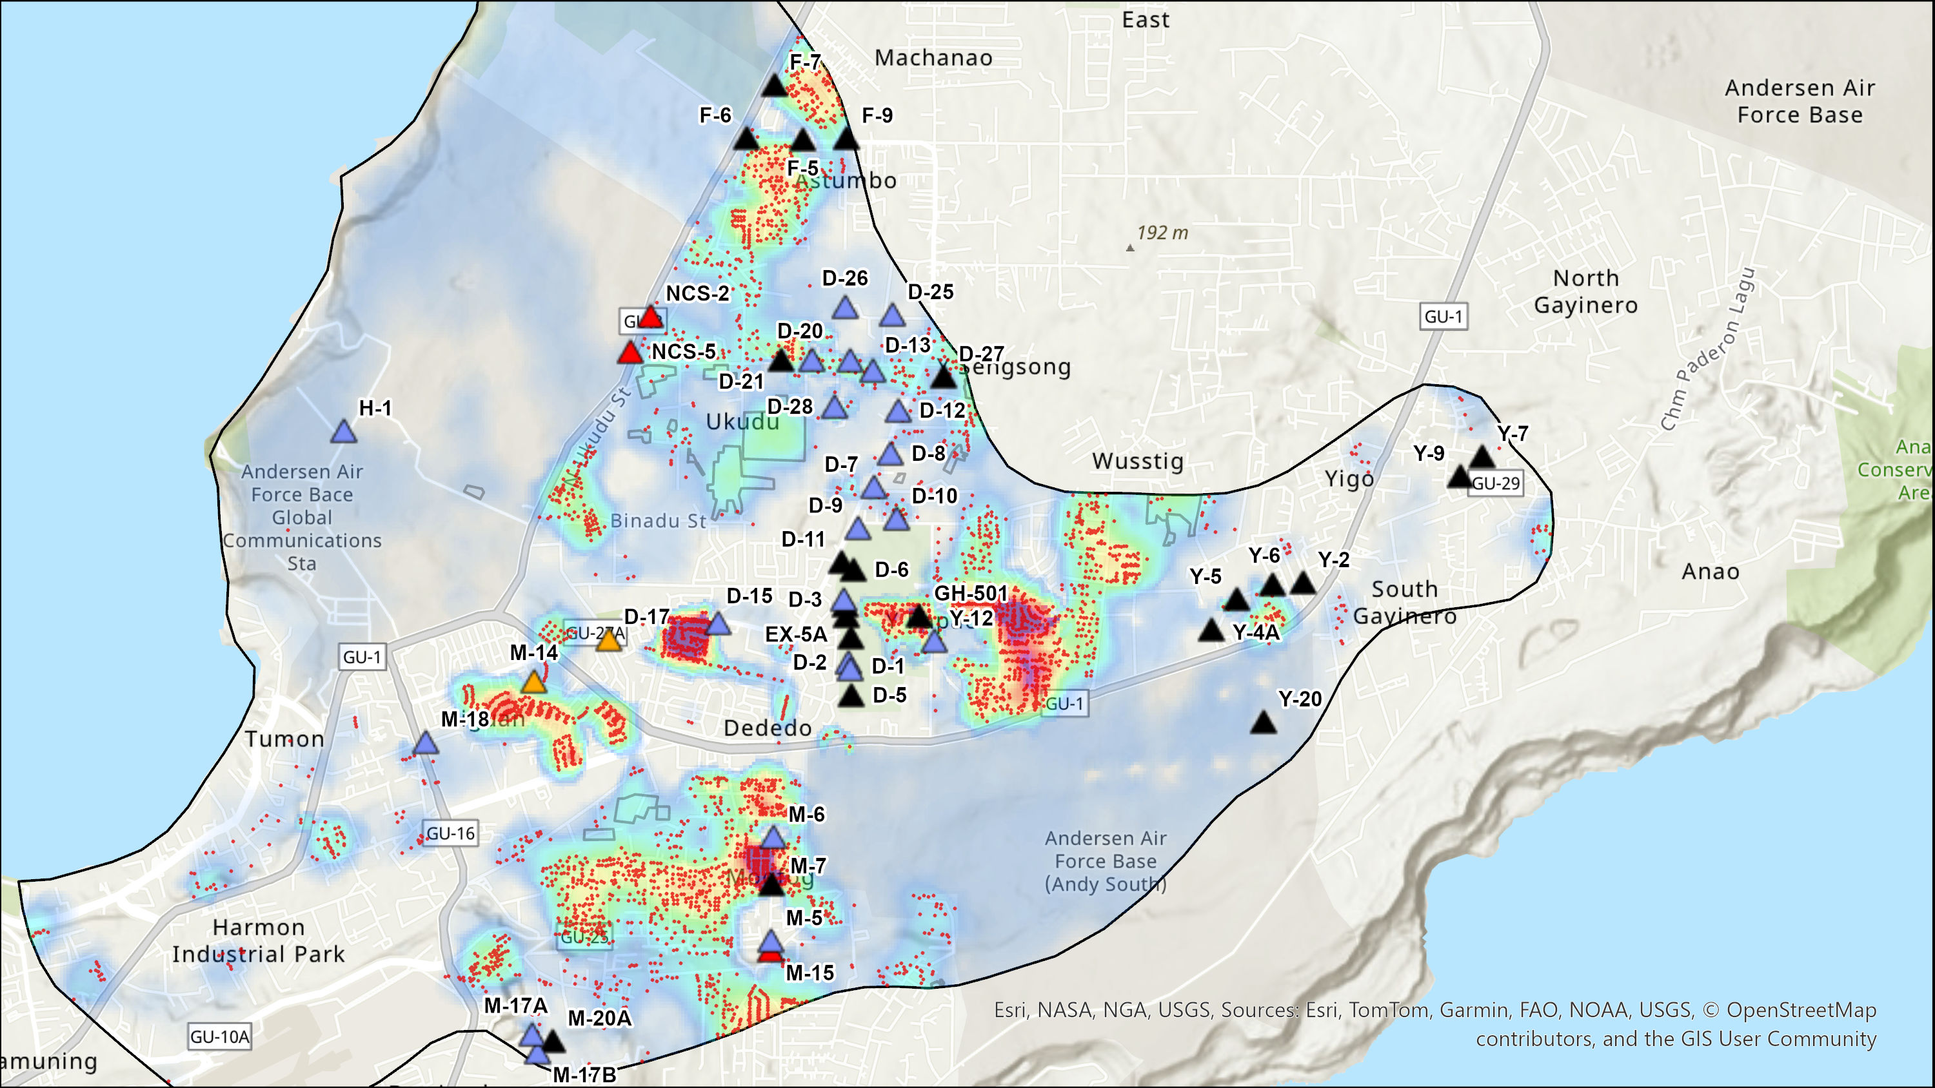
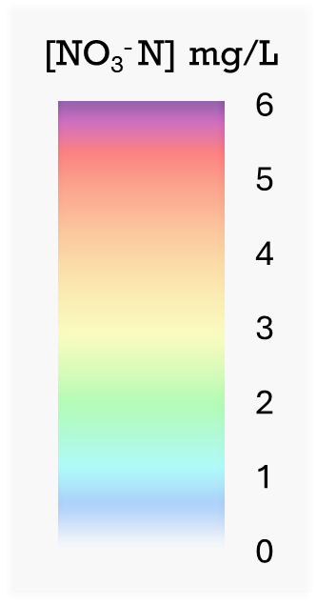
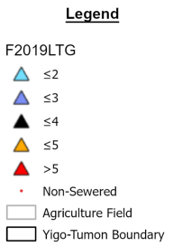
Scenario 3
Polygons: legumes, agriculture, recharge
Points: septic tanks
Pumping on
Notes:
Scenario 3 introduces the mapped non-sewered septic tanks across the basin.
Compared to the earlier scenarios, we now see clear hotspots forming where septic systems are clustered.
Next, we’ll zoom into specific areas of this map to highlight some key takeaways.

Slide 13
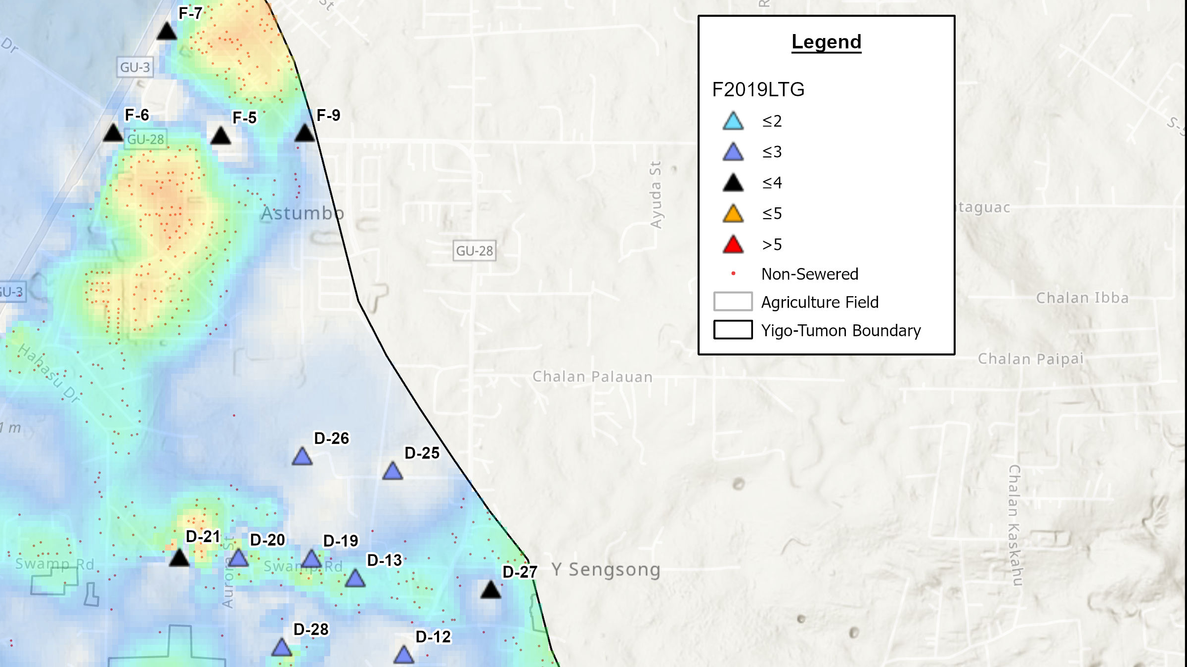

Notes:
Based on Ms. Bulaklak’s analysis, the F wells show nitrate-N concentrations below 4 mg/L. Our model supports this, indicating a contaminant plume in the area at about 2–3 mg/L, which these wells are able to capture.
Similarly, the model results near several D wells, including D-20, D-19, and D-13, align with Ms. Bulaklak’s findings, where concentrations remain below 3 mg/L.

Slide 14
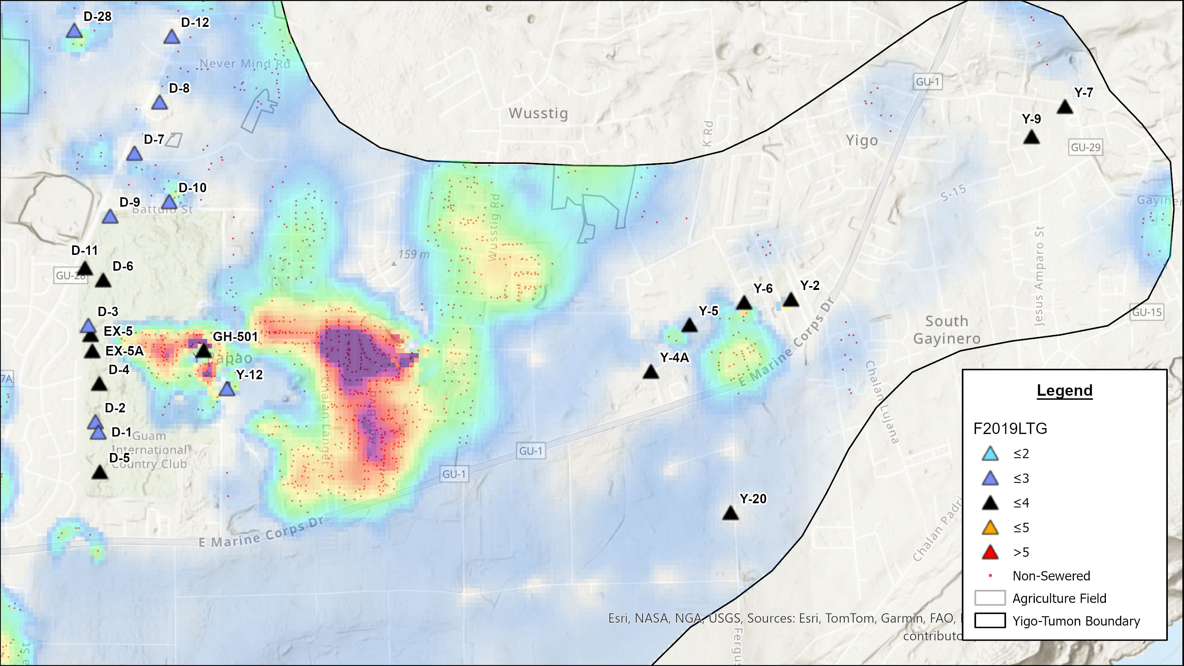
Notes:
A strong plume is visible near GH-501 and Y-12, with nitrate levels above 5 mg/L, mainly from septic systems.
In contrast, wells on the golf course show no plume, since the area was modeled as recharge and golf course inputs have not yet been addressed.

Slide 15
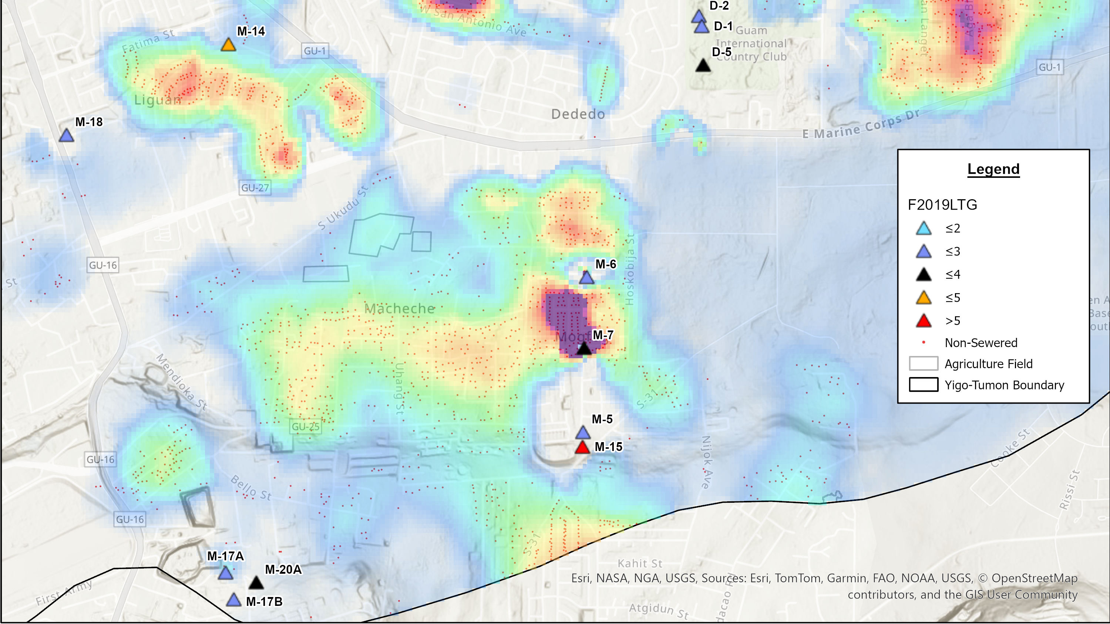
Notes:
Lastly, this area still needs refinement, as the modeled contaminant plumes do not fully align with Ms. Bulaklak’s analysis. Further adjustments are required to better capture the nitrate behavior in this region.

Slide 16
Limitations
Assumptions in Modeling
  Estimated flow rates and nitrate-N concentrations
  Hydraulic properties and dispersivity values from regional studies
Data Availability
  Land cover classifications
  Septic data points
Notes:
Modeling gives us valuable insight into how nitrates may reach our production wells, but it does come with limitations.
The model parameters involve a degree of assumptions, including estimated flow rates, nitrate concentrations, and hydraulic and dispersivity values derived from regional studies.
We are also limited by the availability of data, particularly in land cover and septic system locations.

Slide 17
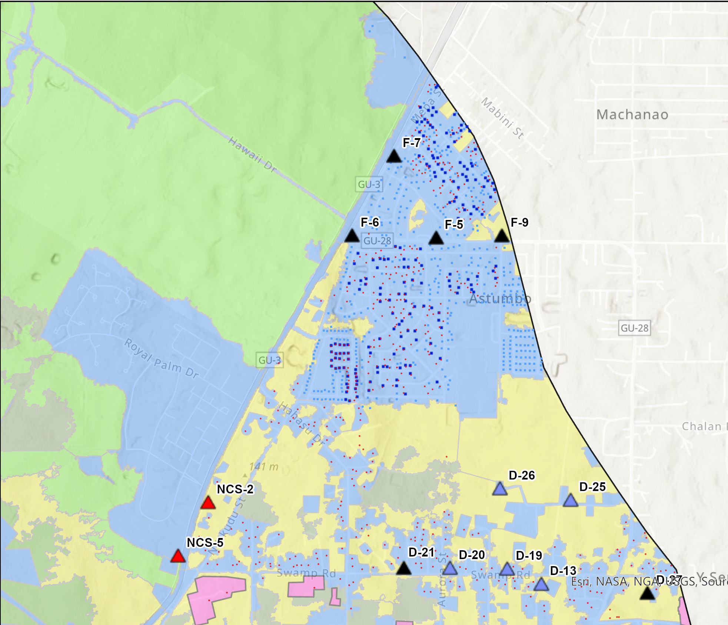
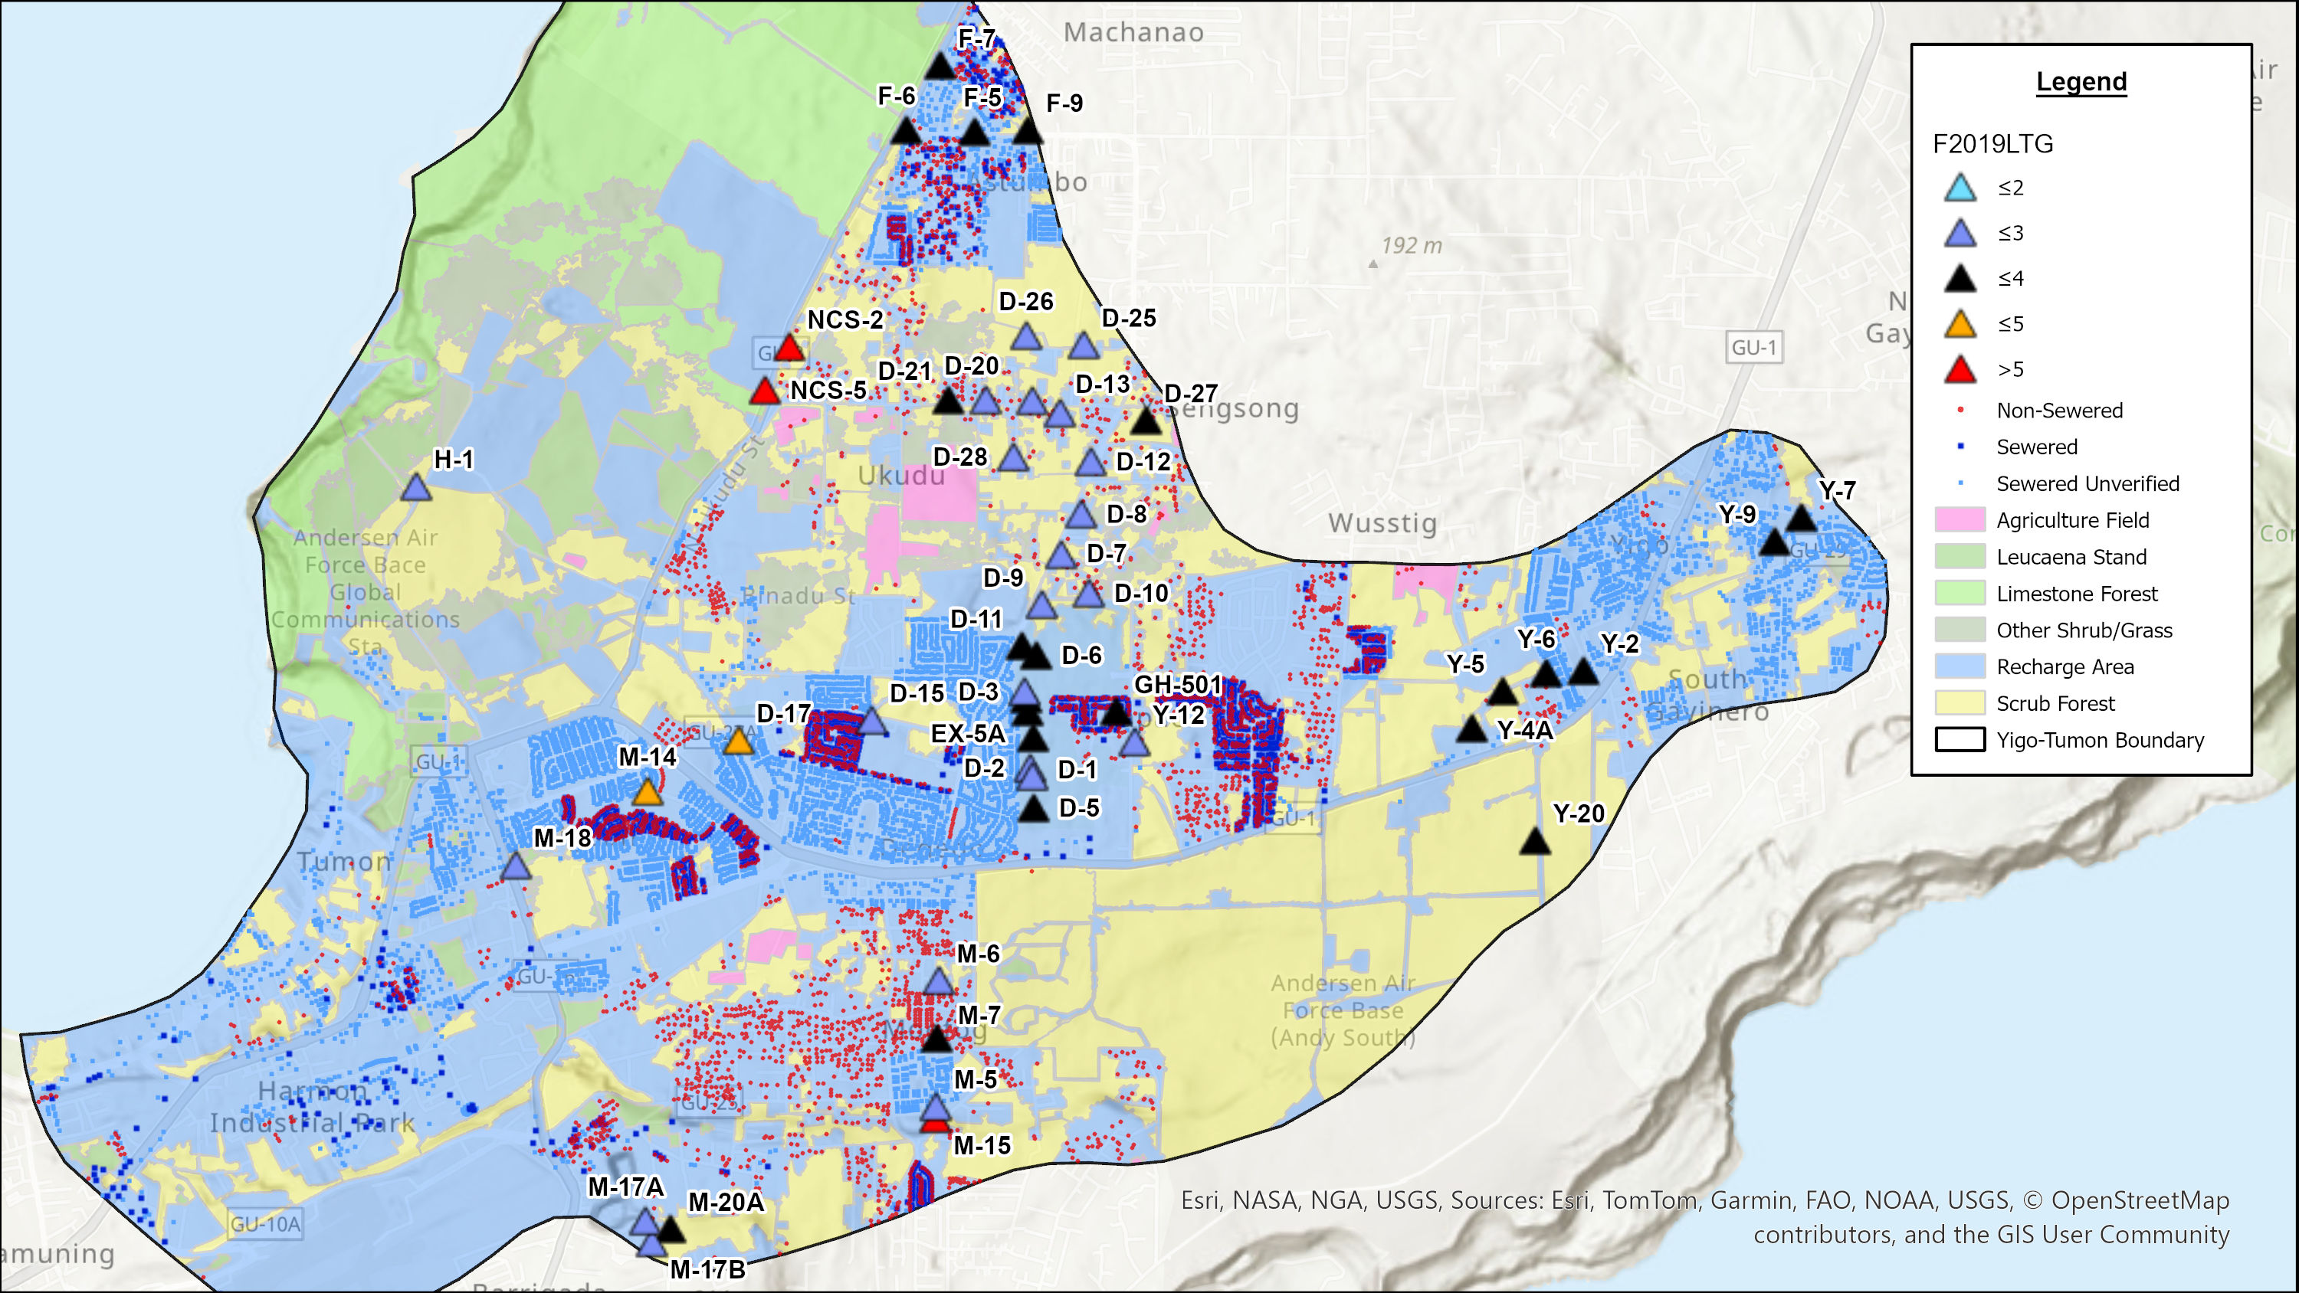
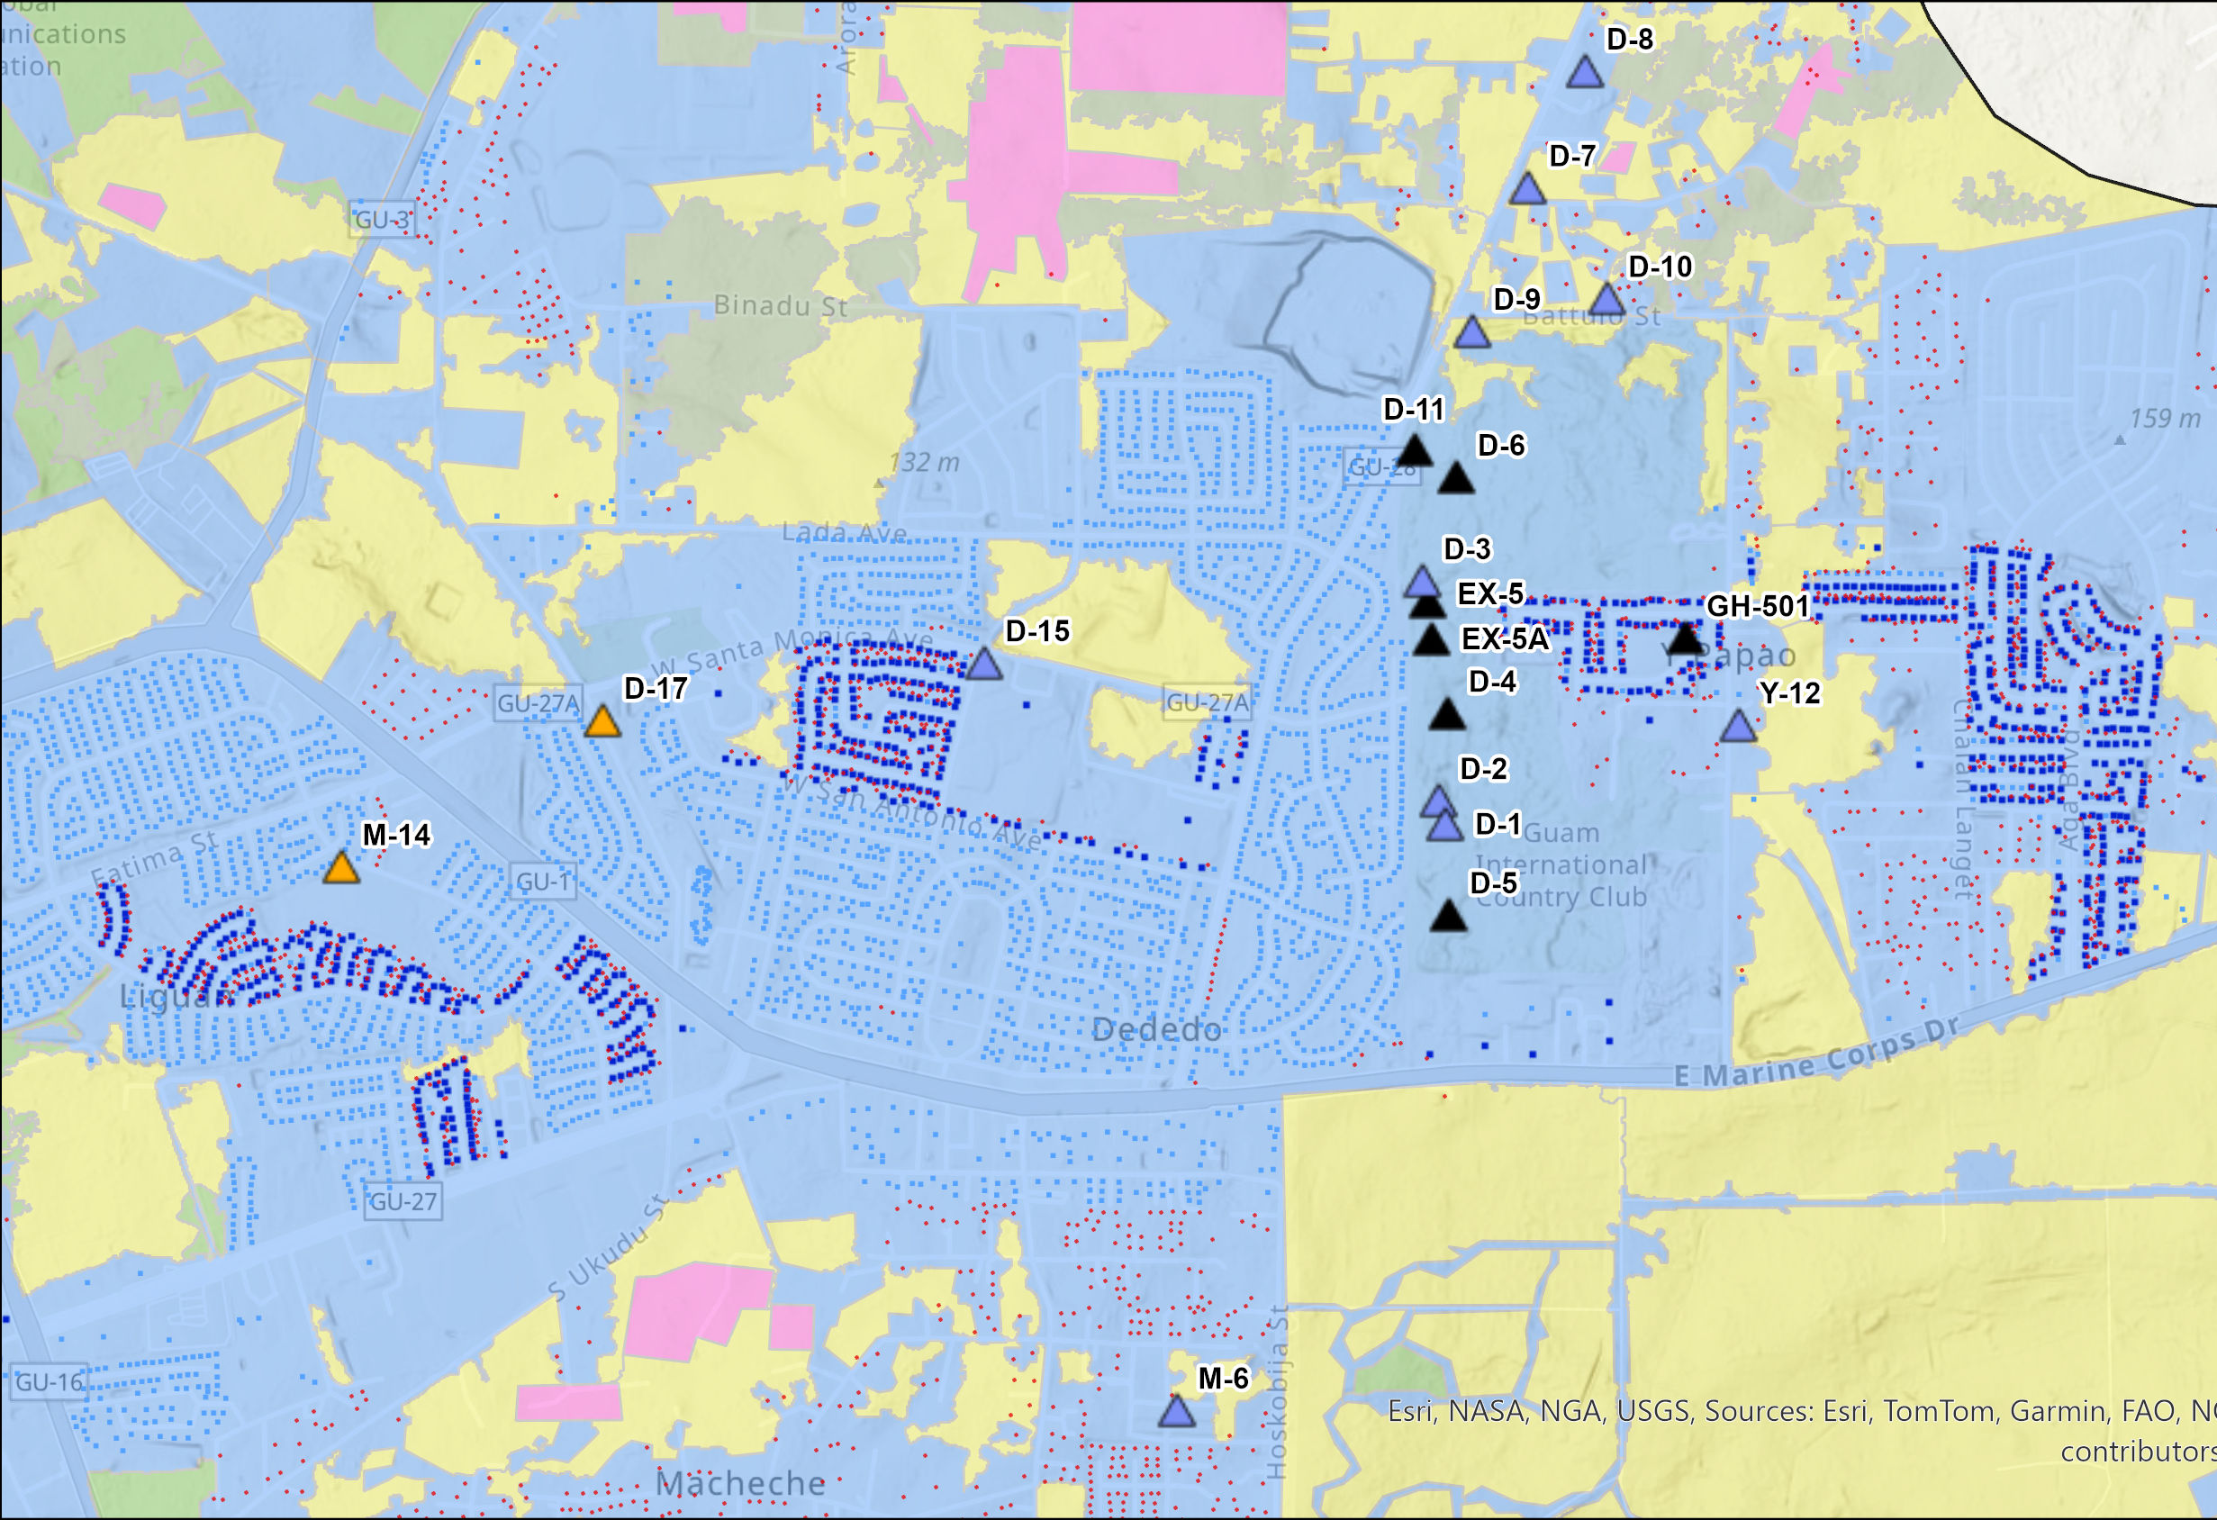
Notes:
The land cover we used was based on 2006 data, and while we updated it with satellite imagery, it may not perfectly reflect current conditions.
We also recently discovered some discrepancy with the septic survey data used in this model — there are homes marked as non-sewered but were actually sewered (CLICK). This shows us that verifying these data points is really important to better represent our setting. At the same time, it also highlights how if these homes are non-sewered, it could make an impact on nearby wells.

Slide 18





Thank you!
Any Questions?
Atasha Bautista
Jovic Caasi
Dr. Nathan C. Habana
Todd Wood, PE
Research Assistant II
Groundwater Modeling
1-671-735-2685
bautistaa14770@triton.uog.edu
Research Assistant II
Groundwater Modeling
MS Mathematics
caasij11947@triton.u1-671-735-2685
og.edu
Associate Professor of Groundwater
Hydrology
Chief Hydrologist
1-671-735-2685
nchabana@triton.uog.edu
Aquaveo GMS Groundwater Model Software Specialist
twood@aquaveo.ccom
Notes:
As we wrap up today's presentation, if you're interested in staying informed about our research or have any further questions, please feel free to reach out to the modeling team using the contact information provided.
Thank you!

Slide 19
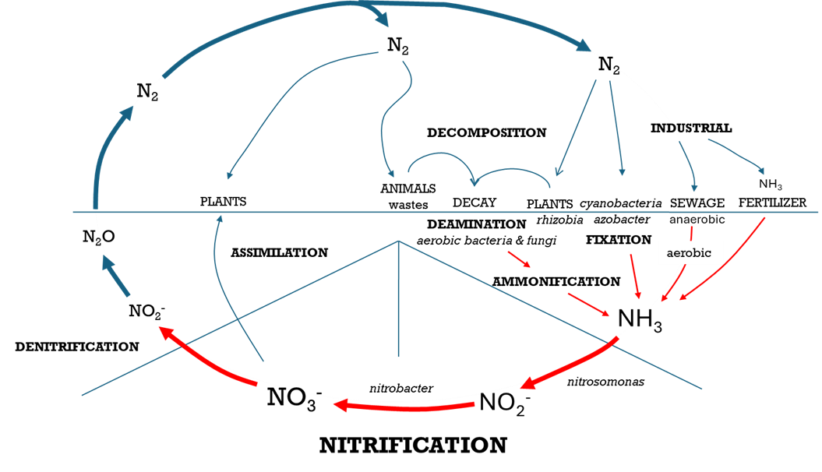
The Nitrogen Cycle
(Tortora et al., 2004)

Slide 20
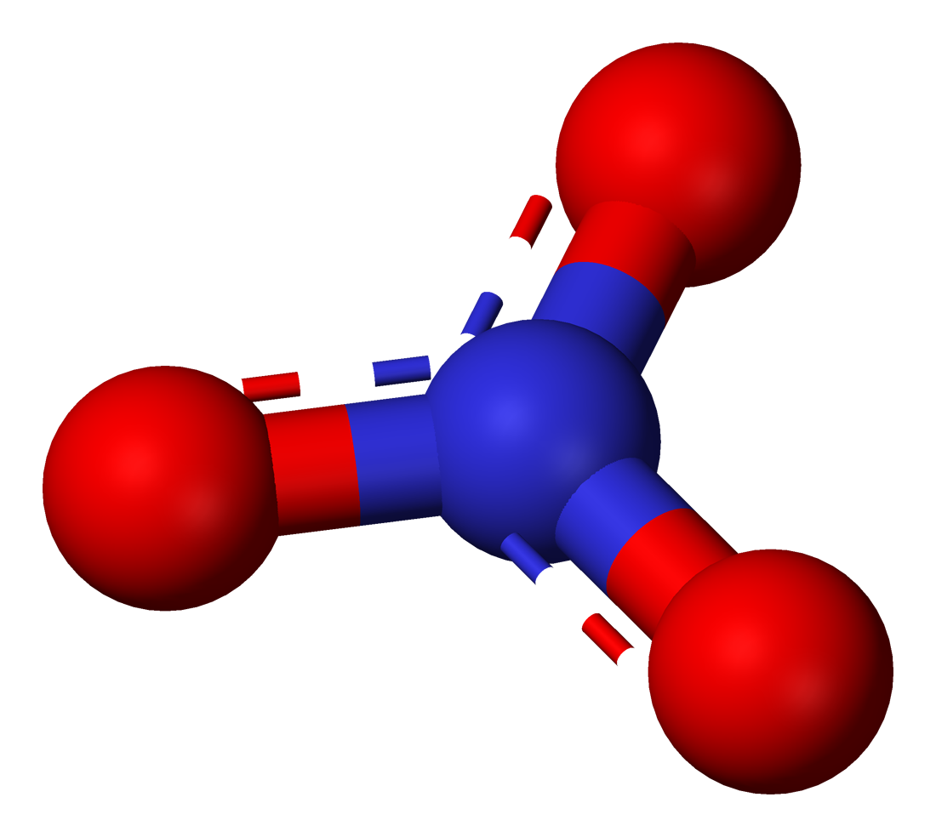
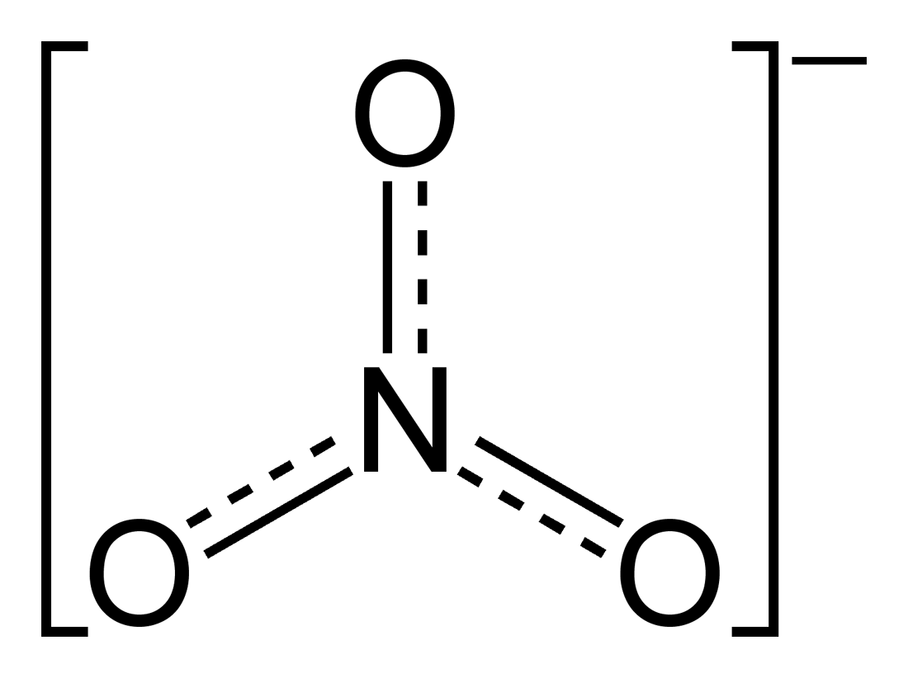
Nitrate
NO₃⁻
Nitrate-nitrogen
[NO₃⁻ -N]

Slide 21
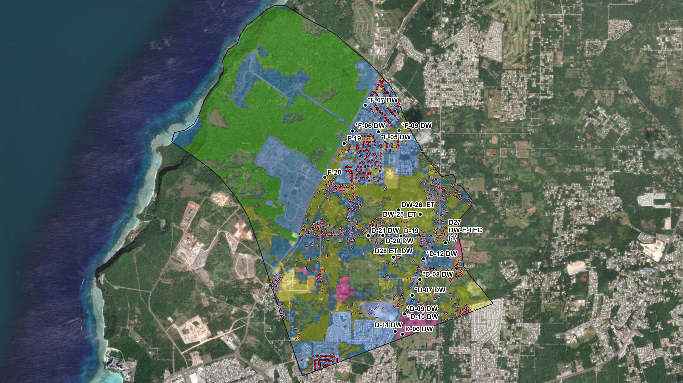

Slide 22
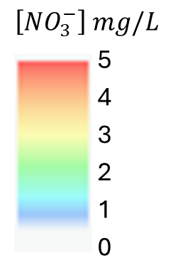


$$\left[{NO}_{3}^{−}\right] mg/L$$
5
4
3
2
[NO₃⁻ ] mg/L
[NO₃⁻ N] mg/L
[NO₃⁻ N] mg/L
1
1
6
1
0
5
4
3
2
1
0
0
0

Slide 23
Intro
Talk about SR model
  Showed us that intensity from the new development by using septic system is a problem
  Technical report is coming soon…

Slide 24


Slide 25
Background
Study area (Yigo-Tumon)
Data used in the model
  Vegetation land cover (Wen)
  Unsewered Meter (2006, GWA and Habana)
  Production Well
Any Refinements made to the data
Limitation to the data

Slide 26
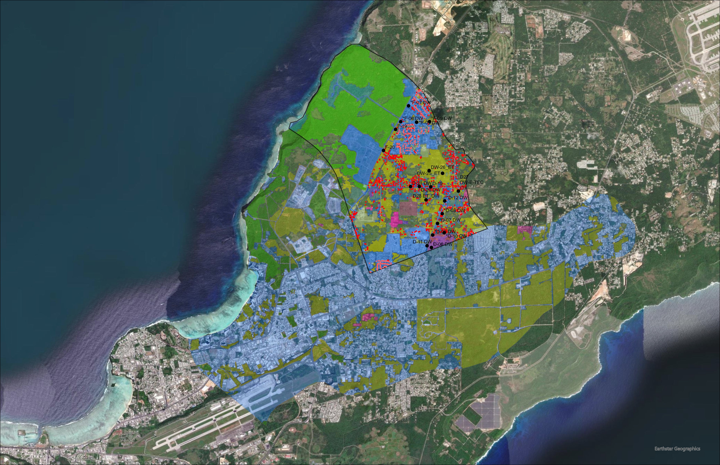

Slide 28
Methods
Description on how the model was made

Slide 29
Results and Discussion
Scenario 1-3
  S1: pump off / A&N
  S2: pump on / A&N
  S3: pump on / A&N / Septic
  limitations to the data…

Slide 30
Background: Nitrogen Cycle
N₂
N₂
N₂
_{DECOMPOSITION}
_{INDUSTRIAL}
_{ANIMALS}
NH₃
_{PLANTS}
_{DECAY}
_{PLANTS}
_{SEWAGE}
_{FERTILIZER}
_{wastes}
cyanobacteria
rhizobia
azobacter
anaerobic
_{DEAMINATION}
N₂O
aerobic bacteria & fungi
_{FIXATION}
_{ASSIMILATION}
aerobic
_{AMMONIFICATION}
NO₂⁻
NH₃
_{DENITRIFICATION}
NO₃⁻
nitrobacter
nitrosomonas
NO₂⁻
_{NITRIFICATION}
_{Leaching}
McDonald, 2002; Tortora et al., 2004
Notes:
Nitrate (NO₃⁻) is one of the most common indicators of groundwater contamination. Its formation is explained by the nitrogen cycle, where atmospheric nitrogen (N₂)—the most abundant form of nitrogen—is converted into biologically available forms such as ammonium (NH₄⁺), nitrite (NO₂⁻), and nitrate (NO₃⁻) through processes like ammonification and nitrification. While some nitrate is taken up by plants, excess amounts often remain in the soil. Because nitrate is highly soluble and weakly retained by soil, it can leach easily beyond the root zone, reaching aquifers and surface waters where it becomes a contaminant of concern.

Slide 31




Solute Transport Model Concept
cross-section | polygon sources | points sources
wells package
legumes
agriculture
recharge
polygon
sources
Q (daily discharge)
point
sources
and
wells
septic point
Q (daily discharge)
[${NO}_{3}^{−}−N$]
Q (daily discharge)
[${NO}_{3}^{−}−N$]
-Q (pump rate)
[${NO}_{3}^{−}−N$]
Q (daily discharge)
[${NO}_{3}^{−}−N$]
well point
Voronoi grid| MODFLOW USG
3-D mesh
N-Sources | Recharge | Wells
cross-section

Slide 32

