Slide 1

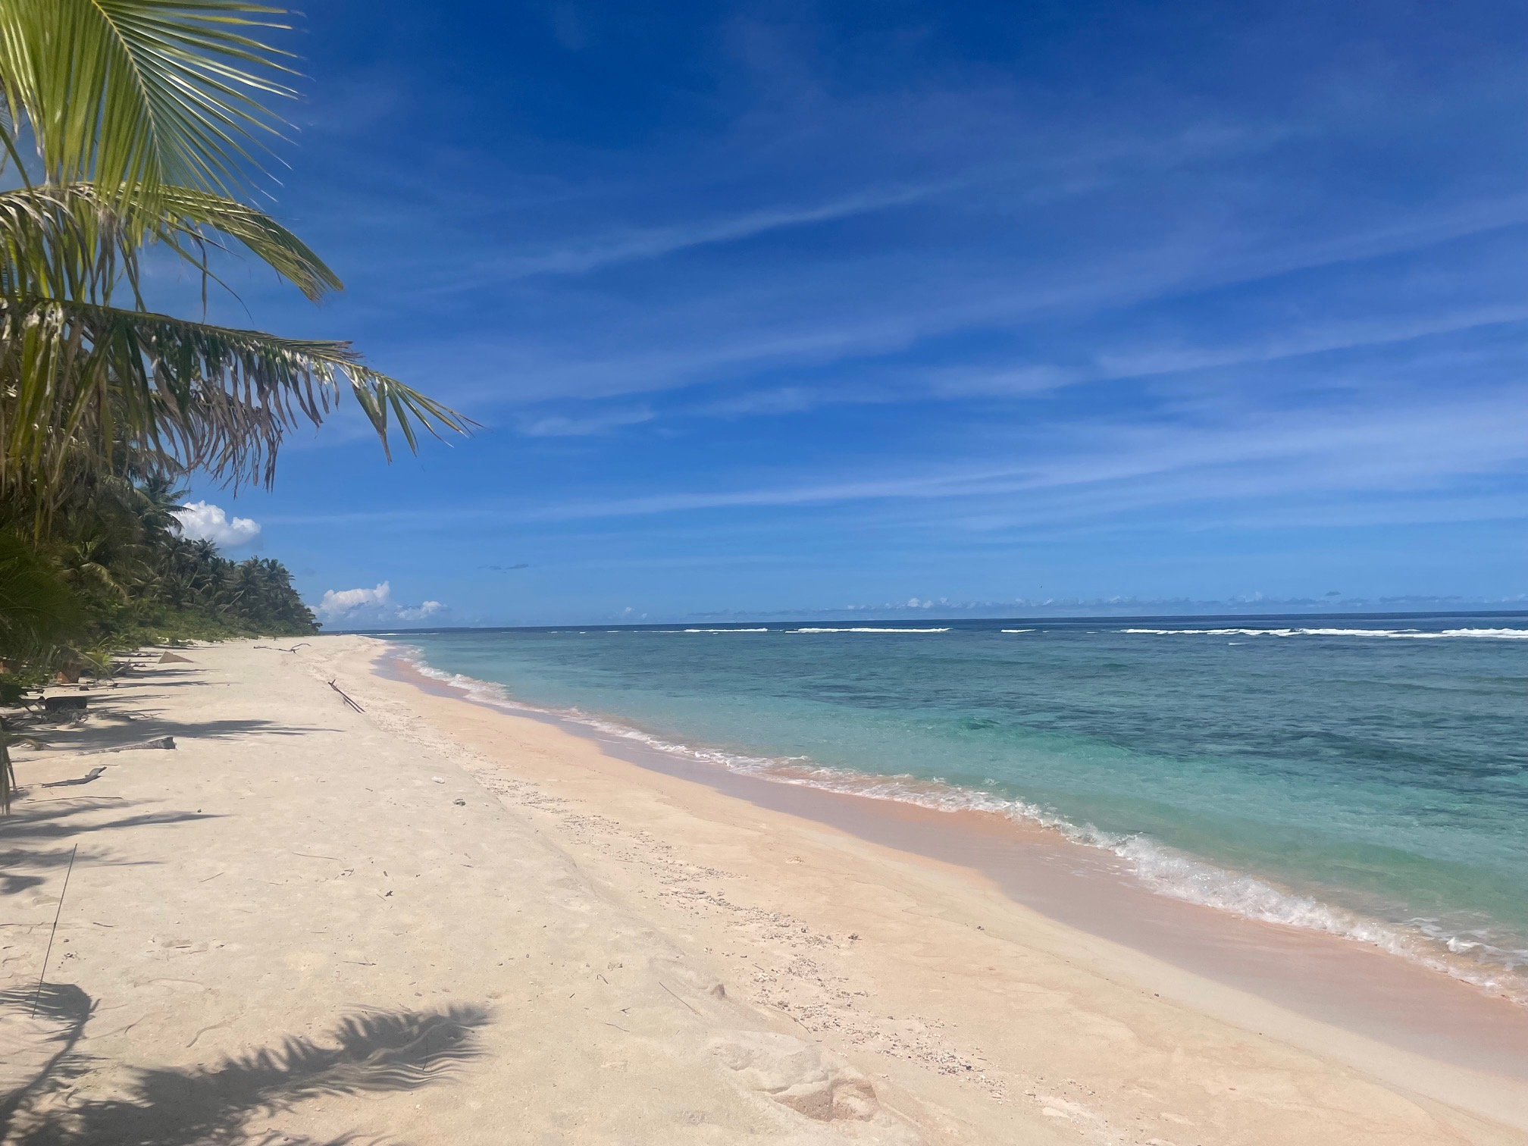
CHALLENGES IN GUAM’S DRINKING WATER: PFAS
PRESENTED BY:
SIERRA ARMSTRONG-BETTIS & NICOLE HA’ANE DIRAS
GUAM ENVIRONMENTAL PROTECTION AGENCY
SAFE DRINKING WATER PROGRAM
WERI WORKSHOP
AUGUST 29, 2025
Notes:
SIERRA
DISCLAIMER THAT NOTHING IS USED FOR COMPLIANCE PURPOSES

Slide 2
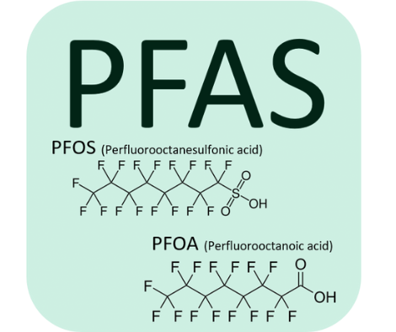
WHAT IS PFAS?
A GROUP OF MANMADE CHEMICALS
NICKNAMED AS A “FOREVER CHEMICAL”
MANUFACTURED AND USED SINCE THE 1940S
REPELS OIL, GREASE, WATER, AND HEAT
Notes:
NICOLE
PFAS, also known as per- and polyfluoroalkyl substances, are a group of man-made chemicals that are used almost everywhere across the world. PFAS is a group of nearly 15,000 synthetic chemicals according to a chemicals database maintained by the US EPA. They are very resistant to breaking down in the environment, which is why they were given the nickname ‘forever chemicals’.
PFAS are manufactured chemicals that have been used in industry and consumer products since the 1940s.
Pfas was made and used for their ability to repel oil, grease, water, and heat.
The sampling procedure for PFAS is extremely(very) strict, this includes specialized hygiene requirements and the use of unique testing equipment so as not to skew readings.

Slide 3

HOW DOES PFAS IMPACT PEOPLE?
STUDIES SUGGEST THAT EXPOSURE TO SPECIFIC PFAS CAN LEAD TO:
INCREASES IN CHOLESTEROL LEVELS (PFOA, PFOS, PFNA, PFDA)
LOWER ANTIBODY RESPONSE TO SOME VACCINES (PFOA, PFOS, PFHXS, PFDA)
CHANGES IN LIVER ENZYMES (PFOA, PFOS, PFHXS)
PREGNANCY-INDUCED HYPERTENSION AND PREECLAMPSIA (PFOA, PFOS)
SMALL DECREASES IN BIRTH WEIGHT (PFOA, PFOS)
KIDNEY AND TESTICULAR CANCER (PFOA)
RISK OF HEALTH EFFECTS DEPENDS ON:
EXPOSURE FACTORS
INDIVIDUAL FACTORS
OTHER DETERMINANTS OF HEALTH
Notes:
NICOLE
Now we’ll go over how PFAS impacts people.
The health effects of PFAS are not fully known due to the variety of PFAS compounds that exist . The health effects of pfas vary. Additional studies will need to be conducted to determine the exact health effects for each type of pfas.
But There are some studies that have suggested that exposure to specific PFAS can lead to:
- Increases in cholesterol levels (PFOA, PFOS, PFNA, PFDA)
- Lower antibody response to some vaccines (PFOA, PFOS, PFHxS, PFDA).
- Changes in liver enzymes (PFOA, PFOS, PFHxS)
- Pregnancy-induced hypertension and preeclampsia (PFOA, PFOS).
- Small decreases in birth weight (PFOA, PFOS)
- Kidney and testicular cancer (PFOA)
The risk of health effects associated with PFAS depends on:
- Exposure factors (e.g., dose, frequency, route, and duration).
- Individual factors (e.g., sensitivity and disease burden).
- Other determinants of health (e.g., access to safe water and quality healthcare).

Slide 4
INTRODUCTION
GUAM FACES SEVERAL CHALLENGES IN REGARD TO PFAS
  PFAS ACROSS THE ISLAND
  IMPORT AND EXPORT COSTS OF GAC
  FUNDING FOR TESTING AND TREATMENTS
THE GOAL IS TO IDENTIFY CHALLENGES IN GUAM’S DRINKING WATER THAT RELATE TO PFAS AND ALSO THE PEOPLE WHO DRINK IT
  CENTERS AT RISK? POTENTIAL PFAS MCLS?
Notes:
NICOLE
DISCLAIMER THAT NOTHING IS USED FOR COMPLIANCE PURPOSES
Guam faces several challenges in regard to PFAS such as large amounts of PFAS across the island, import and export costs of GAC, and limited funding for testing and treatments. There are multiple hot spots of PFAS, military presence and our airport that encompasses only 212 square miles of land.
So what is the goal of this presentation? The goal of this presentation is to identify challenges in Guam’s Drinking Water that relate to PFAS and also the people who drink it. In order to achieve that goal, we need to understand the areas at risk of drinking PFAS by identifying the centers at risk, population per village, and how many potential PFAS MCL and MCL Triggers (Levels) there are per village.

Slide 5

DATA AND METHODS
PFAS DATA FROM USEPA REGION 9 RESULTS AND UCMR5
  PWSS ANALYZED: GUAM WATERWORKS AUTHORITY NORTH, CENTRAL, AND SOUTH, ANDERSON AIR FORCE BASE (AAFB), US NAVY, GUAM INTERNATIONAL AIRPORT AUTHORITY (GIAA), GUAM REGIONAL MEDICAL CITY (GRMC), AND THE GUAM PLAZA RESORT (GPR)
  HOW MANY VILLAGES WOULD BE SUBJECT TO PFAS MCLS OR PFAS TRIGGER LEVELS?
  WHAT ABOUT THE VILLAGES WITH NO PRODUCTION WELLS?
Notes:
SIERRA
We started by using PFAS data from Unregulated Contaminant Monitoring Rule 5 (UCMR5) and USEPA Region 9 American Rescue Plan (ARP) sampling event from this past February
The public water systems analyzed are Guam Waterworks Authority (GWA), GIAA, GRMC, Guam Plaza Resort, AAFB, and US NAVY. By taking the sample results, we predicted which entry points would be over the PFAS MCLs and MCL Trigger levels per village.
For villages with no wells, we used flow data from wells to villages to determine what percentage of the village would be impacted from the PFAS MCLs and also including PFAS MCL Trigger Levels. We decided to include the Trigger Levels to show where there could be future MCL violations and where PFAS is residing in the aquifer.

Slide 6
METHODS
HOT SPOTS IN GUAM:
  LANDFILLS/HARDFILLS
  AIRPLANE RELATED INCIDENTS
  FIREFIGHTING EXERCISES
  DOD
CENTERS AT RISK PER VILLAGE:
  DAYCARE CENTERS
  PRE-K - ELEMENTARY SCHOOLS
  GHURA HOUSING
  HOSPITALS/CLINICS
Notes:
NICOLE
We also wanted to include the known hot spot areas around the island. It is important to note hot spot areas around Guam such as landfills, hard fills, airplane crashes and aborted take-offs, known firefighter exercise trainings, and the Guam International Airport Authority. Additionally, we added the Department of Defense (DOD) properties in Guam.
Next we wanted to look at the centers at risk per village. So we wanted to calculate how many centers at risk divided by the population per village based off of the 2020 Census report. We selected areas that are at a higher-risk in the population such as daycare centers, pre-k to elementary schools, Guam Housing and Urban Renewal Authority (GHURA) housing, and hospitals/clinics.

Slide 7
AVERAGE PFAS RESULTS PER VILLAGE
VILLAGE | PFOS | PFOA | PFHxS | HI
AGANA HEIGHTS | 11.02 | 0.94 | 7.67 | 0.77
SINAJANA | 33.08 | 2.98 | 17.82 | 1.79
CHALAN PAGO | 18.00 | 1.67 | 10.28 | 1.04
MANGILAO | 4.22 | 1.03 | 6.31 | 0.63
TAMUNING | 7.43 | 1.60 | 6.67 | 0.67
YIGO | 2.81 | 1.97 | 4.74 | 0.47
DEDEDO | 1.11 | 0.28 | 5.13 | 0.51
BARRIGADA | 5.01 | 0.93 | 7.67 | 0.77
Notes:
SIERRA
These are the 8 villages with production wells/entry points (Guam Waterworks Authority, Guam Plaza Resort, and Guam Regional Medical City – consecutive system from GWA)
Average PFAS results for PFOS, PFOA, PFHxS, and HI are chosen for this graph because these are the most common PFAS in Guam. There have been no detections of GenX in Guam’s drinking water, hardly any PFBS, and there are detections for PFNA and they are included in the HI calculation.
Still showing pfhxs and hi to also show general occurrence of pfas in guams drinking water
Not to be used for compliance monitoring purposes since these are all averages

Slide 8
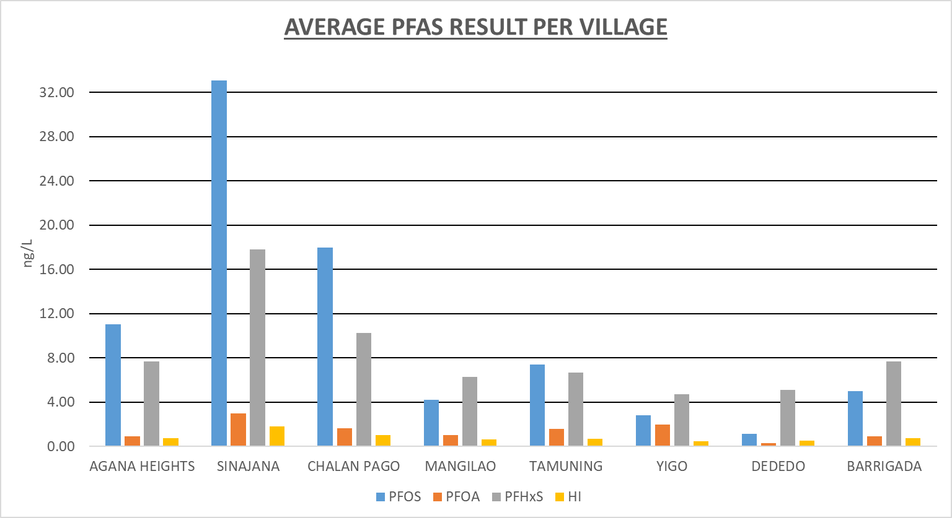
Notes:
These are the 8 villages with entry points (Guam Waterworks Authority, Guam Plaza Resort, and Guam Regional Medical City – consecutive system from GWA)
Average PFAS results for PFOS, PFOA, PFHxS, and HI are chosen for this graph because these are the most common PFAS in Guam
Also to note that the highest values are from pfos and pfhxs
Not to be used for compliance monitoring purposes since these are all averages

Slide 9
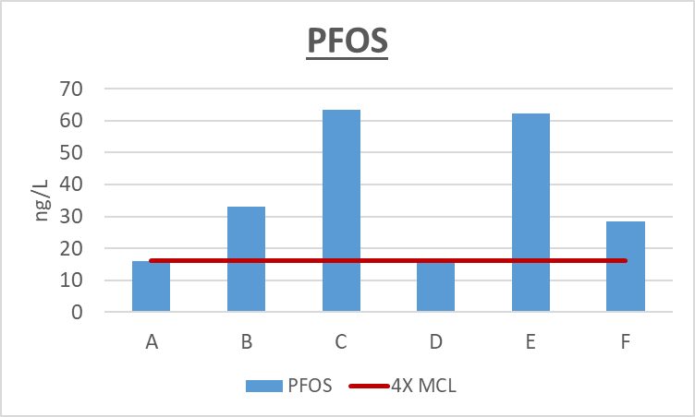
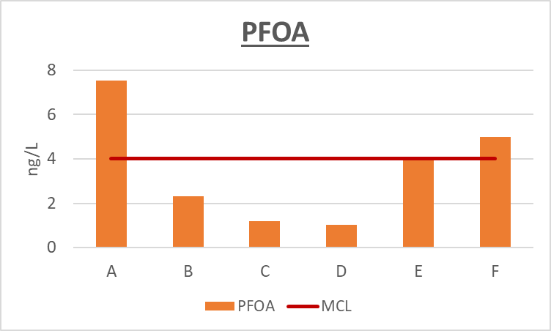
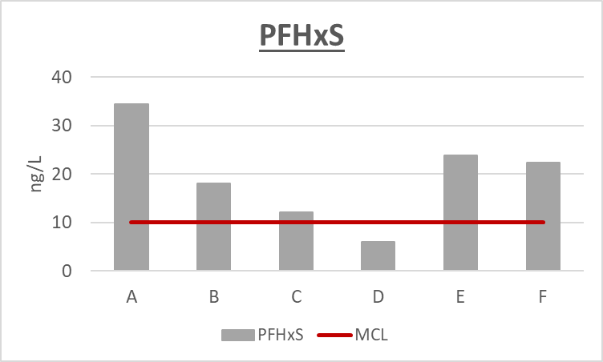
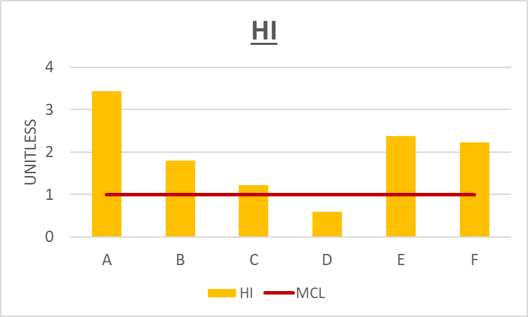
PFAS IN THE HIGHEST PRODUCTION WELLS
Notes:
SIERRA

Slide 10
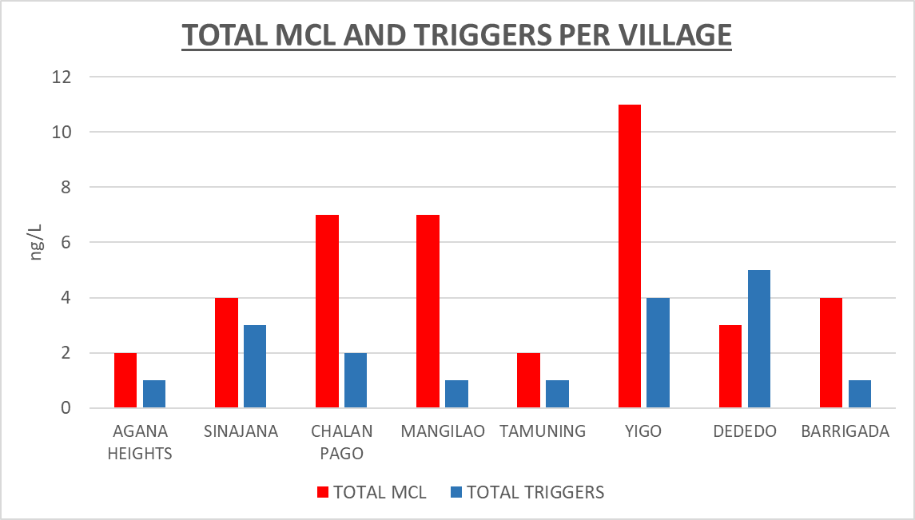
Notes:
SIERRA
THIS GRAPH IS ONLY PFOS AND PFOA FOR THE NEW PROPOSED MCLS FOR PFAS

Slide 11
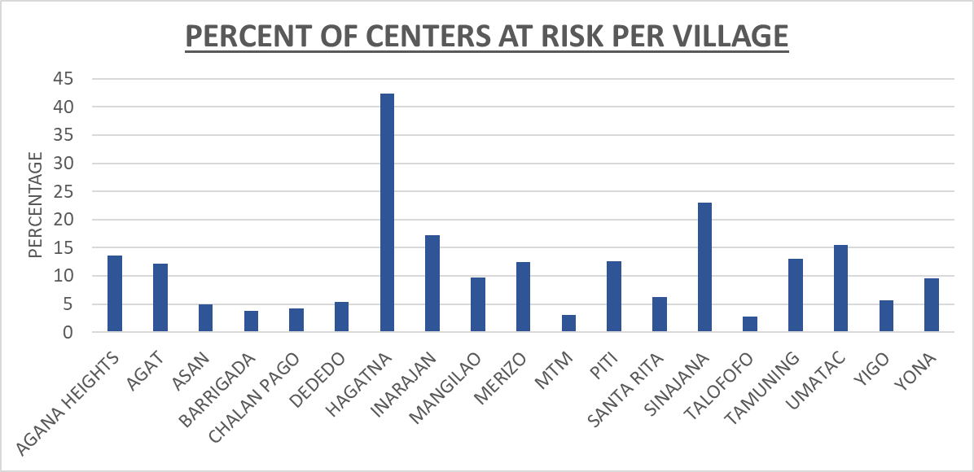
Notes:
NICOLE
HERE WE HAVE ALL 19 VILLAGES OF GUAM REPRESENTED.
WE GRAPHED THE PERCENT OF CENTERS AT RISK PER VILLAGE BY CALCULATING THE POPULATION FOR EACH VILLAGE FROM THE 2020 CENSUS AND THEN WE DIVIDED THE POPULATION BY THE AMOUNT OF CENTERS AT RISK PER VILLAGE. FOR THE CENTERS AT RISK WE FOCUSED ON PREGNANT WOMEN, YOUNG CHILDREN, AND FAMILIES AT RISK SINCE THEY ARE THE MOST VULNERABLE TO THE IMPACTS OF PFAS.
SO SHOWN ON THE GRAPH, YOU CAN SEE THAT HAGATNA, SINIJANA, AND UMATAC ARE THE TOP THREE WITH THE HIGHEST PERCENT OF CENTERS AT RISK WHILE TALOFOFO, MTM, BARRIGADA. ARE THE TOP 3 WITH THE LEAST PERCENT OF CENTERS AT RISK.
SO WHILE IT DOES LOOK LIKE A HUGE JUMP BETWEEN ALL THE OTHER VILLAGES AND HAGATNA IT IS IMPORTANT TO NOTE THAT HAGATNA IS ONE OF GUAMS SMALLEST VILLAGES. IT IS ALSO THE CAPITAL OF GUAM AND GENERATES ALOT OF TRAFFIC AND BUSINESS. THE POPULATION THERE IS ROUGHLY 943 PEOPLE. BUT COMPARED TO OUR BIGGEST VILLAGE, WHICH IS DEDEDO, THE POPULATION THERE IS ROUGHLY 45000 PEOPLE . DEDEDO ALSO HAS THE HIGHEST NUMBER OF CENTERS AT RISK COMPARED TO ANY OTHER VILLAGE.
HERE WE HAVE ALL 19 VILLAGES REPRESENTED
THE PERCENT OF CENTERS AT RISK PER VILLAGE IS CALCULATED BY THE POPULATION FOR EACH VILLAGE FROM THE 2020 CENSUS AND WE DIVIDED THE POPULATION BY THE AMOUNT OF CENTERS AT RISK PER VILLAGE - PREGNANT WOMEN, YOUNG CHILDREN, AND FAMILIES AT RISK BIGGEST CONCERN
SHOWN ON THE GRAPH, HAGATNA HAS THE HIGHEST PERCENT OF CENTERS AT RISK (THEY ARE ALSO ONE OF THE SMALLEST VILLAGES (943 PEOPLE) BUT IT IS OUR CAPITAL OF GUAM), AND DEDEDO (45000) IS ONE OF THE LEAST AT RISK AND THEY HAVE ONE OF THE HIGHEST NUMBERS OF CENTERS AT RISK FOR ANY VILLAGE- ONLY CHOSE 100 PEOPLE PER CENTER AT RISK

Slide 12
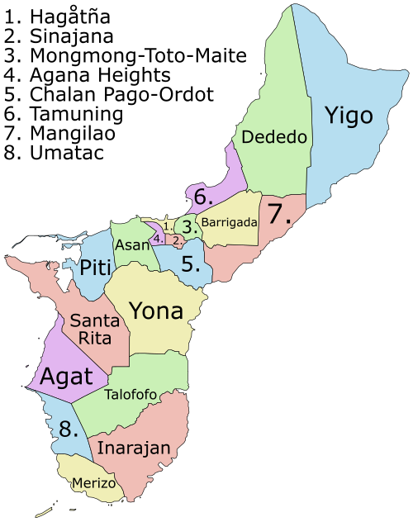
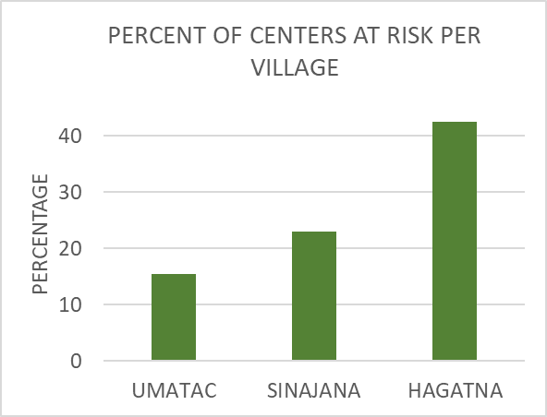
Notes:
NICOLE
SO SHOWN ON THE GRAPH, YOU CAN SEE THAT HAGATNA, SINIJANA, AND UMATAC ARE THE TOP THREE WITH THE HIGHEST PERCENT OF CENTERS AT RISK
SO WHILE IT DOES SEEM LIKE A HUGE JUMP BETWEEN ALL THE OTHER VILLAGES AND HAGATNA IT IS IMPORTANT TO NOTE THAT HAGATNA IS ONE OF GUAMS SMALLEST VILLAGES. IT IS ALSO THE CAPITAL OF GUAM AND GENERATES A LOT OF TRAFFIC AND BUSINESS. THE POPULATION THERE IS ROUGHLY 943 PEOPLE. BUT COMPARED TO OUR BIGGEST VILLAGE, WHICH IS DEDEDO, THE POPULATION THERE IS ROUGHLY 45000 PEOPLE . DEDEDO ALSO HAS THE HIGHEST NUMBER OF CENTERS AT RISK COMPARED TO ANY OTHER VILLAGE.

Slide 13
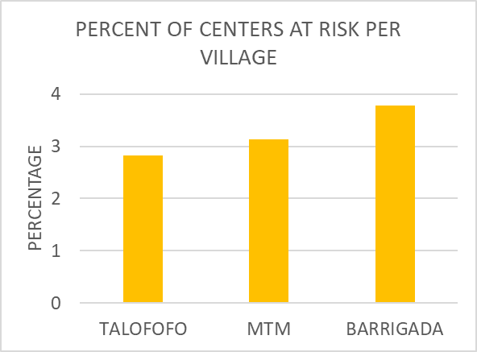
Notes:
NICOLE
TALOFOFO, MTM, BARRIGADA. ARE THE TOP 3 WITH THE LEAST PERCENT OF CENTERS AT RISK.

Slide 14
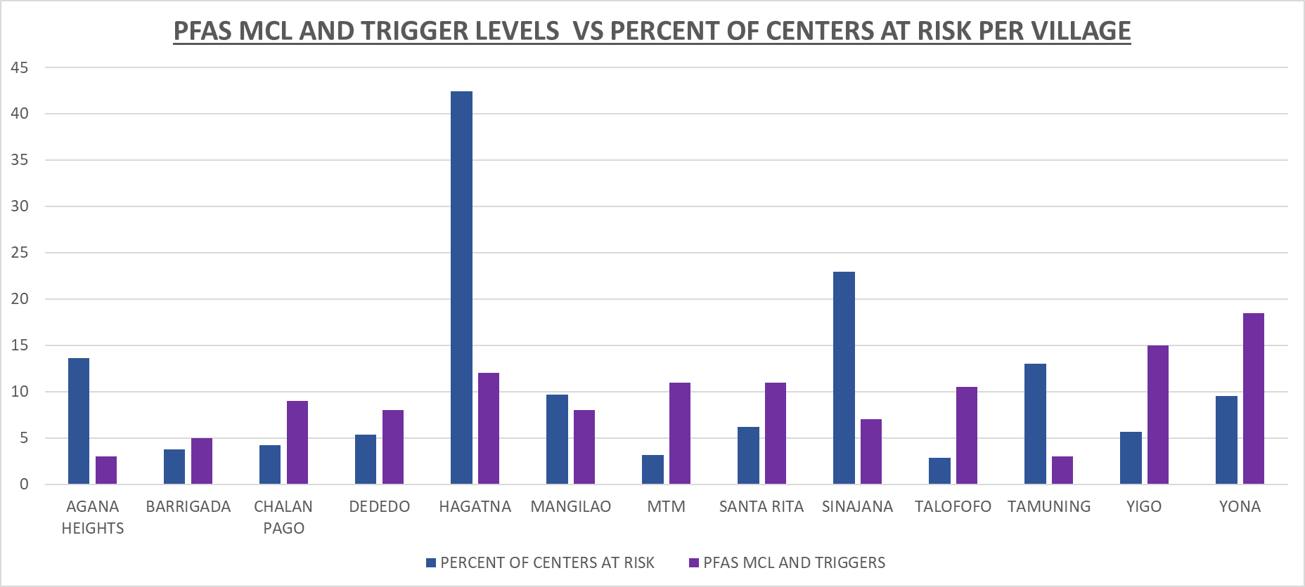
Notes:
NICOLE
NOW WE ARE COMBINING TOGETHER WITH PFAS MCLS AND TRIGGER LEVELS AND THE PERCENT OF CENTERS AT RISK PER VILLAGE
THERE ARE LESS VILLAGES SHOWN ON THIS GRAPH BC WE REMOVED AGAT, ASAN, INARAJAN, MERIZO, PITI, AND UMATAC SINCE THEY DO NOT HAVE ANY KNOWN PFAS IN THEIR DRINKING WATER
BASED ON THE DATA GRAPHED HERE, BARRIGADA, CHALAN PAGO, DEDEDO, MTM, SANTA RITA, TALOFOFO, YIGO, YONA HAVE HIGHER LEVELS OF PFAS THAN PERCENTAGES OF CENTERS AT RISK - WHICH COULD MEAN THAT THEY ARE MORE VULNERABLE AND OR LIKELY TO BE EXPOSED TO PFAS IN THEIR DRINKING WATER COMPARED TO THOSE WITH A LOWER AMOUNT OF PFAS MCLS AND TRIGGER LEVELS.

Slide 15
CONCLUSION
CALCULATED RISK PER VILLAGE USING: RISK = LIKELIHOOD X IMPACT
  LIKELIHOOD = PERCENT OF CENTERS AT RISK IN EACH VILLAGE
  IMPACT = NUMBER OF PFAS MCLS AND TRIGGER LEVELS DIVIDED BY THE NUMBER OF WELLS PER VILLAGE
TOP VILLAGES AT RISK ARE:
  HAGATNA - 127%
  SINAJANA - 99%
  TAMUNING - 45%
Notes:
SIERRA

Slide 16
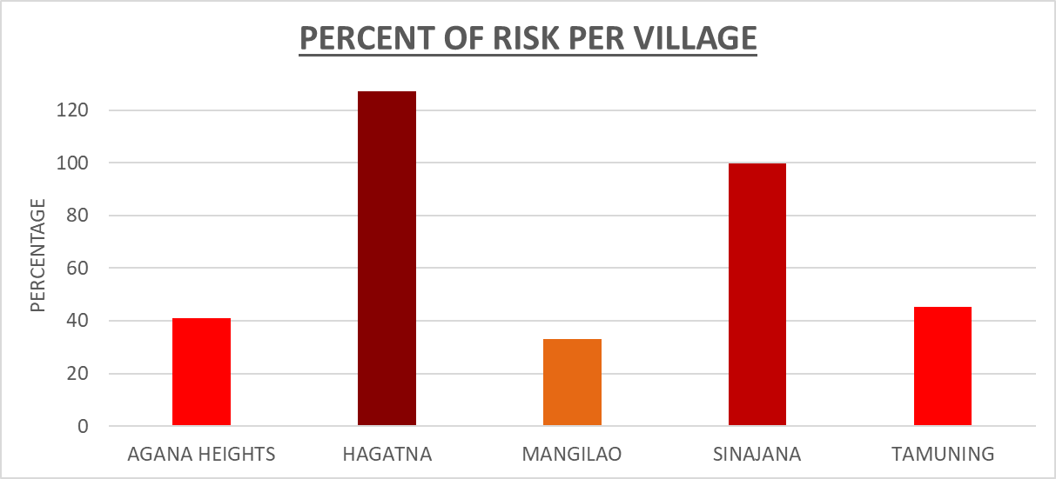
Notes:
NICOLE

Slide 17
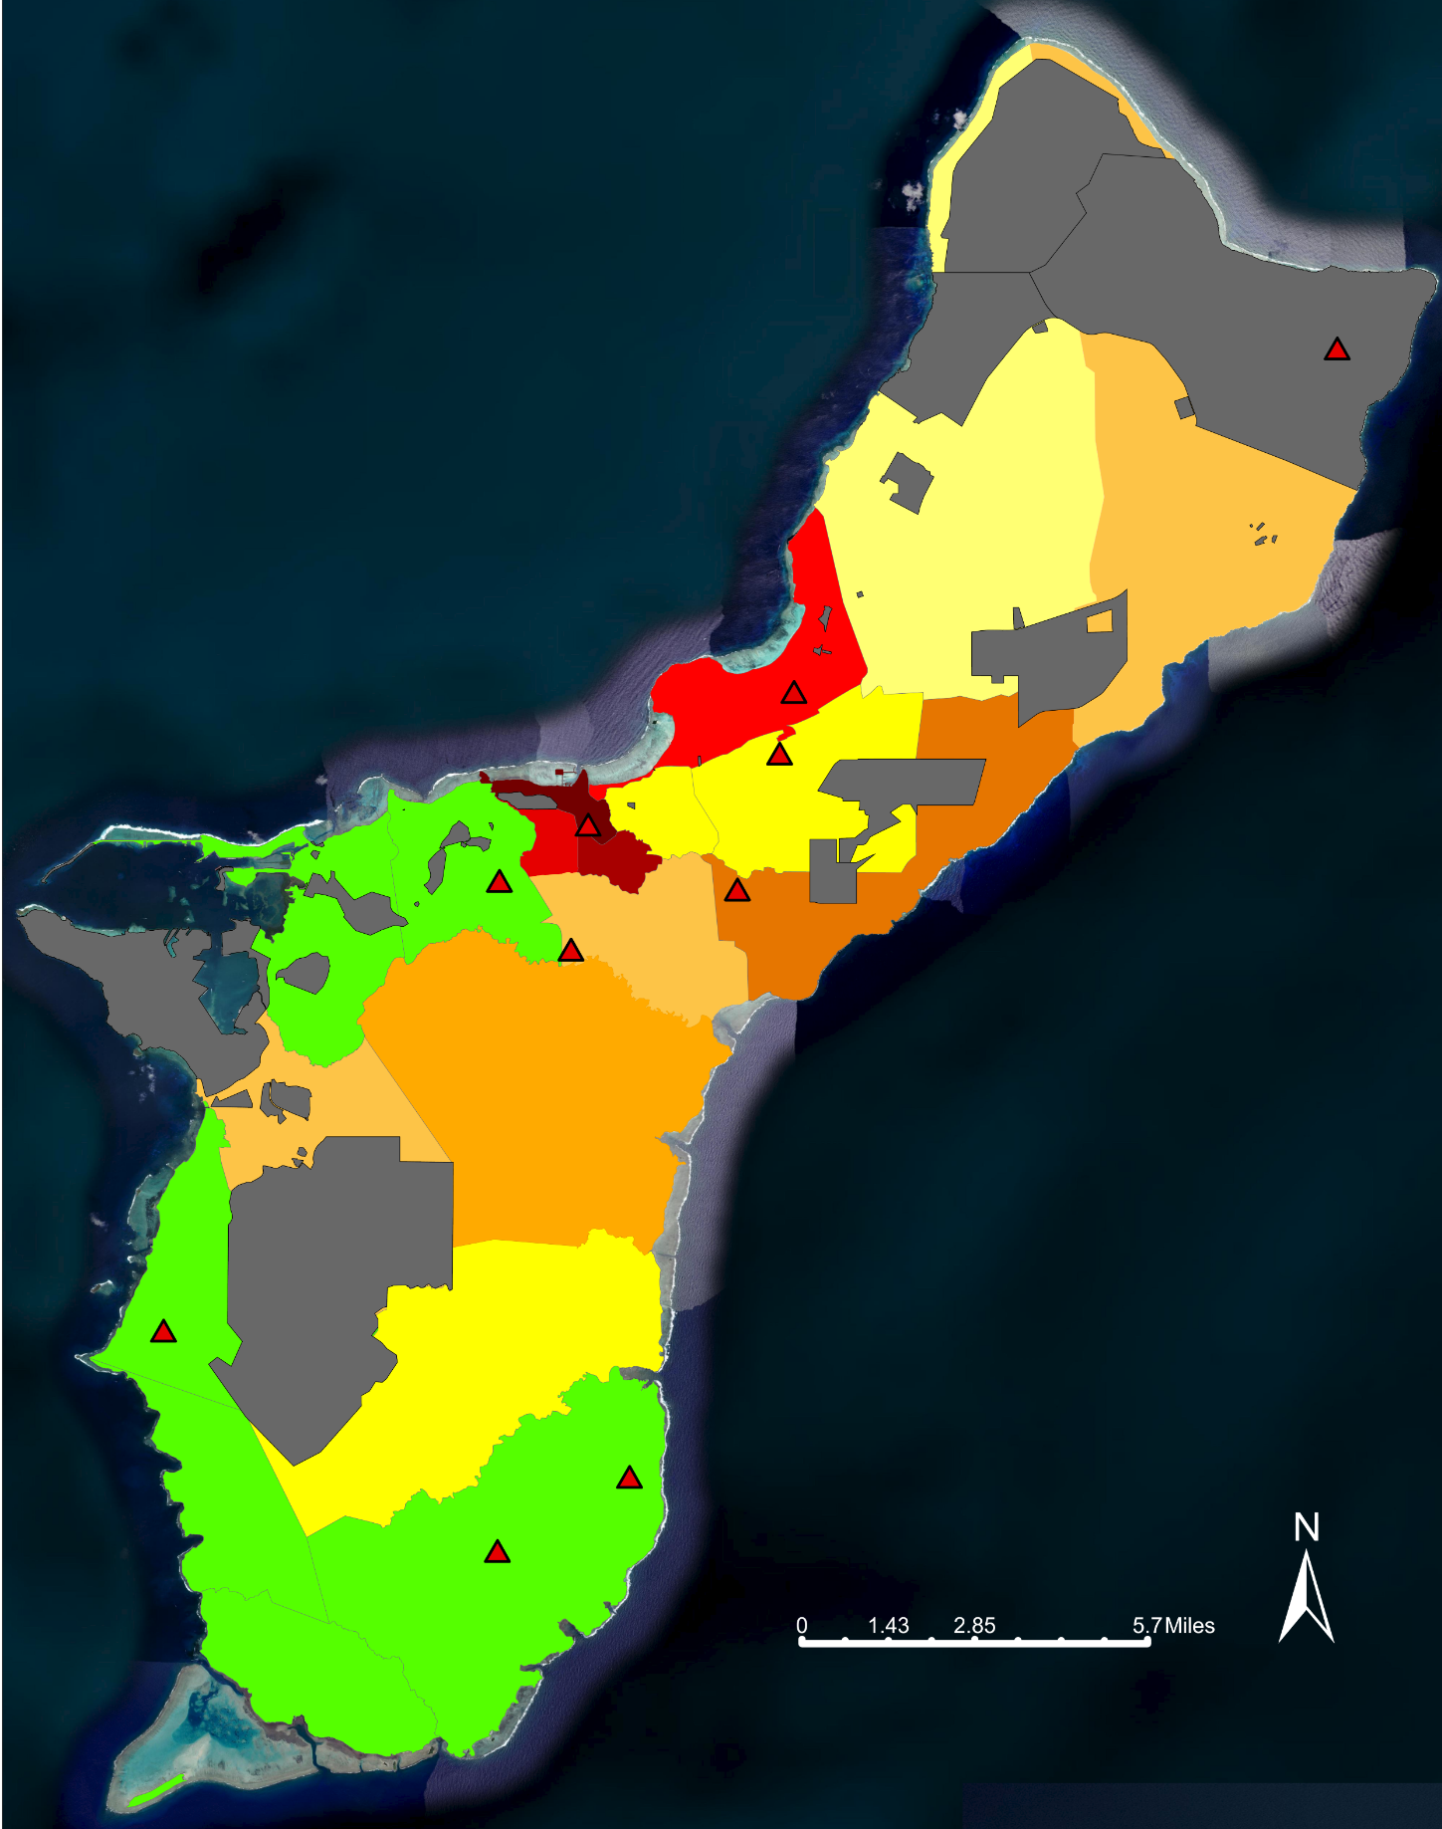
PERCENT OF RISK OF PFAS PER VILLAGE IN GUAM
LEGEND:
GREEN = ZERO RISK
LIGHT YELLOW = 1 - 5% RISK
YELLOW = 6 - 10% RISK
LIGHT ORANGE = 11 - 20% RISK
ORANGE = 21 - 30% RISK
DARK ORANGE = 31 - 40% RISK
RED = 41 - 50% RISK
DARK RED = 90 - 100% RISK
DARKEST RED = 100+% RISK
GRAY = DOD PROPERTIES
RED TRIANGLE = HOT SPOT
Notes:
SIERRA & NICOLE
ZERO RISK: GREEN
1-5% RISK: LIGHT YELLOW
5-10% RISK: BRIGHTER YELLOW
10-20% RISK: LIGHT ORANGE
20-30% RISK: ORANGE
30-40% RISK: DARK ORANGE
40-50% RISK: RED
90-100% RISK: DARK RED
100%+ RISK: DARKEST RED
THE GRAY AREAS SHOW THE DOD PROPERTIES
RED TRIANGLES SHOW HOT SPOTS, WHICH INCLUDE …

Slide 18
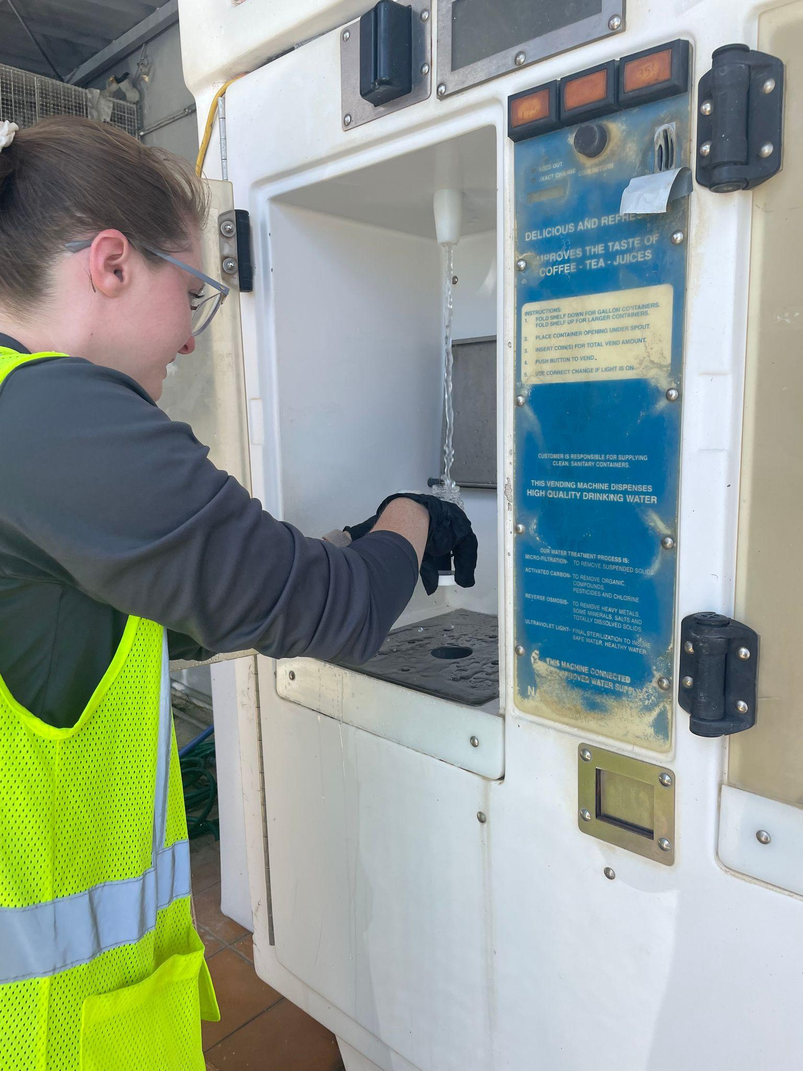
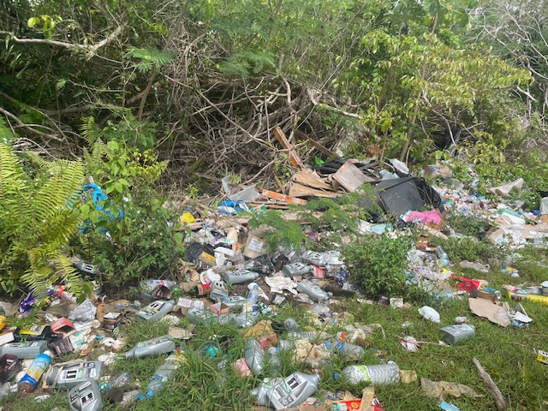
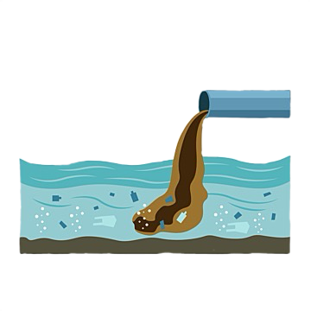
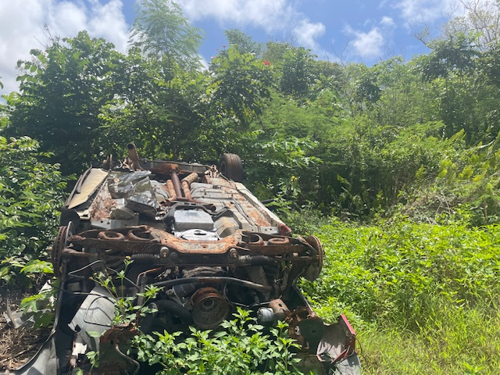
OTHER CONSIDERATIONS
HOW MANY PEOPLE ACTUALLY DRINK THE TAP WATER?
  GUAM HAS 120+ REFILL/WATER FILLING STATIONS
ALL RESULTS ARE TAKEN FROM ENTRY POINTS
WASTEWATER CONTAMINATION?
SEPTIC SYSTEMS?
ILLEGAL DUMPING?
MILITARY BUILD-UP/CONSTRUCTION?
Notes:
SIERRA & NICOLE
SEPTIC SYSTEMS COULD BE A POTENTIAL SOURCE OF PFAS IN GUAM - FAILURE MAINTENANCE OR PUMP FAILURES THAT WOULD RESULT IN AN OVERFLOW OF WASTEWATER WHICH HAS LOW LEVELS OF PFAS FROM HOMEGOODS AND PRODUCTS
ILLEGAL DUMPING - PRODUCTS CONTAINING PFAS LEACHING INTO THE SOIL AND OUR SOLE WATER SOURCE
MILITARY BUILD UP / CONSTRUCTION - THE BREAKING OF SOIL COULD DISTURB ANY PFAS THAT WAS THERE, THE IMPORT OF CONSTRUCTION MATERIALS THAT CONTAIN PFAS, ETC.
ADD IN BIOACCUMULATION OF OTHER CHEMICALS? DIELDRIN

Slide 19
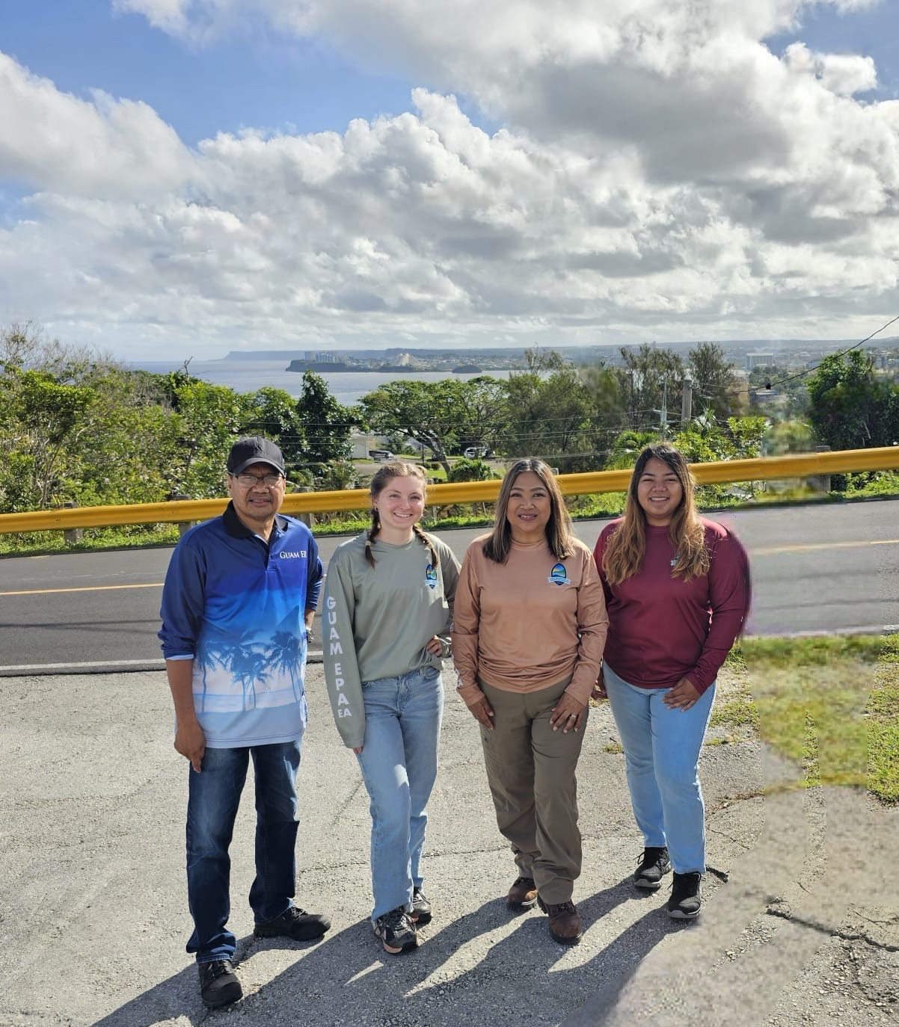
SI YU’US MA’ASE!!
EMAIL: SIERRA.BETTIS@EPA.GUAM.GOV
PHONE NUMBER: 671-588-4776
EMAIL: NICOLE.DIRAS@EPA.GUAM.GOV
PHONE NUMBER: 671-588-4798
Notes:
NICOLE

