Slide 1






PROTECTING THE HEALTH AND SUSTAINABLE YIELD OF NOTHERN GUAM’S LENS AQUIFER
WERI-GLE GHS Workshop 2025 | AUGUST 29, 2025

Slide 2
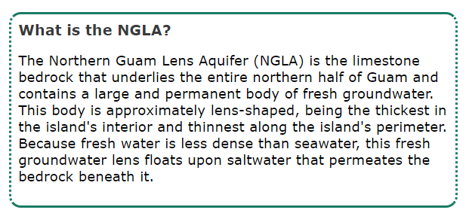
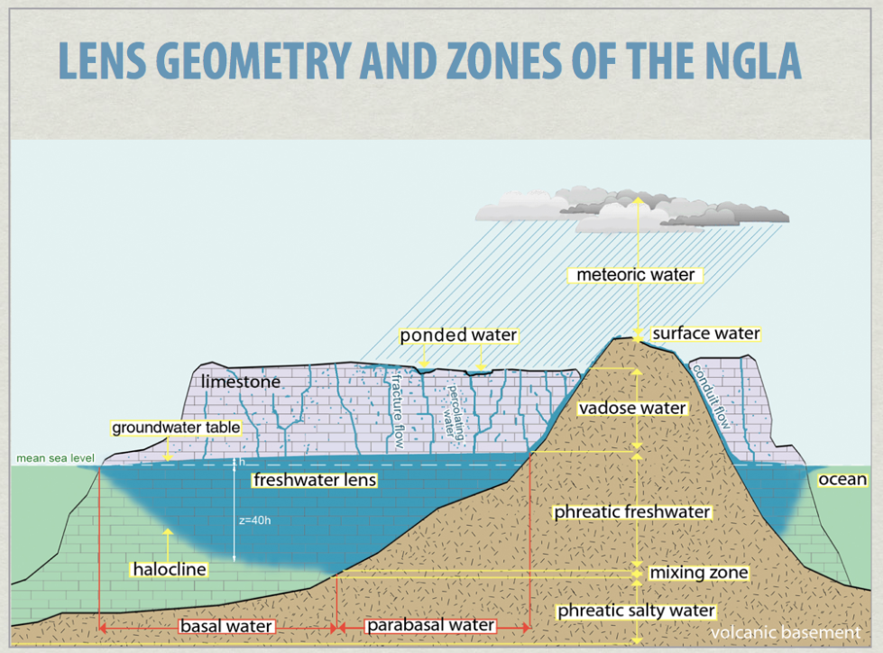
The Northern guam lens aquifer
Lens Geometry and Zones of the NGLA, Hydroguam.net, Digital Atlas of Northern Guam | WERI | IREI (hydroguam.net)
Notes:
Agenda
* Introduction
* Overview of GWA’s 5-year CIP
* Overall Program and Priorities
* Specific Project Categories
* Currently Available Funding
* Approved 5-yr CIP
* Projected Needs and Adjustments
* Market Update
* Expected Financing Structures
* Short-Term Options Discussion
* Planned Long-Term Takeout Financing
* Strategy Outline
* Follow-up Meeting Schedules

Slide 3








Wastewater System
GWA collects and treats wastewater throughout the island
84
Wastewater
Lift Stations
7
Service
basins
~300
Miles of
collection piping
3
Outfalls: 2 owned
1 shared
6
Wastewater Treatment Plants
~31,232
Customers served

Slide 4




Current challenges
Aging Infrastructure
Lack of Redundancy
Rising Contaminants
Increasing Population
Notes:
Agenda
* Introduction
* Overview of GWA’s 5-year CIP
* Overall Program and Priorities
* Specific Project Categories
* Currently Available Funding
* Approved 5-yr CIP
* Projected Needs and Adjustments
* Market Update
* Expected Financing Structures
* Short-Term Options Discussion
* Planned Long-Term Takeout Financing
* Strategy Outline
* Follow-up Meeting Schedules

Slide 5

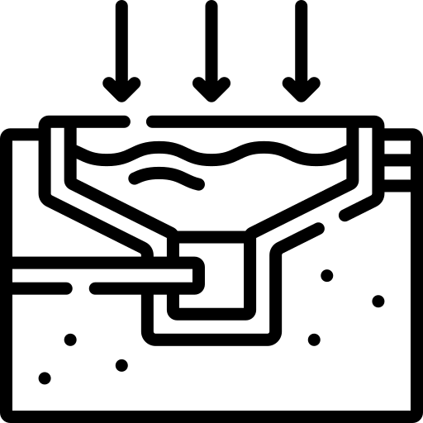

Current Challenges – 2024 Partial Consent Decree
Major elements to be completed within 10 years:
GRAVITY SEWERS
30 miles of gravity main rehabilitation
5 priority capacity assurance projects
PUMP STATIONS
All Tier 1 stations rehabilitated
50% of Tier 2 stations rehabilitated
Plan for Tiers 3 and 4
FORCE MAINS
Inventory, assessment
25% of total LF rehabilitated
HAGATNA WWTP
Feasibility Study on Secondary Treatment
Upgrade and/or relocation

Slide 6
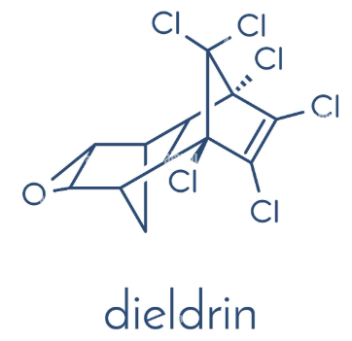
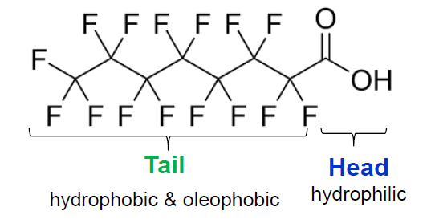


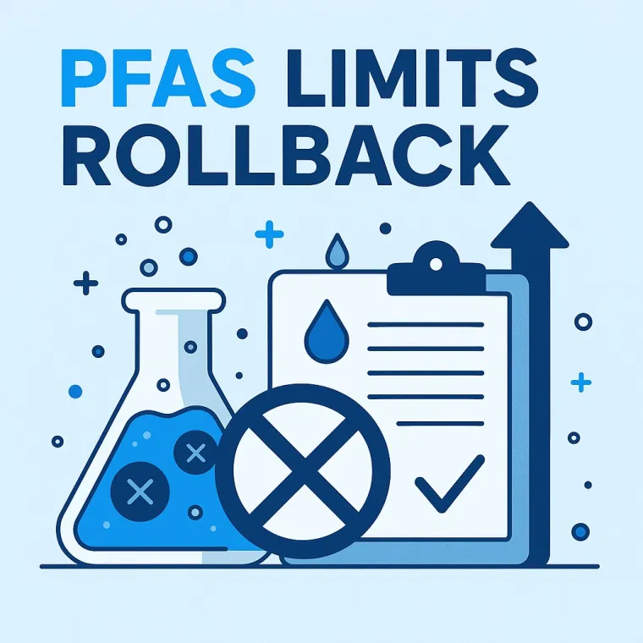
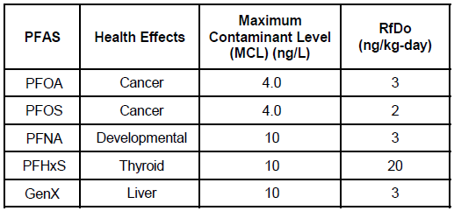
Rising contaminants
Dieldrin
  Powerful insecticide
  Used 1950s to 1970s
  Probable human carcinogen
  Interim Action Level (IAL): 0.2 ppb or ug/L
PFAS
  PFOS, PFOA, PFNA, PFHxS
Notes:
Agenda
* Introduction
* Overview of GWA’s 5-year CIP
* Overall Program and Priorities
* Specific Project Categories
* Currently Available Funding
* Approved 5-yr CIP
* Projected Needs and Adjustments
* Market Update
* Expected Financing Structures
* Short-Term Options Discussion
* Planned Long-Term Takeout Financing
* Strategy Outline
* Follow-up Meeting Schedules

Slide 7
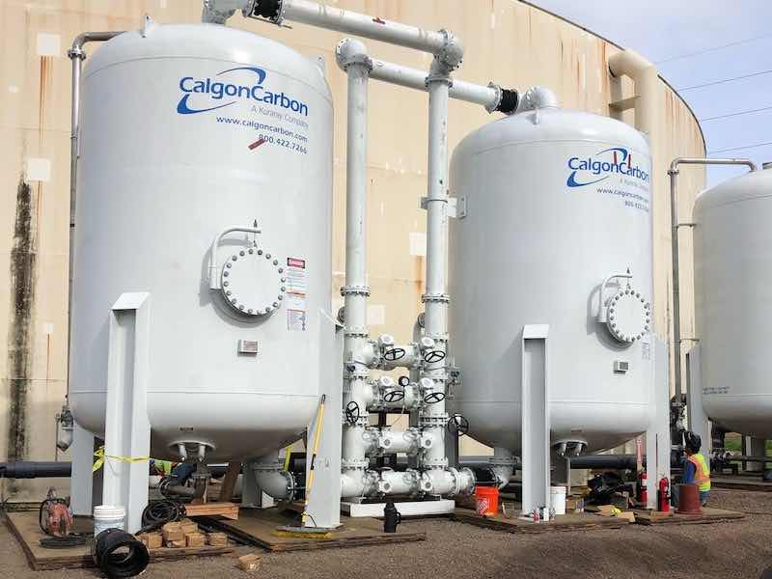
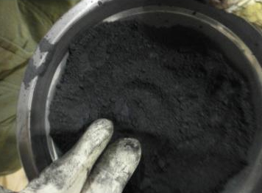
Granular activated carbon (gac) treatment
Treatments
Ion Exchange Resin
High-Pressure Membranes: Reverse Osmosis or Nanofiltration
GAC
  Removes many organic compounds
  Works on both PFAS and Dieldrin
  Simple Operations
  Requires large footprint
  Waste media disposal
Notes:
Agenda
* Introduction
* Overview of GWA’s 5-year CIP
* Overall Program and Priorities
* Specific Project Categories
* Currently Available Funding
* Approved 5-yr CIP
* Projected Needs and Adjustments
* Market Update
* Expected Financing Structures
* Short-Term Options Discussion
* Planned Long-Term Takeout Financing
* Strategy Outline
* Follow-up Meeting Schedules

Slide 8
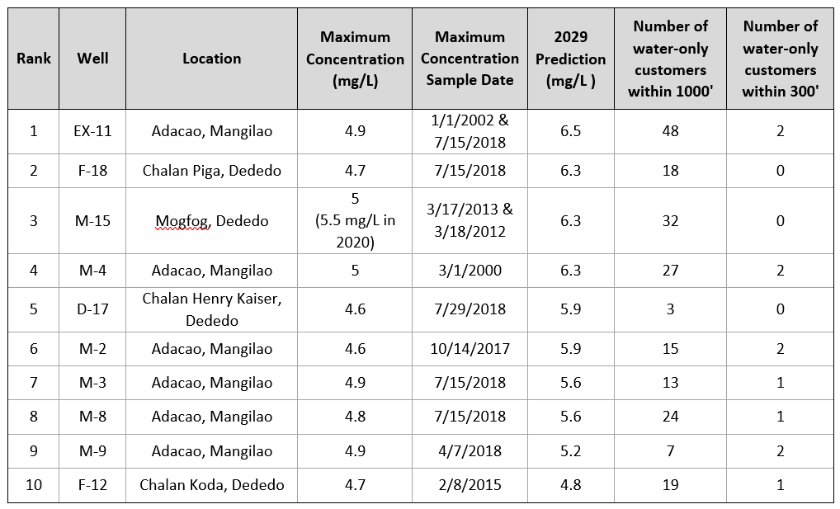
Contaminants: Nitrates
Nitrates
Naturally occurring
High nitrate concentrations in wastewater
Adverse health effects in pregnancy
  Blue Baby Syndrome
Safe Drinking Water Standard:
  10 mg/L
1986 to 2019 - 84 wells w/ increasing nitrates
Notes:
Agenda
* Introduction
* Overview of GWA’s 5-year CIP
* Overall Program and Priorities
* Specific Project Categories
* Currently Available Funding
* Approved 5-yr CIP
* Projected Needs and Adjustments
* Market Update
* Expected Financing Structures
* Short-Term Options Discussion
* Planned Long-Term Takeout Financing
* Strategy Outline
* Follow-up Meeting Schedules

Slide 9
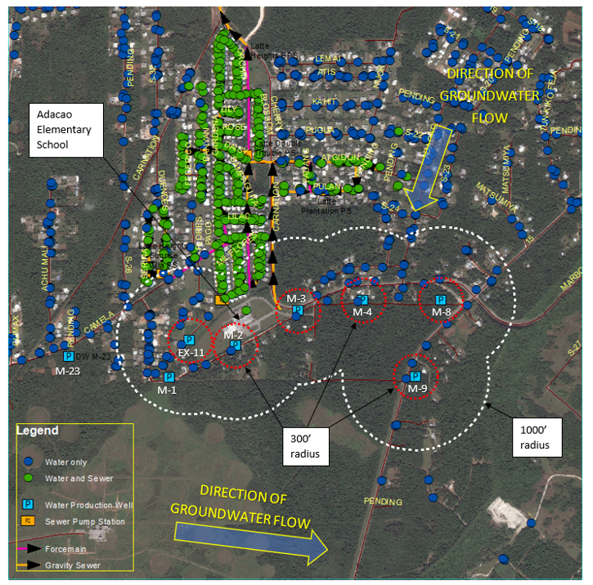
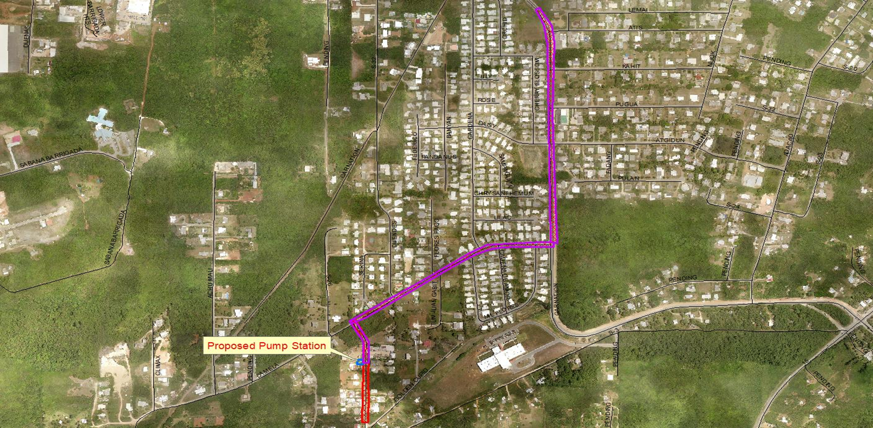
Capacity assurance projects (adacao)
Notes:
Agenda
* Introduction
* Overview of GWA’s 5-year CIP
* Overall Program and Priorities
* Specific Project Categories
* Currently Available Funding
* Approved 5-yr CIP
* Projected Needs and Adjustments
* Market Update
* Expected Financing Structures
* Short-Term Options Discussion
* Planned Long-Term Takeout Financing
* Strategy Outline
* Follow-up Meeting Schedules

Slide 10
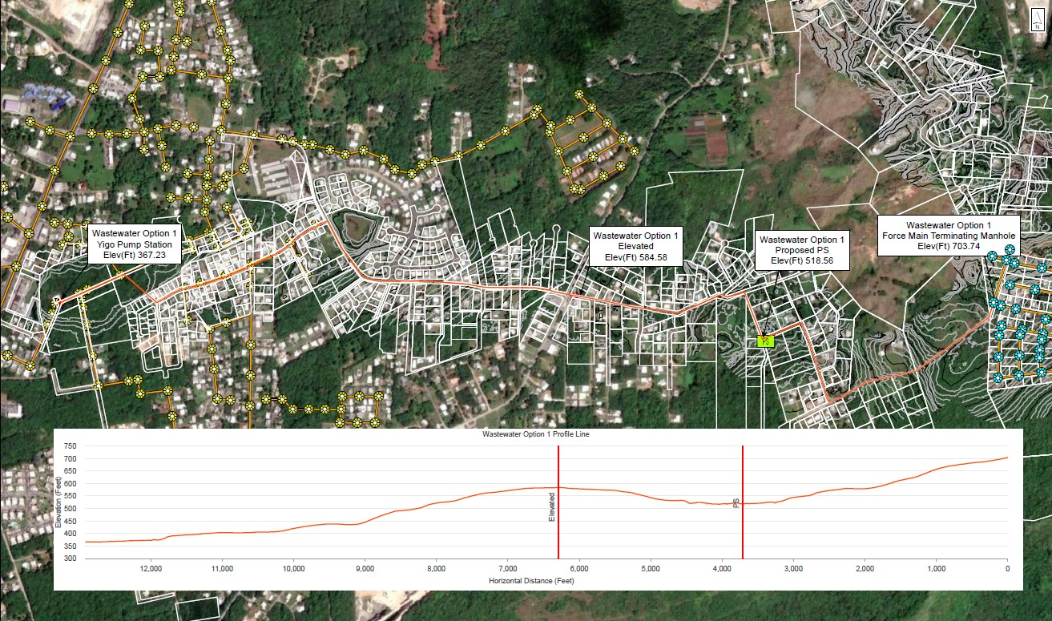
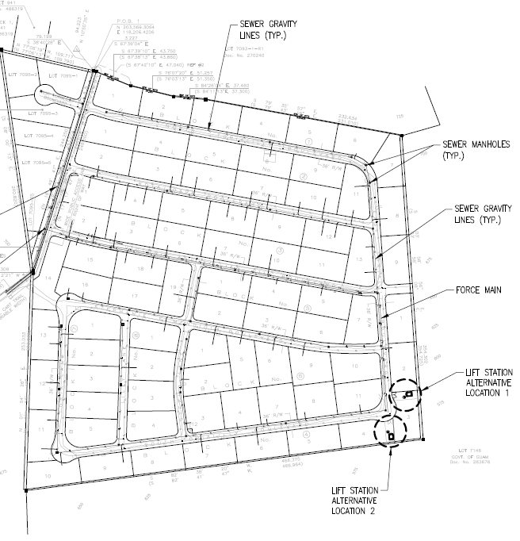
Capacity assurance projects (gill breeze subdivision)
Notes:
Agenda
* Introduction
* Overview of GWA’s 5-year CIP
* Overall Program and Priorities
* Specific Project Categories
* Currently Available Funding
* Approved 5-yr CIP
* Projected Needs and Adjustments
* Market Update
* Expected Financing Structures
* Short-Term Options Discussion
* Planned Long-Term Takeout Financing
* Strategy Outline
* Follow-up Meeting Schedules

Slide 11
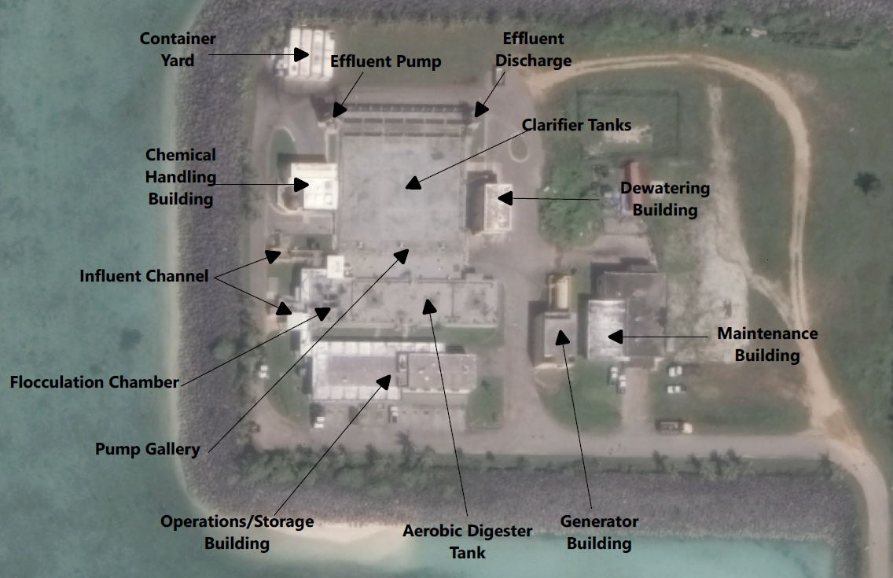
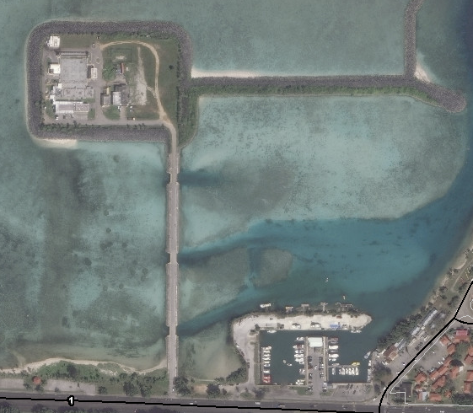
Hagatna wastewater treatment plant upgrades
Notes:
Agenda
* Introduction
* Overview of GWA’s 5-year CIP
* Overall Program and Priorities
* Specific Project Categories
* Currently Available Funding
* Approved 5-yr CIP
* Projected Needs and Adjustments
* Market Update
* Expected Financing Structures
* Short-Term Options Discussion
* Planned Long-Term Takeout Financing
* Strategy Outline
* Follow-up Meeting Schedules

Slide 12
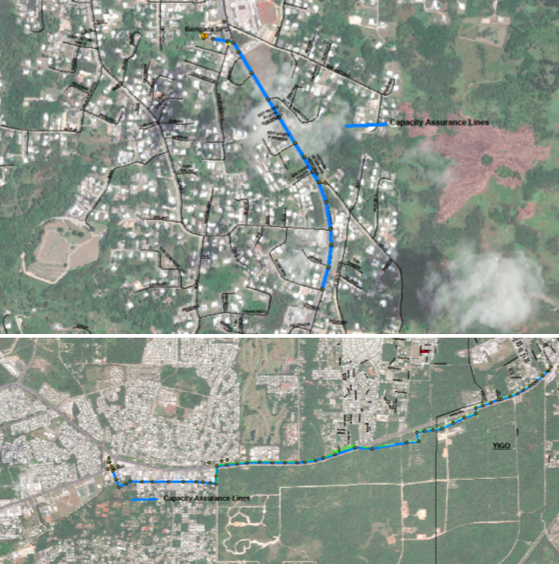
Capacity assurance projects
Barrigada
~4,000 LF of sewer pipe
14 to 18” diameter pipe
Upsizing for Capacity
Dededo
~21,000 LF of sewer pipe
15 to 30” diameter pipe
Upsizing for Capacity
Notes:
Agenda
* Introduction
* Overview of GWA’s 5-year CIP
* Overall Program and Priorities
* Specific Project Categories
* Currently Available Funding
* Approved 5-yr CIP
* Projected Needs and Adjustments
* Market Update
* Expected Financing Structures
* Short-Term Options Discussion
* Planned Long-Term Takeout Financing
* Strategy Outline
* Follow-up Meeting Schedules

Slide 13
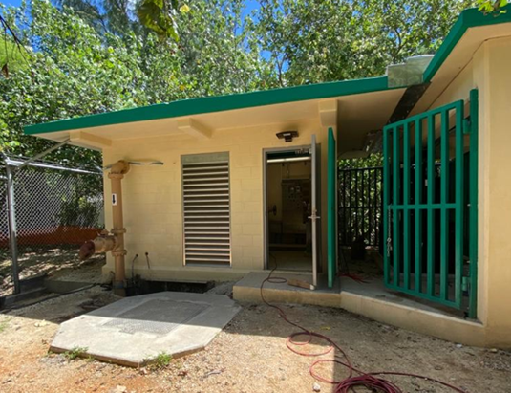
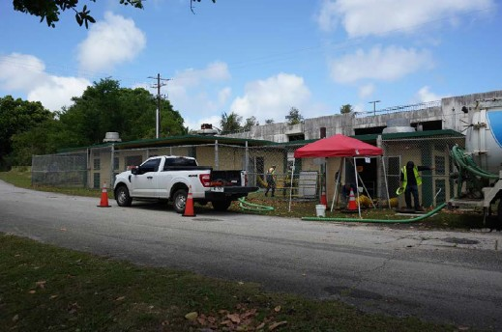
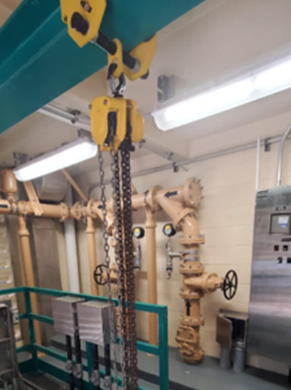
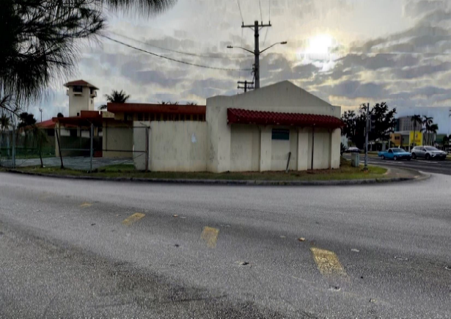
Wastewater pump station upgrades
Pump Station Priority Projects
Tier 1 Pump Station and Force Main Inspections
Notes:
Agenda
* Introduction
* Overview of GWA’s 5-year CIP
* Overall Program and Priorities
* Specific Project Categories
* Currently Available Funding
* Approved 5-yr CIP
* Projected Needs and Adjustments
* Market Update
* Expected Financing Structures
* Short-Term Options Discussion
* Planned Long-Term Takeout Financing
* Strategy Outline
* Follow-up Meeting Schedules

Slide 14


Q&A
OPEN DISCUSSION
Notes:
Agenda
* Introduction
* Overview of GWA’s 5-year CIP
* Overall Program and Priorities
* Specific Project Categories
* Currently Available Funding
* Approved 5-yr CIP
* Projected Needs and Adjustments
* Market Update
* Expected Financing Structures
* Short-Term Options Discussion
* Planned Long-Term Takeout Financing
* Strategy Outline
* Follow-up Meeting Schedules

