Slide 1



Health Effects of PFAS
Claire Marzan, Dr. Barry (Yong Sang) Kim

Slide 2
Disclaimer
This presentation is for educational purposes only. The information presented is based on current scientific literature and does not constitute medial advice or policy recommendations.

Slide 3
Introduction
Understanding PFAS

Slide 4
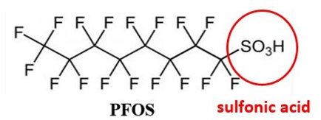
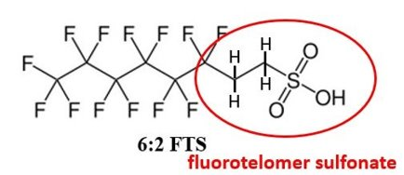
What are PFAS?
Per- and poly- fluoroalkyl substances
Man-made chemicals ^{[1, 2]}
Over 10,000 PFAS compounds and derivatives ^{[1, 2]}
Bioaccumulate ^{[1, 5, 16]}
C
C
C
C
C
C
C
C
C
C
C
C
C
C
C
C
Notes:
PFAS are per and poly fluoroalkyl substances
They are known for their long carbon chains that are either all have fluorine or fluorine with hydrogen that are differentiated with their functional groups
Man made chemicals also nicknamed forever chemicals
They have over 10,000 derivatives
And they also have a tendency to bioaccumulate which we will get into

Slide 5
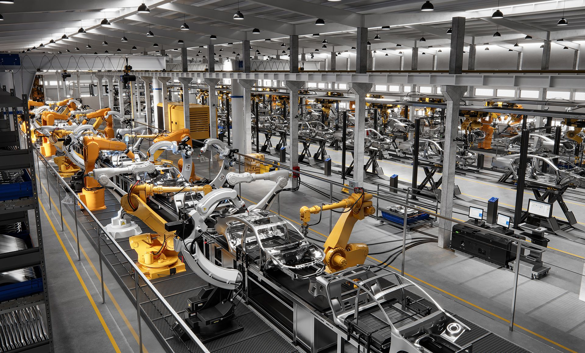


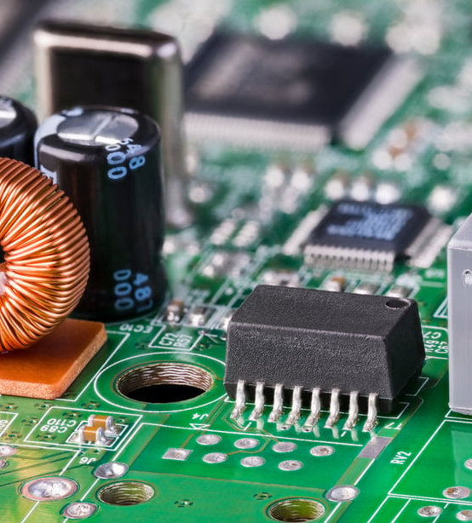



Usage of PFAS
(Iowa Waste Reduction Center)
Consumer products ^{[1, 2]}
Industrial uses ^{[1, 2, 17]}
Firefighting ^{[1, 2, 5,} ^{17]}
(American Chemical Society, 2022)
(FEIHONG Powders, 2024)
(Winmate Inc.)
(iStock)
(iStock)
(Myers, 2021)
Notes:
PFAS are used in consumer products such as personal care products, take out containers, nonstick pans such as Teflon, water proof clothing
Industrial uses such as treating plastic or metal plating
And fire fighting foams

Slide 6
Potential Routes for Human Exposure
Occupational Hazards ^{[1, 2, 5]}
Drinking or ingesting contaminated water and food ^{[1, 2, 5, 16]}
Swallowing contaminated soil or dust ^{[1, 2, 5, 16]}
Prenatal/Infant exposure through placenta or breast milk ^{[3-5, 8]}
Notes:
Occupational hazards
Drinking or ingesting contaminated water and food
Swallowing contaminated soil or dust
Prenatal/Infant exposure through placenta or breast milk

Slide 7

The Immune System

Slide 8
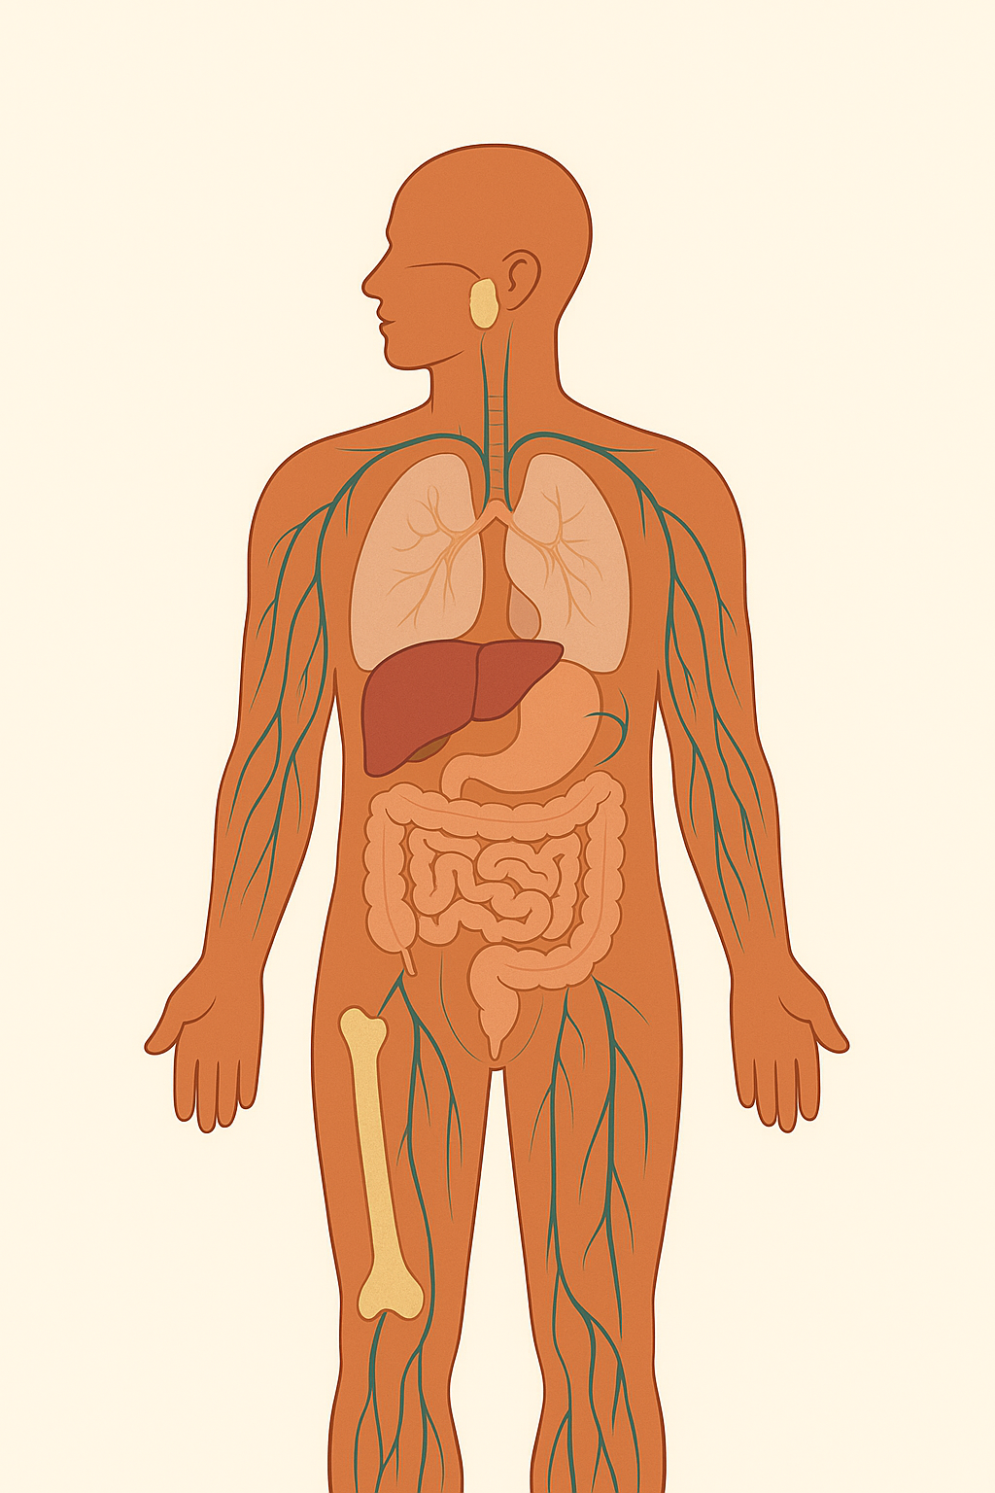
Functions ^{[12-15]}
Protection -> Recognizes & attacks harmful foreign substances
Monitors the body -> Eliminate abnormal cells
Homeostasis -> Cleans cellular debris, assists with tissue repair
(OpenAI, 2025)
Notes:
On the screen we have a photo of immune system organs and glands such as bone marrow or the lymphatic system
The immune system functions to protect the body by recognizing and attacking harmful substances that may enter the body
Monitor for abnormalities and eliminating them
And for homeostasis to clean cellular debris such as return blood when we get bruises

Slide 9




Mechanism ^{[12 – 15]}
Foreign Substance/Virus
Memory Cells
Virus enters the body
Immune cells detect the virus and unfamiliar proteins
B cells make antibodies that target the virus
Killer T cells locate the infected cells
Cells either die or become memory cells
Immune cells
Antibodies
(OpenAI, 2025)
Notes:
Now we will try to understand how the how the immune system works in general
On the diagram we have green for our foreign substance, yellow for cells of the immune system, and the blue for the antibodies
First a virus will enter our body
Immune cells will then detect unfamiliar proteins and attach our blue antibodies to the virus
The yellow cells known as killer T cells can then locate infected cells and eliminate them
Remaining cells either die with the virus or become a memory cell which has the ability to create more antibodies that allows our body to react faster in case the same virus ends up in our body again

Slide 10



Effects of PFAS:
PFAS contaminated food is ingested ^{[5]}
PFAS is distributed to target organs ^{[5 – 6]}
Antibody production decreases ^{[6 – 8]}
(OpenAI, 2025)
Notes:
Now that we understand the immune system under normal circumstances, we will see how PFAS affects our body
One of the most common ways we get PFAS in our system is through contaminated food
So we will first ingest PFAS contaminated food
The food is digested and since PFAS cant be digested, it gets distributed to target organs whos main function is to remove and filter toxins from our body
PFAS being present in the blood has the ability to mimic certain proteins needed to make antibodies
This leads to the body having less antibodies and less likely to recognize foreign substances that make enter our body

Slide 11
PFAS Effects on the Immune System
PFAS | Effect | Result | Reference #
PFOA | Suppresses antibody response to vaccines (tetanus, diphtheria) Alters immune cell activity | Reduced vaccine effectiveness; slower immune response to infections | [4, 6, 7]
PFOS | Associated with lower antibody response in both human and animal studies | Increased susceptibility to infections; weaker vaccine protection | [4, 6, 7]
PFHxS | Maternal exposure linked to increased childhood gastroenteritis | Higher frequency of gastrointestinal infections in children | [5, 7]
PFDA | Linked to reduced antibody production and immune suppression | Increased infection risk in children | [5, 7]
PFNA | Some evidence of altered immune responses and antibody suppression | Increased risk of infection; weaker immunity | [5, 7]
PFUnA, PFDoDA | Limited evidence for decreased antibody responses | Possible immune suppression, especially in children | [5, 7]
Notes:
Here we can see how different type of PFAS can affect the immune system
We have the type of PFAS, its effect, the results on our body, and my sources
The table is also organized in a way where the top rows are highly studied and have more evidence compared to the bottom
The illustration I made earlier was PFAS in a more general sense and its potential mechanism within the body
Going back to the table we see that PFOA and PFOS are shown to suppress antibody responses and lower antibody effectiveness which was means our immune response is slower to infections
PFHxS was more focused on exposure during pregnancy
PFHxS has been linked to more frequent childhood infections like gastroenteritis or the inflammation of the stomach and intestines that’s usually caused by a virus, bacteria or other toxins
Other PFAS such as PFDA and PFNA were also connected with weaker antibody production and higher risk of infections in children due to their weaker immune system

Slide 12
The Liver

Slide 13
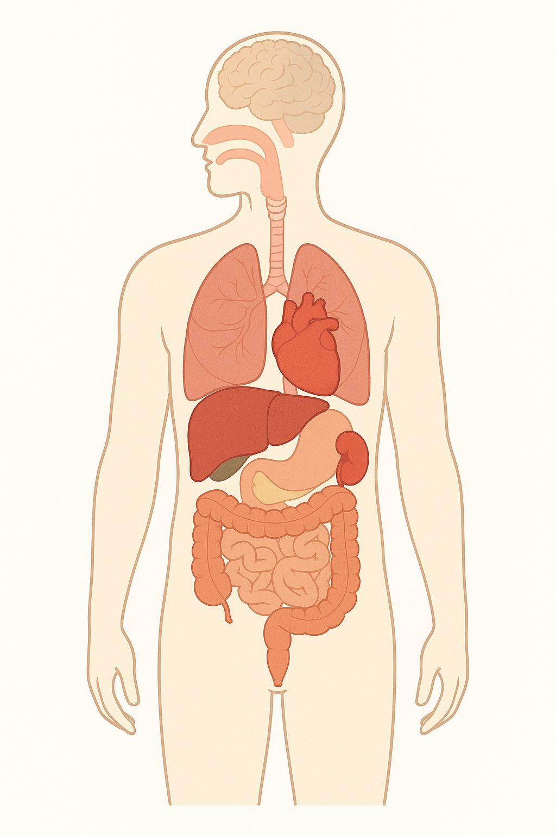
Introduction ^{[18]}
Bile production
Vitamin storage
Drug metabolism
Clotting factor and protein synthesis
Sex hormone metabolism and production of carrier proteins
Immune defense via Kupffer and pit cells
(OpenAI, 2025)
Notes:
The liver is one of the most important organs in the body because of its overlapping functions
It helps with digestion
Stores vitamins
Breaks down drugs and toxins
Produces blood clotting factors
Helps manages our sex hormones
And contributes to our immune defenses

Slide 14


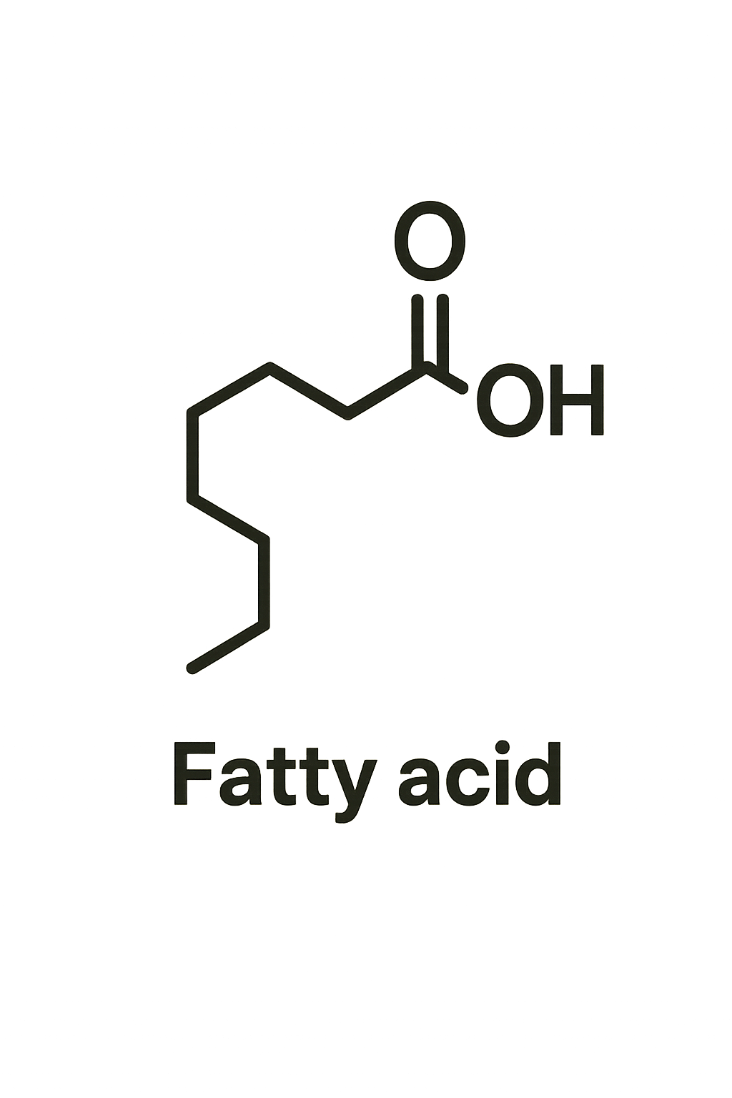

Mechanism ^{[19]}
Food is broken down in the stomach
Nutrients are absorbed in the small intestine
Nutrients are transported through blood or lymph to the liver
The liver processes nutrients and produces bile to help digest fats
(OpenAI, 2025)
Notes:
Under normal conditions we know that food is digested by the stomach
Nutrients are absorbed in the small intestine like vitamins minerals, amino acids, and fatty acids
Nutrients are transported through blood or lymph and go to the liver
The liver then processes the nutrients and produces bile to help digest fats

Slide 15
Comparing PFAS and Fatty Acids
PFOA
Fatty Acid
F
F
F
F
F
F
F
F
H
H
H
H
H
H
H
H
H
C
C
C
C
H
C
C
C
C
O
O
F
H
C
C
C
C
C
C
C
C
F
F
F
F
F
F
O
O
H
H
H
H
H
H
Notes:
According to my review on the effects of PFAS on the liver, the one thing researchers are trying to understand is the mechanism of how the body digests the PFAS
Because of the livers essential role in digestion and detoxification, it is very much one of the target organs of this substance
As we can see on the slide, PFOA a specific PFAS substance looks nearly identical to fatty acids which we normally consume through our diet
The only difference between the two would be the fluorine bonds that we see in green
This similarity is crucial because it means PFAS can trick the body into treating it like a fatty acid
Which may explain why PFAS tends to accumulate in the liver
The liver cannot metabolize PFAS so it tends to build up and cause stress to the liver over time

Slide 16
Mechanism w/ PFAS ^{[19]}
Food is broken down in the stomach
Nutrients are absorbed in the small intestine
Nutrients are transported through blood to the liver
PFAS mimics fatty acids and enter the liver
Liver produces bile to digest fatty acids
PFAS cannot be broken down
Liver produces more bile trying to process PFAS
Excess bile stresses the liver, mimics a high fat diet, and and may cause inflammation
(OpenAI, 2025)
Notes:
So we know that usually food gets digested, nutrients are absorbed in the small intestine and then enter the bloodstream where it is transported to the liver to be cleaned
This is where PFAS gets carried to the liver as if it was a fatty acid
Normally the liver processes proteins and produces bile to breakdown fatty acids
Since PFAS cannot actually be digested it is extremely resistant to breakdown
The liver ends up producing more bile to process PFAS
Overproduction stresses the liver as if we had a high fat diet
Over time this can lead to inflammation, liver damage, and a higher risk of fatty liver disease

Slide 17
Liver Function Tests
Component | Function | What does this tell us
ALT (alanine transaminase) ^{[9, 10]} | Converts alanine to pyruvate | Marker of liver cell injury, especially from hepatitis, fatty liver, or toxins
AST (aspartate transaminase) ^{[9, 10]} | Involved in amino acid metabolism | May indicate liver, muscle, or heart damage
GGT (y-glutamyltransferase) ^{[9, 10]} | Helps metabolize drugs and toxins | Often elevated in alcohol-related liver disease or bile duct issues
Bilirubin ^{[5, 16]} | Byproduct of RBC breakdown processed by liver | Elevated when liver can’t process bilirubin
Notes:
Liver function tests are routine blood tests that measure enzymes/substances the liver makes
When these levels are too high it tells us our liver is under stress or injured
For example ALT and AST are linked to liver metabolism and elevated levels usually points to liver injury
GGT indicated drug and toxin metabolism which can point to alcohol releated liver disease or bile duct problems
And bilirubin is a waste product that suggest that the liver is not working properly
In PFAS studies, changes in these markers were used to show how exposure affected the liver

Slide 18
PFAS Effects on the Liver
PFAS | Effect | Result | Reference #
PFOA | Elevated ALT levels; altered lipid and carbohydrate metabolism | Fatty liver disease, especially in heavy drinkers Advanced fibrosis | [9, 10]
PFOS | Correlates with increased ALT; disrupts liver pathways | Liver injury, metabolic disturbances | [9, 10]
PFHxS | Strong association with fatty liver disease; affects lipid metabolism | Higher FLD risk, especially with obesity or high-fat diet | [10]
PFHpS | Associated with alcohol-related FLD | Advanced fibrosis risk in heavy drinkers | [10]
PFNA | Linked with biomarkers of liver injury (ALT, GGT, bilirubin) | Impaired liver function | [5, 16]
PFDA, PFUnA, PFBS, PFBA, PFDoDA, PFHxA | Evidence of hepatotoxicity (increased enzymes and decreased bilirubin) | General liver damage, dysregulation of metabolism | [5, 16]
Notes:
Here is a summary of my findings
PFOA and PFOS were strongly linked to elevated ALT levels and if we go back to the LFT we see that this means direct liver injury and changes in metabolism
PFHxS and PFHpS were shown to increase fatty liver disease and advanced fibrosis especially in people with obesity, high-fat diets, or heavy alcohol use
PFNA and other PFAS chemicals were tied to a mix of markers which showed impaired liver function
And shower chain PFAS like PFBA and PFBS showed signed of liver damage even if they do not stay in the body as long

Slide 19
Endocrine and Reproductive System
Notes:
Next is the endocrine and reproductive system I chose to combine the two as there are many overlaps with the two in each study which we will get into why later on

Slide 20
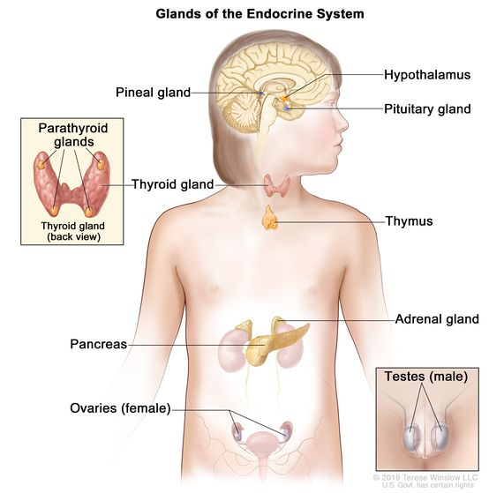
Endocrine System
Complex network of glands and organs that use hormones to control and coordinate metabolism, energy, growth and development, and reproduction ^{[12 – 15]}
Notes:
Pictured are the endocrine system and its organs and glands
Complex network of glands and organs that are responsible for hormones that control many things in our body

Slide 21
Reproductive System
Tissues, glands, and organs involved in producing offspring ^{[3, 8]}
Notes:
Reproductive system which are tissues, glands, and organs that are responsible for producing offspring

Slide 22
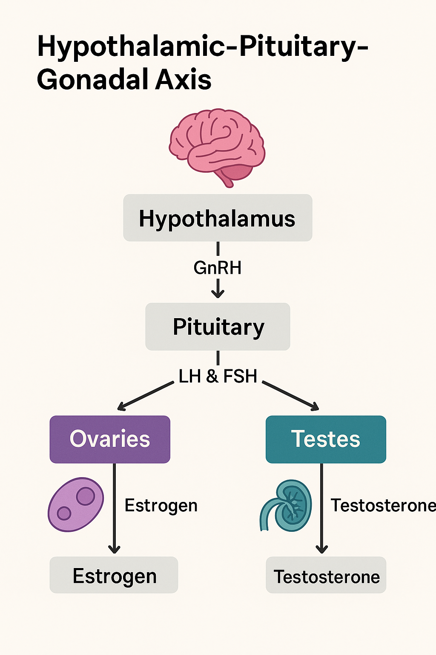
Why are hormones important? ^{[11-15]}
Act as chemical messengers
Control and regulate many processes
  Blood sugar control (Insulin)
  Differentiation, growth, and function of reproductive organs
(OpenAI, 2025)
Notes:
Within our body there is bound to be communication between different organs, glands, and even tissues
Hormones are used as those messengers which help control and regulate many processes such as blood sugar or when it is time for a new mother to produce milk
The brain is able to signal a hormone whos presence will signal another hormone which will then produce what the body needs

Slide 23
Endocrine Disruption ^{[11-15]}
Mimic hormones
Block hormone signals
Change hormone levels
Notes:
Definitely there is bound to be something that interferes with our body’s communication with each other and these are known as endocrine disruptors
Endocrine disruptors mimic hormones, block hormone signaling, and change our hormone levels
PFAS are considered as endocrine disruptors which is why they’ve been link to many problems that affect more than just the endocrine or reproductive system

Slide 24
Impacts of PFAS on the Endocrine System
Hormone | Function ^{[13-15]} | PFAS Effects | Results
Thyroid (T3, T4, TSH) | Controls metabolism, growth, neurodevelopment | PFOS, PFOA, PFHxS, PFNA = Disrupt thyroid hormone levels ^{[7, 11, 16]} | Hypothyroidism, growth delays, neurodevelopmental problems ^{[7, 11]}
GnRH | Regulation of LH and FSH | PFOA, PFOS, PFHxS = Suppression of GnRH signaling ^{[5, 14, 16]} | Hormonal imbalance ^{[5, 14, 16]}
Notes:
Now let’s look at how PFAS affects the endocrine system
Thyroid hormones are critical for regulating metabolism, growth, and neurodevelopment
Disruption to the production of these hormones can lead to hypothyroidism, growth delays, and neurodevelopmental problems especially in children and during pregnancy
LH: Stimulates cells in the testes to produce testosterone which is essential to spermatogenesis, libido, and male secondary sex traits
In females it triggers the release of an egg and the ability to maintain early pregnancy
FSH: Used for sperm maturation which is key for viability and fertility
In females it stimulates ovarian follicle growth and regulates estrogen which is necessary for menstruation or egg development

Slide 25
Male vs Female Reproductive System ^{[13-15]}
Male | Female
Producing sperm and producing hormones and fluids for fertilization | Produce eggs, regulating sex hormones, and maintaining fertilized eggs as they develop

Slide 26
Impacts of PFAS on the Female Reproductive System
Hormone | Function ^{[13-15, 18]} | PFAS Effects ^{[3, 5, 7, 8, 11, 16]} | Results ^{[3-5, 8-10]}
Estrogen | Menstrual cycle, pregnancy prep, bone health | PFOS, PFOA, PFHxS = Interfere with estrogen receptors and aromatase | Menstrual irregularity, infertility, and increased PCOS risk
Progesterone | Prepares uterus for implantation, maintains pregnancy | PFOA, PFOS, PFHxS = imbalance of progesterone | Miscarriage, preterm birth, preeclampsia
Luteinizing Hormone | Triggers ovulation, corpus luteum support | PFOA, PFOS, PFHxS = Disruption of gonadotropin axis | Premature ovarian insufficiency, poor ovulation
Follicle Stimulating Hormone | Stimulates ovarian follicle growth | PFOA, PFOS, PFHxS = Altered follicle development | Diminished ovarian reserve, infertility
Prolactin | Stimulates milk production postpartum | Indirect effects via progesterone and prolactin balance disruption | Reduced lactation potential
Notes:
Most studies show PFAS exposure is linked to disrupted hormone regulation (estrogen, progesterone, LH, FSH, prolactin).
Dose-response trends: Higher PFAS blood levels are often associated with greater risks (e.g., infertility, miscarriage, PCOS).
Timing matters:
Prenatal exposure → affects fetal development, increases risk of preeclampsia and preterm birth.
Reproductive years → linked to irregular cycles, poor ovulation, and infertility.
Postpartum → reduced lactation potential.
Sex-specific effects: Women often show stronger associations in fertility and pregnancy outcomes, while men show impacts in sperm quality and testosterone.
Multiple PFAS compounds: Effects are not limited to one chemical — PFOS, PFOA, PFHxS, and PFNA all show endocrine-disrupting patterns.
Mechanistic overlap: PFAS often mimic or block natural hormones → disrupting receptor signaling, enzyme activity (like aromatase), or hormone balance.
Health outcomes: Across studies, the pattern is:
Disrupted hormone signaling → reproductive complications → long-term health risks for mothers and infants.

Slide 27
Impacts of PFAS on the Male Reproductive System
Hormone | Function ^{[13-15, 18]} | PFAS Effects ^{[3, 5, 7, 8, 11, 16]} | Results ^{[3-5, 8-10]}
Testosterone | Spermatogenesis, libido, male secondary sex traits | PFOS, PFOA, PFHxS, PFNA = Decreased testosterone production | Infertility, poor sperm quality and motility
Luteinizing Hormone | Stimulates Leydig cells to produce testosterone | PFOA, PFOS, PFHxS = Impaired LH signaling | Reduced androgen production
Follicle Stimulating Hormone | Stimulates Sertoli cells for sperm maturation | PFOA, PFOS = Impaired Sertoli cell support | Decreased sperm viability and motility
Notes:
Testosterone
Function: Drives spermatogenesis, libido, male secondary sex traits
PFOS, PFOA, PFHxS, PFNA → ↓ testosterone production
Results → infertility, poor sperm quality and motility
Luteinizing Hormone (LH)
Function: Stimulates Leydig cells to produce testosterone
PFOS, PFOA, PFHxS → impaired LH signaling
Results → reduced androgen production
Follicle Stimulating Hormone (FSH)
Function: Stimulates Sertoli cells for sperm maturation
PFOA, PFOS → impaired Sertoli cell support
Results → decreased sperm viability and motility
Takeaway
PFAS interfere with key male reproductive hormones

Slide 28
What is being done?
Monitoring | Removal | Policy
UCMR5 ^{[20]} | GAC ^{[21]} Foam Fractionation ^{[22]} | US States and individual standards California banning PFAS in textiles and apparel ^{[23]} Amara Law ^{[24]}

Slide 29
References
¹ RSC (Royal Society of Chemistry). (2020). The challenges of PFAS environmental remediation. Environmental Science: Processes & Impacts, 22(9), 1855–1870. https://doi.org/10.1039/D0EM00291G
² U.S. Environmental Protection Agency (EPA). (2023). Our current understanding of the human health and environmental risks of PFAS. https://www.epa.gov/pfas/our-current-understanding-human-health-and-environmental-risks-pfas
³ He, X., et al. (2023). Prenatal exposure to PFAS and male reproductive health: Mechanistic insights. Environmental Research, 232, 113–120. https://doi.org/10.1016/j.envres.2023.115509
⁴ Grandjean, P., Andersen, E., Budtz-Jørgensen, E., Nielsen, F., Mølbak, K., Weihe, P., & Heilmann, C. (2012). Serum vaccine antibody concentrations in children exposed to perfluorinated compounds. JAMA, 307(4), 391–397. https://doi.org/10.1001/jama.2011.2034
⁵ Agency for Toxic Substances and Disease Registry (ATSDR). (2021). Toxicological profile for perfluoroalkyls. U.S. Department of Health and Human Services. https://www.atsdr.cdc.gov/toxprofiles/tp200.pdf
⁶ National Toxicology Program (NTP). (2016). Monograph on immunotoxicity associated with exposure to perfluorooctanoic acid (PFOA) and perfluorooctane sulfonate (PFOS). U.S. Department of Health and Human Services. https://ntp.niehs.nih.gov/sites/default/files/ntp/ohat/pfoa_pfos/pfoa_pfosmonograph_508.pdf
⁷ Zhou, Y., et al. (2024). PFAS and thyroid disruption: Mechanistic evidence and epidemiological links. Frontiers in Public Health, 12, 1152092. https://doi.org/10.3389/fpubh.2023.1152092
⁸ Zhang, Y., Beesoon, S., Zhu, L., & Martin, J. W. (2023). PFAS exposure and female reproductive health outcomes: A systematic review. Environmental Health, 22, 115. https://doi.org/10.1186/s12940-023-00992-3
⁹ Gallo, V., Leonardi, G., Genser, B., Lopez-Espinosa, M. J., Frisbee, S. J., Karlsson, L., ... & Fletcher, T. (2012). Serum PFOA and PFOS concentrations and liver function biomarkers in a population with elevated PFOA exposure. Environmental Health Perspectives, 120(5), 655–660. https://doi.org/10.1289/ehp.1104436
¹⁰ Wang, Z., Cousins, I. T., Scheringer, M., & Hungerbuehler, K. (2023). Risk assessment of PFAS exposure and liver disease. The Innovation, 4(3), 100325. https://doi.org/10.1016/j.xinn.2023.100325

Slide 30
References
¹¹ Gore, A. C., Chappell, V. A., Fenton, S. E., Flaws, J. A., Nadal, A., Prins, G. S., ... & Zoeller, R. T. (2020). EDC-2: The Endocrine Society’s second scientific statement on endocrine-disrupting chemicals. Frontiers in Endocrinology, 11, 612320. https://doi.org/10.3389/fendo.2020.612320
¹² National Institute of Environmental Health Sciences (NIEHS). Endocrine disruptors. National Institutes of Health. https://www.niehs.nih.gov/health/topics/agents/endocrine
¹³ Johns Hopkins Medicine. (n.d.). Anatomy of the endocrine system. https://www.hopkinsmedicine.org/health/wellness-and-prevention/anatomy-of-the-endocrine-system
¹⁴ U.S. Environmental Protection Agency (EPA). (2023). Overview of the endocrine system. https://www.epa.gov/endocrine-disruption/overview-endocrine-system
¹⁵ National Cancer Institute (NCI). (n.d.). Endocrine system. https://www.cancer.gov/publications/dictionaries/cancer-terms/def/endocrine-system
¹⁶ Agency for Toxic Substances and Disease Registry (ATSDR). (2022). Toxicological profile addendum: Perfluoroalkyls. U.S. Department of Health and Human Services. https://www.atsdr.cdc.gov/toxprofiles/tp200.pdf
¹⁷ U.S. Environmental Protection Agency (EPA). (2023). PFAS treatment methods. https://www.epa.gov/pfas/our-current-understanding-human-health-and-environmental-risks-pfas
¹⁸ Kalra, A., Yetiskul, E., Wehrle, C. J., & Tuma, F. (2023). Physiology, Liver. In StatPearls [Internet]. StatPearls Publishing. https://doi.org/10.1016/B978-0-323-52902-2.00077-5
¹⁹ Jividen, L., Duran, T., Niu, X.-Z., & Bai, J. (2024). Uncovering the mechanism of hepatotoxicity of PFAS targeting L-FABP using GCN and computational modeling. ArXiv. https://doi.org/10.48550/arXiv.2409.10370
²⁰ U.S. Environmental Protection Agency. (2022, February). The Fifth Unregulated Contaminant Monitoring Rule (UCMR 5): Program overview fact sheet. Office of Water. https://www.epa.gov/system/files/documents/2022-02/ucmr5-factsheet.pdf

Slide 31
References
²¹ U.S. Environmental Protection Agency. (2018, August 23). Reducing PFAS in drinking water with treatment technologies. Science Matters. https://www.epa.gov/sciencematters/reducing-pfas-drinking-water-treatment-technologies
²² Rahmani, A. R., Torkashvand, J., & Ahadi, M. H. (2021). Removal of per- and polyfluoroalkyl substances (PFASs) by reverse osmosis and nanofiltration membranes: A comprehensive review. Environmental Research, 194, Article 110661. https://doi.org/10.1016/j.envres.2020.110661
²³ California State Senate. (2025). Senate Bill 730: Product safety: perfluoroalkyl and polyfluoroalkyl substances. California Legislature. https://legiscan.com/CA/text/SB730/id/3191117
²⁴ Minnesota Office of the Revisor of Statutes. (2023). Minnesota Statutes § 116.943: Amara’s Law (products containing PFAS). Minnesota Legislature. https://www.revisor.mn.gov/statutes/cite/116.943

Slide 32
Si Yu’os ma'åse'
Thank you!
Claire Marzan
Research Assistant II
marzanc@triton.uog.edu
(671) 735 - 1223
Dr. Barry (Yong Sang) Kim
Advisor
kimys@triton.uog.edu
(671) 735 - 1223
Check out our website!
https://weri.uog.edu/ | https://guamhydrologicsurvey.uog.edu/

