Slide 1

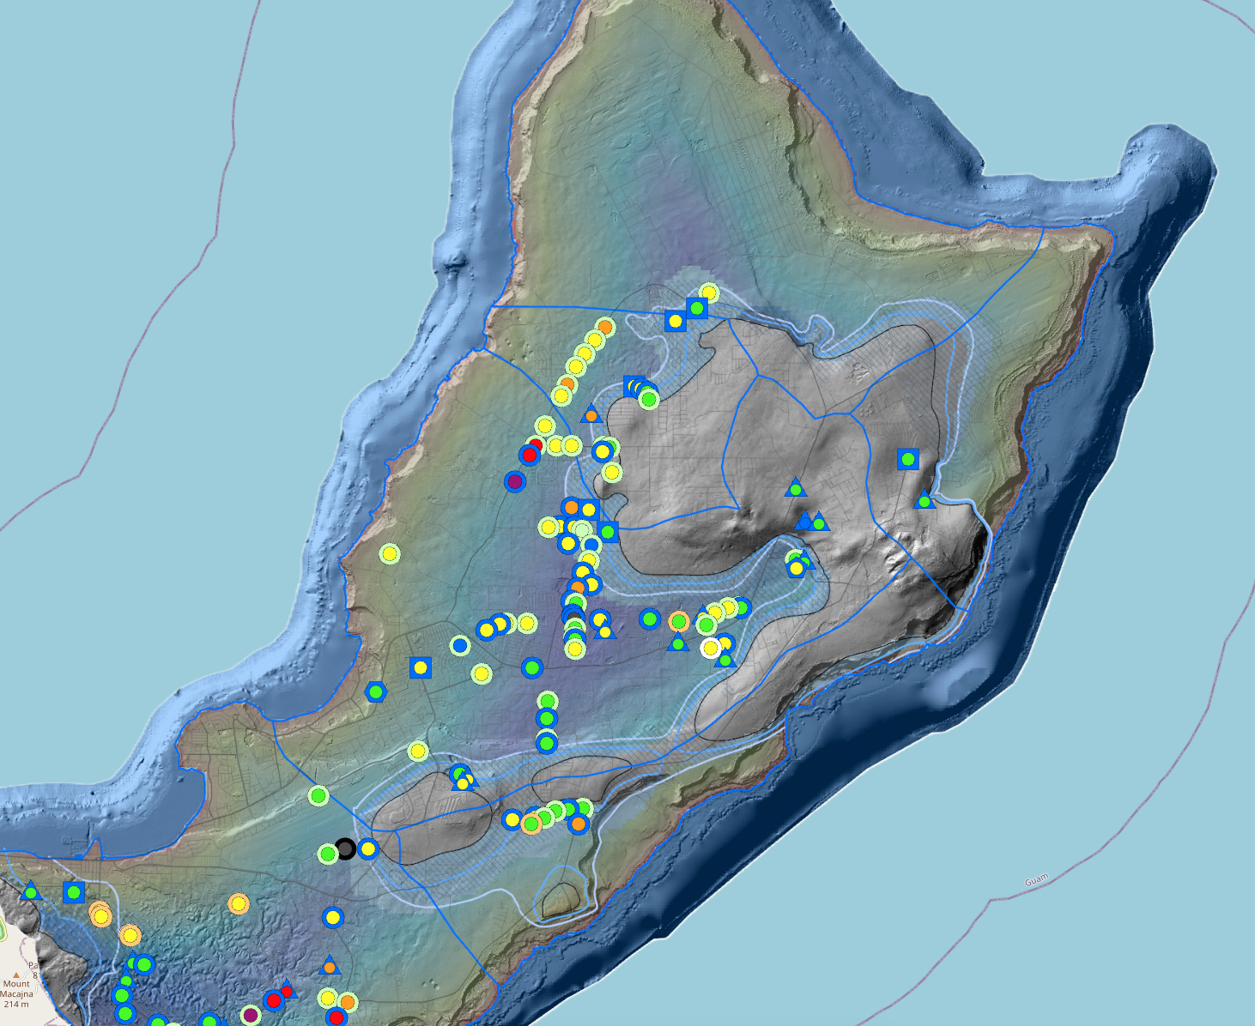
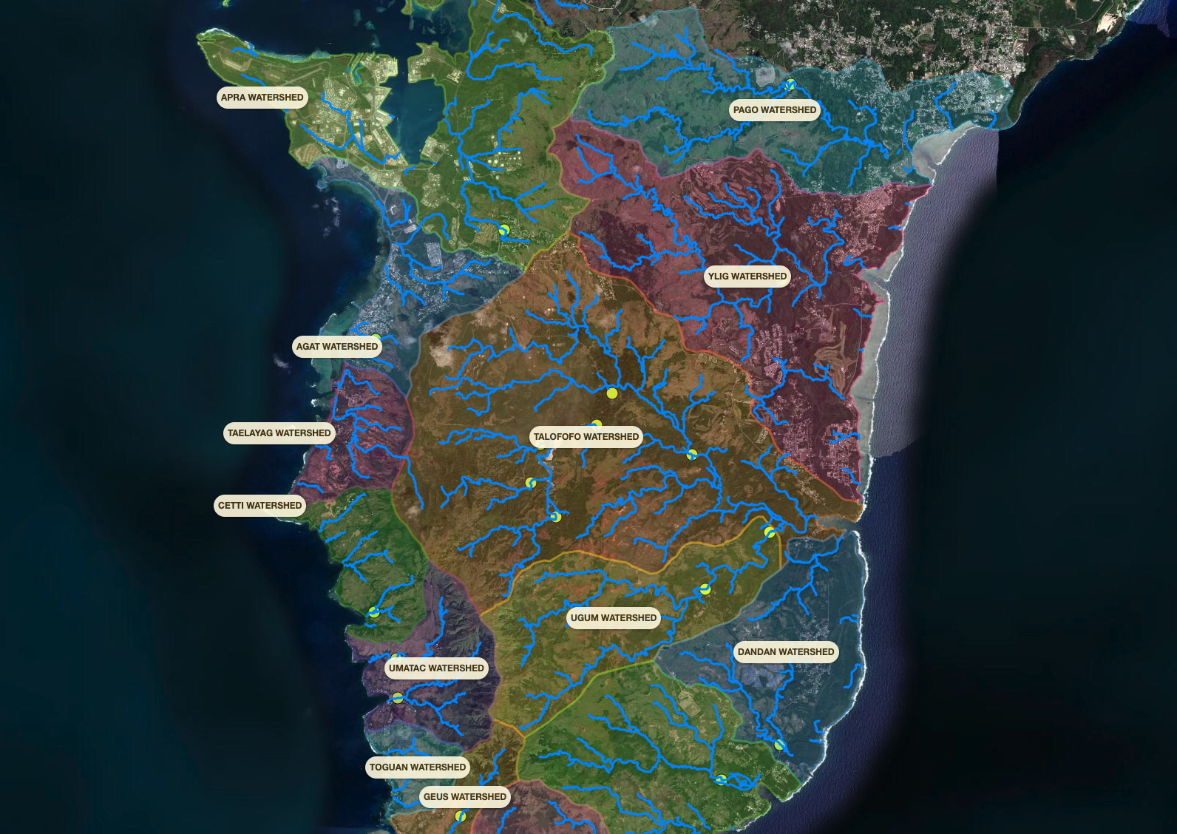
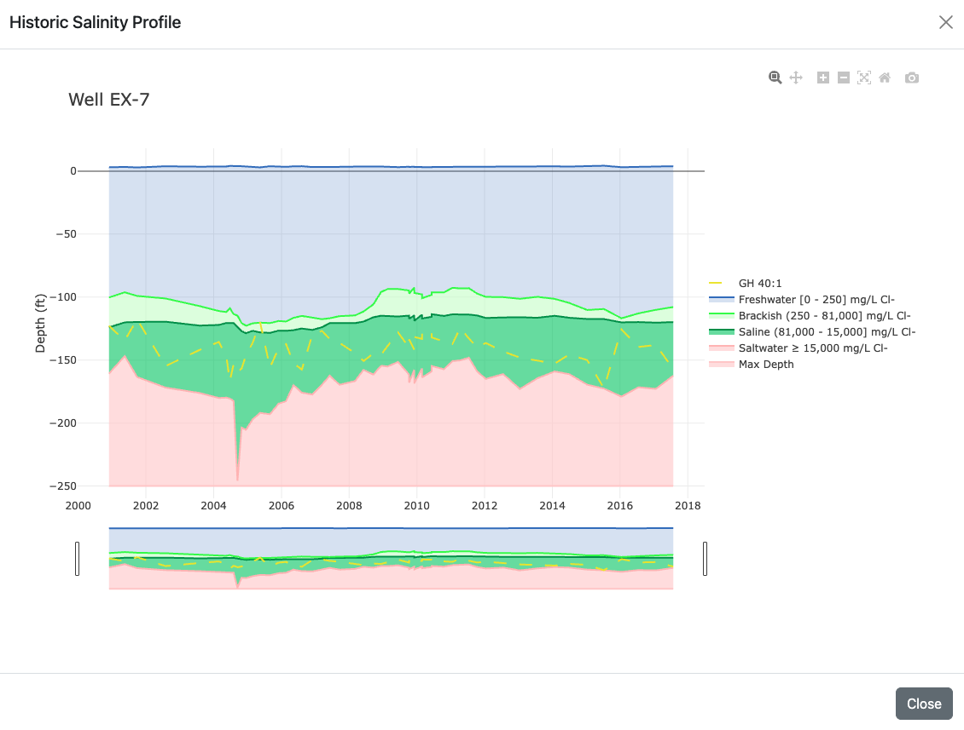
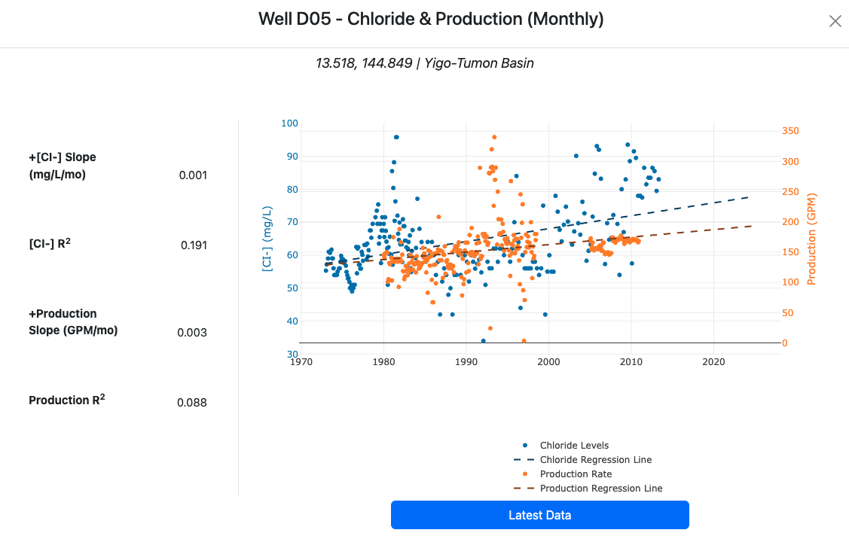

MAppFx:
An Interactive Data Visualization Interface
Developed by the Guam Hydrologic Survey Information Management Team at WERI
Dannika Kate Valerio, Research Assistant III
Sydney Quintanilla, Research Assistant II
Dr. Nathan Habana, Principal Investigator, Groundwater Hydrologist
WERI-GHS Workshop | Friday, Aug. 26, 2025 | UOG School of Health Room 242
Notes:
Good afternoon, everyone! My name is Dannika Kate Valerio and I work as a research assistant at the Water & Environmental Research Institute of the Western Pacific [in the University of Guam]. I’m also the Information Manager for the Guam Hydrologic Survey website, which is one of the things I work on at WERI. One of the ways we’ve been handling our data as of late is through the use of web apps, but more specifically through an online data visualization interface we developed and call MAppFx.

Slide 2
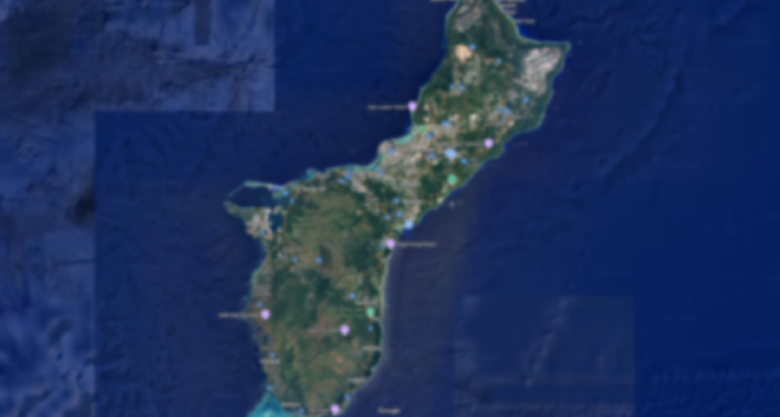
Data Availability
Agencies use in decisions and management strategies
Reliable scientific information must be readily available
Notes:
The Guam Hydrologic Survey, which was established by Guam Public Law 24-247, is the go-to repository for hydrologic data. It has an extensive library of WERI reports and publications, presentations, posters, maps and hydrologic data. With the availability of interactive web technologies and interfaces and in the age of big data, we want to address interagency partners needs to quickly access useful maps and historic graphs of survey points. More recently, the information management team at WERI-GHS has been at work in developing a platform that makes it easier to show data and better streamline the transfer of data files among interagency partners. Transforming big data formats (physical copies, excel sheets) into something digestible and easy to access. Stepping into the development of web applications, it opens opportunities for hydrologic data management and represents the future of accessing hydrologic databases.

Slide 3
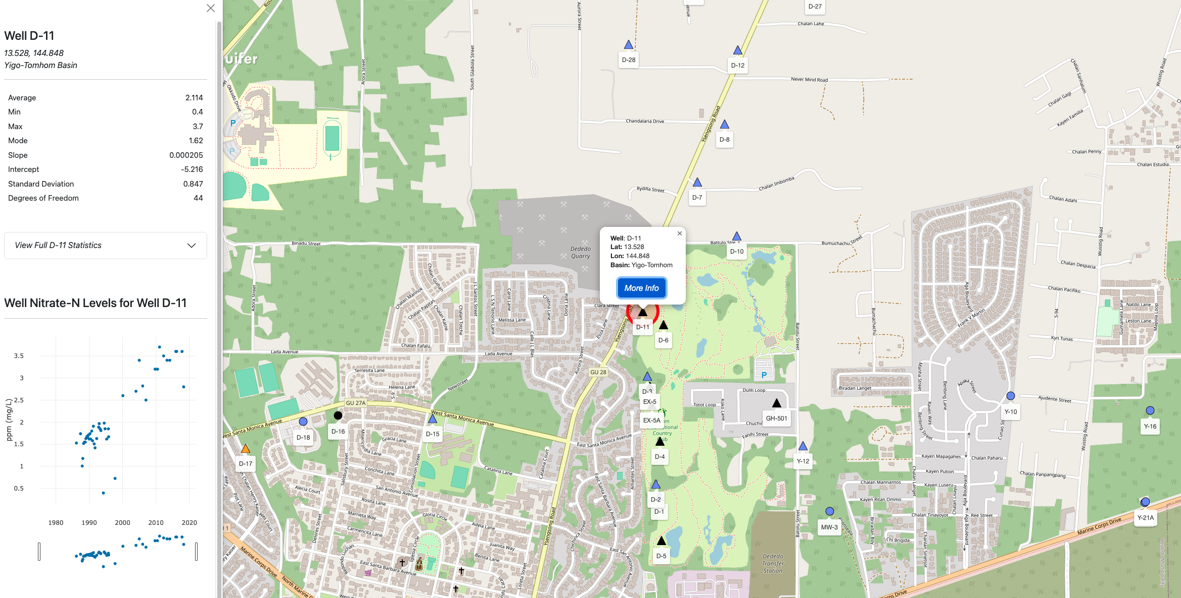
MAppFx
A data visualization interface that features two main components: a map of survey points and historic graphs.
Notes:
This project is MAppFx which is a data visualization interfaces that features two main components: a map of survey points or features and historic graphs.

Slide 4
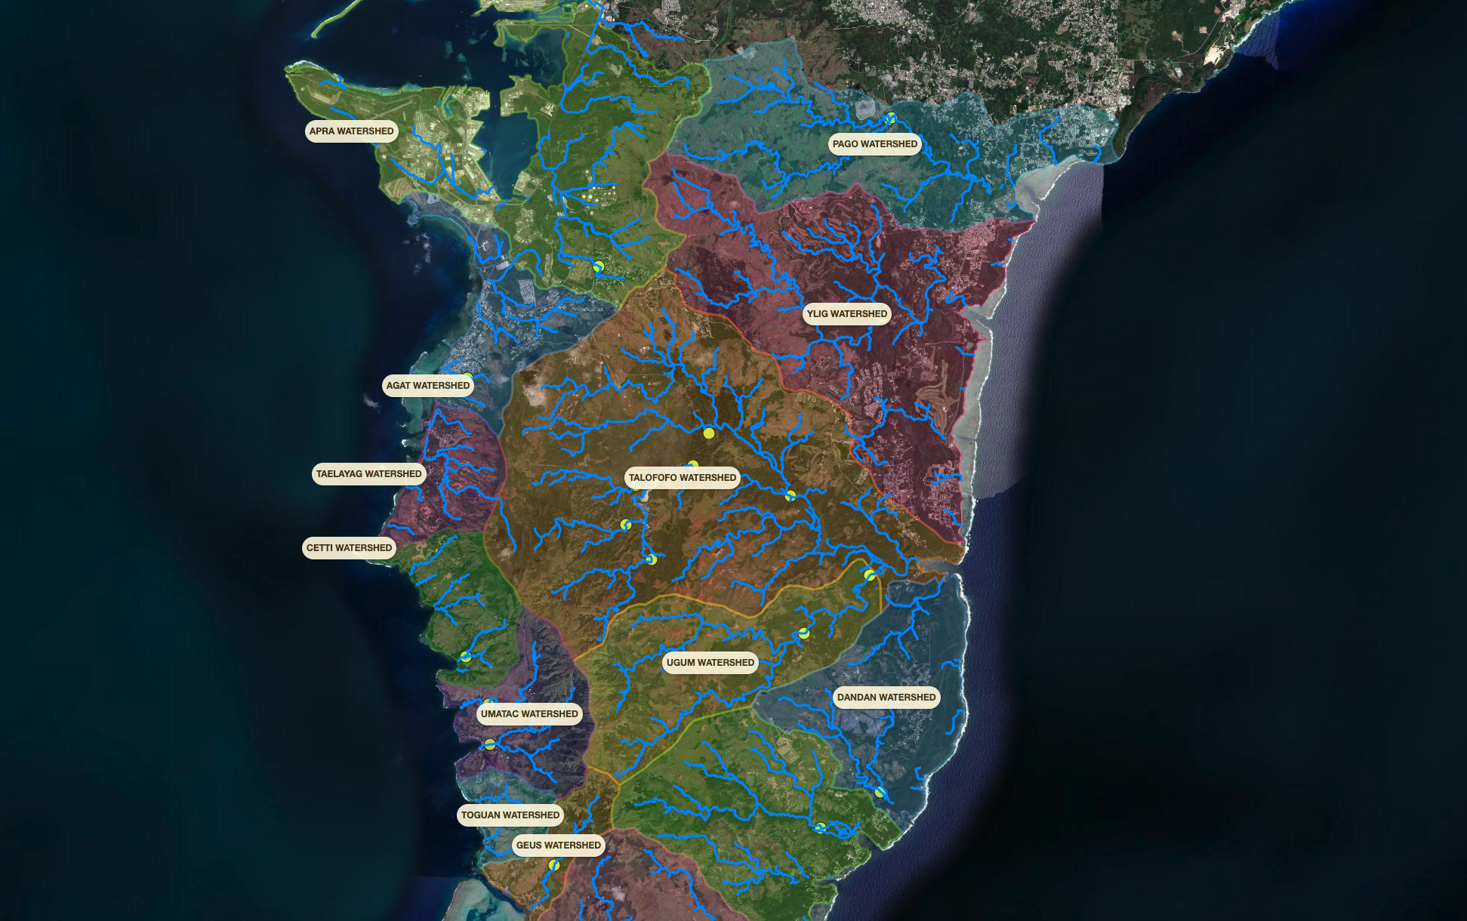
MAppFx
Simplifies complex data and enables better insights
Easy to use, user-friendly interface
Access and portability (Internet connection)
Notes:
With MAppFx, we can simplify complex data (often lost or overwhelming in an Excel sheet) and enable better insights in regard to spatial and temporal variation of information. This tool was designed with the user in mind (“intuitive”) with its easy-to-use features. And if you have a stable Internet connection, you can access it virtually anywhere.

Slide 5
MAppFx
First project:
“Northern Guam Lens Aquifer
Production Well Nitrates”
WERI Technical Report No. 180 (2023)
Notes:
Our first MAppFx project was on the Northern Guam Lens Aquifer Production Well Nitrates. Data was from a nitrate analysis by former WERI research assistant Ms. Jez Bulaklak and Dr. Nathan Habana in 2021. In their study, they graphically analyzed and mapped four decades of nitrate-N concentration data for more than 140 [local and military] wells and found that more than 60 production wells showed increased nitrate-N concentration during the period of record.
With the data from both Ms. Bulaklak and Ms. McDonald available, the GHS Information Management team was able to clean and organize it in such a manner that can be used in MAppFx.
If you would like to learn more about the project, you can check out WERI Technical Report No. 180 on the WERI website.

Slide 6
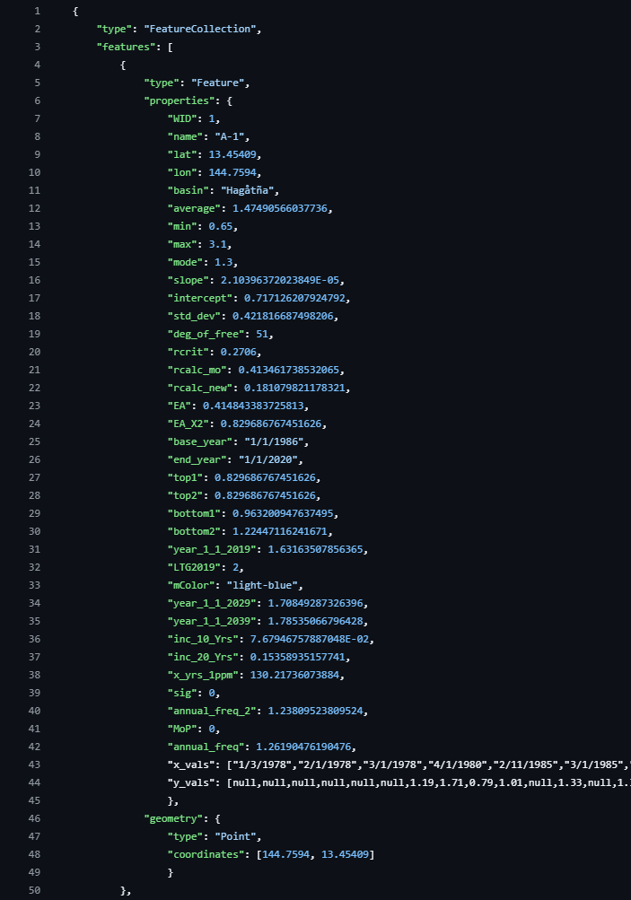
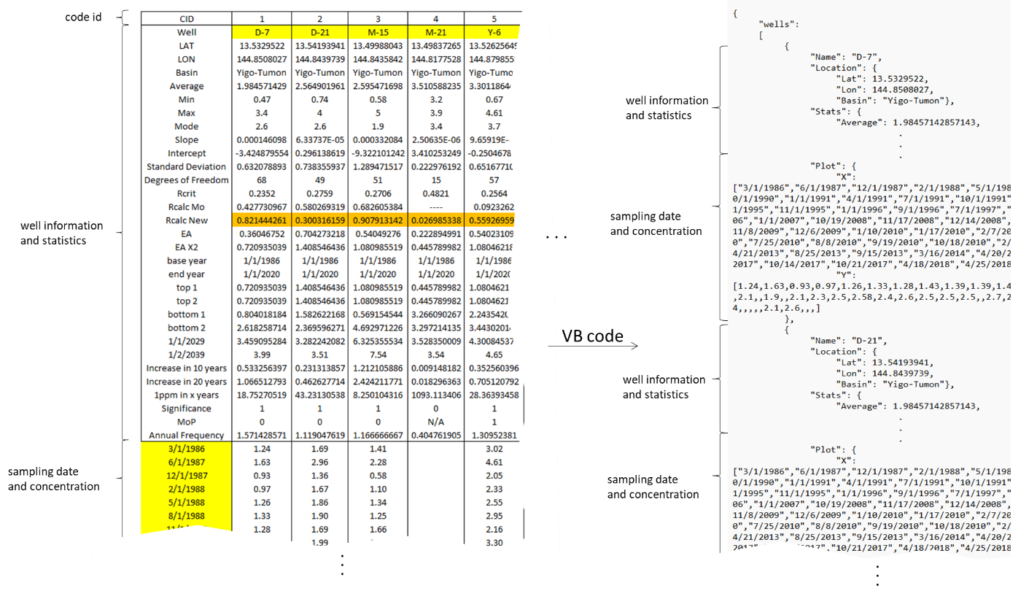

Information Transfer
Notes:
Raw data from GWA (e.g., nitrates, chloride and production)
Typically, in Excel
Review, organize, and export data as a JSON file
JavaScript Object Notation
Input into MAppFx code

Slide 7

Information Transfer
Notes:
Raw data from GWA (e.g., nitrates, chloride and production)
Typically, in Excel
Review, organize, and export data as a JSON file
JavaScript Object Notation
Input into MAppFx code

Slide 8
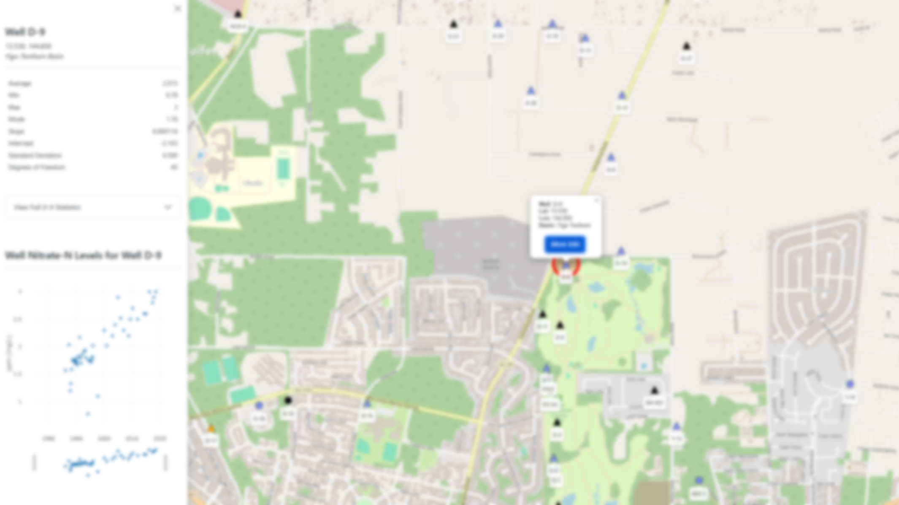
Features
Map and graph components
Configurable additional features
  Map widgets
  Different views
User-friendly interface
Notes:
Let me walk through the major features available through our MAppFx projects. Again, at its core, it contains two primary components—the map of survey points and a graph of historical data. The visual representation of the data set varies from project to project, which I will demonstrate in further detail in the latter part of my presentation. It’s configurable, meaning that we can add or remove widgets during the development process. This could include additional visualizations (such as video components) and other map tools (like a selection of a group of survey points). Putting this together creates an interface that is approachable and fairly easy to use.

Slide 9
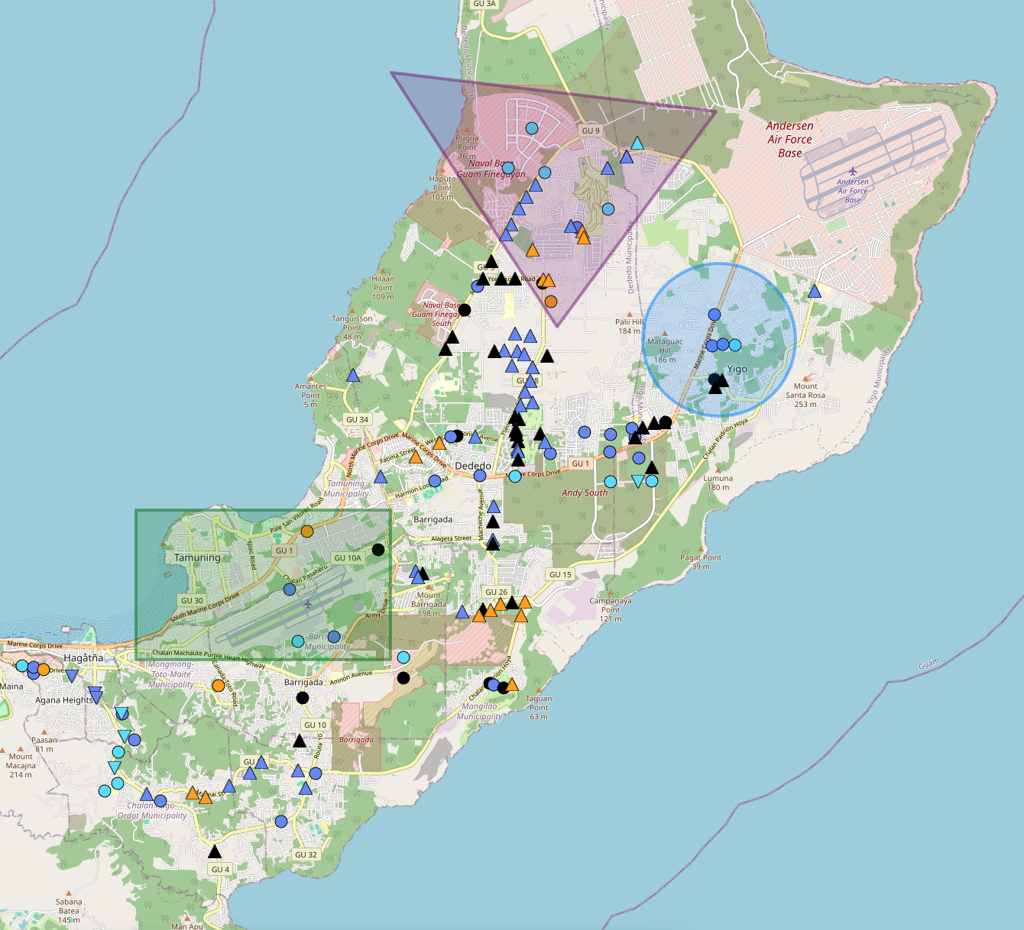


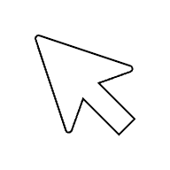

MAppFx:
Northern Guam Lens Aquifer Production Wells Nitrates
Drawing
Notes:
One of the features I would like to highlight in our MAppFx projects is the drawing tool. You can find this widget set towards the bottom right of the map. You can use it to draw different shapes, like a triangle, circle, or rectangle, to highlight a group of points or a region on the map.

Slide 10
MAppFx:
Northern Guam Lens Aquifer Production Wells Nitrates
Drawing
Notes:
One of the features I would like to highlight in our MAppFx projects is the drawing tool. You can use it to draw different shapes, like a triangle, circle, or rectangle, to highlight a group of points or a region on the map.

Slide 11
MAppFx:
Northern Guam Lens Aquifer Production Wells Nitrates
Drawing
Notes:
One of the features I would like to highlight in our MAppFx projects is the drawing tool. You can use it to draw different shapes, like a triangle, circle, or rectangle, to highlight a group of points or a region on the map.

Slide 12
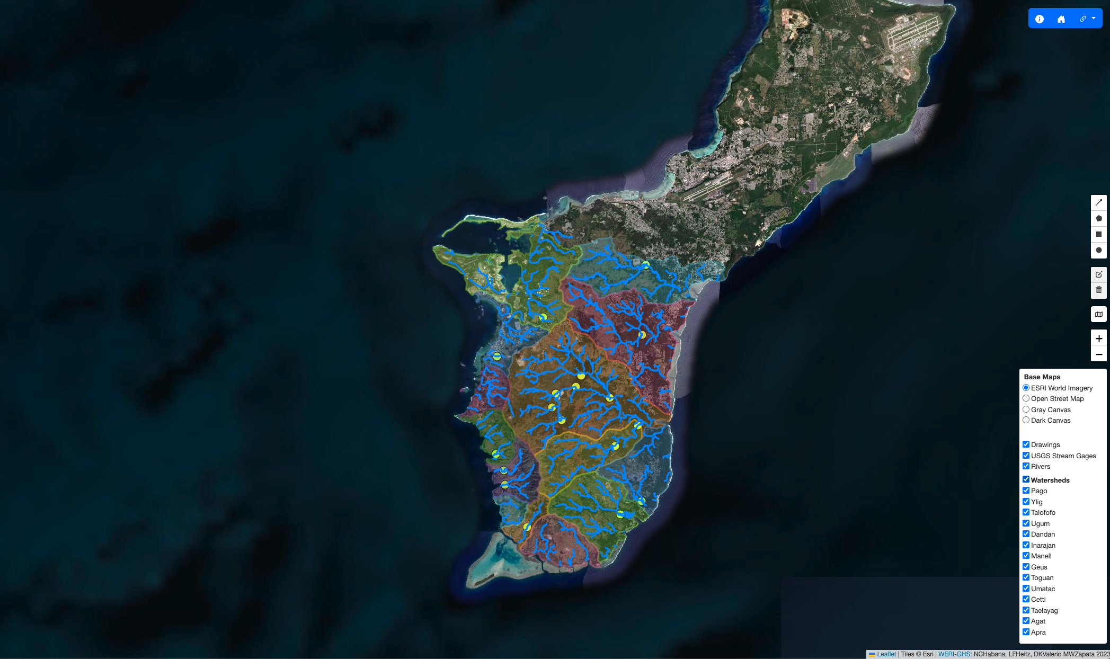

MAppFx:
Southern Guam Watersheds Streamflow Duration Curves
Layers
Notes:
Another feature I would like to point out is how we can change different layers. Here, we have the MAppFx for the Southern Guam Watersheds Streamflow Duration Curves. On the map, you can see that we have a lot of features with the blue lines as the streams, yellow dots as USGS gages, and the polygons outlining the southern watersheds. If we want to focus on a single watershed, for example, the Ugum watershed, we can simply turn off all the other layers.

Slide 13
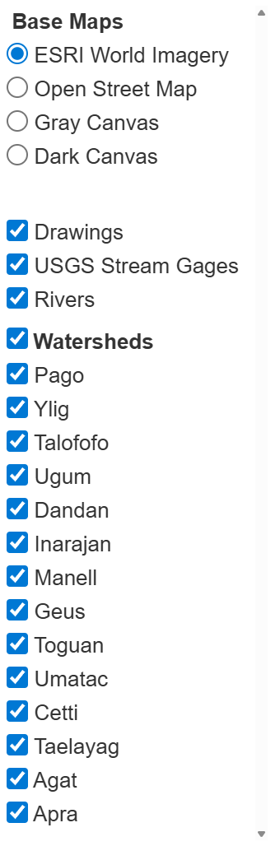
MAppFx:
Southern Guam Watersheds Streamflow Duration Curves
Layers
Notes:
Another feature I would like to point out is how we can change different layers. Here, we have the MAppFx for the Southern Guam Watersheds Streamflow Duration Curves. On the map, you can see that we have a lot of features with the blue lines as the streams, yellow dots as USGS gages, and the polygons outlining the southern watersheds. If we want to focus on a single watershed, for example, the Ugum watershed, we can simply turn off all the other layers.

Slide 14
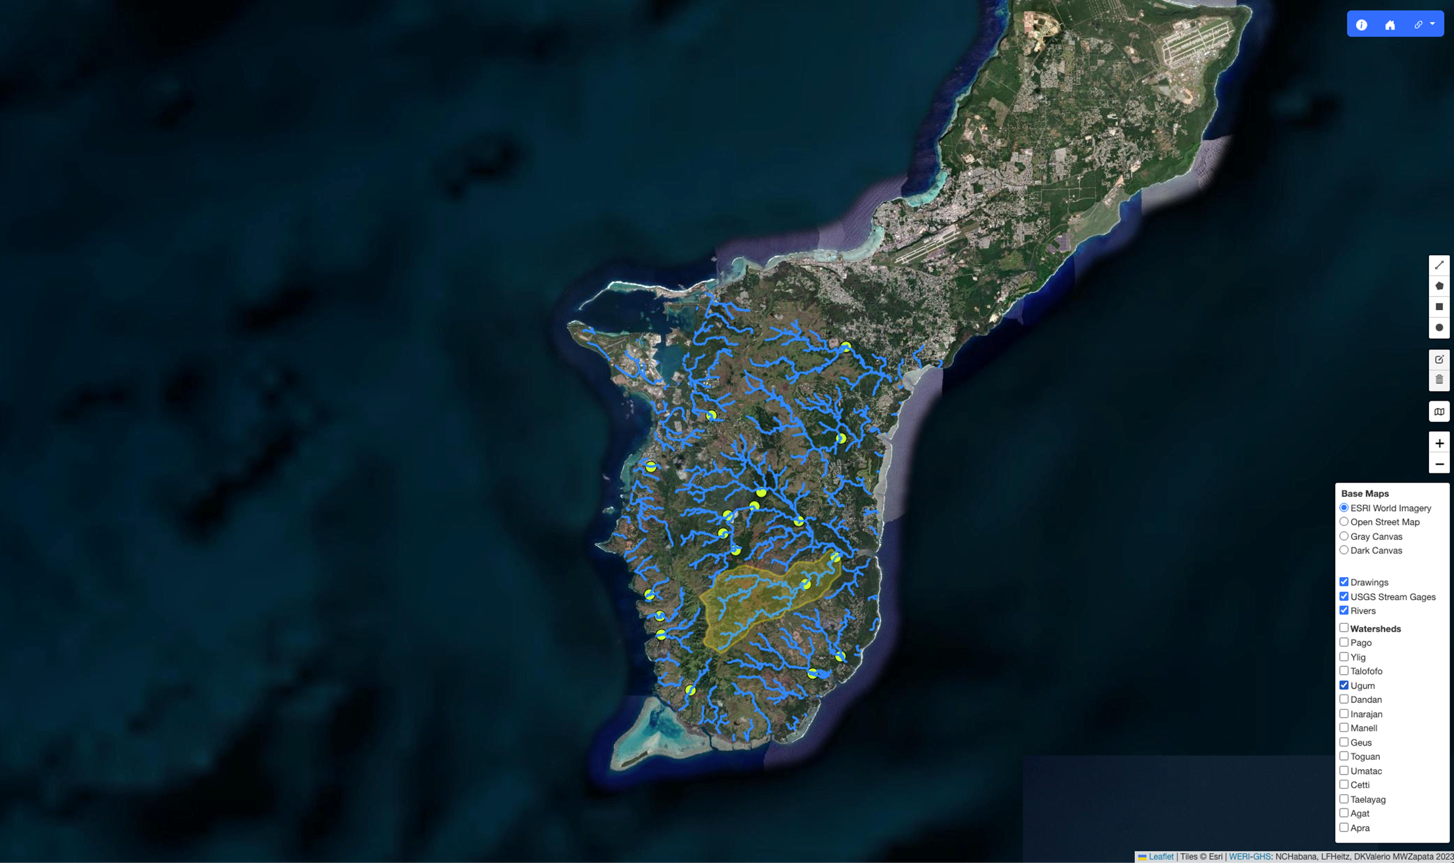
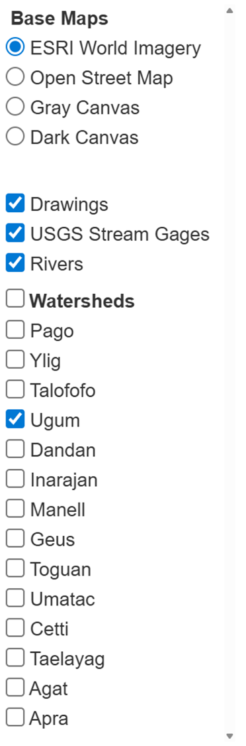
MAppFx:
Southern Guam Watersheds Streamflow Duration Curves
Layers
Notes:
Another feature I would like to point out is how we can change different layers. Here, we have the MAppFx for the Southern Guam Watersheds Streamflow Duration Curves. On the map, you can see that we have a lot of features with the blue lines as the streams, yellow dots as USGS gages, and the polygons outlining the southern watersheds. If we want to focus on a single watershed, for example, the Ugum watershed, we can simply turn off all the other layers.

Slide 15
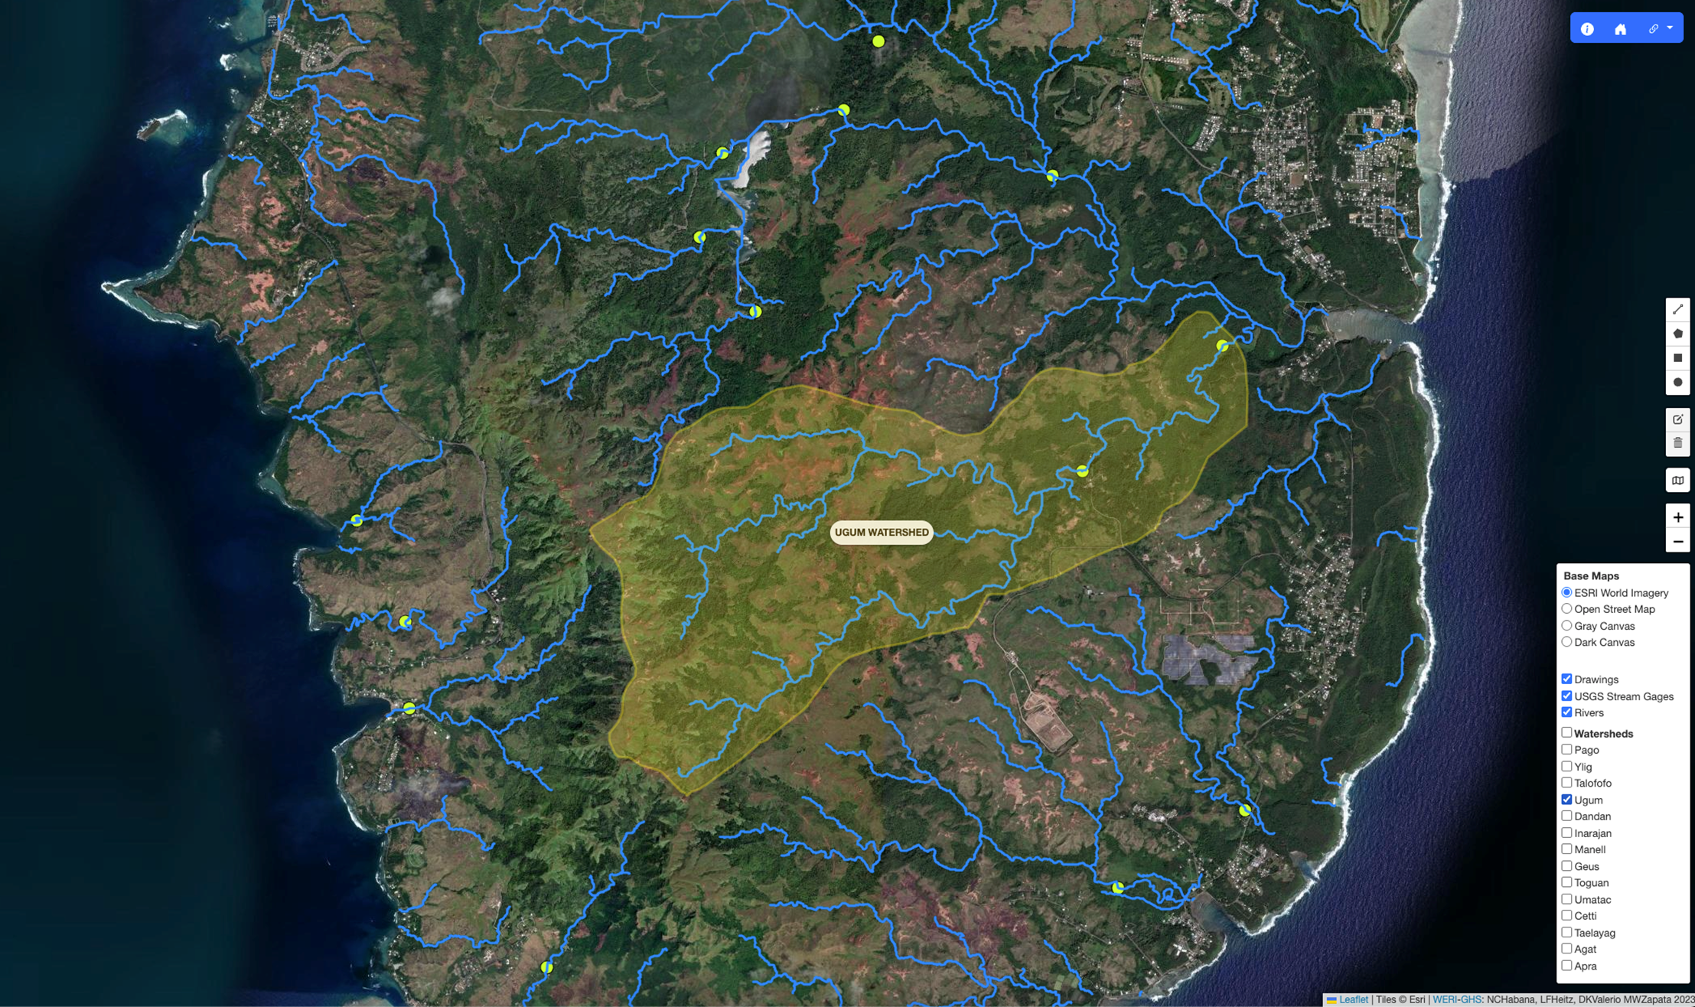
MAppFx:
Southern Guam Watersheds Streamflow Duration Curves
Layers
Notes:
Zoom in a little bit… And we can get a better view of our area of interest. For our other MAppFx projects, we can isolate different layers based on the trends of their data.

Slide 16
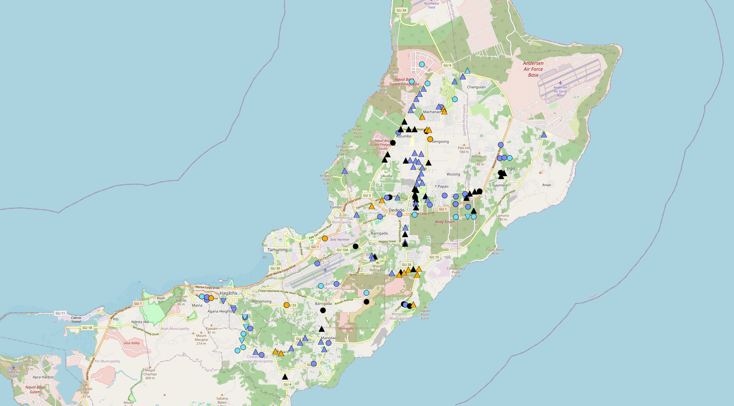
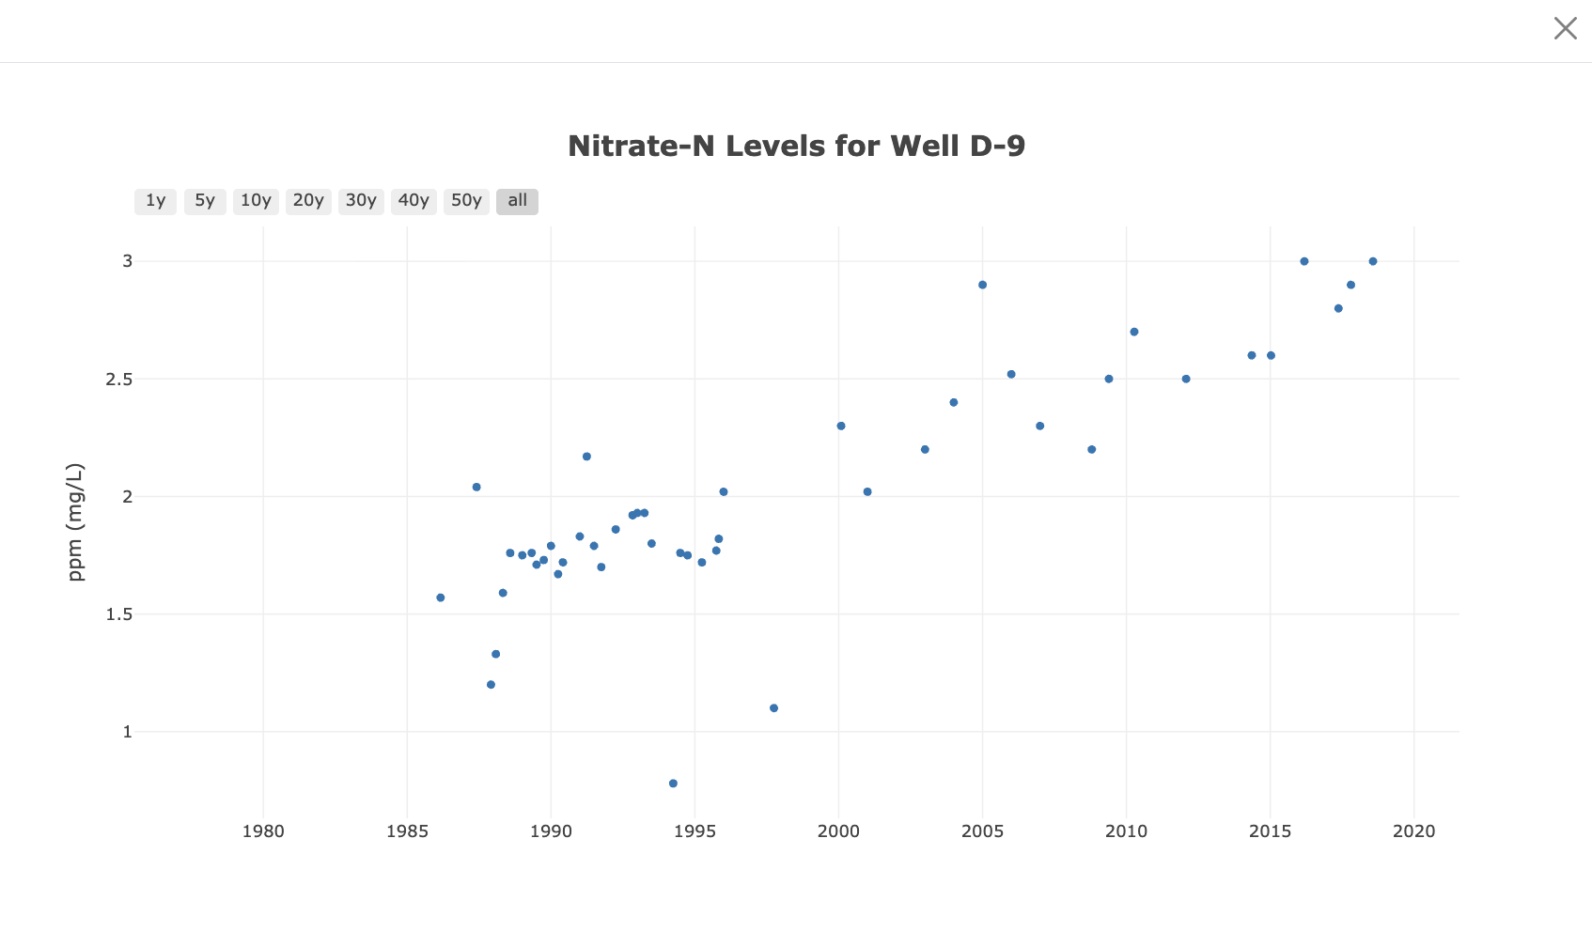
Time Series
Notes:
Let’s go over with the graph component of our MAppFx projects. Here is a timeseries for the NGLA Production Well Nitrates MAppFx. The graph is interactive so that you can zoom into point in time or select points to highlight.

Slide 17
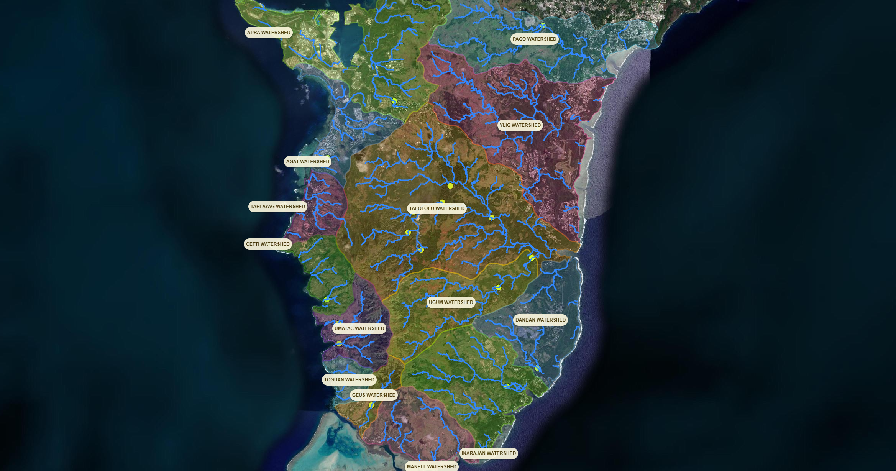
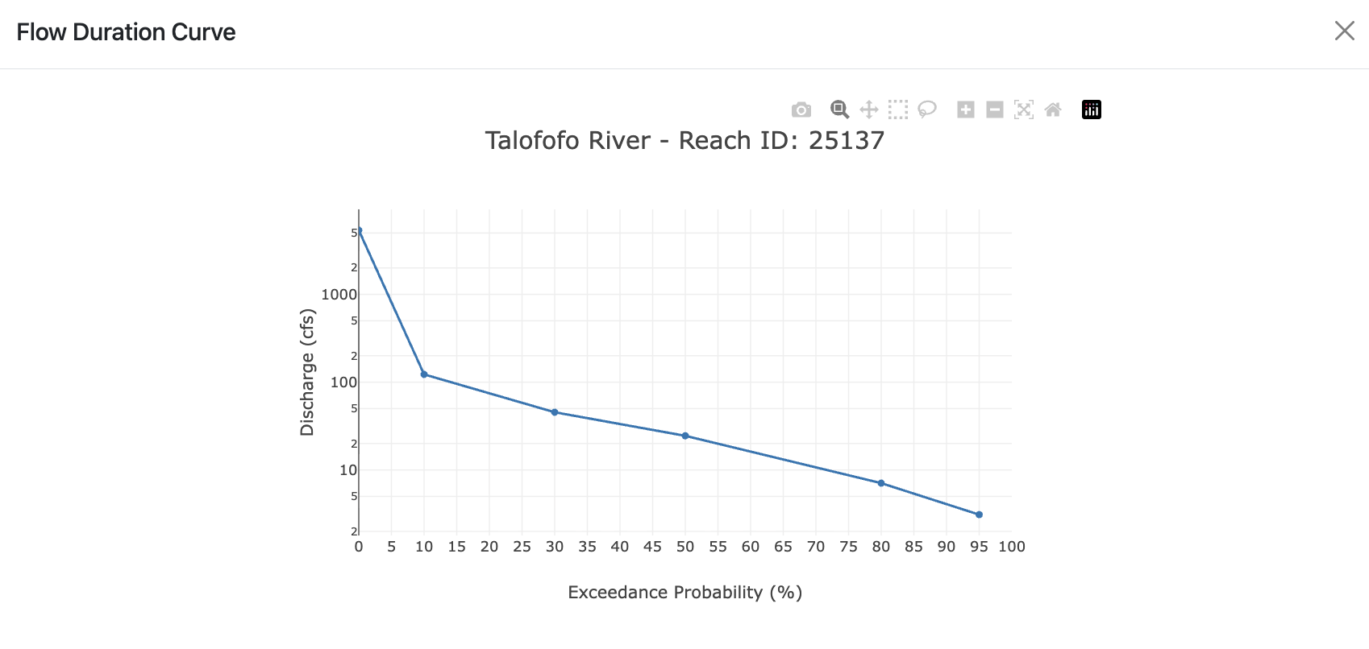
Flow Duration Curve
Notes:
This is the one we have for the Southern Guam Watersheds Streamflow Duration Curves, which is pretty similar to our first MAppFx.

Slide 18
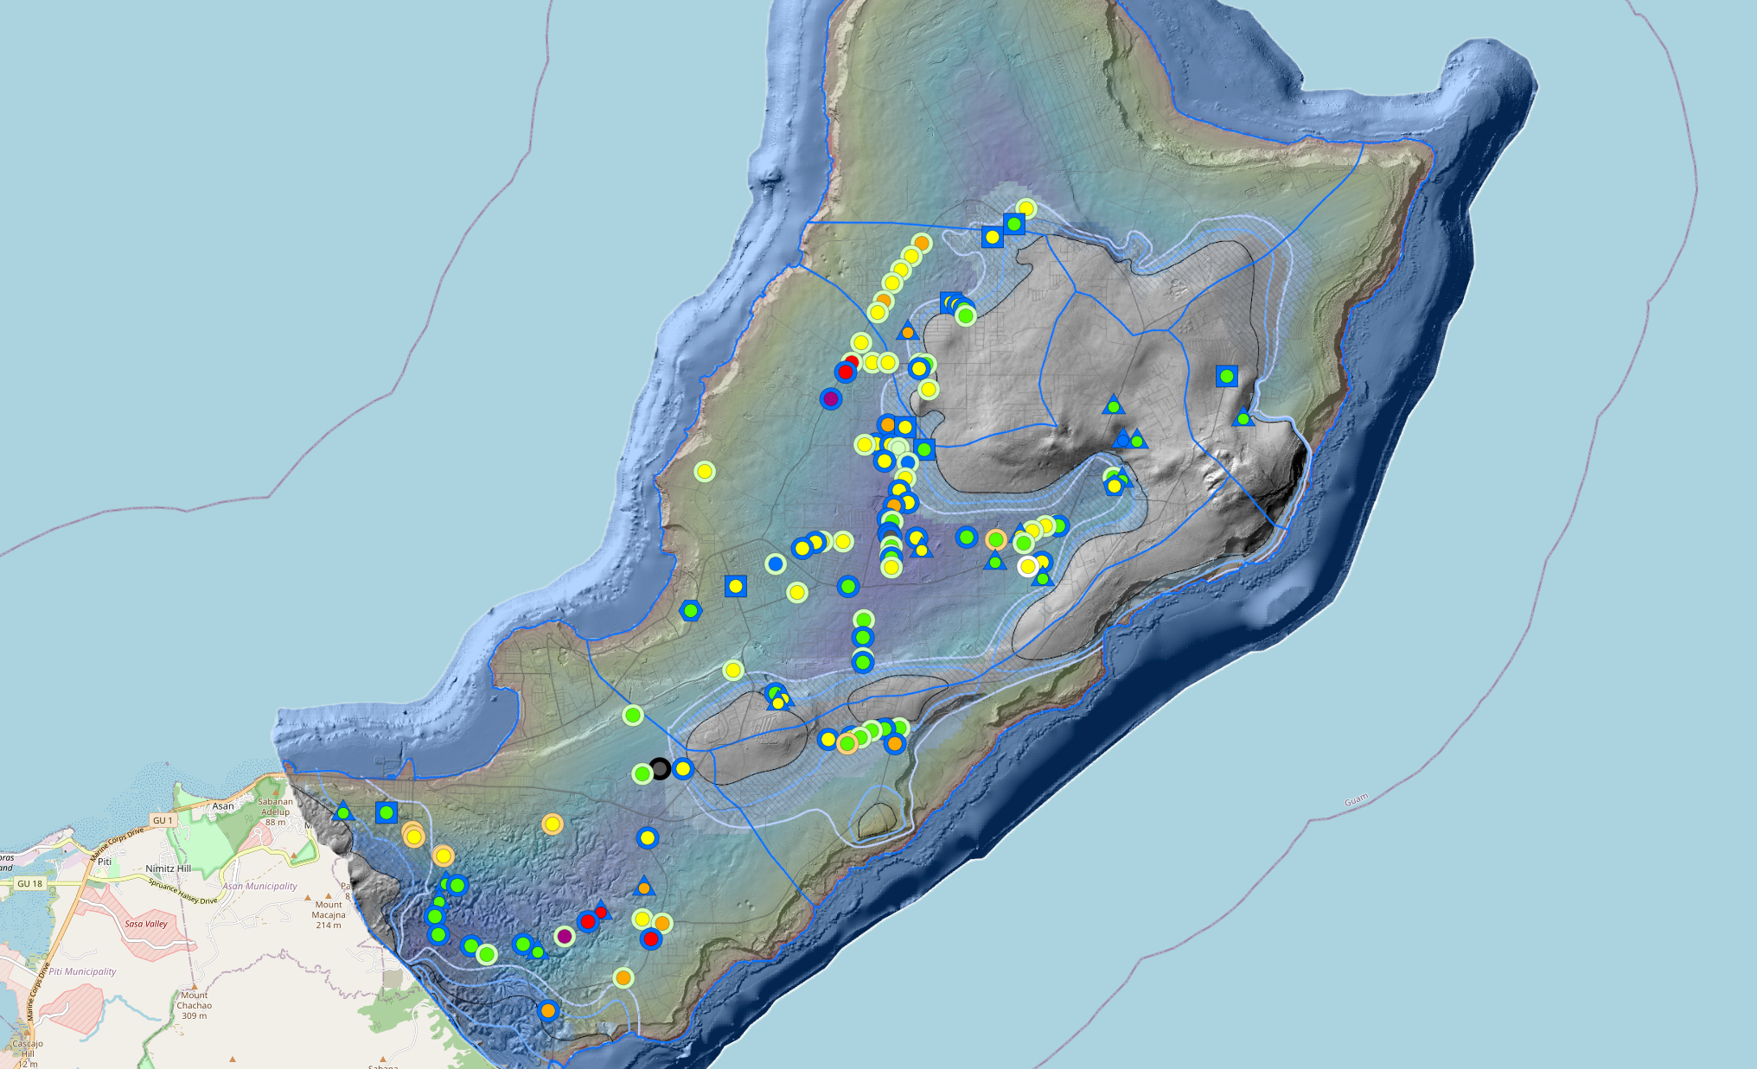
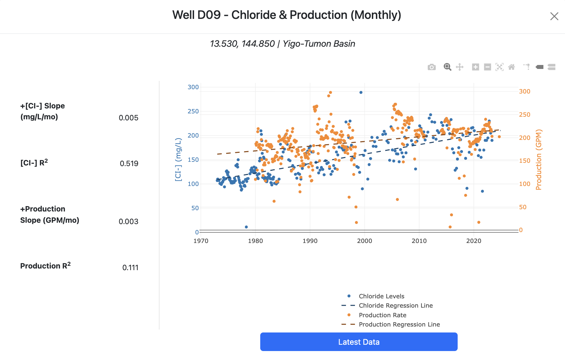
Double Axis
Notes:
For this MAppFx on Chloride and Production, chloride concentration data is an essential parameter for assessing the water quality, compliance with regulations, and pump rate management. Within the NGLA lie numerous wells, their pump rates are regularly monitored with respect to chloride due to saltwater intrusion or updraw.
(Management of utility water production requires quick access to time-series graph of production and chloride for each of the 100 wells that produce about a total of 40 MGD)
To help visualize the wells history, we created this double axis graph to showcase the relationship between the production rate (orange data, right side) and the chloride concentration levels (blue data, left side).

Slide 19
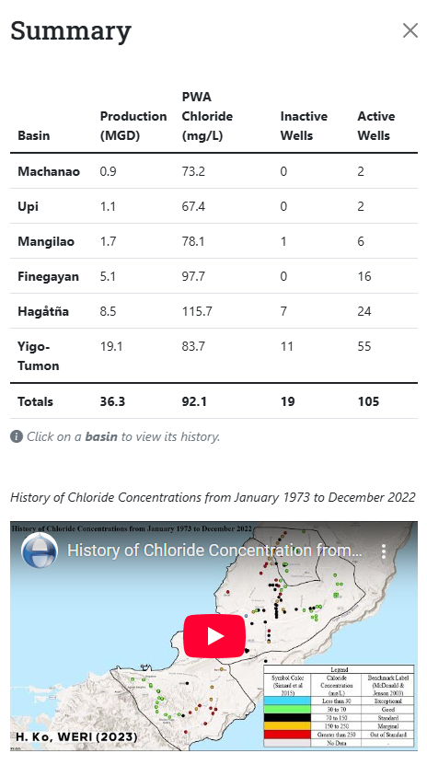
Notes:
We also added a summary table that displays the production history from the last 10 years. It provides an overview of the latest available data for someone looking for a summary.

Slide 21
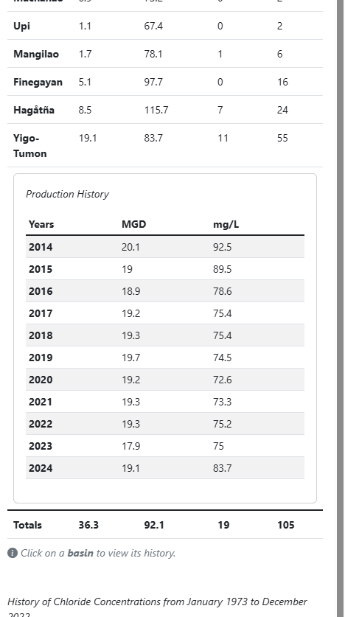

Slide 22
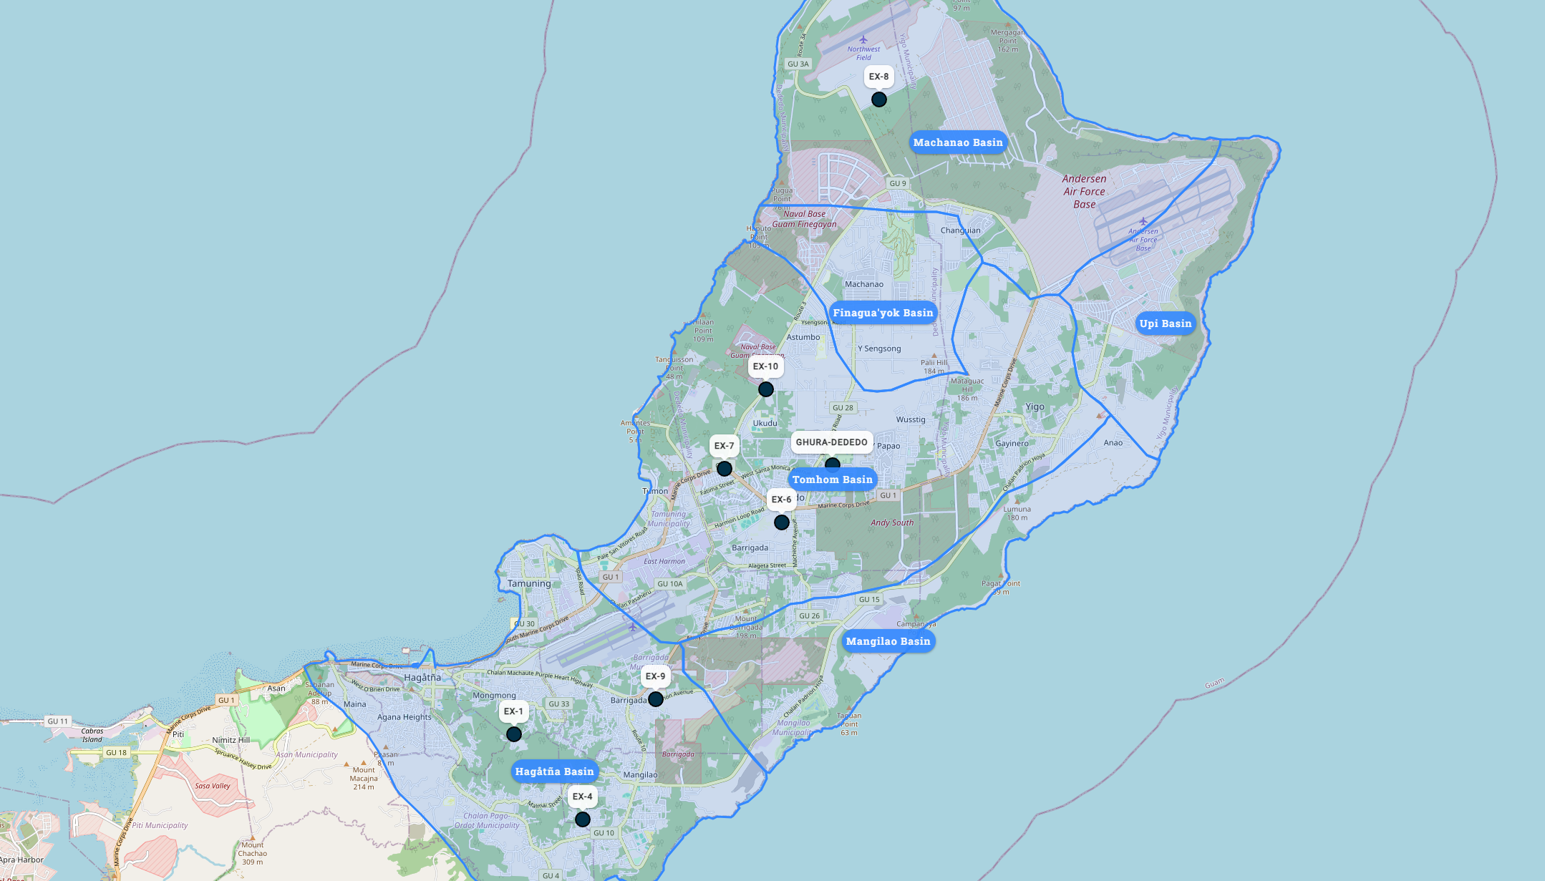
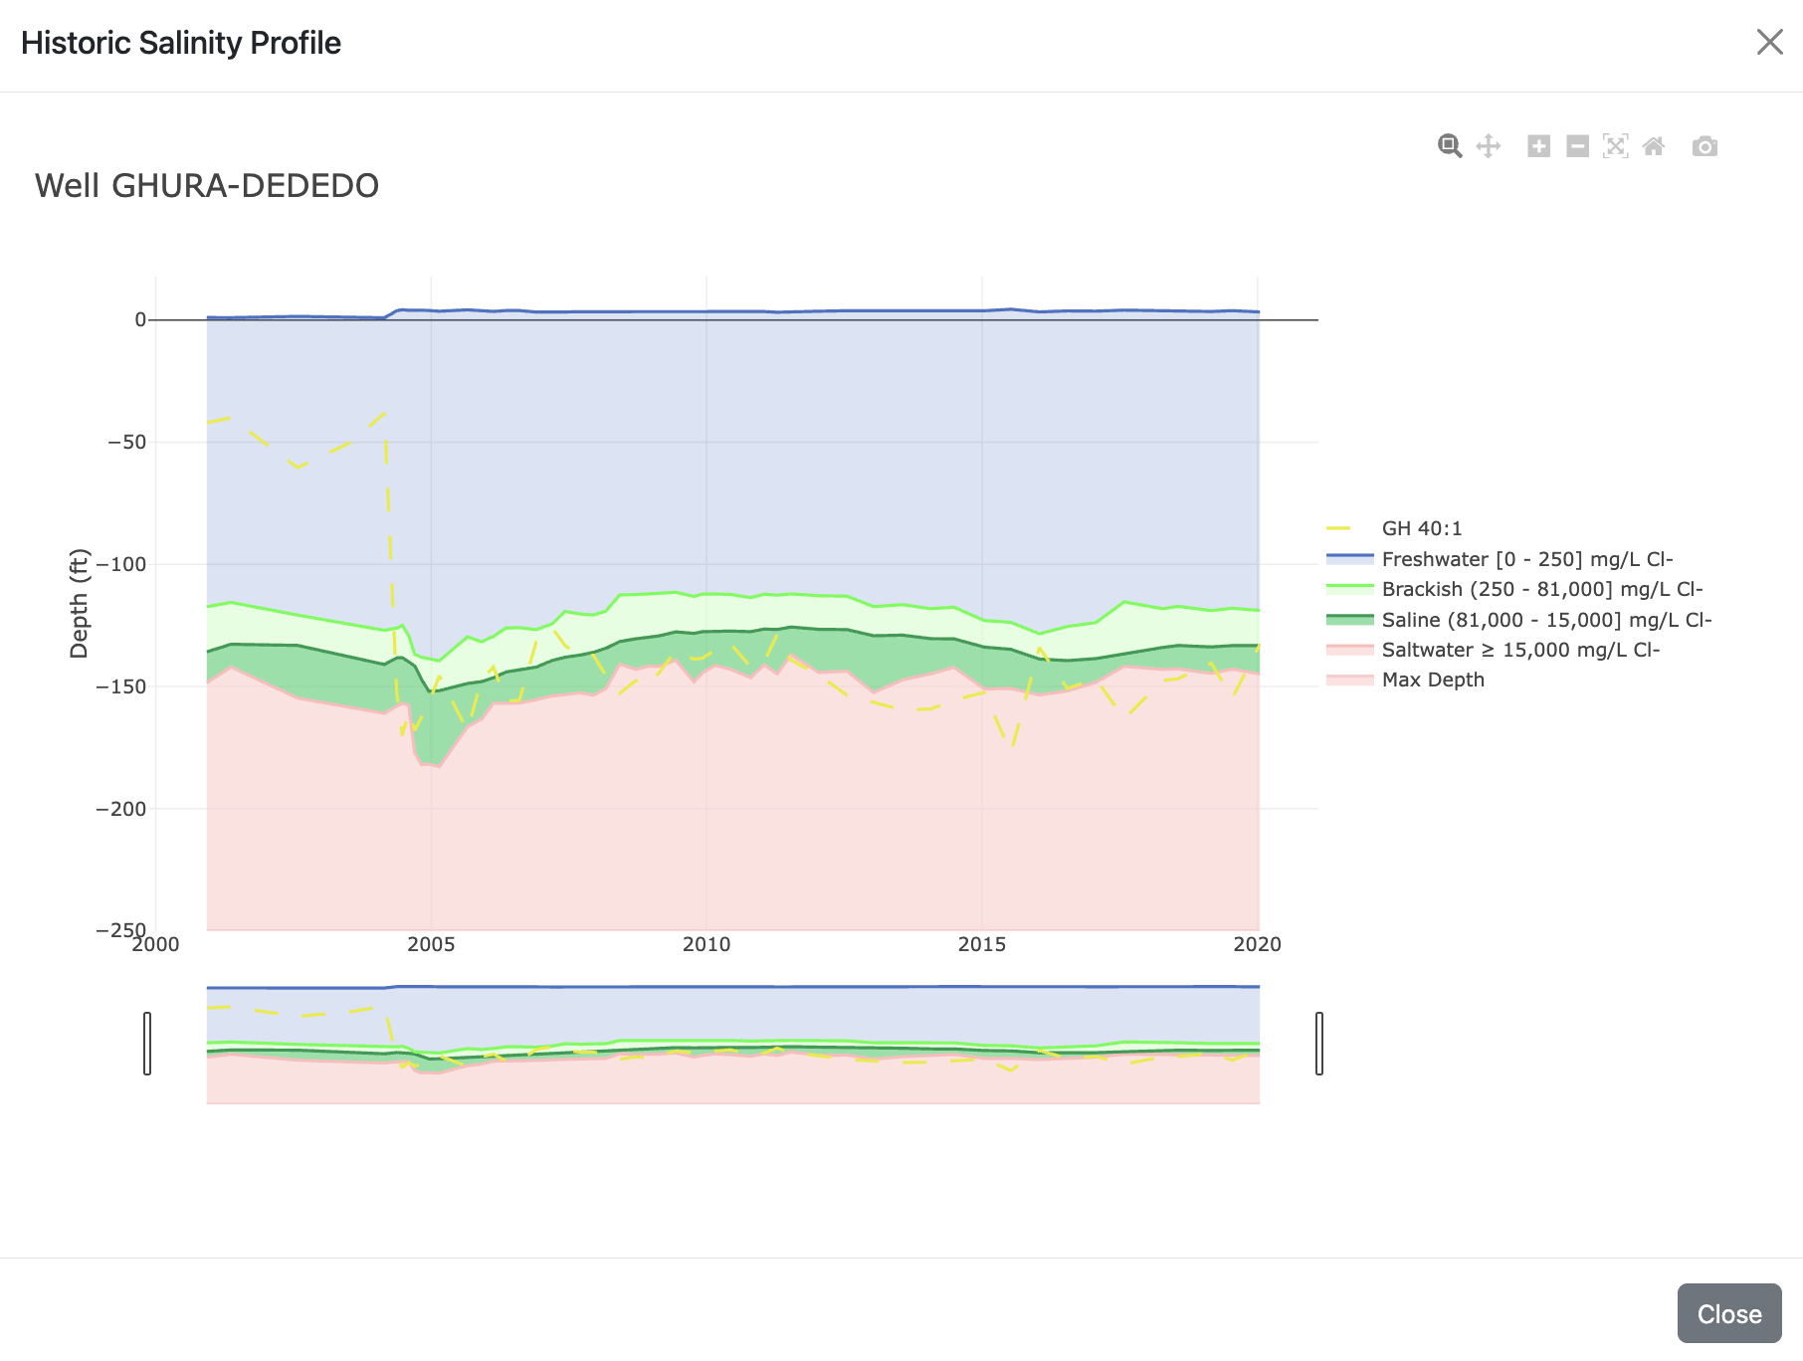
Lens Profile
Notes:
This is the MAppFx for Deep Observation Wells which looks at the dynamics of the aquifer lens (recharge). The plot here provides a historical view of the NGLA’s freshwater lens thickness, a breakthrough compared to the past where we were only able to view snapshots of the freshwater profile.

Slide 23
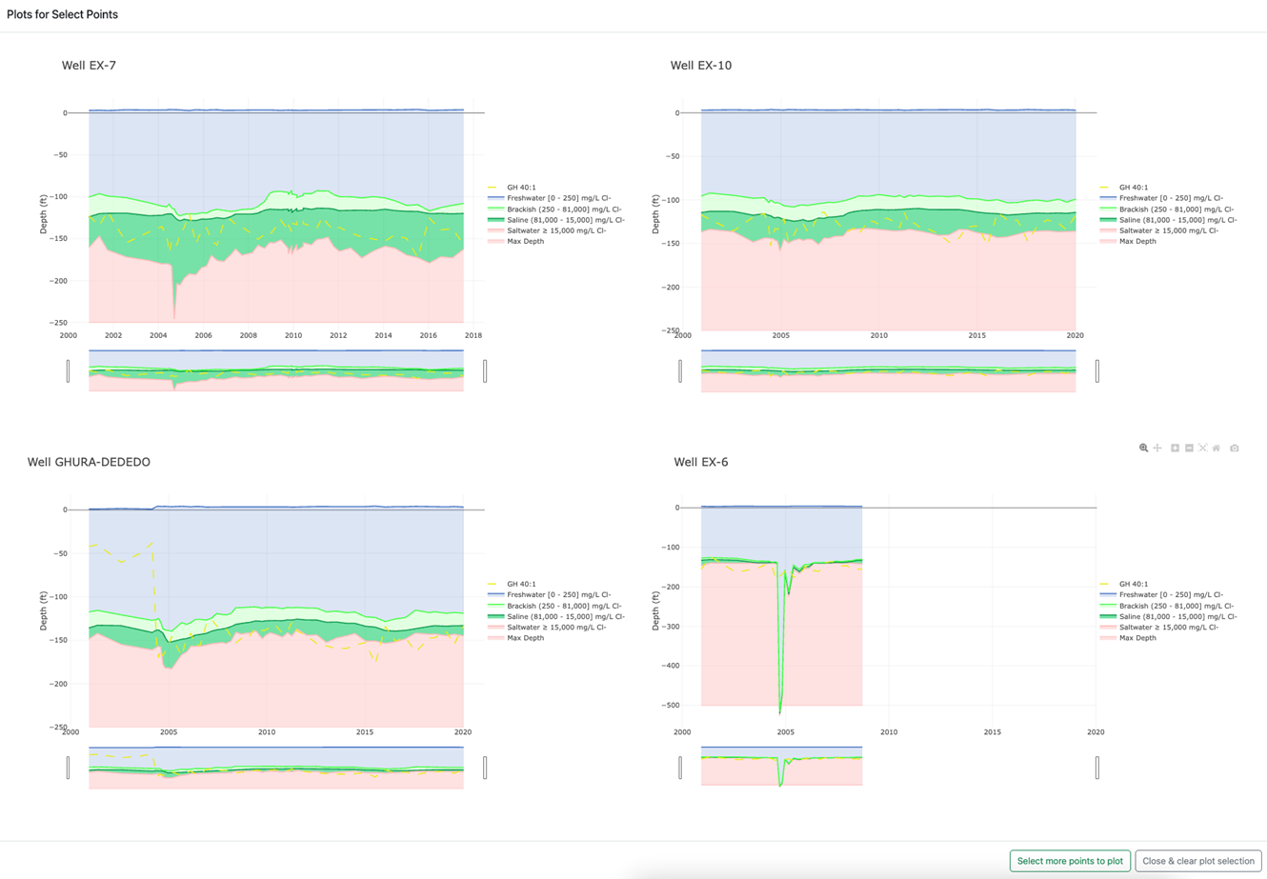
Multi-Graph View via Lasso Selection
Notes:
We applied the selection tool and multi-plot view for DOWs for a more comparative observation and analysis of select wells.

Slide 24
MAppFx: Northern Guam Lens Aquifer
Production Well Nitrates

Slide 25
MAppFx: Southern Guam Watersheds
Streamflow Duration Curves

Slide 26
MAppFx:
Chloride & Production

Slide 27
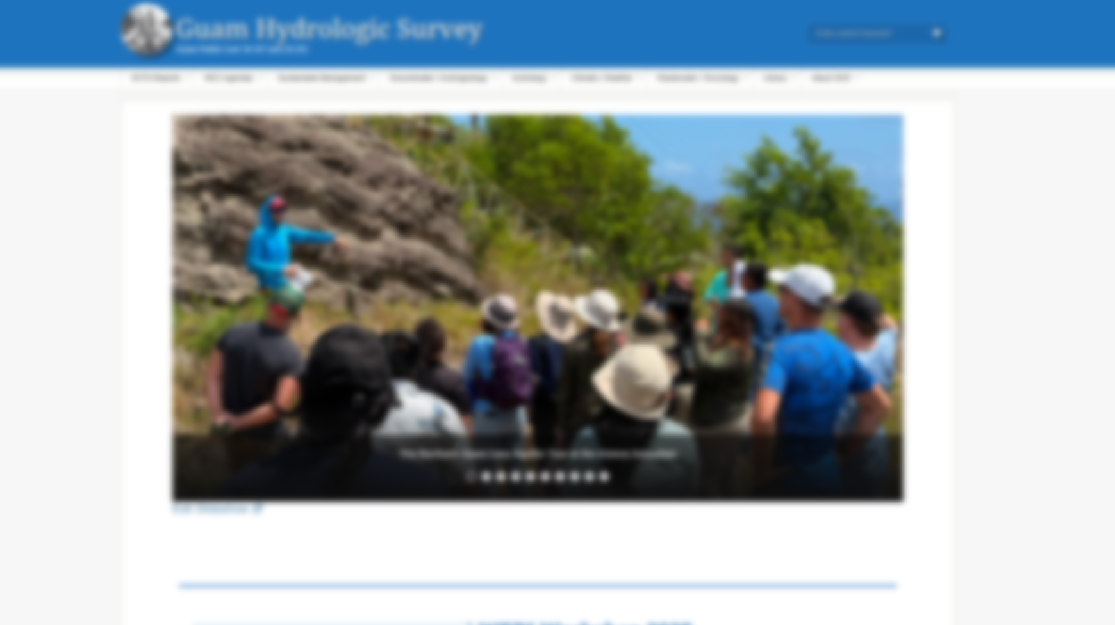
MAppFx:
Deep Observation Wells (DOWs)

Slide 28
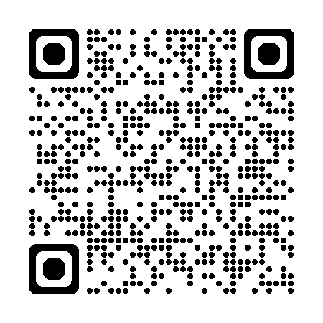
guamhydrologicsurvey.uog.edu
Notes:
Just like what Sydney showed you earlier with the tour of the Guam Hydrologic Survey, you can find our MAppFx Library here.

Slide 29
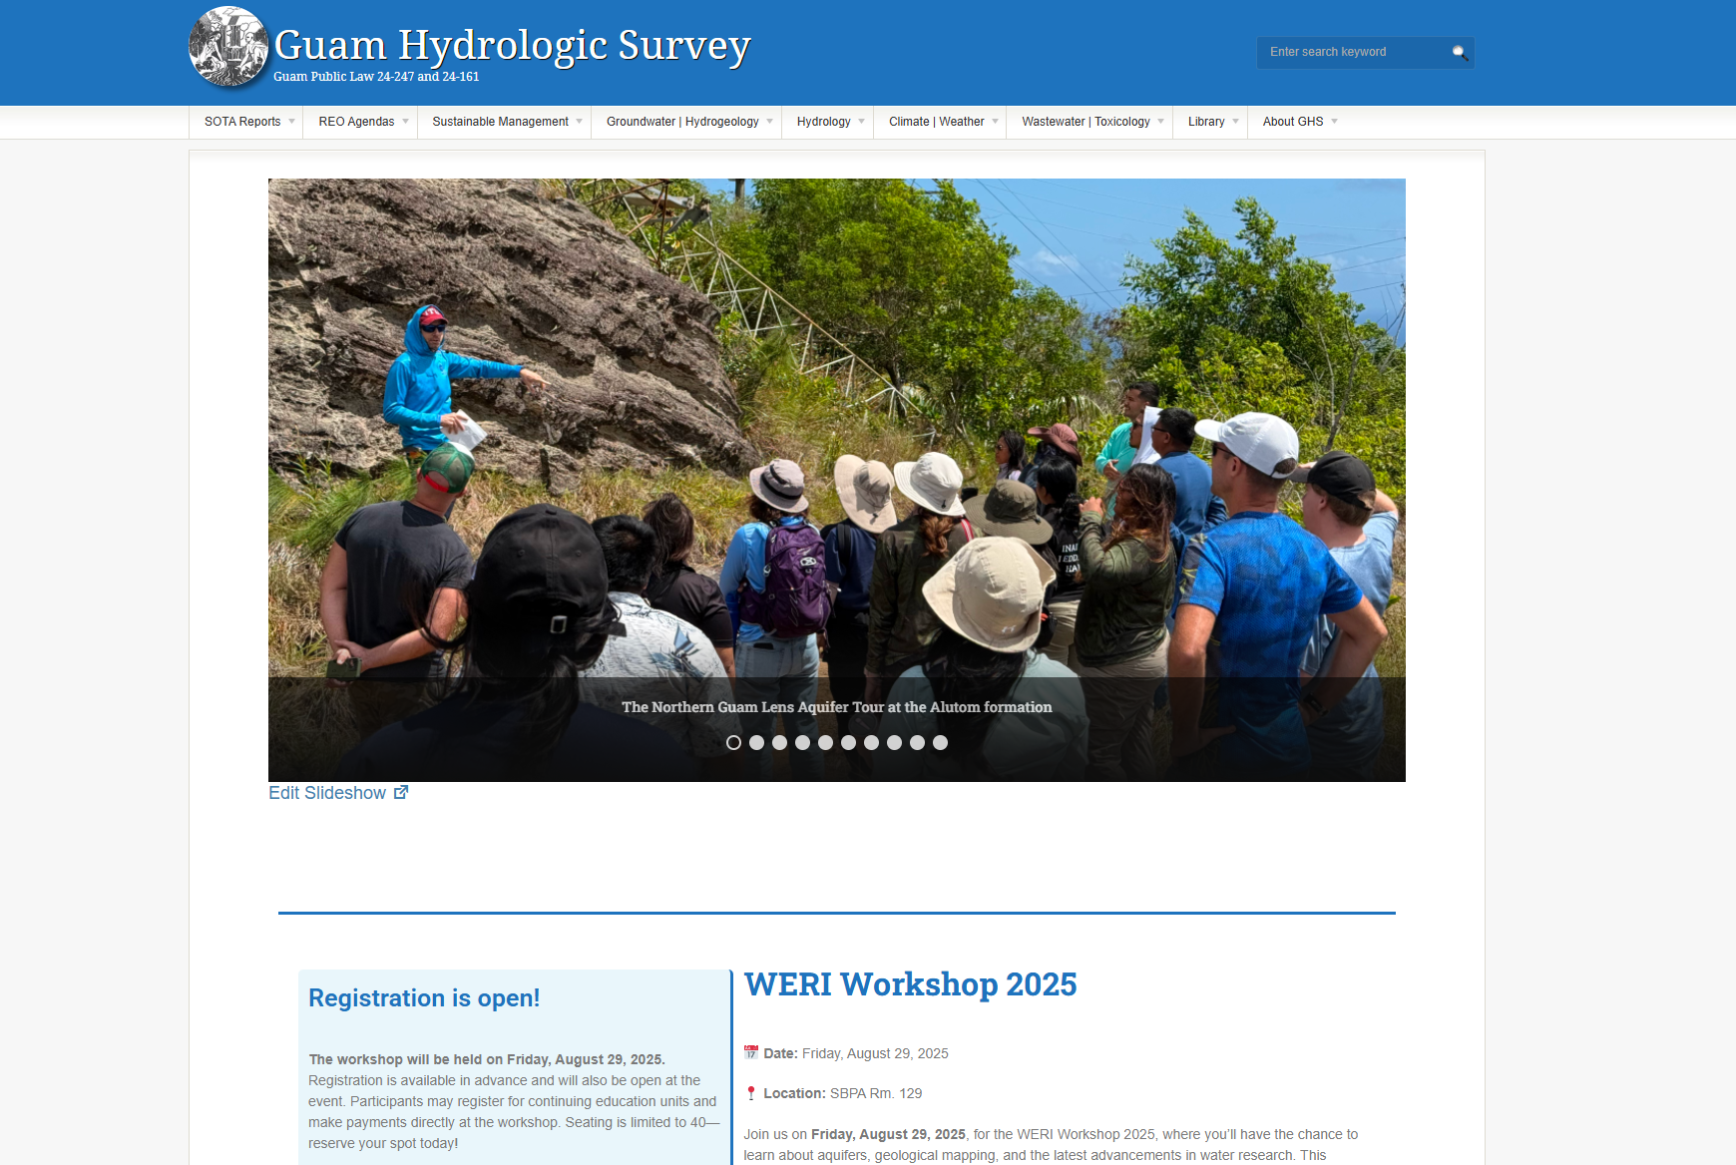

Slide 30
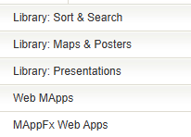

Slide 31
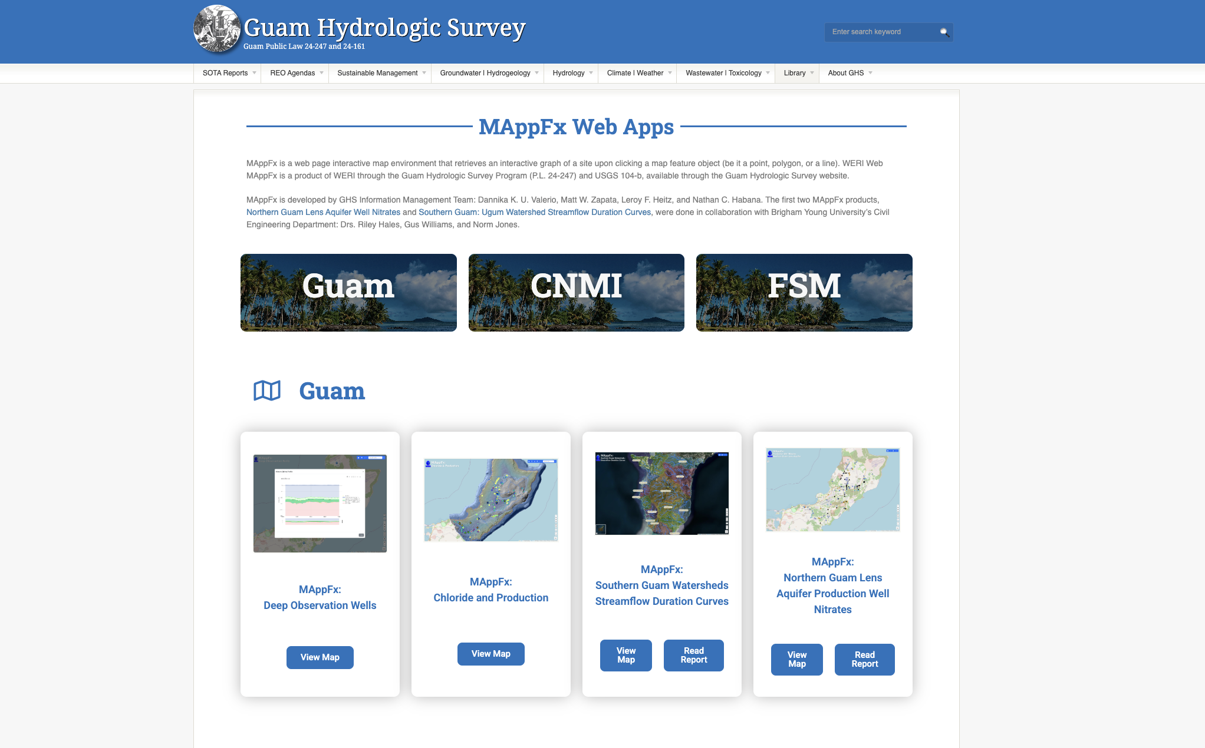

Slide 32
Looking Ahead
Information transfer and sharing
Continual expansion of the Guam Hydrologic Survey website
  Field survey databases
  Library of resources
  guamhydrologicsurvey.uog.edu
Notes:
The future of MAppFx is looking bright in terms of how we can further develop our web application based on the data to be observed and analyzed. New mapping projects are currently underway.
Overall, this map and graph product serves to share information with agency partners in water protection, production and legislation to aid in their water resource management discussions in water quality, production, and sustainability of our freshwater resource and to the people in the community, Guam and beyond, who are interested in obtaining information through an easy to use and accessible platform.
With the established Guam Hydrologic Survey website and this new online interactive interface technology available, the GHS Information Management Team strives to expand our library hydrologic web products and field survey databases.
Using MAppFx as a tool is critical to observing and analyzing our island’s water supply, the NGLA, and assessing actions and measures for its sustainability.
With the use and development of MAppFx, it sets the path for a streamline process of data transfer between interagency partners and brings forth the future in interagency collaboration, hydrologic information dissemination, and as a scientific information resource for aquifer and water management.

Slide 33

Si Yu’us Ma’åse’ | Thank You
Dannika Kate Valerio
Research Assistant III
valeriod@triton.uog.edu
Sydney Quintanilla
Research Assistant II
quintanillas15886@triton.uog.edu
Dr. Nathan Habana
Advisor, Groundwater Hydrologist
nchabana@triton.uog.edu
Water & Environmental Research Institute of the Western Pacific (WERI)
University of Guam

