Slide 1
ARC Geodatabase
Bureau of Statistics and Plans

Slide 2
Application Review Committee (ARC)
What is the ARC?
Interagency body established through E.O. 96-26 which provides technical and professional evaluations, impact analyses, and official recommendations related to development on Guam to the Guam Land Use Commission (GLUC) and Guam Seashore Protection Commission (GSPC)
The ARC ensures land development proposals comply with local regulatory standards, environmental policies, zoning laws, building codes, and land-use plans.

Slide 3
Application Review Committee (ARC)
Who sits on the committee, and include the ex-officio members?
Department of Land Management
Guam Environmental Protection Agency
Department of Agriculture
Guam Waterworks Authority
Guam Power Authority
Department of Parks and Recreation
Department of Public Works
Bureau of Statistics and Planning
Ex-officio members
Chamorro Language Commission
Guam Department of Education
Guam Fire Department
Department of Public Health and Social Services
Guam Economic Development Authority (formerly, Department of Commerce)

Slide 4
Bureau of Statistics and Plans (BSP)
BSP serves as the primary entity responsible for baseline data collection, socio-economic research, comprehensive long-term planning, and environmental resource coordination across the island.
Divisions within BSP
  Guam Coastal Management Program
  Planning information Program
  Bureau of Economics and Statistics
  Socio-economic Planning
Notes:
Business and Economic Statistics Division:
Compiles and publishes key economic metrics, including the quarterly Consumer Price Index (CPI), external trade reports (imports/exports), and business development surveys.
Acts as the primary liaison for the U.S. Census Bureau regarding demographic, population, and housing data.
Planning Information Program & Socio-Economic Planning:
Develops comprehensive island-wide growth strategies, long-range planning initiatives (such as sustainability frameworks and land-use guidelines), and policy recommendations.
Publishes official state documentation like the annual Guam Statistical Yearbook and regional economic impact assessments.
Guam Coastal Management Program (GCMP):
Manages shoreline policy, coastal zone preservation, and watershed health in partnership with NOAA.
Conducts Federal Consistency Reviews to ensure federal projects, military activities, and major local coastal development comply with local environmental regulations.
Geospatial Information System (GIS) Program:
Serves as the central clearinghouse for Guam's spatial mapping, developing tools like the Guam Shoreline Atlas, topographic flood models, and zoning geodatabases.
Socio-Economic Planning / Federal Grants Administration:
Administers key federal funding streams, including justice assistance grants, criminal justice planning, and local subrecipient monitoring.

Slide 5
Guam Coastal Management Program (GCMP)
GCMP acts as the lead reviewer for coastal policy, land-use planning, and environmental resource protection on the ARC.
Because the entire island of Guam is designated as a coastal zone under federal and local frameworks, GCMP evaluates how proposed land developments align with the island's coastal policies, environmental mandates, and long-term land-use plans.

Slide 6
Considerations for BSP’s Position
North & Central Guam Land Use Policies
Governmental Process Policy
Development Policies
  Shore Area Development
  Urban Development
  Rural Development
  Major Facility Siting
  Hazardous Areas
  Housing
  Transportation
  Erosion and Siltation
  Resource Policies:
    Conservation of Natural Resources
    Air Quality
    Water Quality
    Fragile Areas
    Living Marine Resources
    Visual Quality
    Recreational Areas
    Public Access
    Agricultural Lands

Slide 7
Land Cover/Watershed Analysis
NOAA Coastal Change Analysis Program to see the changes land cover class features in the watershed where the development is proposed

Slide 8
Development Highlight
Application No. 2023-36 - Conditional Use
Application No. 2025-67 - Zone Change
Notes:
Discuss a development in the recent past in which we utilized our ARC Geodatabase to come to a conclusion that there would be reasonable and foreseeable effects related to two or more enforceable policies.
Application No. 2023-36 - Conditional Use
Application Overview:
JMC Equipment Rental Inc. applied for a Conditional Use permit for an "extractive industry" (quarrying/mineral extraction) on a 1.08-acre property (Lot 5228-1-1NEW-R1) located in an "A" Agricultural Zone along Alageta Street in Dededo.
The applicant initially proposed clearing and grading to create a level pad for a single-family dwelling, but the Guam Environmental Protection Agency classified the work as quarrying, triggering the need for Guam Land Use Commission approval.
Application No. 2025-67 - Zone Change
Application Overview
Applicant & Location: Salas Development LLC requested a zone change for a 1,784-square-meter property (Lot 40, Block 10) located at the intersection of O'Brien Drive and 5th Street in Hagåtña.
Proposed Change: Rezoning from "R2" (Multi-Family Dwelling) to "C" (Commercial) to utilize the existing three-story structure for commercial use on the first two floors, with an option to renovate the third floor into two residential units. A Conditional Use application will be required for the multi-family residential units.
Background: The property previously operated as a Bank of Guam branch under "R2" zone variances, but a formal rezoning was never finalized. The current applicant purchased the property to align its zoning with surrounding uses and plans to limit improvements to internal structural modifications. Full public utilities are already in place.

Slide 9
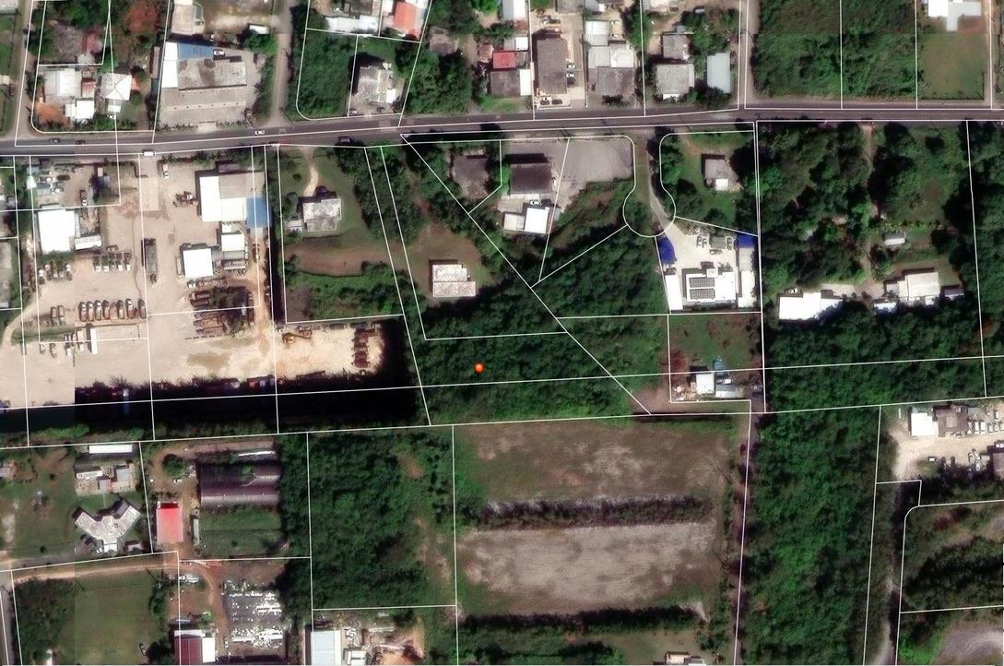
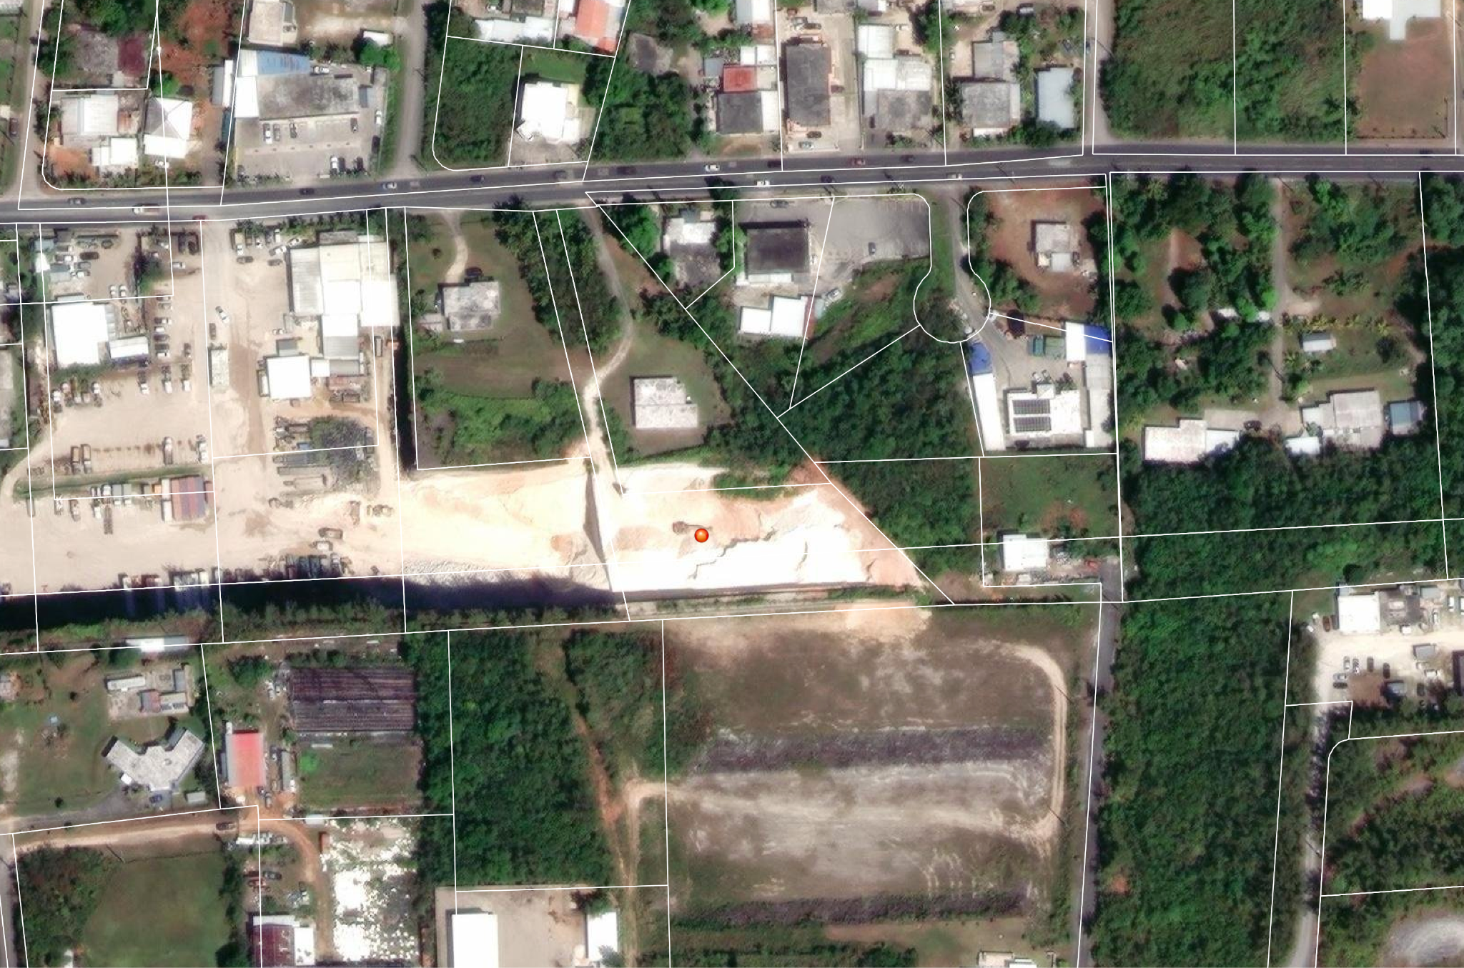
Conditional Use Application No. 2023-36
March 28, 2024
May 29, 2025
Notes:
Share screenshots of what we saw on our ARC Geodatabase that helped to evaluate foreseeable offects to related enforceable policies
Application No. 2023-36 - Conditional Use
Planning Considerations and Constraints:
The surrounding area features heavy traffic, a mix of residential dwellings, vacant land, and commercial uses, with an adjacent property to the west serving as the applicant's heavy equipment processing and staging facility.
Under the North and Central Guam Land Use Plan Future Land Use Map, the lot is designated as Residential. While a single-family dwelling aligns with this designation, an extractive industry is incompatible with it.
The lot sits in the Northern Watershed above the Northern Guam Lens Aquifer. With 30.6% of the watershed already developed and 15.78% covered in impervious surfaces as of 2015, additional development risks increasing flooding, degrading water quality, harming aquatic life, and causing coral mortality.
Land Use Policies and Determinations:
Policy LU-13 (Agricultural Lands): Although the zoning law permits "extractive industry" conditionally in agricultural zones, the Bureau determines this should be limited to renewable biological/agricultural resources (e.g., water, plants). Limestone is non-renewable.
Policy LU-1g (Industrial Lands): Mineral extraction is permitted in industrial designations and M2 Heavy Industrial Zones (where objectionable operations like dust, noise, or vibrations are allowed). However, the proposed removal of 37,000 cubic yards of limestone (requiring about 2,300 full-size dump truck loads) is excessive for a single-family home pad, indicating the true intent is to profit from limestone extraction rather than merely build a house.
Final Determination:
Pursuant to Executive Order 96-26, the Bureau recommends disapproval of the conditional use application due to conflicts with Guam land use policies.
The Bureau would reconsider support if the residential dwelling is redesigned to fit the property's natural constraints without requiring excessive grading or quarrying operation

Slide 10
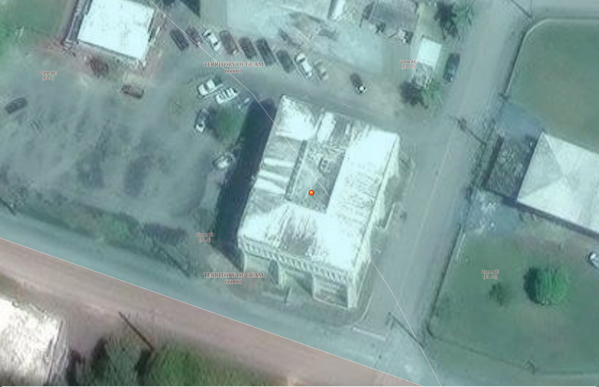
Zone Change Application No. 2025-67
Notes:
Share screenshots of what we saw on our ARC Geodatabase that helped to evaluate foreseeable offects to related enforceable policies
Application No. 2025-67 - Zone Change
Planning Considerations
Surrounding Land Use: The neighborhood features a mix of commercial and residential properties, including the Julale Shopping Center and Title Guarantee.
Urban District Compatibility: The lot is situated within a designated urban district under Guam Land Use Policies (E.O. 78-37), making the commercial rezoning functionally consistent and compatible with the area's mixed-use character and historical precedent.
Environmental & Watershed Assessment
Watershed Context: The property lies within the Agana Watershed and above the Northern Guam Lens Aquifer. As of 2015, 51.78% of the watershed was developed and 29.31% comprised impervious surfaces.
Water Quality Impacts: Future renovations increasing impervious surfaces can limit natural infiltration, generate runoff, and transport pollutants that degrade stream flow and aquifer recharge.
Effects Test, Conditions, and Recommendations
Water Quality Policy: Determined to have an effect. Condition: The applicant must comply with the CNMI and Guam Stormwater Management Manual standards and implement Island Best Management Practices for any future property improvements.
Hazardous Areas (Flooding): Determined to have an effect. The FEMA Flood Insurance Rate Map places the property in Zone AE (EL 9), a special flood hazard area with a 9-foot base flood elevation, though the existing structure predates current flood management regulations. Recommendation: The applicant should consider non-structural flood prevention measures like flood barriers at unsealed ground-level doors.
Final Determination
The Bureau of Statistics and Plans recommends approval of the zone change application, subject to the enforcement of the specified stormwater management conditions. If conditions are unmet or excluded from the Guam Land Use Commission's Notice of Action, the position statement serves as a recommendation for disapproval.

Slide 11
Land Cover/Watershed Analysis
NOAA Coastal Change Analysis Program to see the changes land cover class features in the watershed where the development is proposed
  Issue: NOAA-CCAP for Guam compares class features between 2005 - 2015
  We do have 2022 land cover data provided by NOAA. However, we have not been able to analyze the percentages of the different land cover for each watershed.

