Slide 1

Dieldrin updates
Guam Hydrologic Survey Workshop
Updates Regarding Dieldrin and PFAS in Guam
CAPT Elizabeth DeGrange
25Sept2026

Slide 2
Dieldrin investigations
JRM has awarded contract for AAFB investigation
US EPA ECAD sampling of soil, water
  Awaiting formal report
Guam EPA received data from fish tissue samples
Guam EPA is currently conducting NWCA sampling
  Will be tested for dieldrin, chlordane
ATSDR continues Public Health Assessment work

Slide 3
Dieldrin investigations
JRM has awarded contract for AAFB investigation
  Award made 16Sept2026
  Period of performance is 16Sept2026-15Sept2027
  scope of work for this investigation will include:
    a historical records search for properties, land use, and hydrology in the surrounding area of drinking water production well Y-15
    The preparation and execution of soil and groundwater sampling on AAFB property near Y-15,
    groundwater sampling at groundwater wells with previous detections of dieldrin,
    development of a risk assessment and conceptual site model for the
    fate and transportation of dieldrin,
    development of a final report discussing all of these tasks.

Slide 4
Dieldrin investigations
Guam EPA received data from fish tissue samples
  Approximately 250 fish fillet and carcass samples tested
  11 tested positive for dieldrin above applied screening values (SVs) based on US EPA guidance
    11 additional samples showed detections above SV in carcass
  Only 1 fish sample tested above chlordane SV

Slide 5
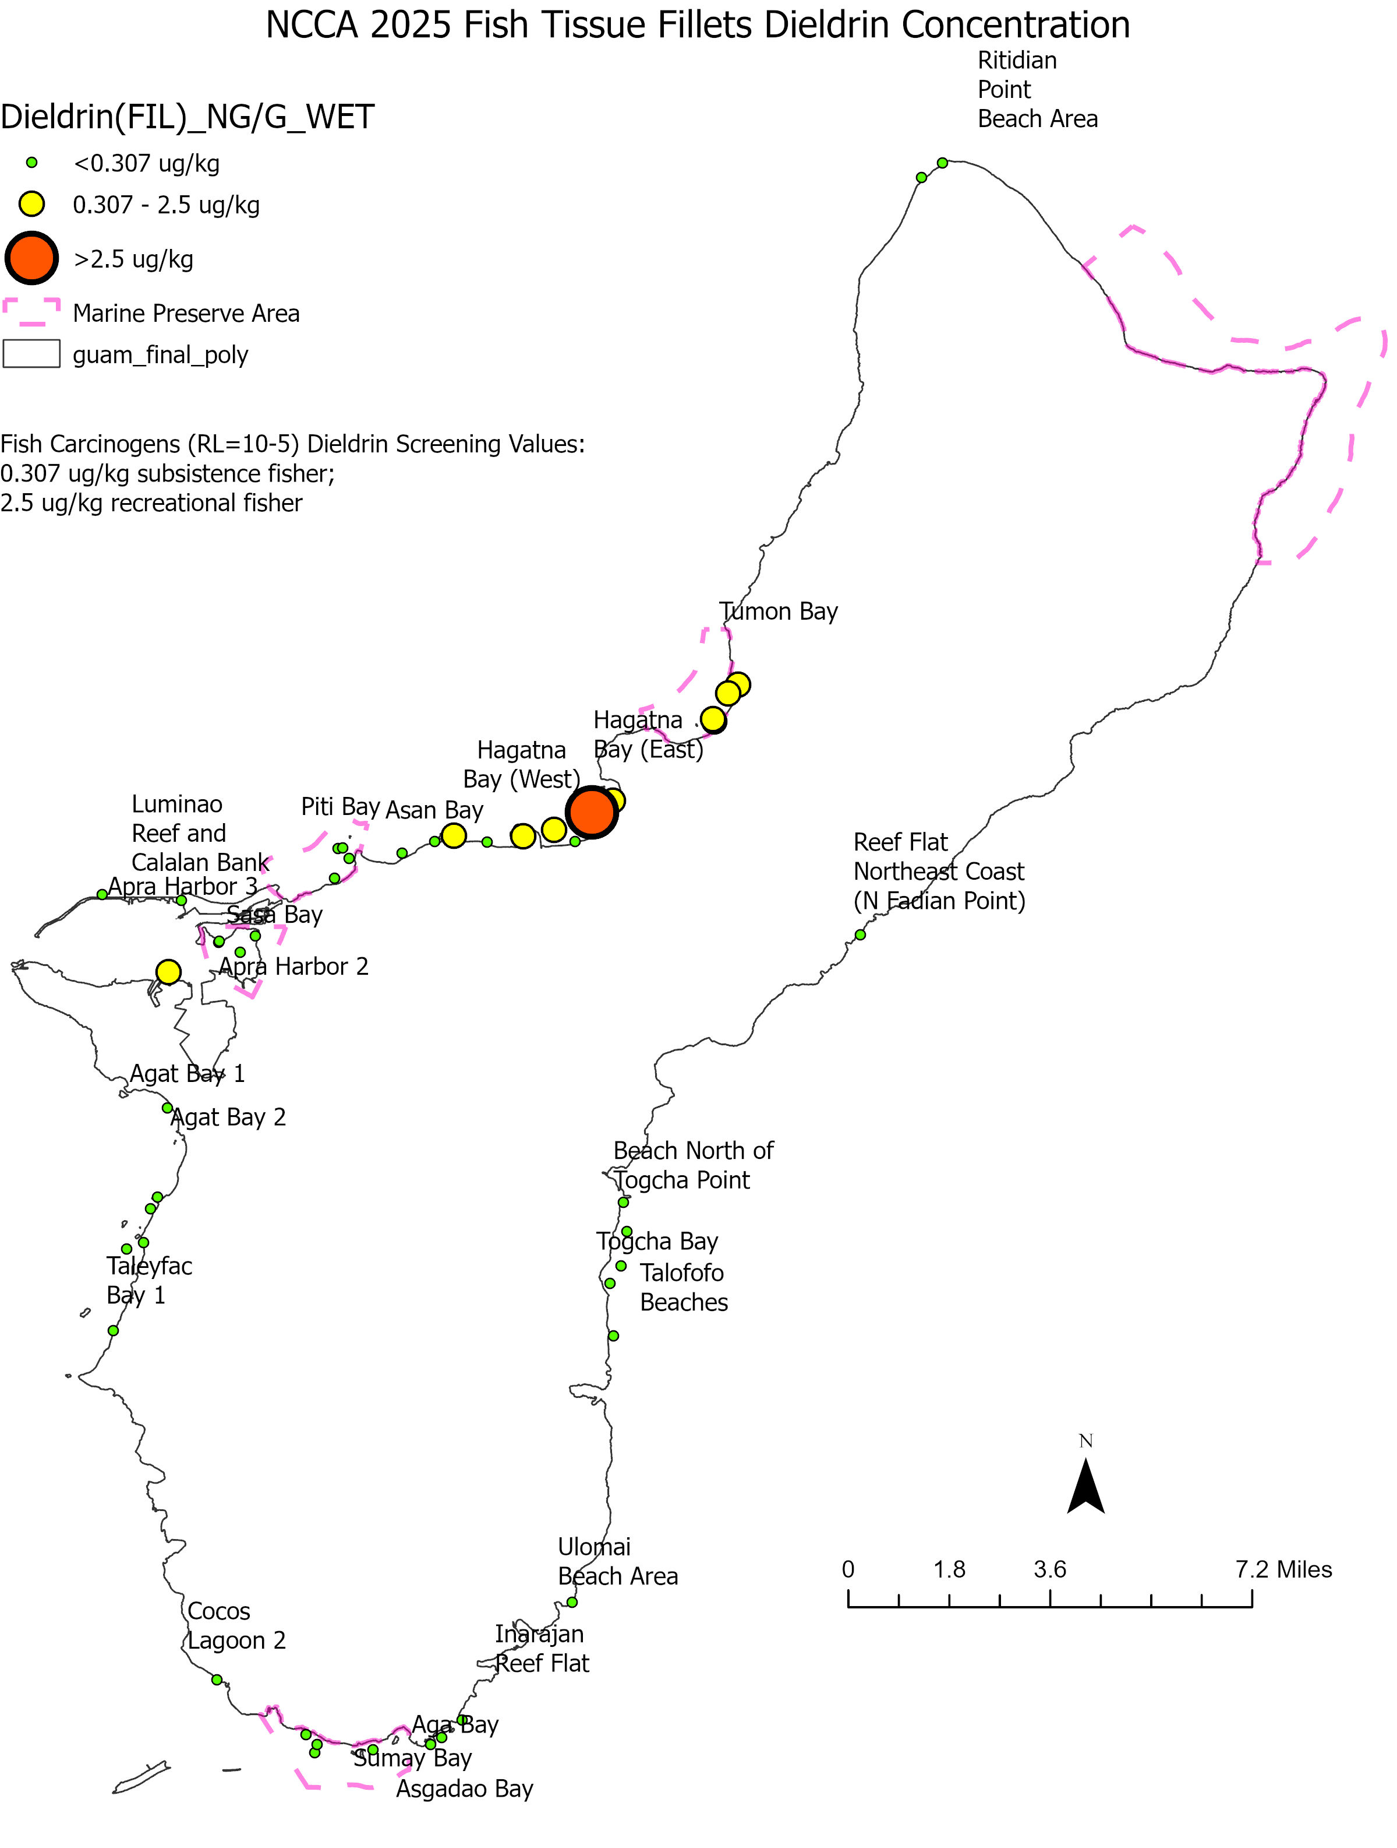
Dieldrin investigations
Triggers a Tier II intensive study
  Working with DOAG and DPHSS to develop and execute
  Will collect multiple species
    Crustaceans
    Variety of fishes
    Sea cucumber

Slide 6
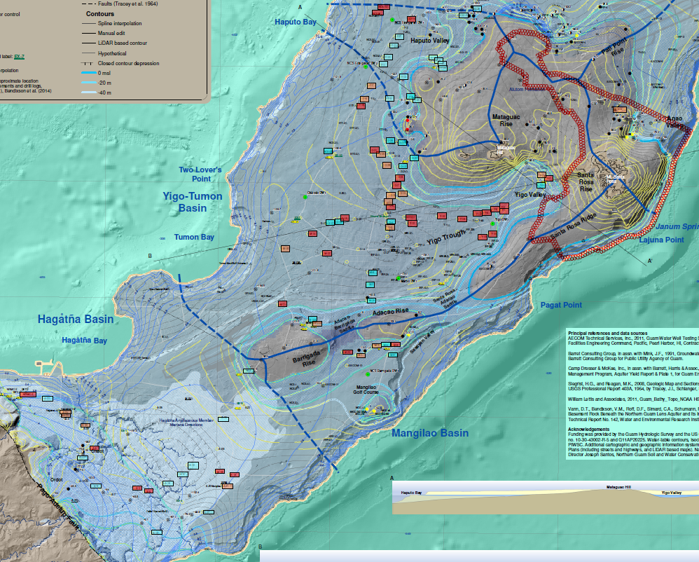

Slide 7
PFAS
US EPA Changes to regulated contaminants
  PFOS and PFOA only
  Initial monitoring for all Public Water Systems (PWSs) required by 26April2027
    4 quarterly samples over a year
  Enforcement starting April 2029*

Slide 8
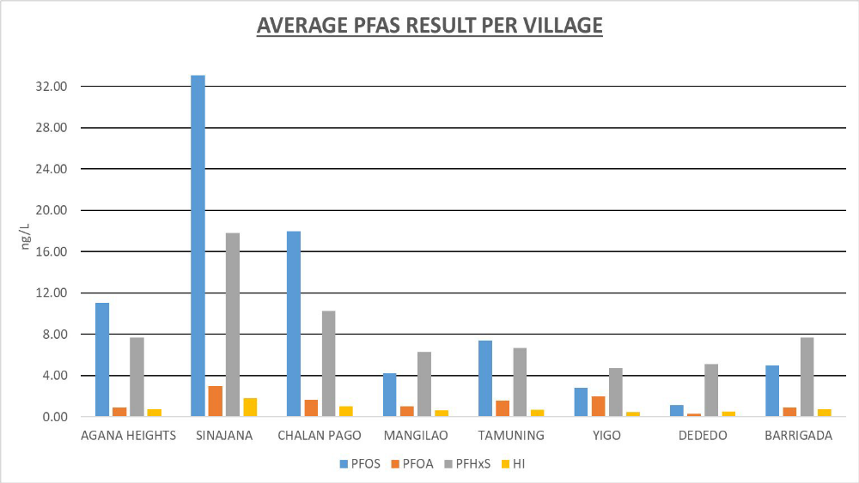
PFAS

Slide 9
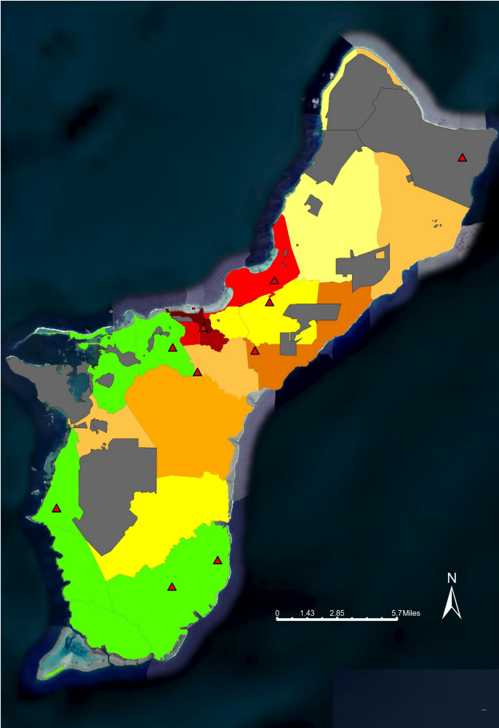
PFAS
LEGEND:
GREEN = ZERO RISK
LIGHT YELLOW = 1 - 5% RISK
YELLOW = 6 - 10% RISK
LIGHT ORANGE = 11 - 20% RISK
ORANGE = 21 - 30% RISK
DARK ORANGE = 31 - 40% RISK
RED = 41 - 50% RISK
DARK RED = 90 - 100% RISK
DARKEST RED = 100+% RISK
GRAY = DOD PROPERTIES
RED TRIANGLE = HOT SPOT

Slide 10
CONTACTS
Guam EPA Safe Drinking Water Program
Juliana Mendoza, EHS III
  julie.mendoza@epa.guam.gov
  671.588.9026
Nicole Diras, EHS 1
  nicole.diras@epa.guam.gov
  671.588.4798
Dieldrin/Other Questions
CAPT Elizabeth DeGrange, Senior Science Advisor
  elizabeth.degrange@epa.guam.gov
  671.588.4779

