Slide 1
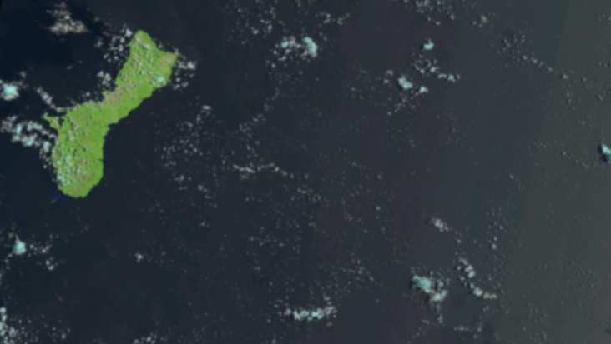
WERI GLE GHS Workshop 2026
Development of Temporal Land Cover Maps for Guam
Nicole Sulla Mathews, RA III
Dr. Yuming Wen, Professor of GIS
Water and Environmental Research Institute of the Western Pacific
University of Guam
Mangilao, GU 96923
25 September 2026
UOG Annex A Warehouse Building, Room 6
USGS LANDSAT 8 (2020). USGS Earth Explorer https://earthexplorer.usgs.gov/

Slide 2
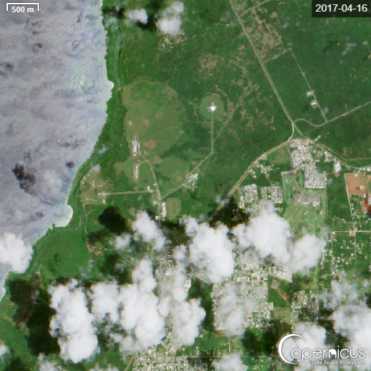
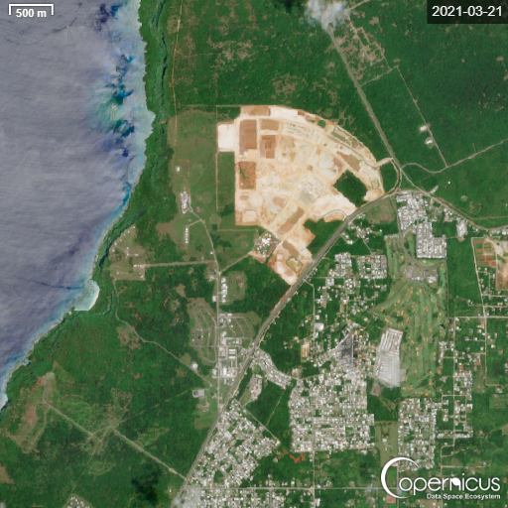
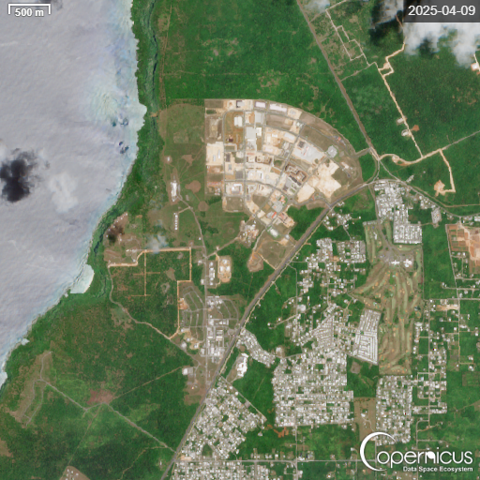
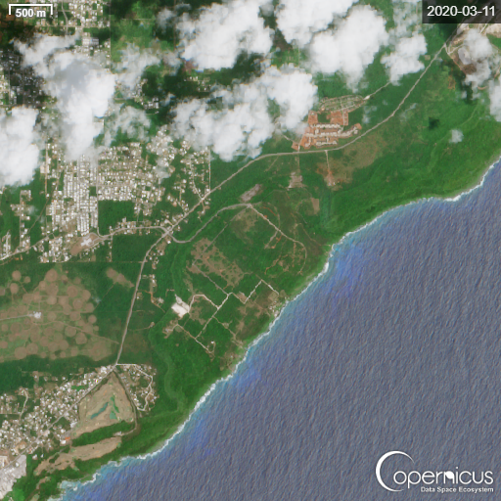
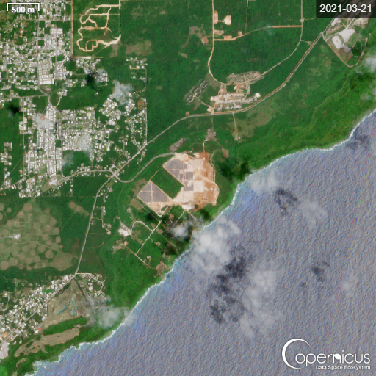
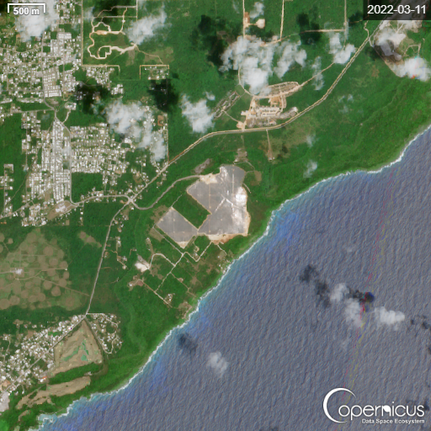
WERI GLE GHS Workshop 2026
Sulla Mathews 2
Land Cover Mapping on Guam
Image 1-3. Sentinel-2 Images of Camp Blaz, RGB:432, Copernicus (2026)
Consistent, accurate land cover mapping is essential for assessing the potential impacts of rapid land transformation on the NGLA
Rapid transformation and urbanization introduce impervious surfaces that alter natural hydrology and potentially affects the pattern and rate of water recharge to NGLA and introduce contaminants
Project objective: development of a seasonally calibrated geospatial workflow that reconstructs 20+ years of land cover and land cover change to support groundwater sustainability
Image 4-6. Sentinel-2 Images of Marbo Solar Farm, RGB:432, Copernicus (2026)

Slide 3
WERI GLE GHS Workshop 2026
Sulla Mathews 3
Current Knowledge Gaps
C-CAP Limitations
Classification Class Gaps
Restrictions & Accuracy Uncertainty
NOAA-provided LC maps are typically released every 5 years, missing rapid annual land cover transitions
Existing datasets often lack Guam-specific classes necessary for basin research (active development/construction sites)
Limited local data regarding total accuracy of Guam LC maps (~80-85%)
C-CAP data is restricted from contributing/evaluating machine learning within 5 years of creation
It’s not intended for use in litigation

Slide 4
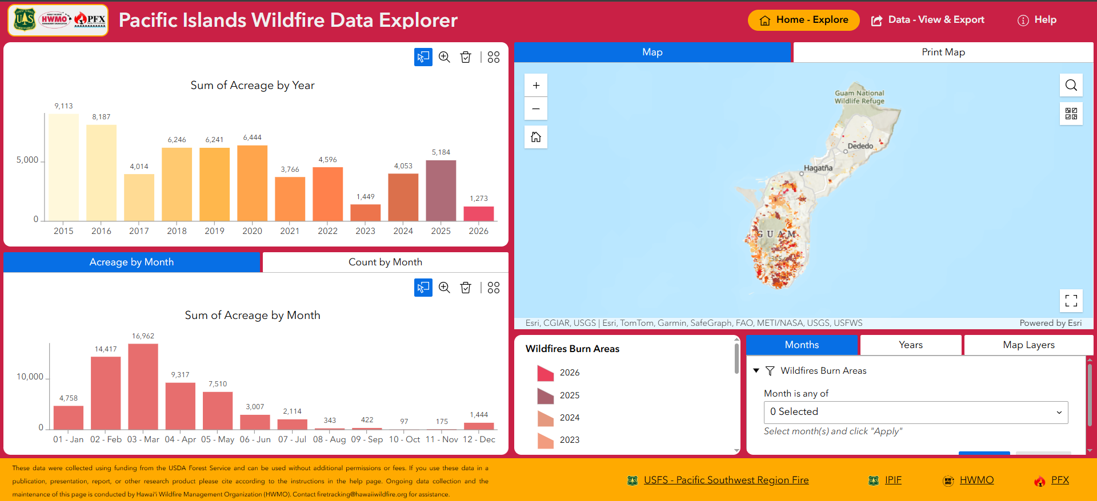
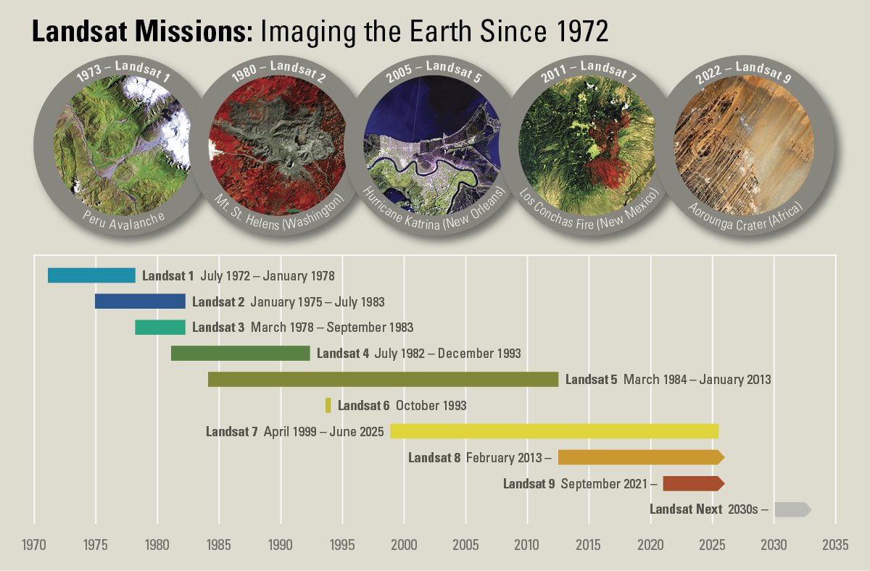
WERI GLE GHS Workshop 2026
Sulla Mathews 4
Data Selection & Reference Material
Landsat 7, 8, and 9 were selected for this project for their multi-decade historical record
Typically provides enough revisits annually to compile reasonably cloud-free mosaics for both wet and dry season
Reference material: Sentinel-2, Google Earth historical images, Pacific Islands Wildfire Data Explorer
Image 8. Pacific Islands Wildfire Website, USDA, HWMO (2026)
Image 7. Landsat Missions Timeline, USGS (2025)
Notes:
Image link: https://www.usgs.gov/media/images/landsat-missions-timeline

Slide 5
WERI GLE GHS Workshop 2026
Sulla Mathews 5
Data Limitations
Spatial Resolution
Landsat 7 SLC Error
Data Sparsity
Landsat is generally limited to 30m resolution, which can be challenging compared to 10m resolution of Sentinel-2
On May 31, 2003, SLC failed, which resulted in strips of missing data throughout all images taken since that time
Images prior to 2015 are more limited, necessitating the use of multi-year seasonal mosaics to achieve full island coverage
Notes:
Image link: https://www.usgs.gov/media/images/landsat-missions-timeline

Slide 6
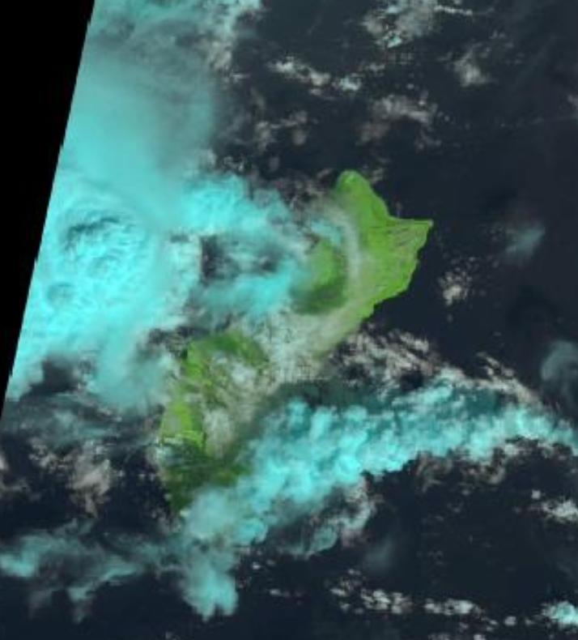
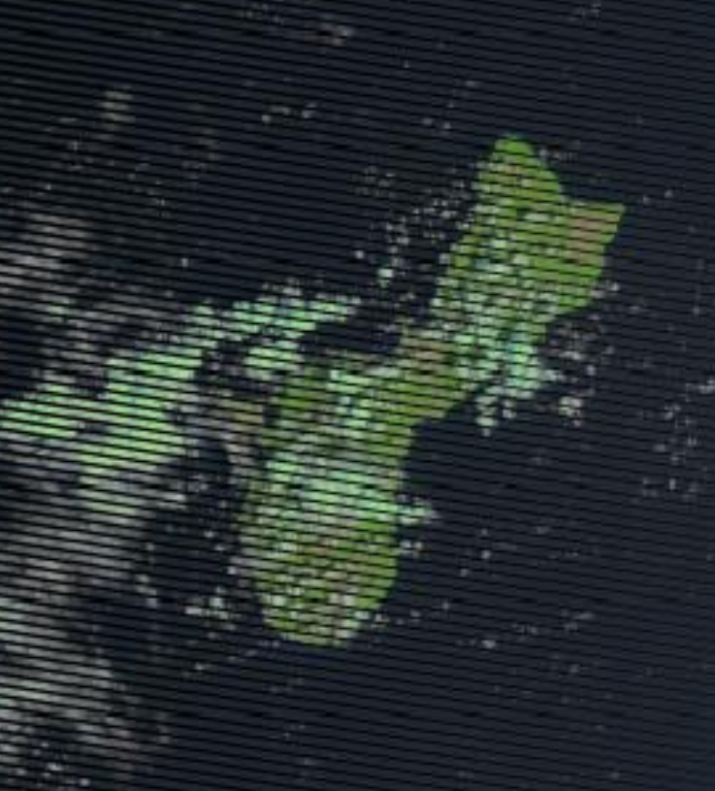
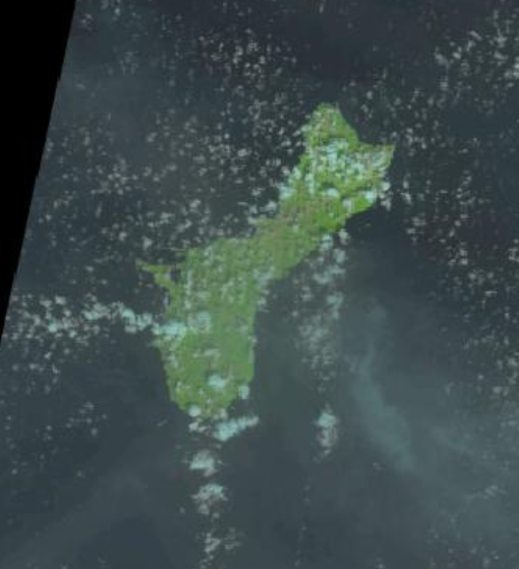
WERI GLE GHS Workshop 2026
Sulla Mathews 6
Mapping Challenges:
Tropical environment makes obtaining a single-cloud free image significantly rare
Persistent Cloud Cover
*Faulty Scan Line Corrector from May 2003 – 2013
LANDSAT 8, Nov. 2024 (RGB: 4 3 2)
LANDSAT 7, March 2010 (RGB: 4 3 2)
LANDSAT 8, Nov. 2019 (RGB: 4 3 2)

Slide 7
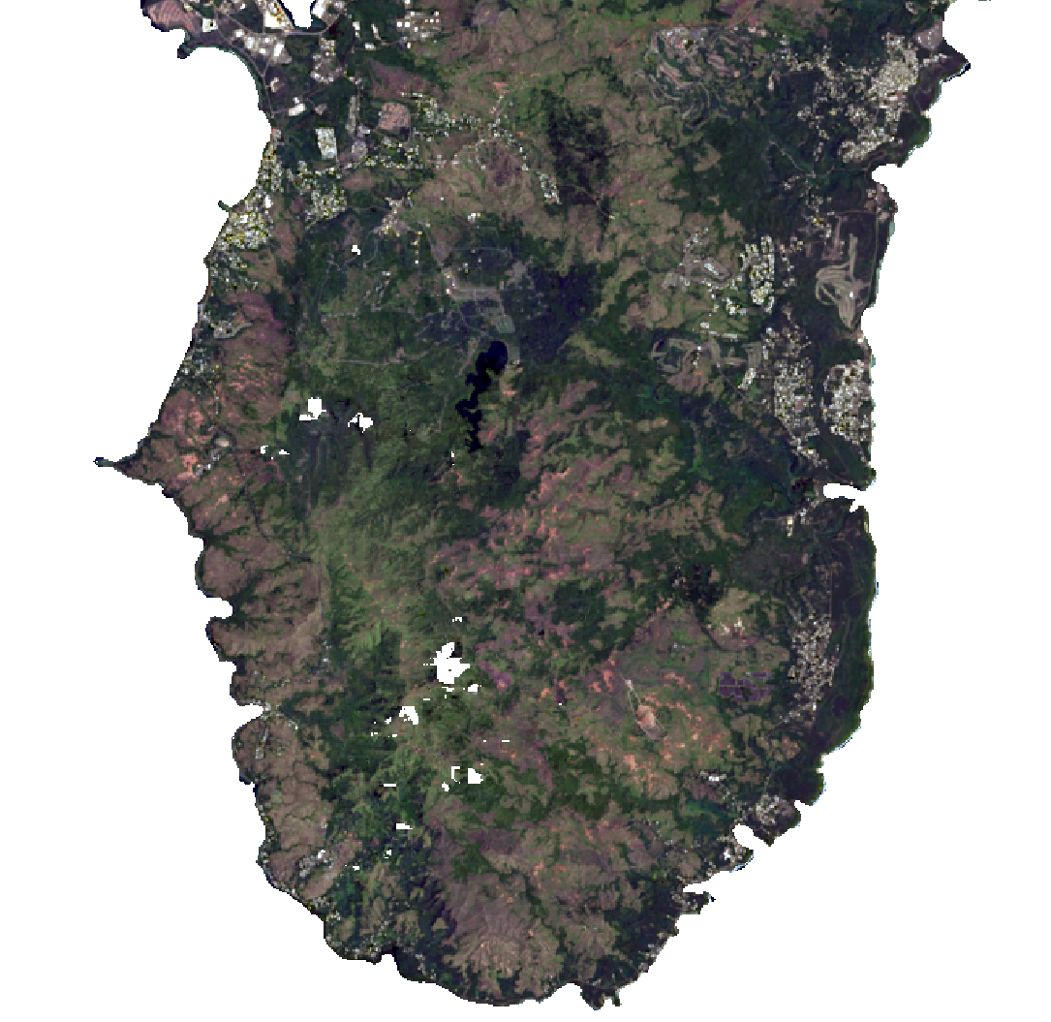
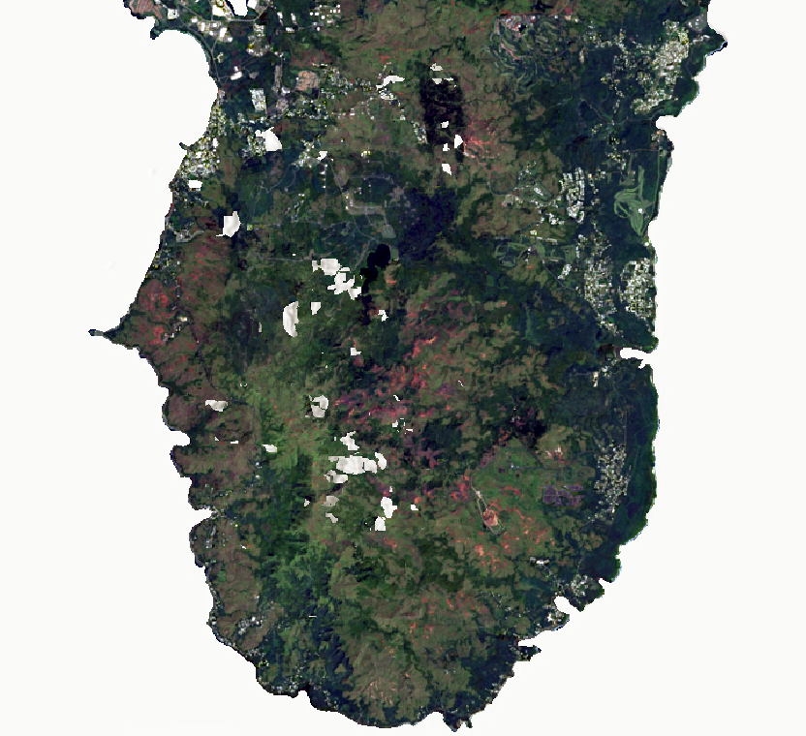
WERI GLE GHS Workshop 2026
Sulla Mathews 7
Mapping Challenges:
Spectral Variability & Seasonal Dynamics
Guam’s landscape shifts between dry season (Jan-June) of badlands & burn scar expansion and a wet season (July-December) of high vegetation vigor
LANDSAT 8, Dry Season 2025
Images obtained from Jan-June 2025
LANDSAT 8, Wet Season 2025
Images obtained from July-Dec 2025

Slide 8
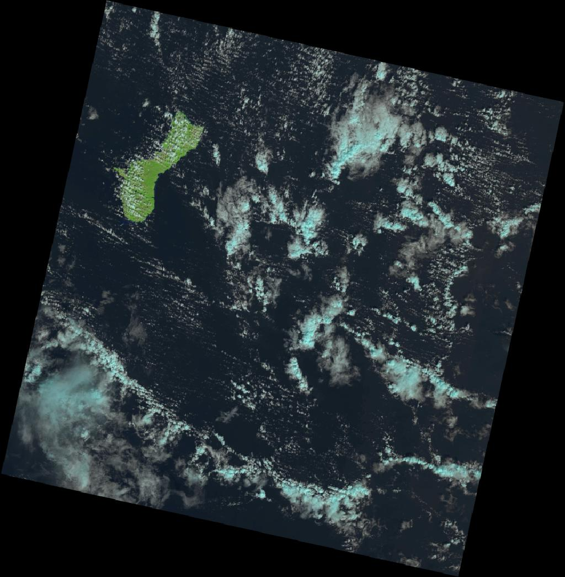
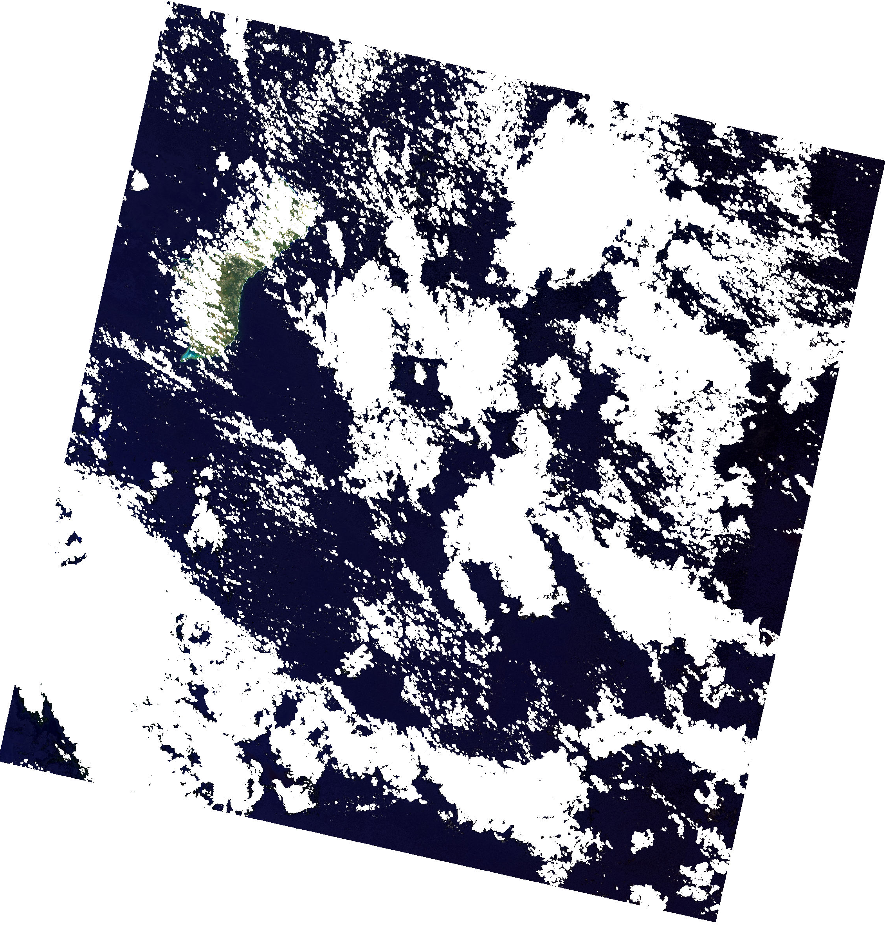
WERI GLE GHS Workshop 2026
Sulla Mathews 8
Workflow:
Automated Cloud Masking
QA Pixel
SR Matching
Use the Remap function on the Quality Assurance (QA) layer to remap all pixels to NoData except land and water.
Use the Clip function on the Surface Reflectance layer to match the SR layer to the QA layer, effectively removing most clouds and shadows
LANDSAT 8, 11 Nov. 2015

Slide 9
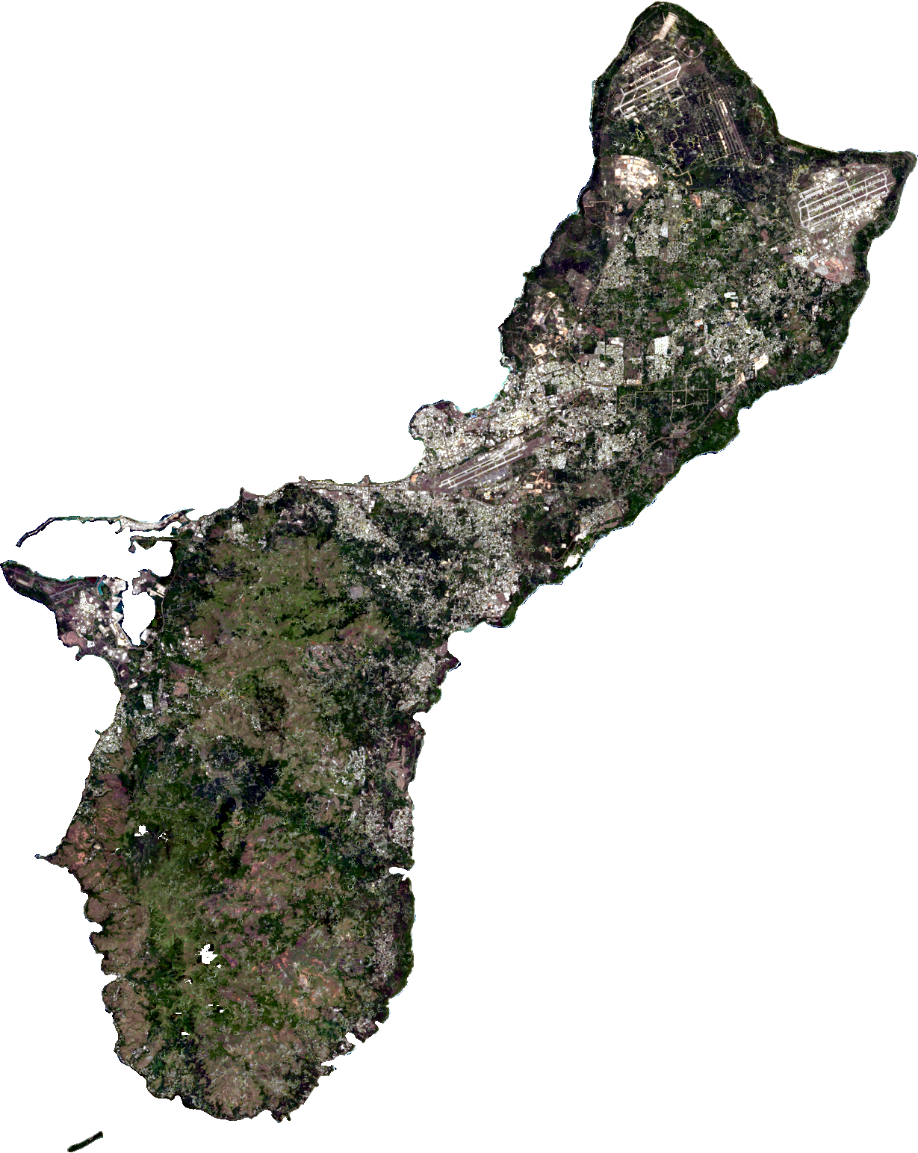
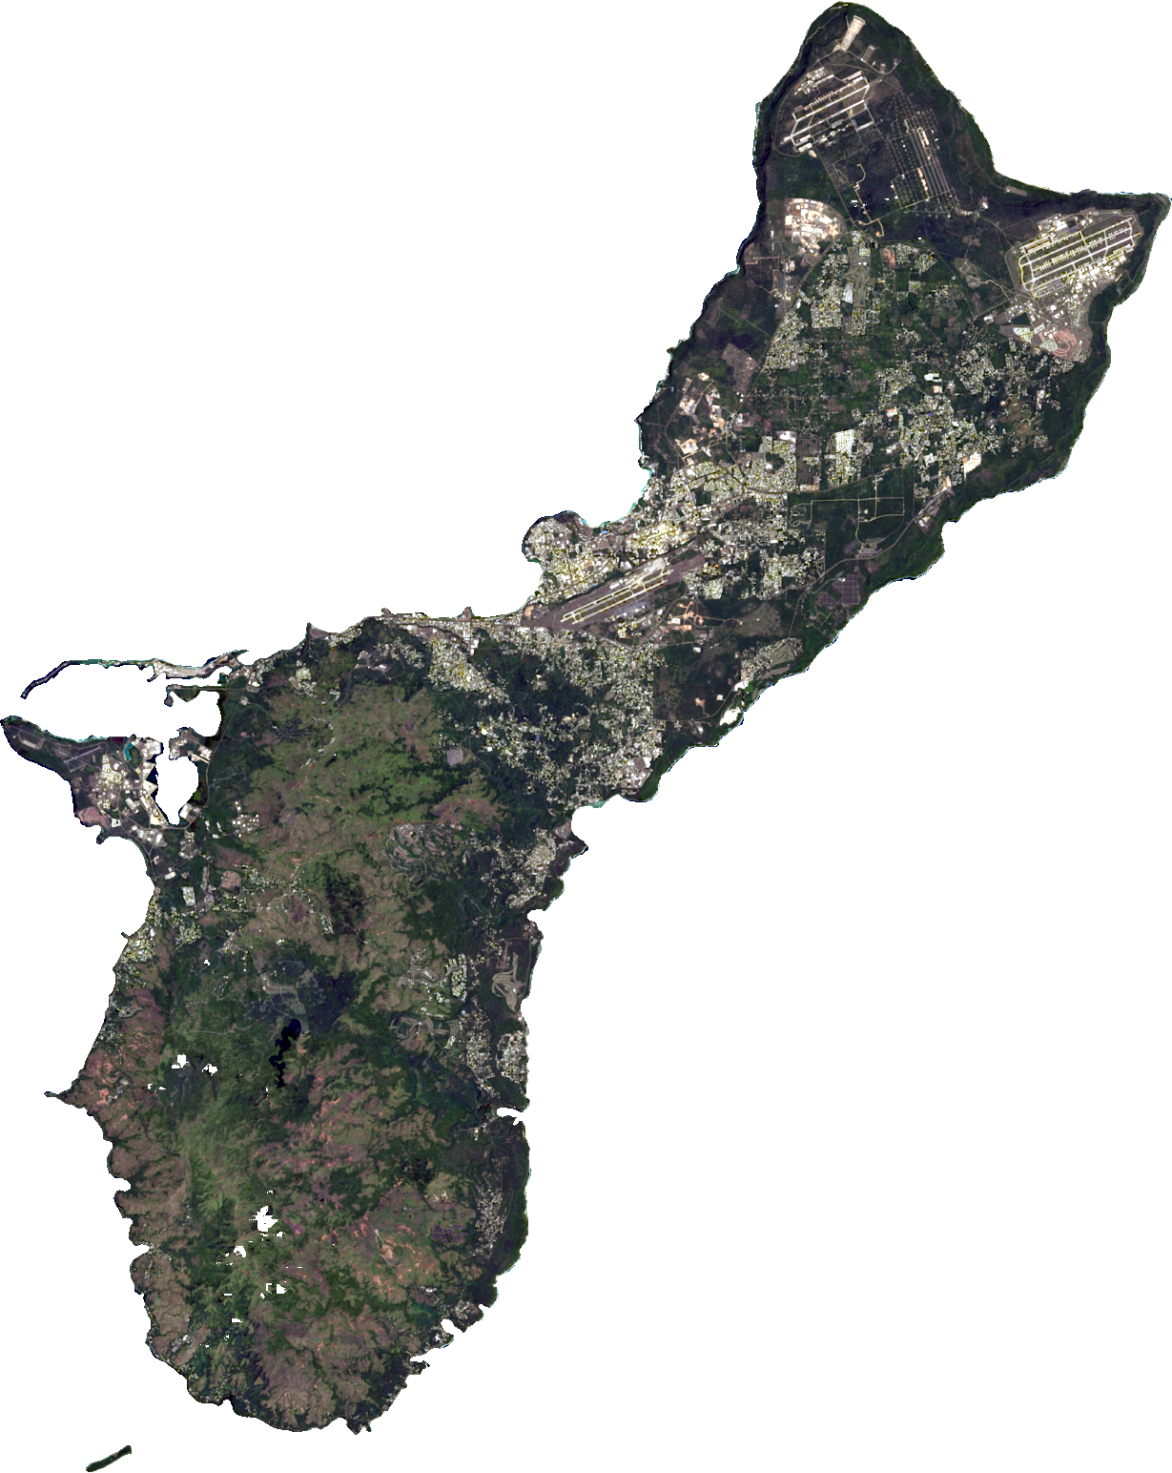
WERI GLE GHS Workshop 2026
Sulla Mathews 9
Workflow:
Manual Refinement
Polygon Clipping
Polygons are digitized manually to outline missed cloud “halos”, shadows, thin clouds
Mosaic without manual refinement (Landsat 8, 2025 Dry Season)
Mosaic with manual refinement (Landsat 8, 2025 Dry Season)
Mosaic without manual refinement (Landsat 8, 2025 Dry Season)
Mosaic with manual refinement (Landsat 8, 2025 Dry Season)

Slide 10
WERI GLE GHS Workshop 2026
Sulla Mathews 10
Supervised Classification
Using Support Vector Machine (SVM)
Base Training Set
Supplemental Training Set
Developed for stable classes (Forest, Water, Urban-Developed) to streamline process across years
Additional samples are added for classes that move or change such as burn scars or active construction sites (Urban-Undeveloped)

Slide 11
WERI GLE GHS Workshop 2026
Sulla Mathews 11
Dry Season
2025: 87% total accuracy, 0.85 Kappa
2020: 90% total accuracy, 0.89 Kappa
2015: 88% total accuracy, 0.86 Kappa
Supervised Classification
Accuracy Assessment Preliminary Results
Wet Season
Validation conducted through 50 random sampling points per class (7 classes) verified against high-resolution reference data
2025: 90.6% total accuracy, 0.89 Kappa
2020: 85.4% total accuracy, 0.83 Kappa
2012-2014: 81% total accuracy, 0.78 Kappa

Slide 12
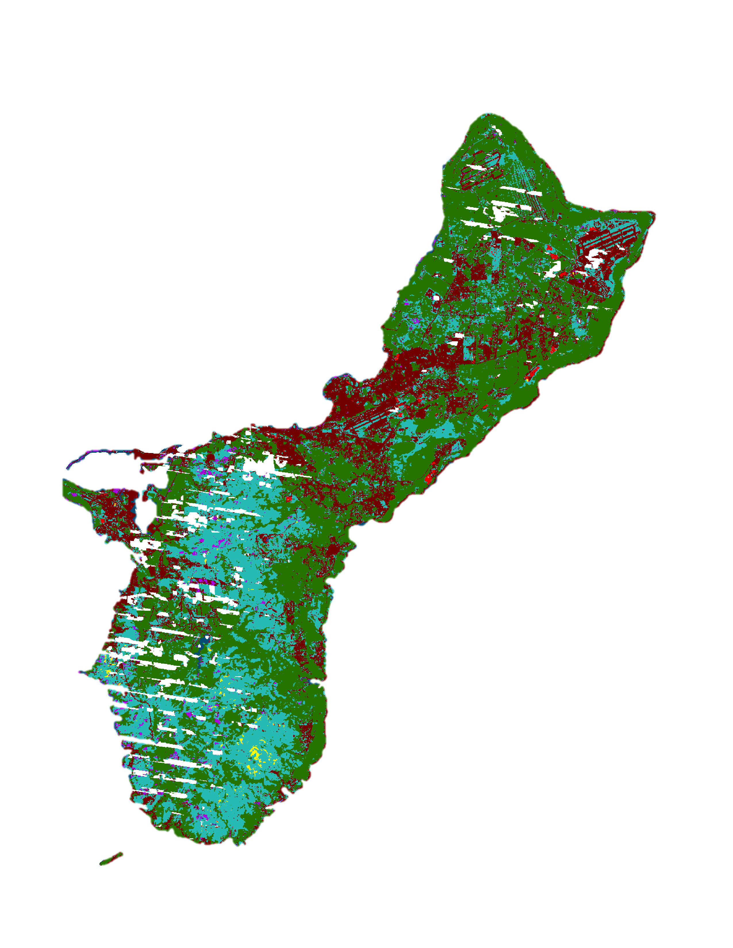
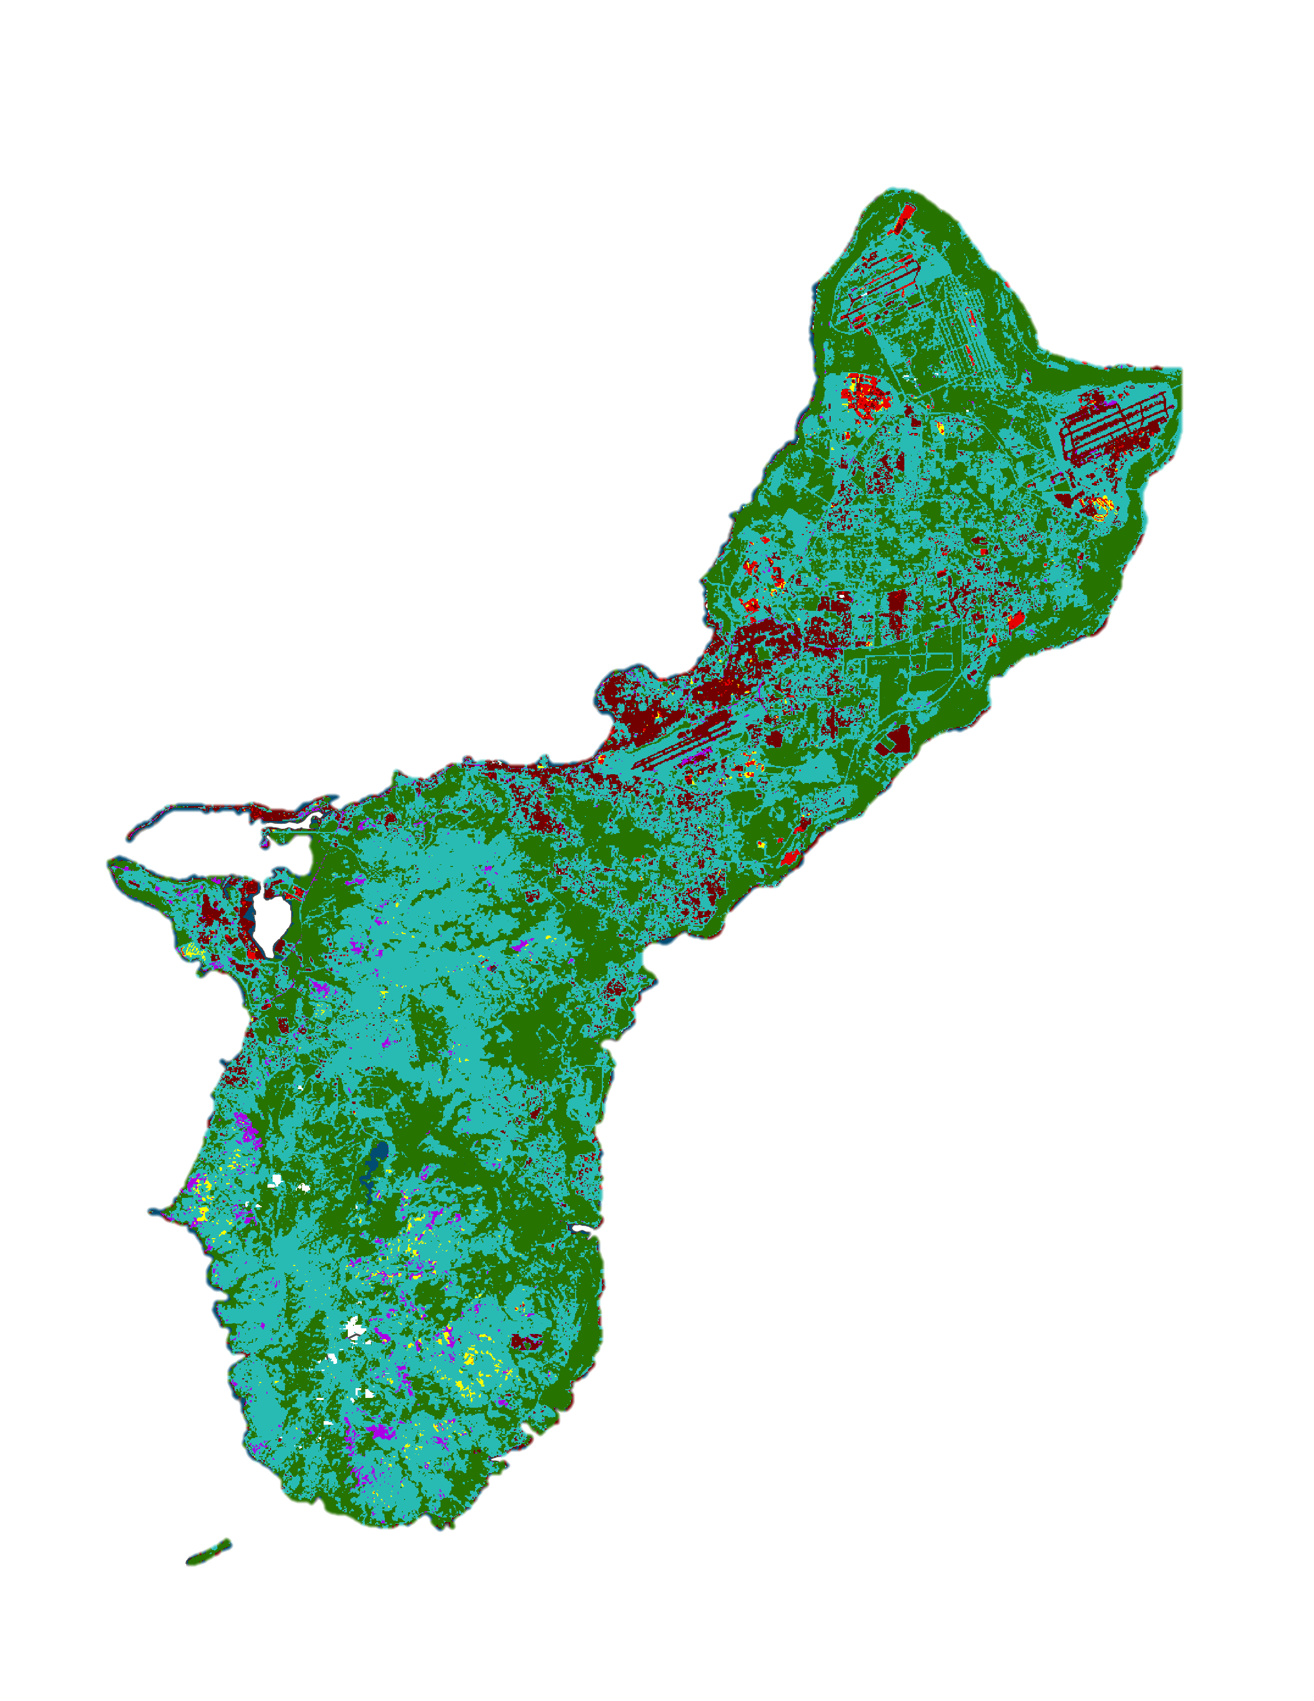
WERI GLE GHS Workshop 2026
Sulla Mathews 12
Land Cover Maps
Years/Season Completed | Not Enough Data
2025 (Dry + Wet) | 2008-2011 (Wet)
2024 (Dry + Wet) | 2004-2007 (Wet)
2023 (Dry + Wet) | 2000-2003 (Dry)
2022 (Dry + Wet)
2021 (Dry + Wet)
2020 (Dry + Wet)
2019 (Dry + Wet)
2018 (Dry + Wet)
2017 (Dry + Wet)
2015 (Dry + Wet)
2012-2014 (Dry + Wet)
2008-2011 (Dry)
2004-2007 (Dry)
2000-2003 (Dry)
2004-2007 Dry Season (Jan-June)
2025 Dry Season (Jan-June)
25 Land Cover Maps completed with overall accuracy >80% (as of Sept. 2026)
Limitations:
2000-2014: Multi-year mosaics (3-4 years)

Slide 13
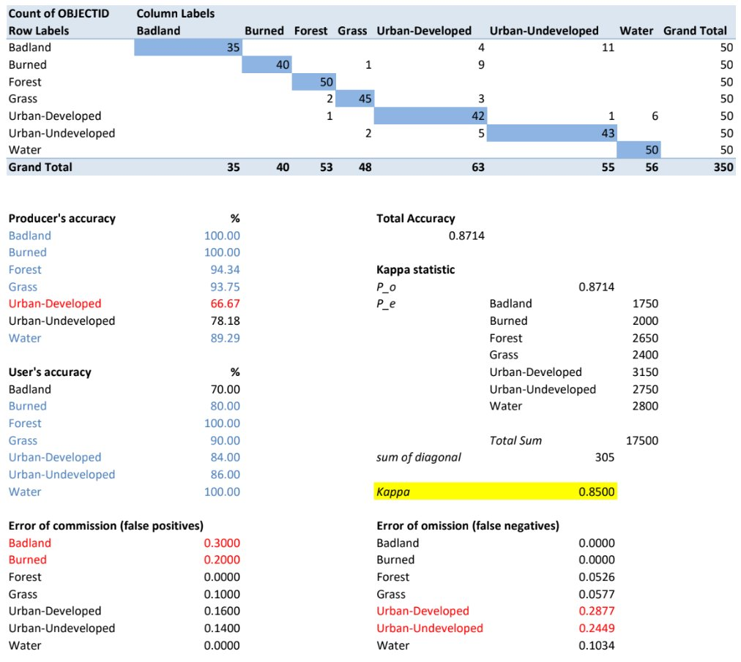
WERI GLE GHS Workshop 2026
Sulla Mathews 13
Supervised Classification
Dry Season Matrices
Dry Season 2025
Columns: Ground Truth
Rows: Classified by SVM
Error of commission: overestimation – the classifier is seeing more of a class than there is
Error of omission: left out – the classifier misclassified a pixel for another class
Classifier correctly identified all badland random samples, but also falsely classified several other classes as badlands as well

Slide 14
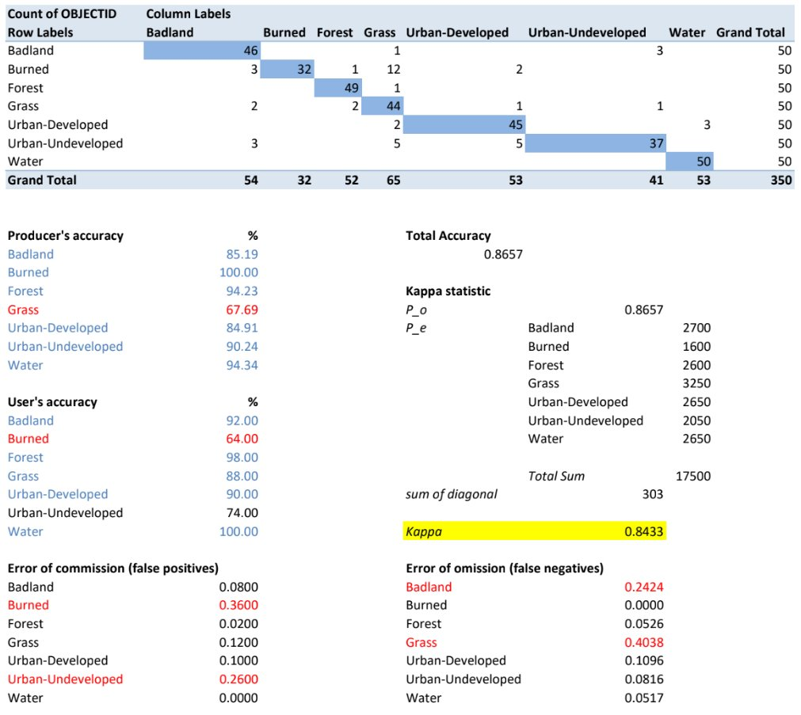
WERI GLE GHS Workshop 2026
Sulla Mathews 14
Supervised Classification
Dry Season Matrices
Dry Season 2000 - 2003
Columns: Ground Truth
Rows: Classified by SVM
Error of commission: overestimation – the classifier is seeing more of a class than there is
Error of omission: left out – the classifier misclassified a pixel for another class
Classifier under classified the target category – while highly accurate, it also missed other badlands found across the map

Slide 15
GUAM ACM 2026
Sulla Mathews 15
Why does this mapping matter?
Camp Blaz
The Finegayan Basin comprises only 7% of the NGLA’s total surface area
Extensive buildup activities in the basin
From 18 wells operated by Guam Waterworks Authority (GWA) and the Naval Facilities Engineering Command (NAVFAC), the basin supplies ~15% of the aquifer’s total production
62.5% of wells in the basin show significant increase trends in chloride levels
By creating accurate annual maps, correlations between rapid urbanization and rising chloride levels can be quantified – providing a technical foundation for land-water resource management in Guam
Image 4. Map of Study Area, Finegayan Basin

Slide 16
WERI GLE GHS Workshop 2026
Sulla Mathews 16
Next Steps
Camp Blaz
The Finegayan Basin comprises only 7% of the NGLA’s total surface area, supplies ~15% of total aquifer production
Recent study found 62.5% of wells in the Finegayan Basin show significant increase trends in chloride levels
By creating accurate annual maps, correlations between rapid urbanization and rising chloride levels can be quantified – providing a technical foundation for land-water resource management in Guam
Image 4. Map of Study Area, Finegayan Basin

Slide 17






Thank you!
Nicole Sulla Mathews
Research Assistant III
+1-671-735-2685
mathewsn@triton.uog.edu
This research is partially funded by U.S. Geological Survey National Water Resource Institute 104(B) Program, and Guam Hydrological Survey.
Dr. Yuming Wen, GISP
Advisor, Professor of GIS
+1-671-735-2687
ywen@triton.uog.edu
Water and Environmental Research Institute of the Western Pacific, University of Guam
https://weri.uog.edu | https://guamhydrologicsurvey.uog.edu
Slide Template provided by SlidesCarnival
USGS LANDSAT 8 (2020). USGS Earth Explorer https://earthexplorer.usgs.gov/

