Slide 1



Nitrate-N Solute Transport Model of the Tomhom Basin, Northern Guam Lens Aquifer
Atasha Bautista, Jovic A. Cassi, Mary Clare Snaer, Todd Wood, and Dr. Nathan Habana
Notes:
Good morning, everyone! My name is Atasha Bautista, and I work with Dr. Nathan Habana, Jovic Caasi, Mary Clare Snaer, and Todd Wood as part of the modeling team. Today, I’ll be presenting our work on the nitrate-N solute transport model of the Tomhom Basin, which is now published as WERI Technical Report 191.

Slide 2
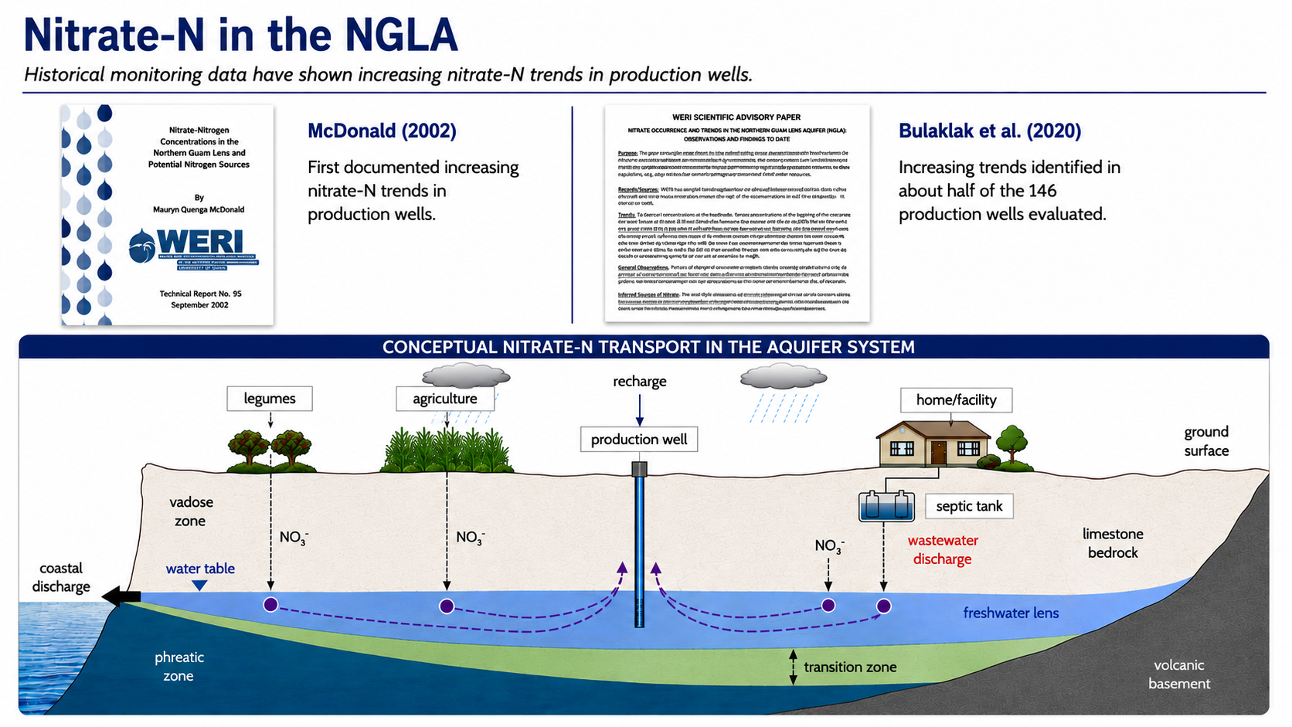
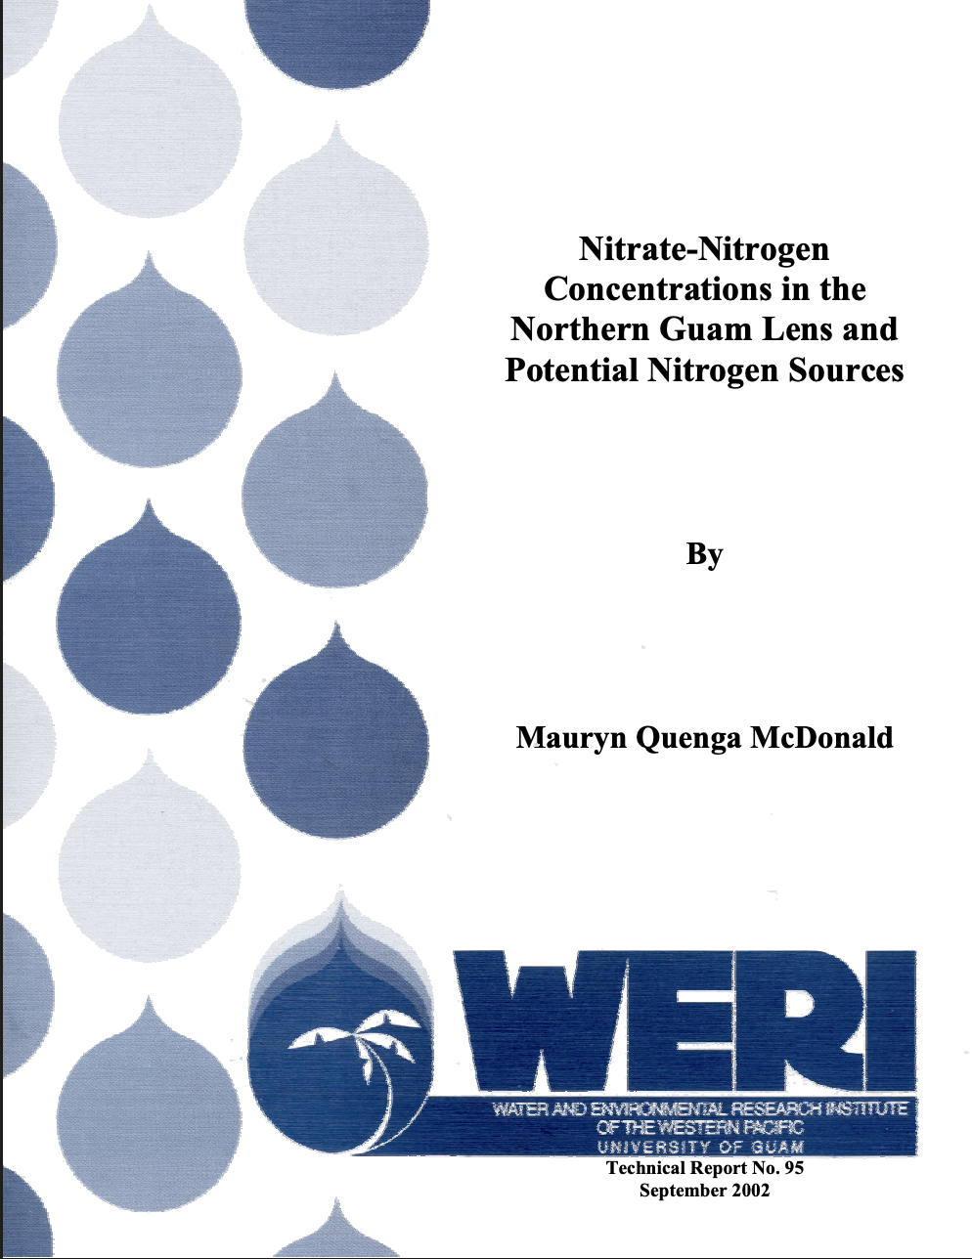


Notes:
Nitrate-N is widely used as an indicator of groundwater contamination.
Historical monitoring data have shown increasing nitrate-N trends in production wells, first documented by McDonald in 2002 and later by Bulaklak in 2020, who found increasing trends in about half of the 146 production wells studied.
Nitrate can originate from both natural and human-related sources. Natural sources include legumes and decomposing organic matter, while additional inputs can come from agricultural activities and wastewater. Nitrate generally forms when nitrogen from these sources enters the system and undergoes processes such as ammonification and nitrification. When nitrates inputs exceed the natural uptake, excess nitrate can leach into the groundwater.
One potential contributor to the increasing nitrate-N trends observed in production wells is wastewater discharge, particularly from septic systems. These concerns led to the request for solute transport modeling to better understand nitrate movement within the aquifer.

Slide 3
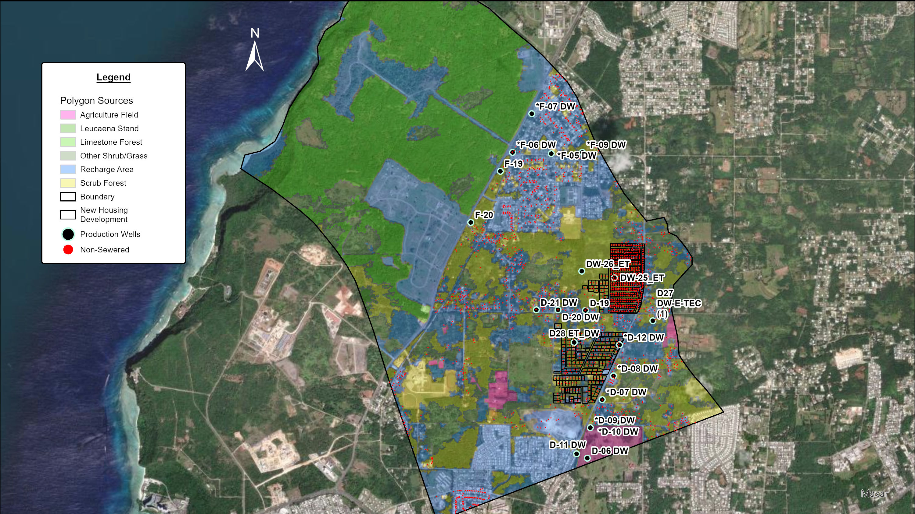
GIS Files
Polygon sources adapted from vegetation landcover (Wen, 2006)
Non-sewered data adapted from GWA and Habana & Heitz (2006)
New housing development (Parcel Map, DLM, 2005)
Notes:
In response, the modeling team developed a pilot nitrate-N solute transport model for the Swamp Road area, which spans from parts of Astumbo to Old South Finegayan.

Slide 4
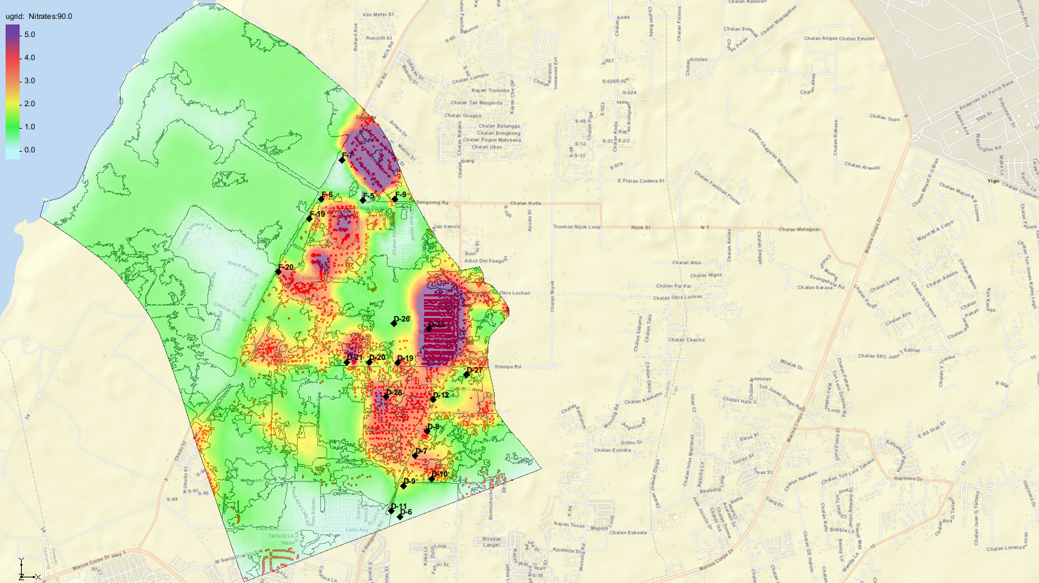
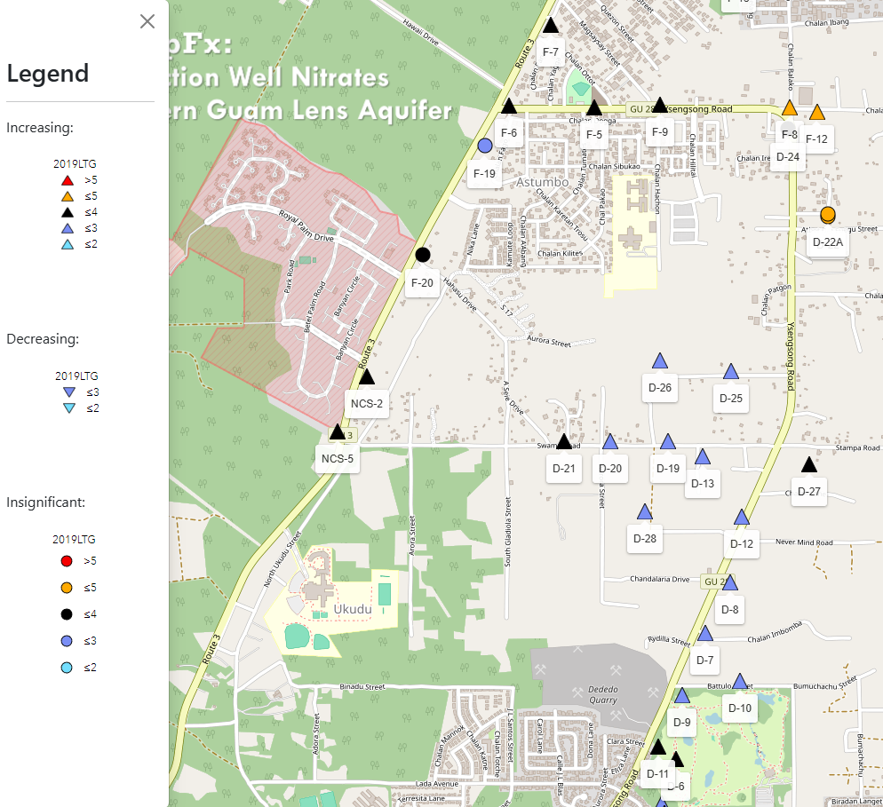

Valerio et al., 2023, MAppFx: Production Well Nitrates
Notes:
The full technical report for this pilot study is available through the Guam Hydrologic Survey and WERI websites.
For this study, one of the scenarios looked at septic systems within a planned residential development in the Swamp Road area. The simulation included newly proposed residential parcels, with one-eighth-acre lots in the upper portion of the study area and 0.44-acre lots, or just under half an acre, in the lower portion.
This pilot study then served as the basis for the nitrate-N solute transport model developed for the Tomhom Aquifer Basin. If you’re interested in learning more about the study, you can scan the QR code shown here.

Slide 5
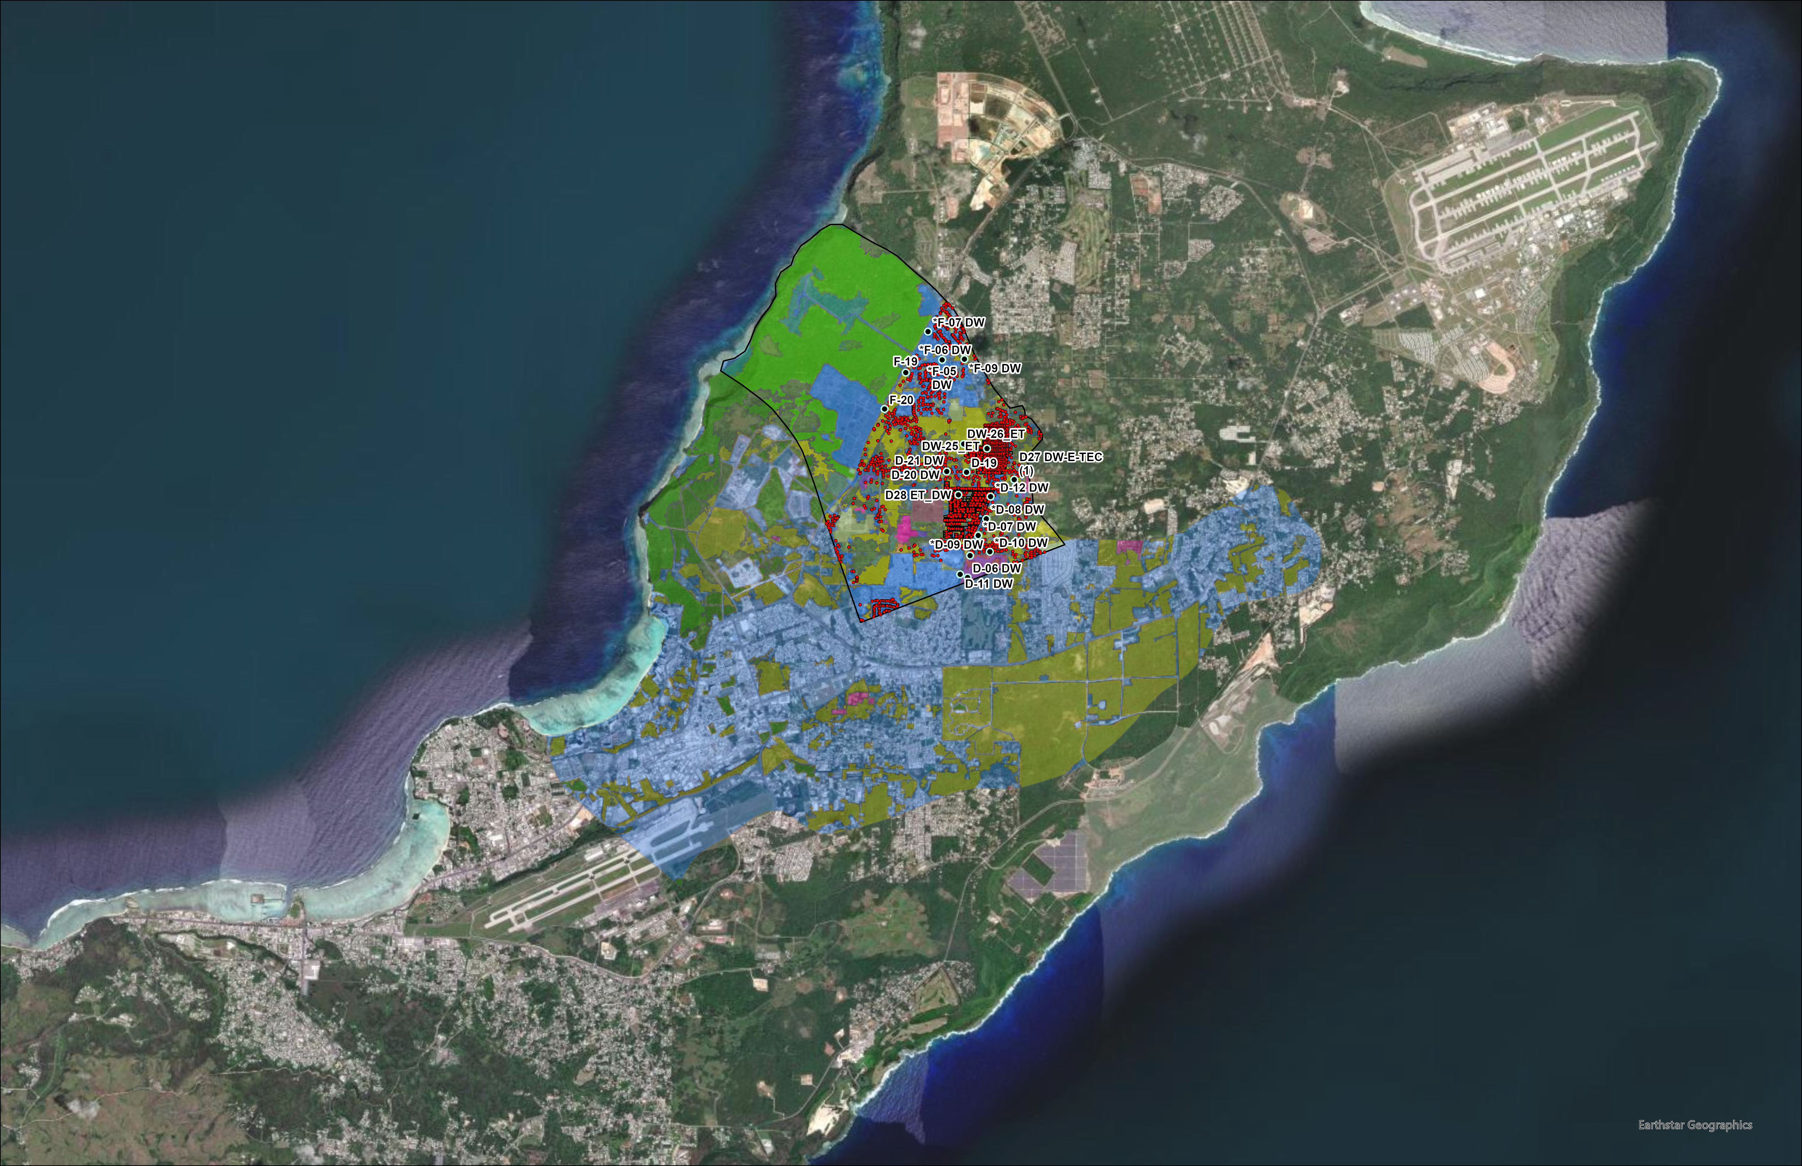
Notes:
Building on our pilot study, we expanded the analysis to a larger area.

Slide 6

Notes:
This area is the Tomhom Basin. A technical report has also been prepared for this study, which you can refer to for more detailed information.

Slide 7
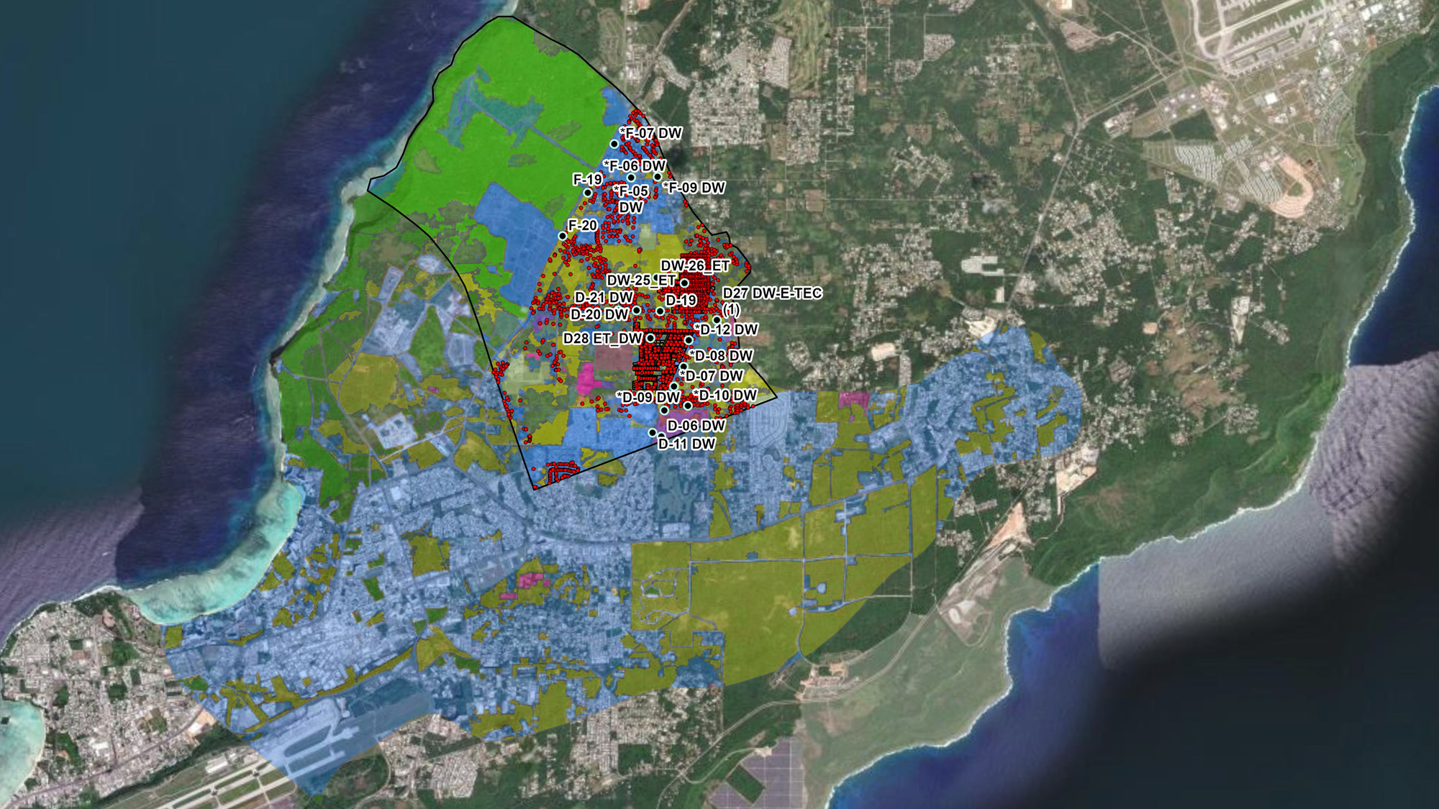
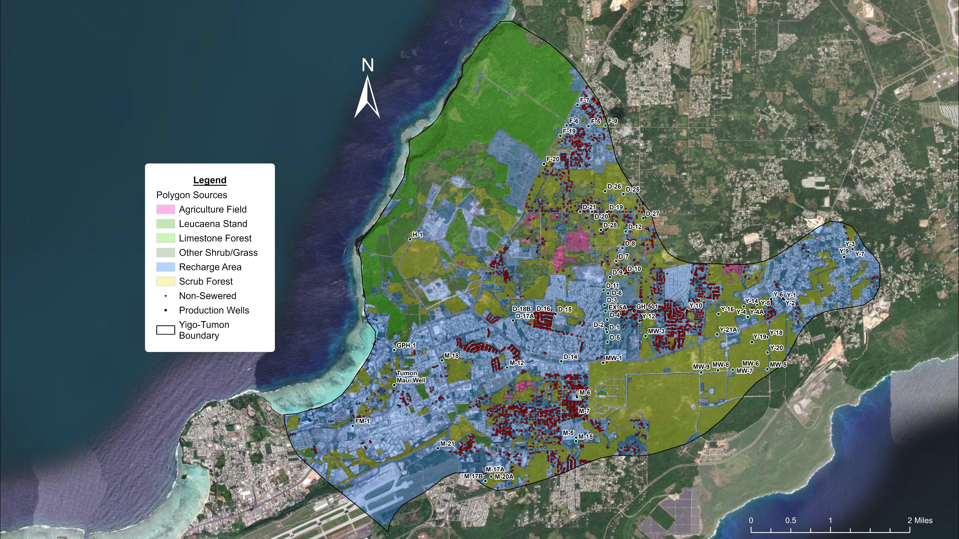
GIS Files
Polygon sources adapted from vegetation landcover (Wen, 2006)
Non-sewered data adapted from GWA and Habana & Heitz (2006)
Notes:
For this model, we compiled data on potential nitrogen sources across the basin. Land-cover data from 2006 were used to represent area-based sources, such as agriculture and legumes. For potential septic locations, we used the 2006 septic tank survey by Habana and Heitz, along with GWA unsewered water-meter data.

Slide 8
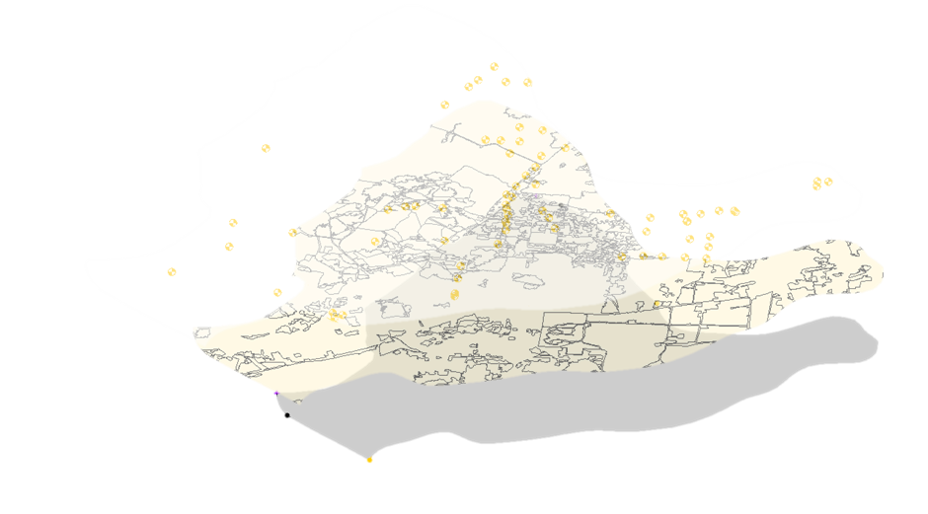

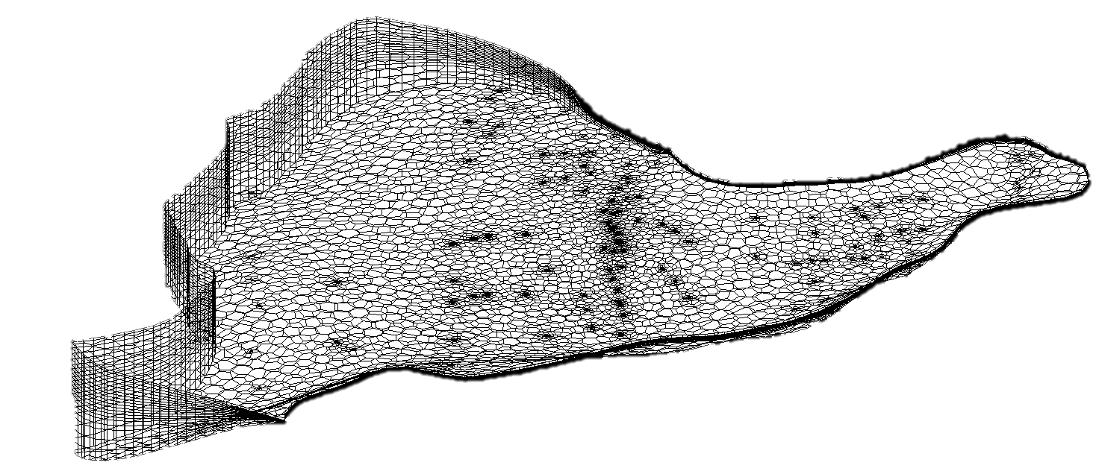
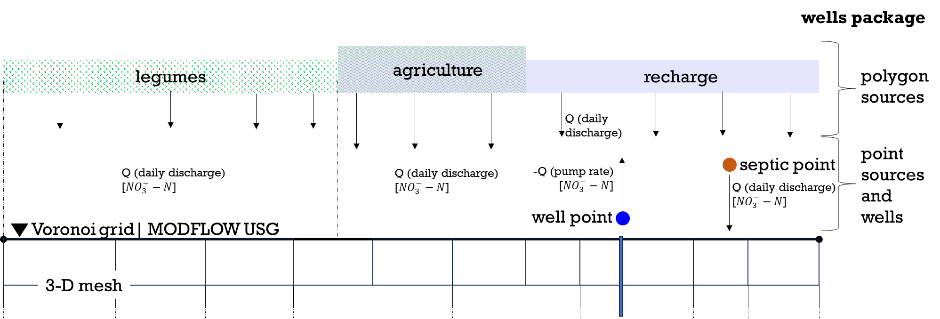
Esri ArcGIS Pro
Aquaveo GMS
② Create Conceptual Model Coverages
③ Generate UGrid
① GIS Shapefiles
boundary
wells
polygon source
point source
Import
④ Configure MODFLOW Packages
Notes:
This figure provides a general overview of how the solute transport model was developed.
We first prepared the shapefiles in ArcGIS Pro, including the model boundary, production wells, and potential nitrate sources. These files were then imported into the Groundwater Modeling System, or GMS, which was the main software used to build model.
Within GMS, we converted the shapefiles into conceptual model coverages and generated the 3-D Voronoi mesh grid. We then used MODFLOW-USG Transport as the numerical modeling code to simulate groundwater flow and solute transport.
Using the different MODFLOW packages, we assigned flow rates and nitrate-N concentrations to the nitrate sources, while production wells were assigned their average pumping rates.
In modeling, we try to bring in hydrologic values and boundaries from the real world (such as pump rate and well depth). Where data was unavailable, we used reasonable assumptions—for example, a household of six using 60 gallons per person per day, discharged through a septic system.
Once these inputs were established, we were able to run the different nitrate-N transport scenarios.

Slide 9
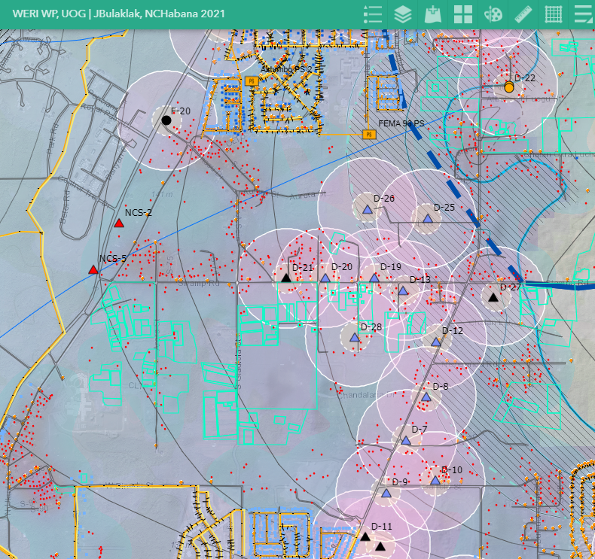
Results and Discussions
Scenario 1 – Natural and Agriculture + Wells off
Scenario 2 – Natural and Agriculture + Wells on
Scenario 3 – Natural and Agriculture + Septic + Wells on
Notes:
So, for the results, we ran 3 model objectives, as 3 scenarios with varying conditions.
Scenario 1 – Natural (meaning legumes, tangantangan) and Agriculture + Wells off
Scenario 2 – Natural and Agriculture + Wells on
Scenario 3 – Natural and Agriculture + Septic + Wells on
I'll briefly summarize the key takeaways from each model results.

Slide 10
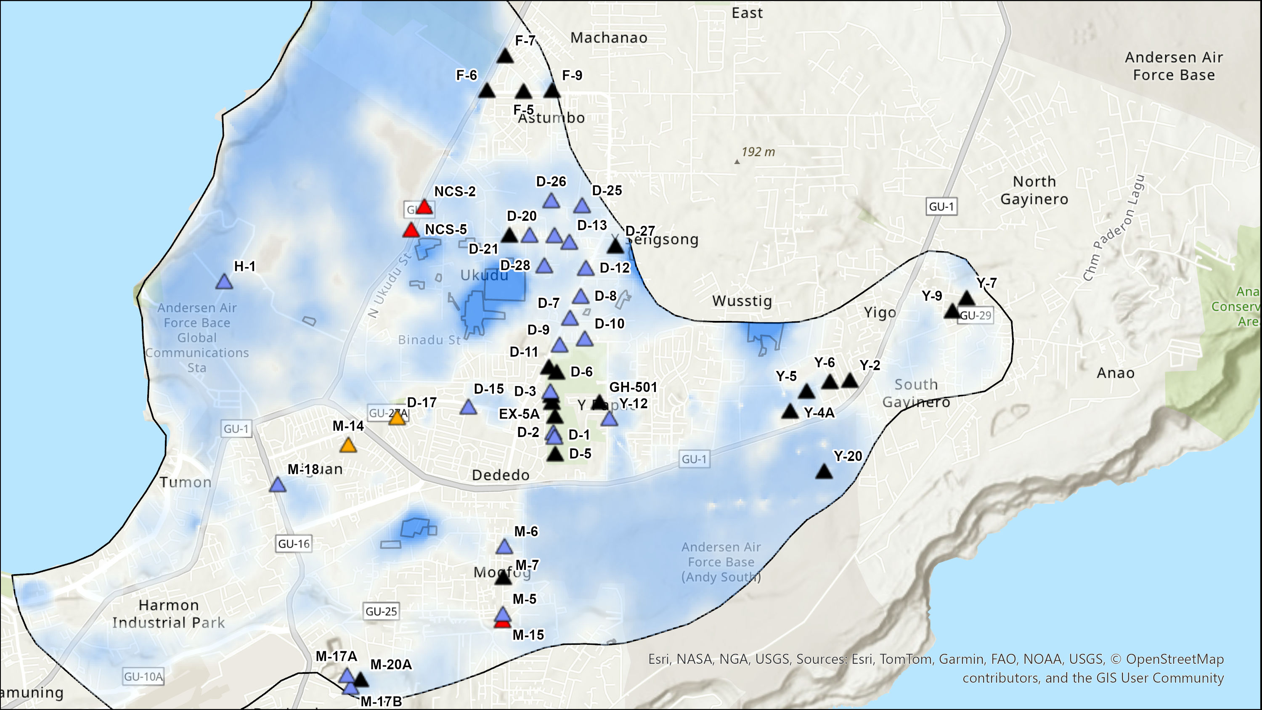
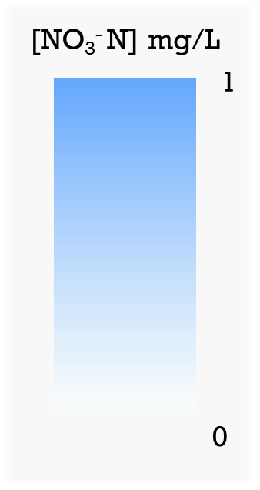
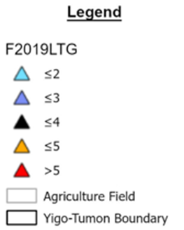
Scenario 1
Polygons: legumes, agriculture, recharge
No pumping
No septic tanks and no pumping scenario
Notes:
In Scenario 1, we focused on nitrate-N from natural and agricultural sources, with no septic inputs and no groundwater pumping.
The scale on the left shows the nitrate-N concentrations, ranging from 0 in white to 1 mg/L in blue.
The triangles represent Ms. Bulaklak’s observed nitrate-N trends in production wells. We included these as a reference to compare the observed concentrations with our simulated results.
In this scenario, the model shows concentrations up to about 1 mg/L in areas influenced by legumes and agriculture, while areas designated as recharge show concentrations near zero.

Slide 11
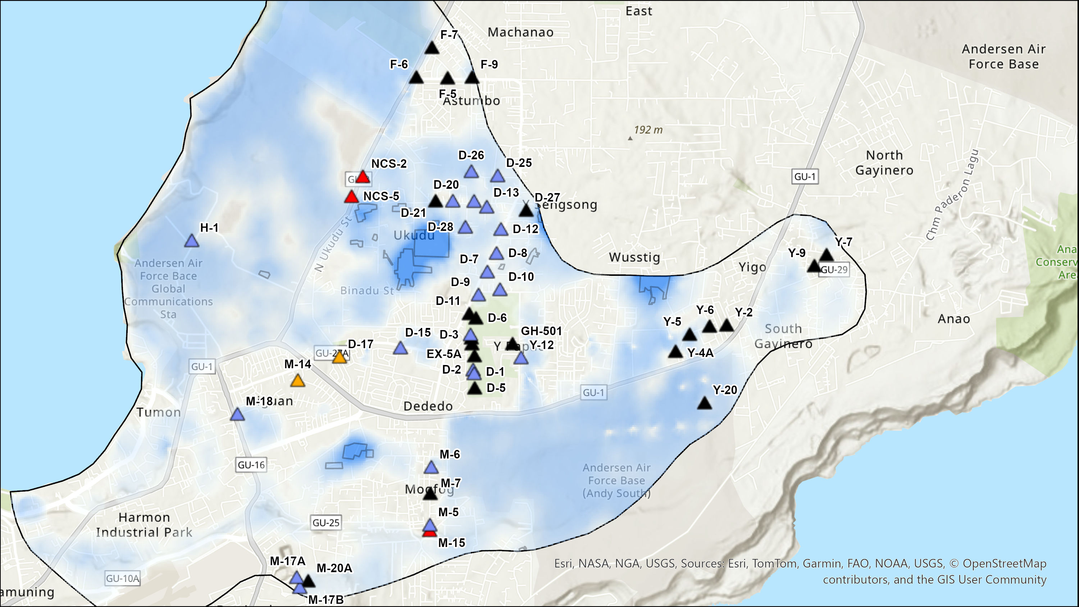
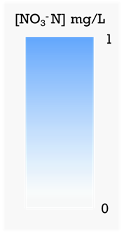
Scenario 2
Polygons: legumes, agriculture, recharge
Pumping on
No septic tanks and pumping scenario
Notes:
Here's scenario 2, similar to scenario 1 but with the wells activated.
Overall, there isn’t a major difference. The similarity between the two scenarios showed that pumping had minimal effect on the overall nitrate-N distribution under these conditions.

Slide 12
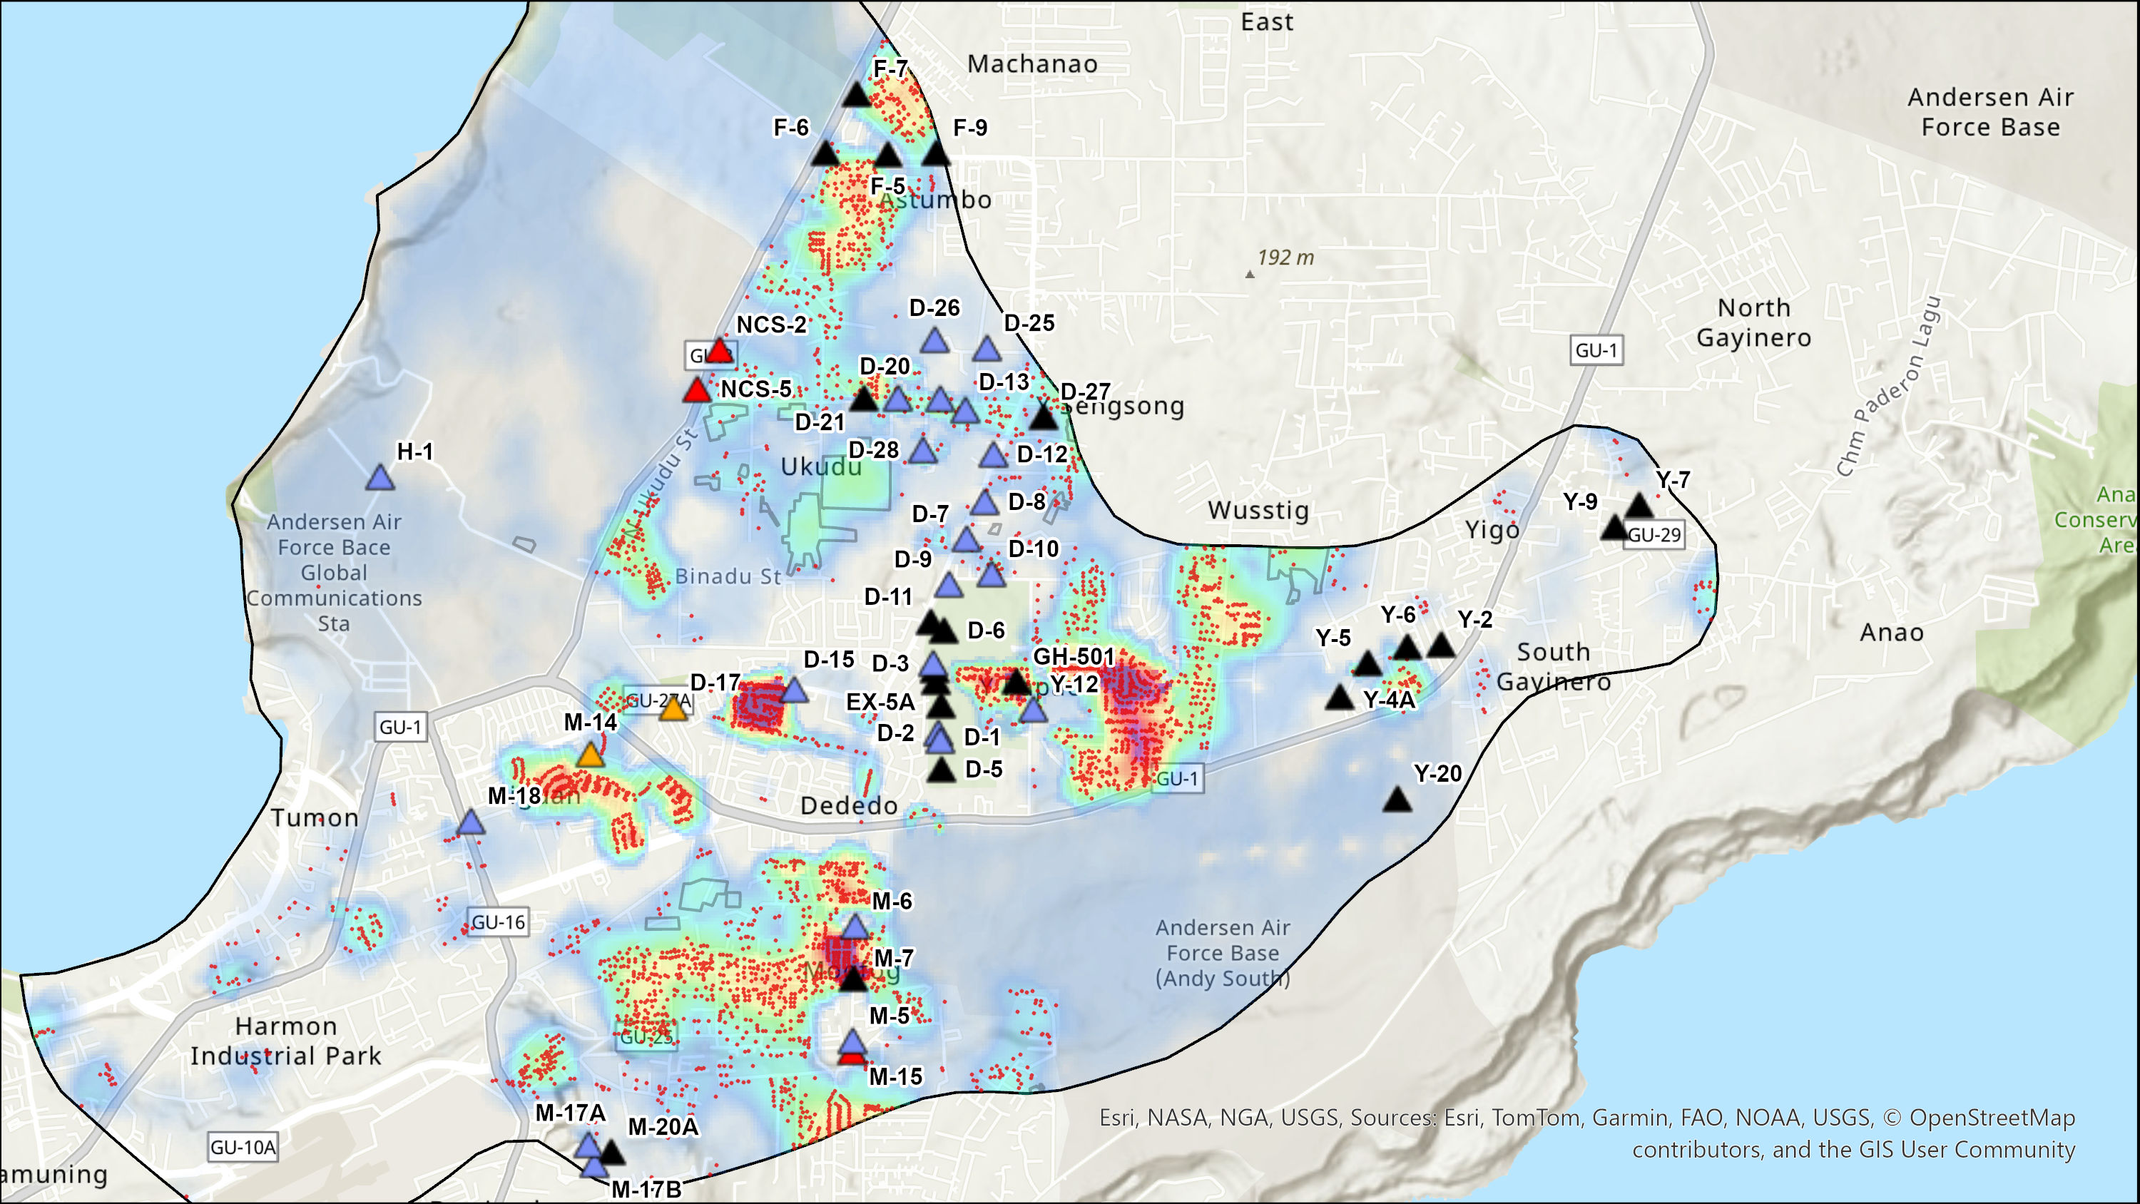
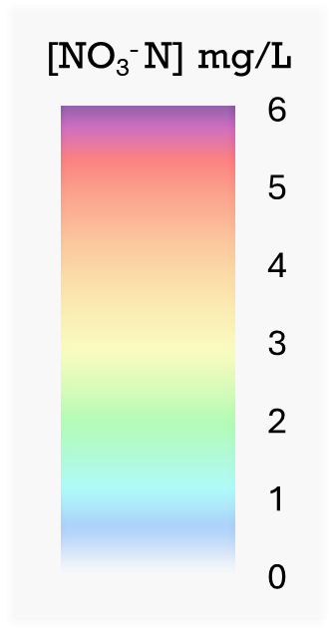
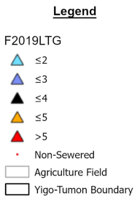
Scenario 3
Polygons: legumes, agriculture, recharge
Points: septic tanks
Pumping on
Notes:
Scenario 3 builds upon Scenario 2 by adding septic systems as a source of nitrate-N loading.
The scale on the left shows the nitrate-N concentrations, ranging from 0 in white to 6 mg/L in purple.
One notable finding is that septic sources can produce localized dispersion and advection of elevated nitrate-N concentrations. The plumes extend from residential areas with higher densities of non-sewered households toward nearby production wells, suggesting that septic systems can contribute to increased nitrate-N concentrations.
Interestingly, N-nitrogen concentrations near the production wells west of GH-501 and Y-12. This result is expected because the golf course was represented as a recharge area in the current model, and potential nitrate-N contributions from golf course management practices were not included.
However, I do want to preface that we did notice a discrepancy in the data used to identify residential areas as non-sewered, which is an important limitation of the current model.

Slide 13
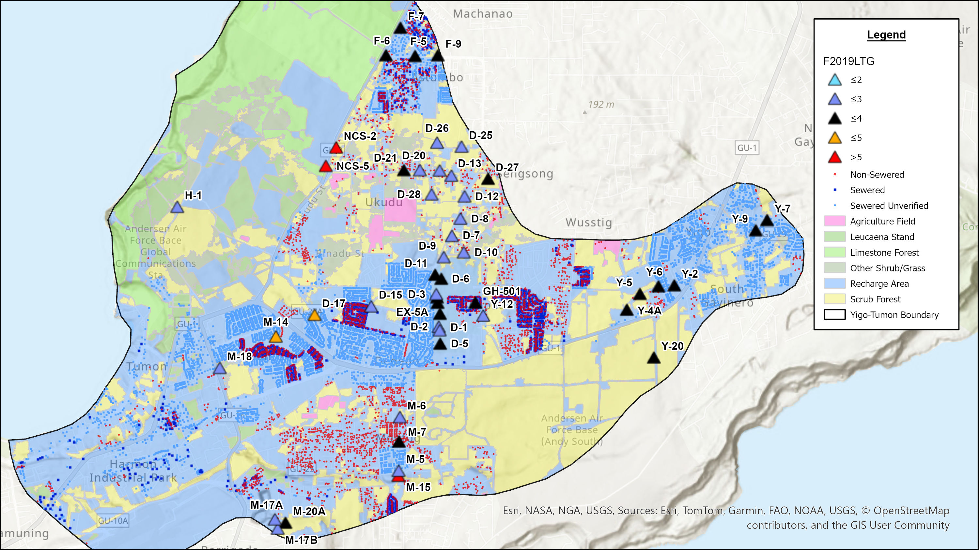
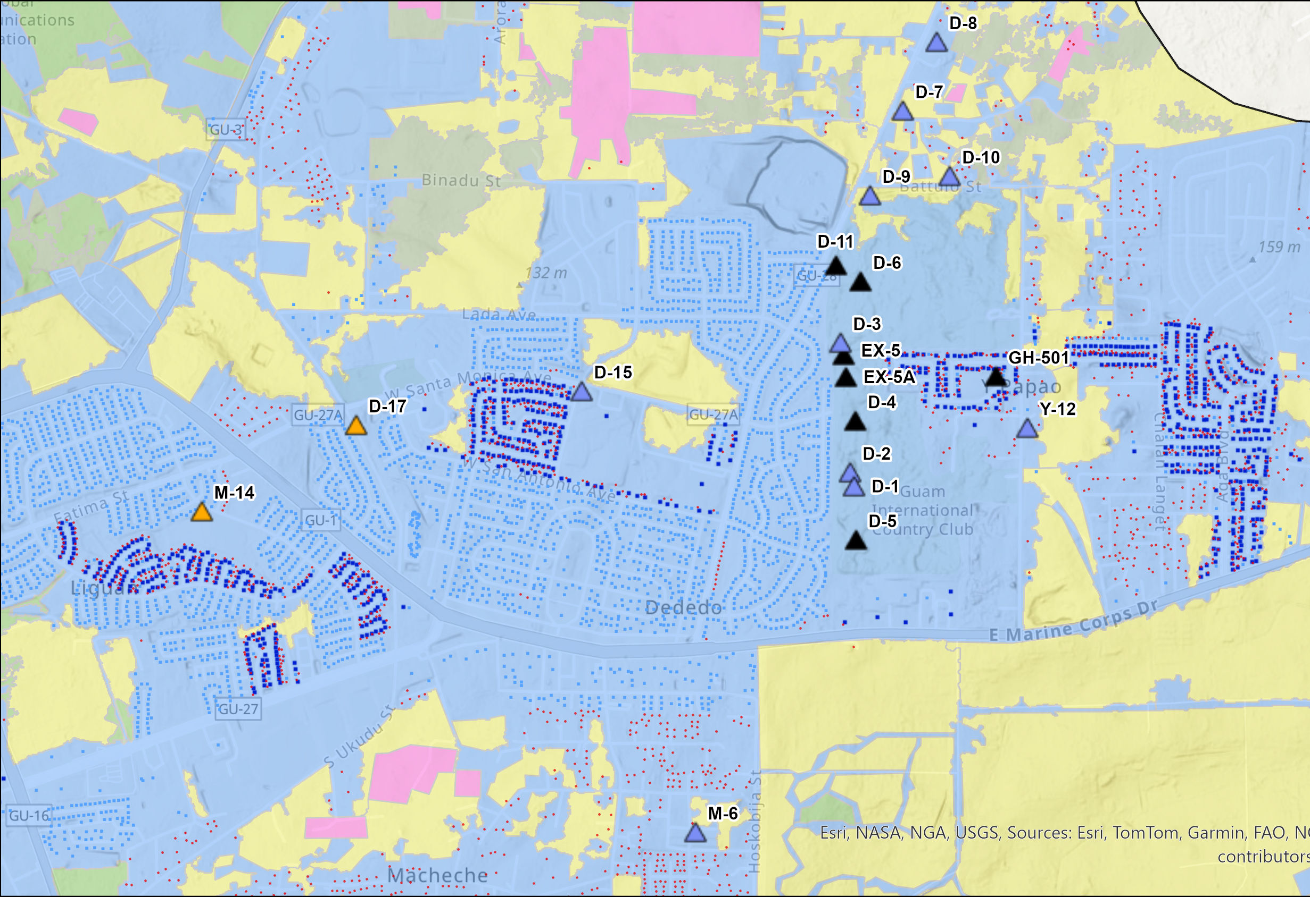
Notes:
In the unsewered water-meter data obtained, some homes identified as unsewered in the dataset were actually connected to the sewer system, particularly in areas such as Liguan, Ypao, and Kaiser. (CLICK)
This shows us the importance of verifying these data points to better represent the actual conditions in the model. Moving forward, an updated density map and verification of residential sewer-system status would help improve the accuracy of the model. When updated GIS data are available, we would be interested in obtaining those data, updating the model inputs, and rerunning the simulations.

Slide 14
Limitations
Assumptions in Modeling
  Estimated flow rates and nitrate-N concentrations
  Hydraulic properties and dispersivity values from regional studies
Data Availability
  Land cover classifications
  Septic data points
Notes:
Solute modeling gives us valuable insight into how nitrate may reach our production wells, but it is also comes with limitations.
The model parameters involve a degree of assumptions, including estimated flow rates, nitrate concentrations, and hydraulic and dispersivity values derived from regional studies.
We are also limited by the availability of data, particularly in land cover and septic system locations.

Slide 15

Thank you!
Any Questions?
Notes:
As we wrap up today's presentation, if you're interested in staying informed about our research or have any further questions, please feel free to reach out using the contact information provided.
Thank you!

Slide 16
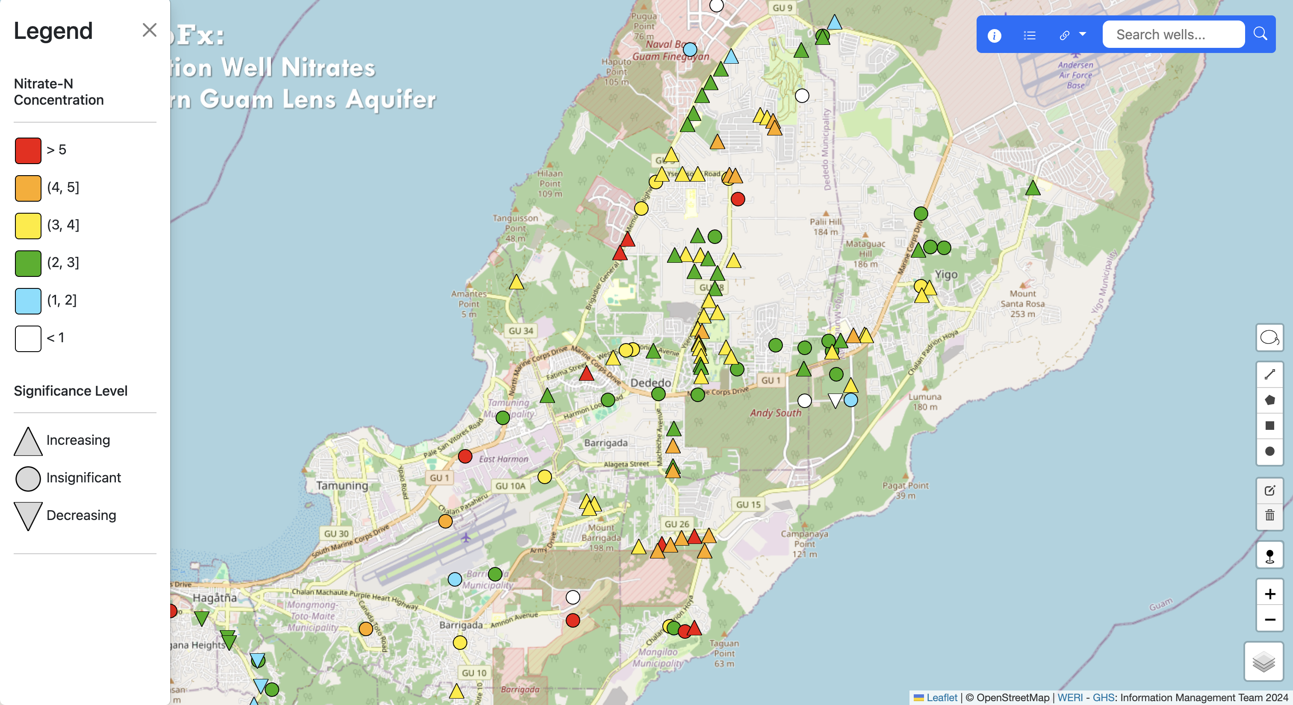

Notes:
Before I end my presentation, I want to highlight again this important tool for examining nitrate-N concentrations in production wells. As highlighted in Ms. Valerio’s presentation, this is MAppFx for production-well nitrates in the NGLA.
Ms. Valerio used the work by Bulaklak in 2020 to develop this interactive visualization tool. MAppFx presents nitrate-N concentrations spatially across the NGLA, and each well is linked to a time-series graph, making it easier to examine changes and trends over time.
Previously, the nitrate-N data available through MAppFx extended through 2019. These records have now been updated through the end of 2026, and the Linear Trend Group analysis established by Bulaklak was applied to the updated data.
If you're interested in exploring, you can scan the QR code here to access the interactive map directly.

Slide 17
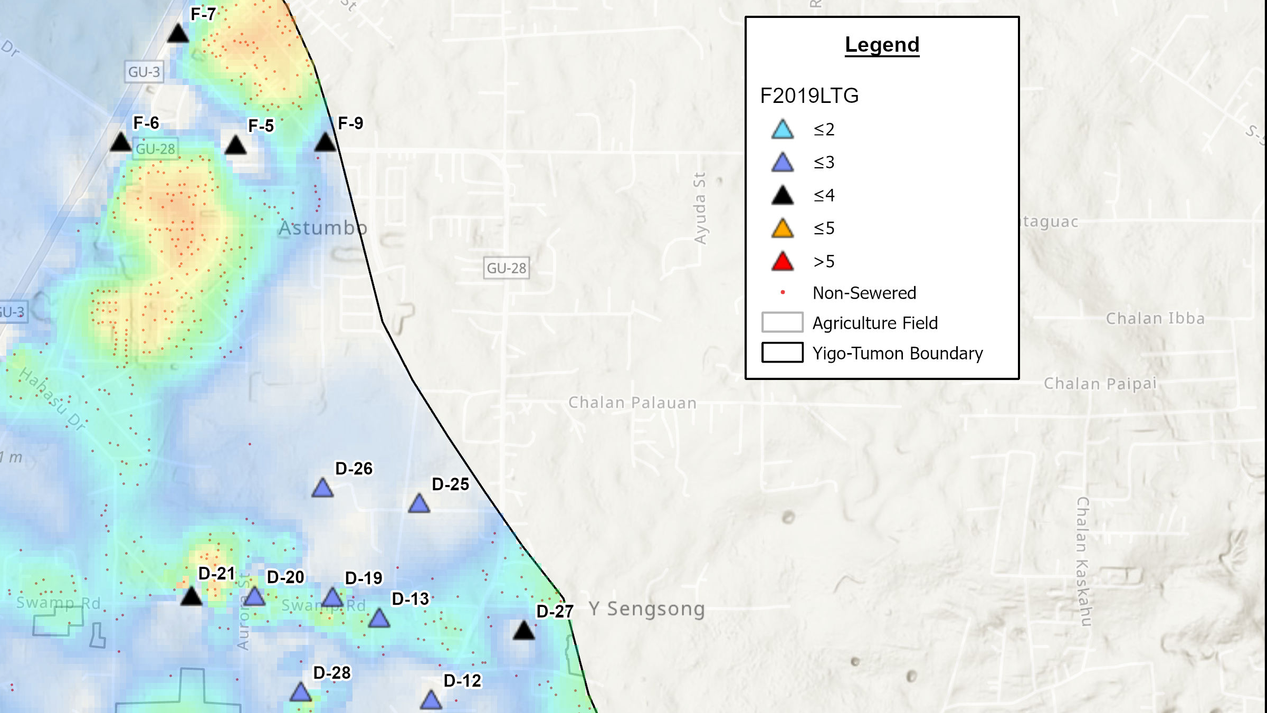

Notes:
Based on Ms. Bulaklak’s analysis, the F wells show nitrate-N concentrations below 4 mg/L. Our model supports this, indicating a contaminant plume in the area at about 2–3 mg/L, which these wells are able to capture.
Similarly, the model results near several D wells, including D-20, D-19, and D-13, align with Ms. Bulaklak’s findings, where concentrations remain below 3 mg/L.

Slide 18
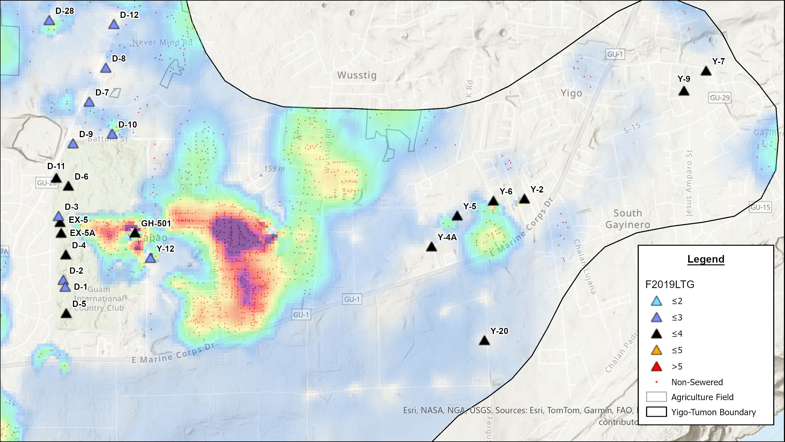
Notes:
A strong plume is visible near GH-501 and Y-12, with nitrate levels above 5 mg/L, mainly from septic systems.
In contrast, wells on the golf course show no plume, since the area was modeled as recharge and golf course inputs have not yet been addressed.

Slide 19
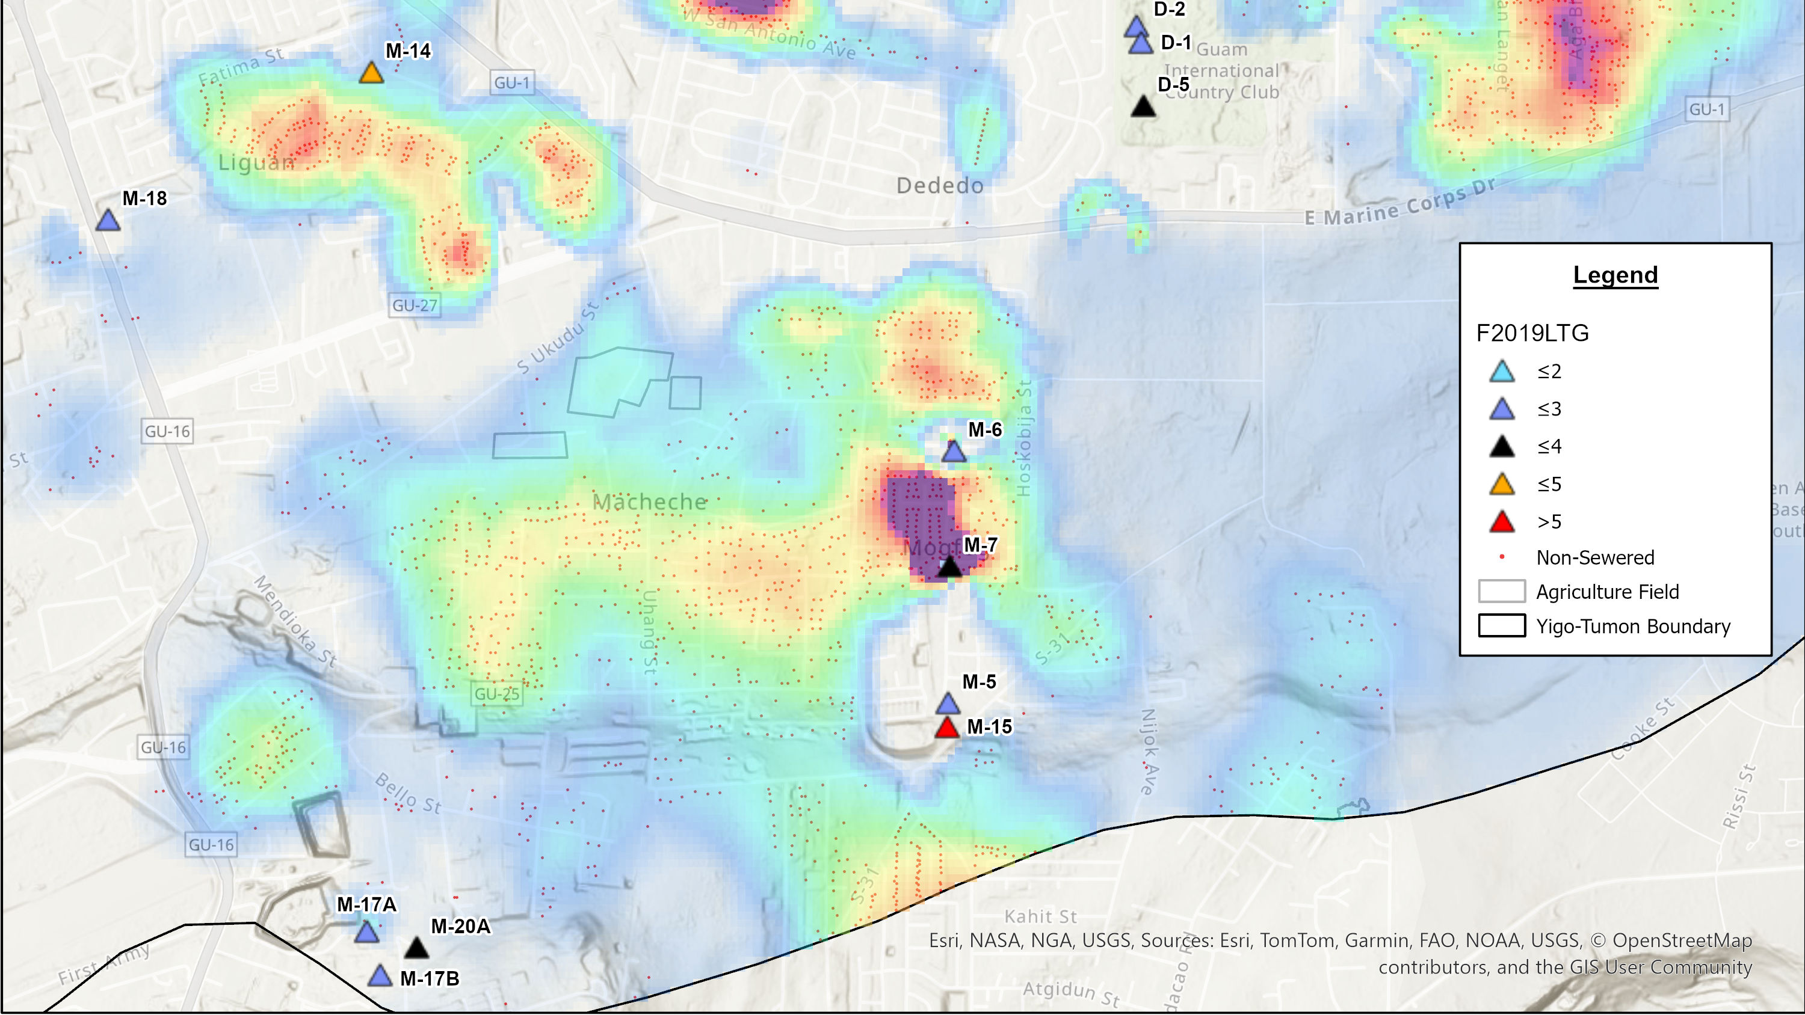
Notes:
Lastly, this area still needs refinement, as the modeled contaminant plumes do not fully align with Ms. Bulaklak’s analysis. Further adjustments are required to better capture the nitrate behavior in this region.

Slide 20
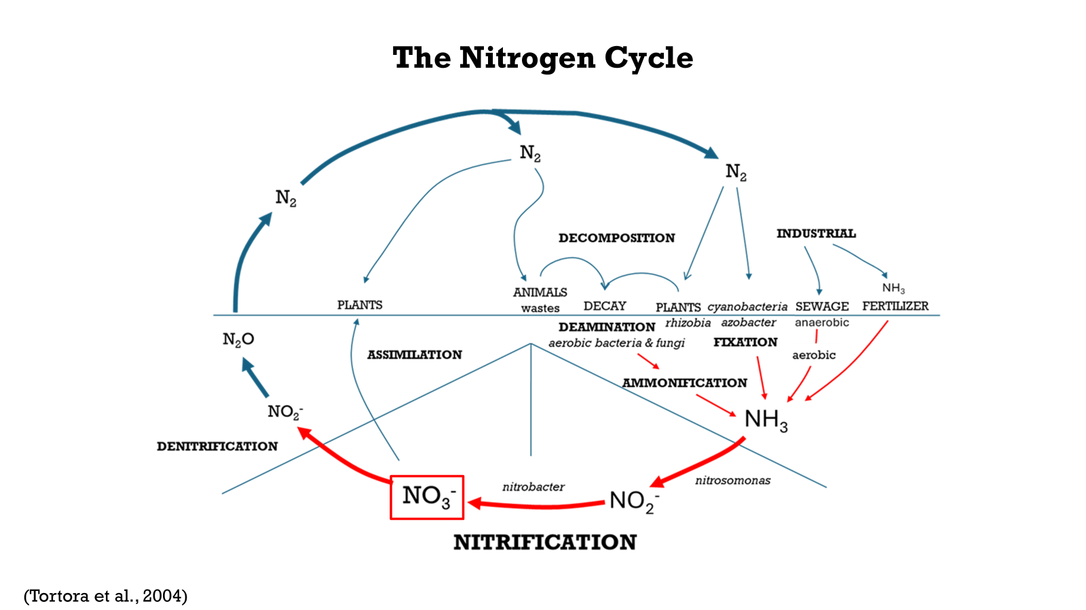
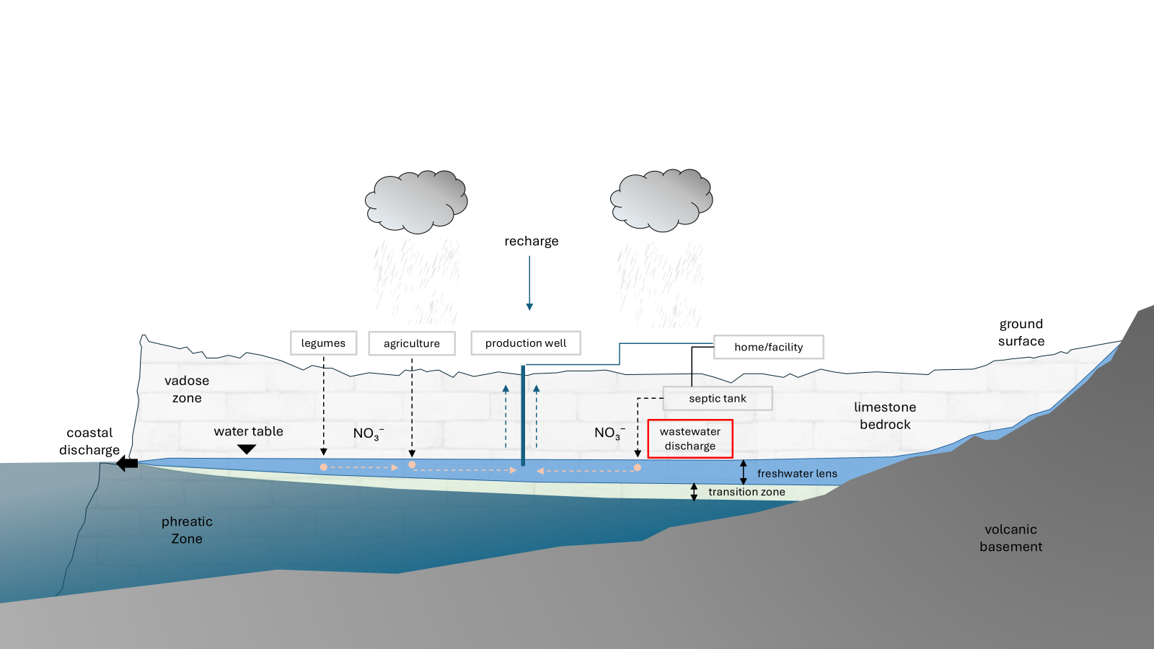
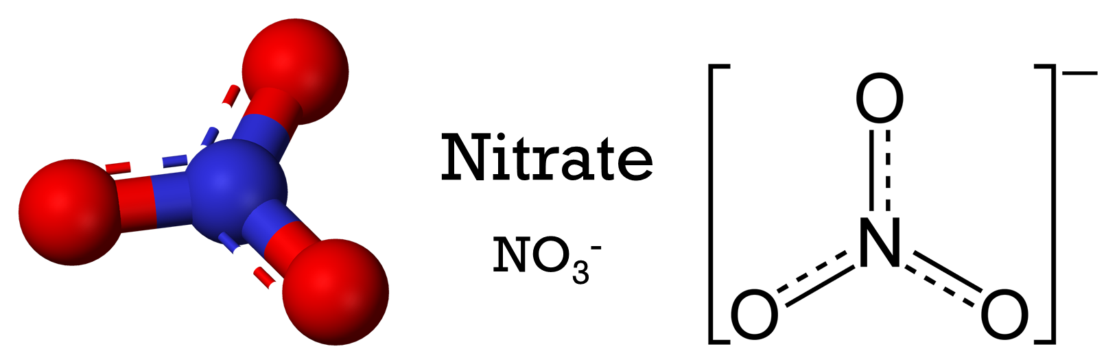
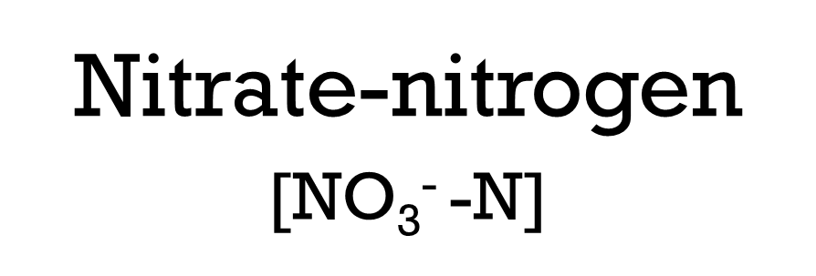
Background
Notes:
Nitrate (NO₃⁻) is a widely recognized indicator of groundwater contamination. (Click) Its concentration is commonly reported as nitrate-nitrogen (NO₃⁻-N), which measures only the nitrogen component of the nitrate ion.
(Click) To understand how nitrate occurs, we can look at the nitrogen cycle. Nitrogen from sewage, fertilizers, legumes, and animal or plant waste undergoes processes that eventually lead to nitrification, producing nitrate.
Natural sources like legumes and animal waste usually contribute background levels of about 1–2 mg/L of nitrate-N in groundwater. When concentrations rise above this range, it often signals anthropogenic sources, particularly from agriculture/farms and residential areas that rely on septic tanks. (CLICK) So when we overload nitrate in our environment, it bypasses natural uptake. It moves past the root zone and leaches into the aquifer, as this diagram shows.

