Slide 1
Introductory Seminar
Presented by:
Rajneesh Singh, PhD
Assistant Professor
Water Environmental Research Institute (WERI) of the Western Pacific
University of Guam, Mangilao, GU, USA
singhraj@triton.uog.edu

Slide 2
Brief Introduction
Current affiliation:
Assistant Professor at WERI, University of Guam, Mangilao, GU, USA (Sept 2026-Till date)
Previous experience:
Assistant Professor (Ramanujan Fellow) at Department of Hydrology, IIT Roorkee, India (May 2023-Sept 2026)
Postdoctoral Research Associate at University of Minnesota (UMN), USA (March 2021-May 2023)
Postdoctoral Research Associate at University of Nebraska-Lincoln (UNL), USA (April 2019-March 2021)
Academic qualification:
Ph.D. in Environmental Engineering (Civil Engineering) from IIT Bhubaneswar (IIT-BBS), India (2014-2019)
  Thesis title: Vermifiltration coupled with adsorption for the enhanced removal of organics & nutrients from brewery wastewater
M. Tech. in Aquacultural Engineering (Agricultural Engineering) from IIT Kharagpur (IIT-KGP), India (2012-2014)
  Thesis title: Aquacultural wastewater treatment using aquaponics
B. Tech. in Agricultural Engineering from CSA Univ. of Agriculture and Technology Kanpur, India (2008-2012)
Research interests:
Agriculture & food industry effluents
Agricultural reuse of wastewater
Rural sanitation
Bioclogging
Greenhouse gas emission
Bioremediation
Stormwater/urban runoff treatment
Details | Numbers
Journal publications (published + in-review) | 24 published (20 Q1 paper) (18 as 1st or Commun. author)
Research grants (Ongoing/approved) | $130K (PI) & $50K (Co-PI)
Patents granted | 1
Book Chapters (SCOPUS) | 3 published + 1 in review
Books edited | 1
Conference proceedings/abstracts | 15
Total citations (Ref.- Google Scholar) | 1040
H index / i10 index (Ref.- Google Scholar) | 15/19
Research articles reviewed | 120+
Note: *= Approved-Funding awaited

Slide 3
Contribution to Research Projects (selected)
Wastewater treatment for agricultural reuse in rural communities
  Antibiotics removal from cattle wastewater
Application of discarded tire wastes for urban runoff management
  Development of design guidelines
  Determination of life span
  Safe disposal of urban runoff to lakes
Treatment and agricultural reuse of wastewaters using low-cost technologies
  Treatment of wastewaters from food and animal production units,
  Performance enhancement of cost-effective treatment systems,
  Impact of feeding pattern on treatment performance, gaseous emission, pathogen
  removal and life span of treatment systems
Encountering the limitations associated with the field-scale adoption of vermifilter
  Mathematical tool for the design and scale-up of vermifiltration based treatment plants
  Increasing life span of vermifiltration
  Enhancement nutrient removal ability of vermifiltration
Macrophyte-assisted vermifiltration for treatment of dairy wastewater
Treatment of aquacultural wastewater by combining trickling filter with Aquaponics
At IIT-R, IND
At UMN, USA
At UNL, USA
At IIT-BBS, IND
At IIT-KGP, IND
Published research/review articles on the topics presented/highlighted: Singh et al., 2017, 2018a, 2018b, 2019a, 2019b, 2019c, 2019d, 2020, 2021, 2022, 2023, 2024, 2025

Slide 4
Overview of the research work/experience

Slide 5
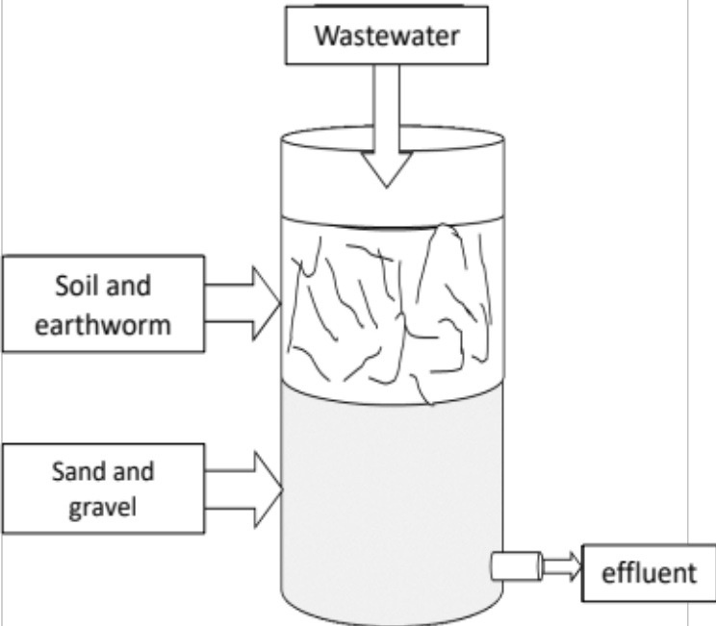
Taking Vermifilters from Laboratory to Field (PHD@IITBBS)
Low nutrients
(N & P) removal
Addition of an adsorbent layer
Anoxic column
Incorporation of macrophytes
Frequent clogging
Optimization of input variables to maximize hydraulic conductivity
Suitable for rural area/onsite treatment:
  1. No aeration/energy needs
  2. Easy to operate/maintain
  3. Affordable
  4. No sludge/by-product generation
  5. Locally made/sustainable
No tool to design and scale-up
Development of a dimensionless equation using design parameters
Research gap
Macrophyte-assisted Vermifiilter (MaVF)
Sustainable treatment of wastewater
Selected output:
Singh et al., (2018). Science of Total Environment 643, 1652.
Singh et al., (2018). Science of Total Environment 633, 145.
Singh et al., (2019). Science of Total Environment 651, 1283.
31±3.8% increase in TN removal & 23.4±1.6% TP removal
Note: Input variables: Earthworm actions, Hydraulic retention time and initial COD
Design parameters: Influent COD, Earthworm Density, Hydraulic loading rate

Slide 6
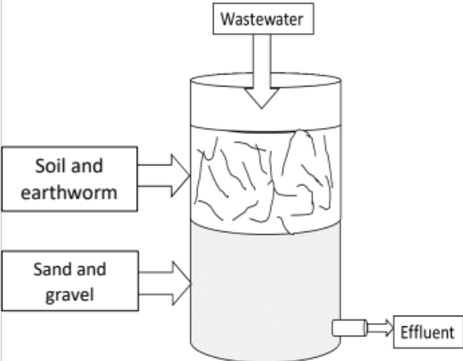
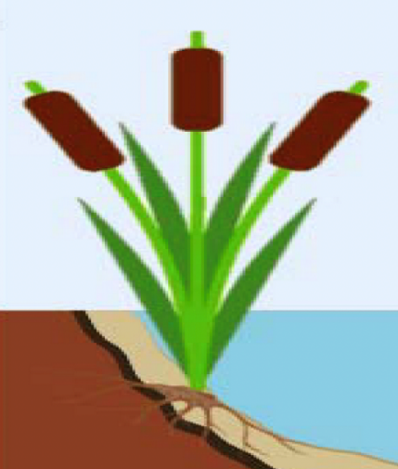
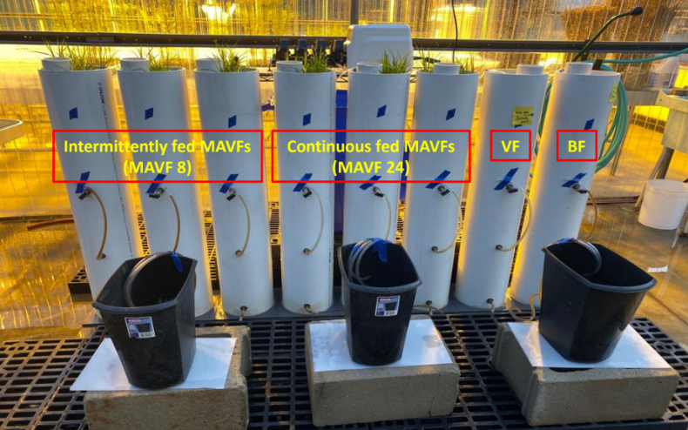
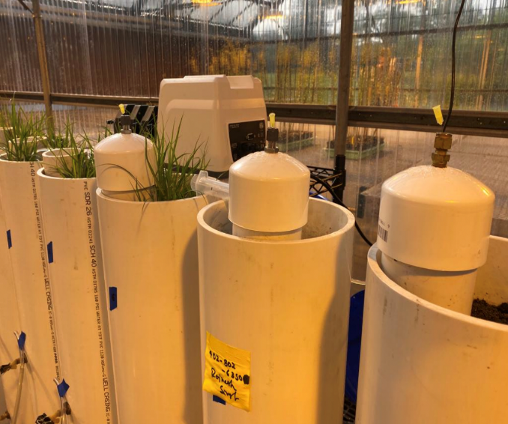
Impact of Intermittent Feeding for vertical MaVF (postdoc@UNL)
Macrophyte-assisted Vermifilter (MaVF)
Continuous operation
High DO utilization and low DO recharge (for high organics WW)
Compromised MaVF (Low removal, unaesthetic appearance, flies, bad odor)
Mechanical/artificial aeration is costly
Added advantage of macrophyte uptake and root aeration
Intermittent feeding (resting period is given)
After intermittent feeding:
Enhanced Nitrification and organic oxidation
Reduced GHG emissions
Low clogging of MaVF
High effluent DO
Selected output: Singh et al., (2022). Npj Clean Water 5(1), 31.
Emission | Intermittent | Continuous
N₂O emission mg N/m² | 2.513±2.629 | 0.328±0.093
CO₂ emission mg C/m² | 246±38 | 123±14
CH₄ emission mg C/m² | 5±4.6 | 75±45
CO₂ equivalents mg C/m² | 1102.5 | 2471

Slide 7
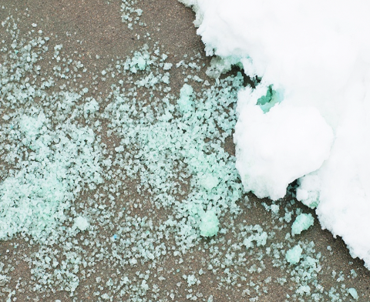
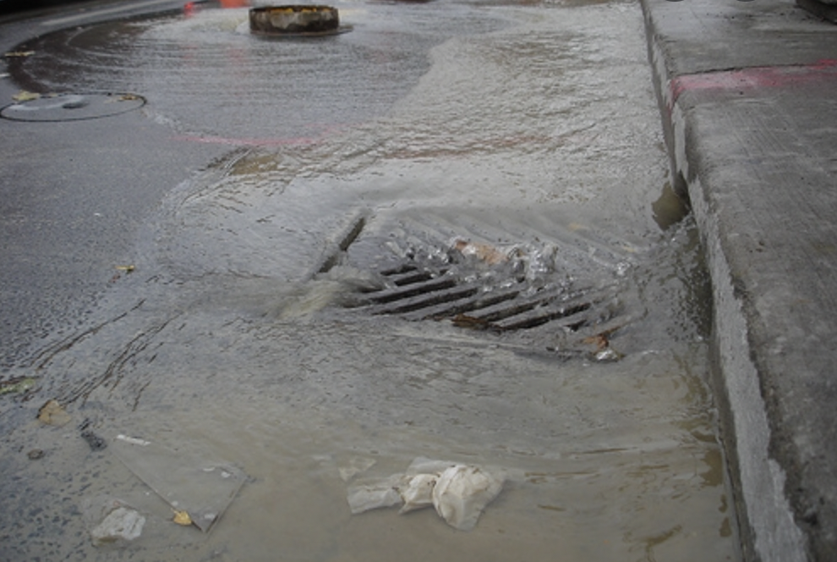
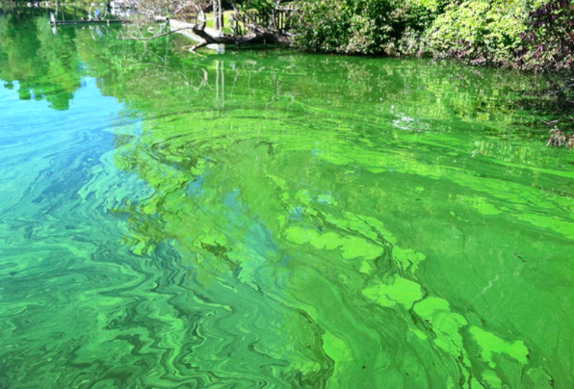
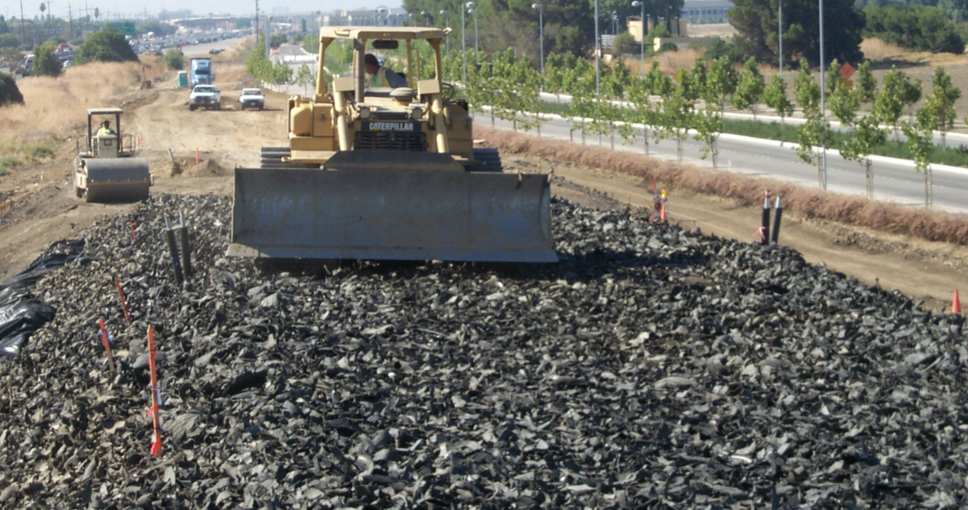
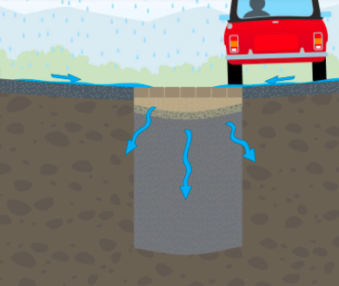
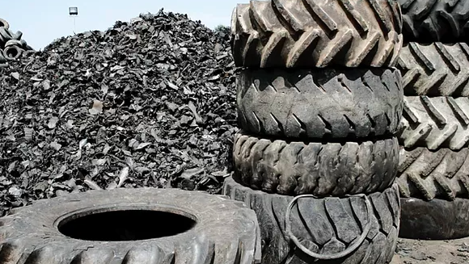
Application of Tire Waste for Urban Runoff (postdoc@UMN)
Existing treatment systems need a lot of money/maintenance/attention
Phosphorous
Urban runoff
Salts for deicing
Image credit: regdist.com
Urban runoff
Image credit: downers.us
Polluted water body
Image credit: pca.state.mn.us
Tire derived aggregate (TDA)
Results so far:
After application
Phosphorous adsorption
(below acceptable limit)
2. Leaching of Fe, Zn and Cu
(new grant funded)
TDA Industry
TDA
Engineering applications
Underground runoff chamber
1 waste tire/person/year in USA
Image credit: shercom industries
Impact of salts for deicing
No impact on leaching of metals or P sorption
Major Benefits:
1- Converts tire waste to a useful resource
2- Affordable and user-friendly solution
3- Longer life span; less clogging; high porosity
4- No floor space needed
Sustainable treatment of stormwater
Landfilling permitted in only 8 states

Slide 8
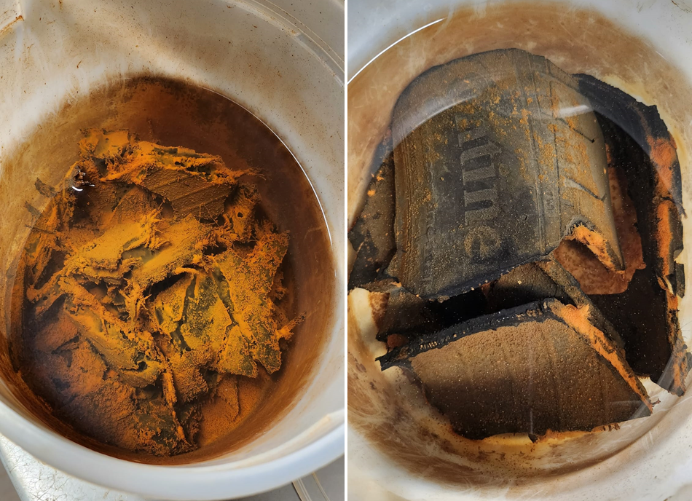
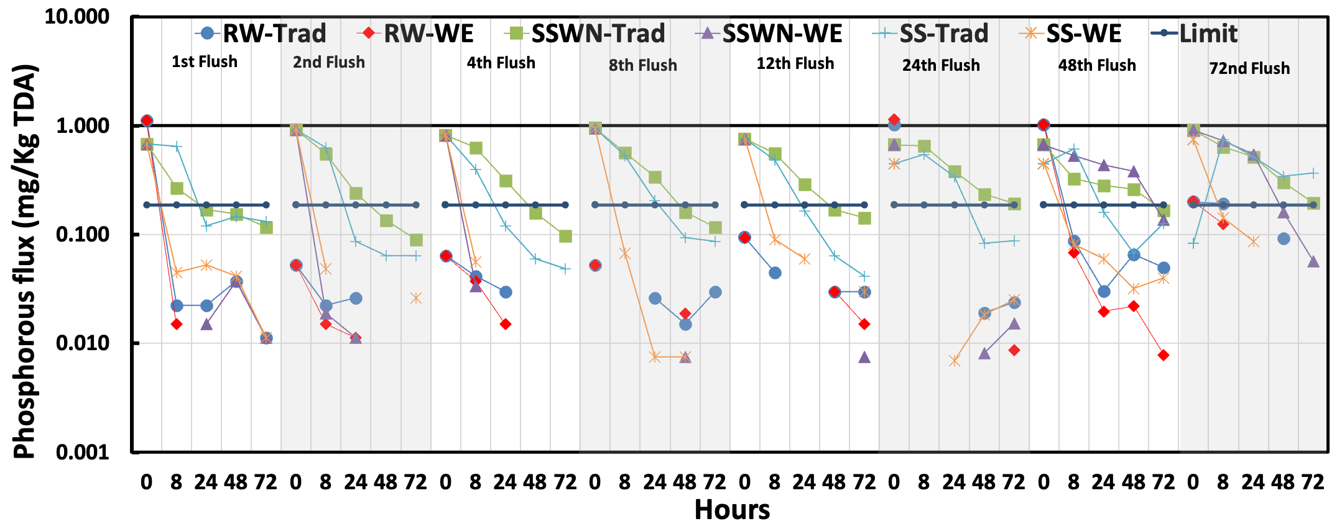
Lifespan estimation and prevention from leaching (postdoc@UMN)
Biofilm on TDA
After application
Phosphorous adsorption
(below acceptable limit)
2. Leaching of Fe, Zn and Cu
(new grant funded)
TDA
Underground runoff chamber
How to prevent leaching from TDA?
After biofilm growth:
1. Unchanged P sorption potential
(Below acceptable limit)
2. Checked metal Leaching from TDA
(Below USEPA recommended limits)
72 flushes are representative of 8-9 years of storms in the mid-west USA
(Calculated using the last 30 years of rainfall data; storm is considered @ 0.5 inches rain/hour)
Working on: limiting MPs release
Quick note: Biofilms are reported to utilize metals through biosorption and bioprecipitation for their bodily needs.
Selected output: Singh & Gulliver, (2025). Water Research 257, 121716. Singh et al., (2023). Journal of Cleaner Production 395, 136428.

Slide 9
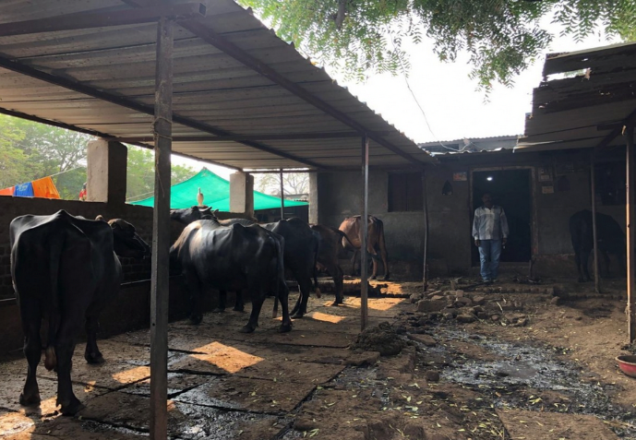
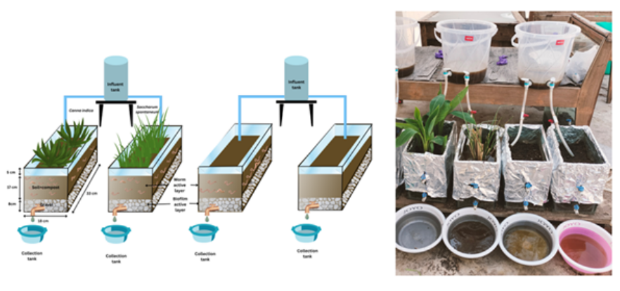
PhD Students work at IITR- MAvF for Cattle feedlot runoff
Cattle feedlot WW
Organics
Antibiotics
Solids
Nutrients
Pathogens
Antibiotics disturb/kill the microbial community resulting in unwanted microbes/pathogens
Preliminary research
Cattle shed runoff
Antibiotics type | Removal efficiency (%)
 | MaVF-Canna | MaVF-Sacch | VF
Erythromycin | 36.2±6.6 | 30±0.9 | 25.7±3.4
Oxacillin | 54.6±10.2 | 49.9±8.1 | 45.3±8.8
Oxytetracycline | 39.9±7.7 | 36.7±8 | 24.6±1.2
Sulfadimethoxine | 50.7±5.3 | 42.2±4.8 | 39±7
Ampicillin | 3.2±0.9 | 2±1.27 | 1.3±1.1
Comparison between plant types; Analysis of the roles of plants and earthworms for antibiotics and pollutant removal
Next course of action:
Assess impact on Microbial flora within the system
Optimize the proposed treatment system
Analyse the impact on GHG emission due to inclusion of electroactive microbes through MFC
Summary:
Suboptimal antibiotics (AB) removal for ampicillin, erythromycin and oxytetracycline.
Need for enhancement of AB removal from MAVF.
Selected output: Singh et al., (2025). Process Safety and Environmental Protection 204, 108030. Kumar et al., (2026). Journal of Water Process engineering 86,109896.

Slide 10
Thank You
Questions?

Slide 11

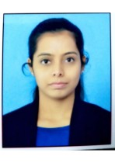

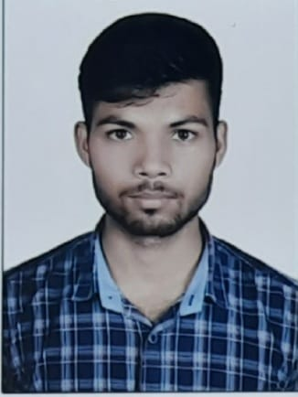
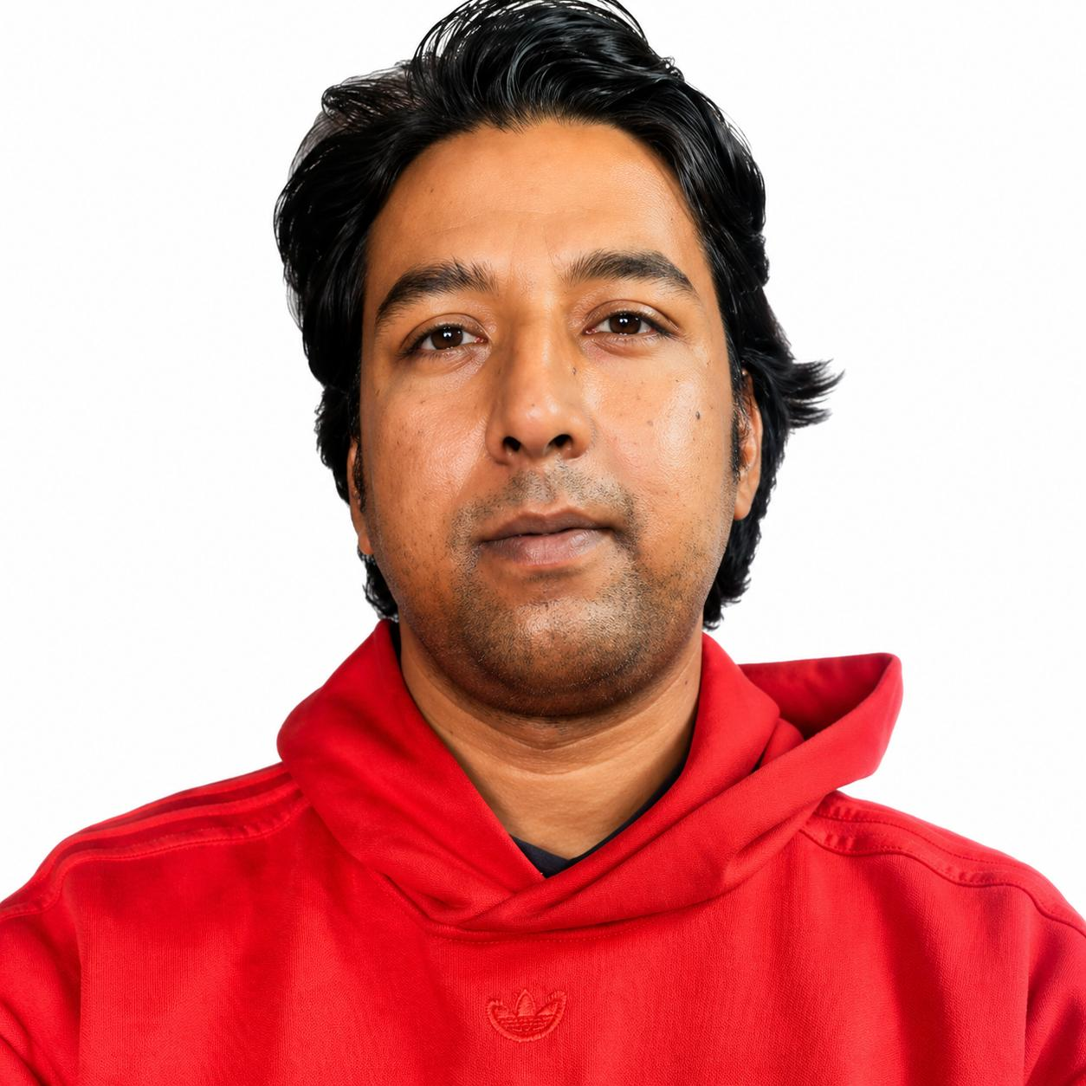
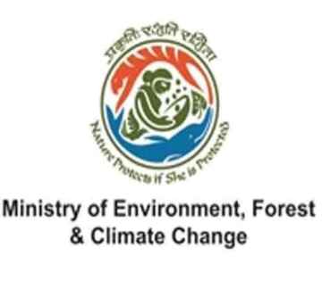


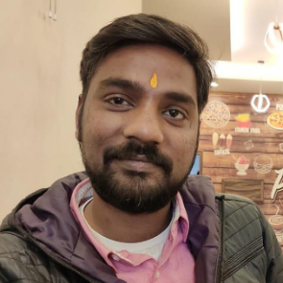
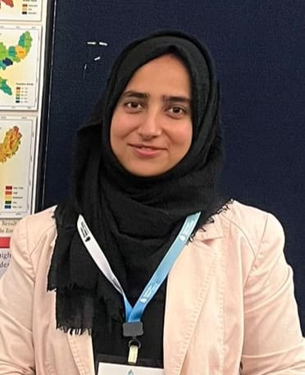
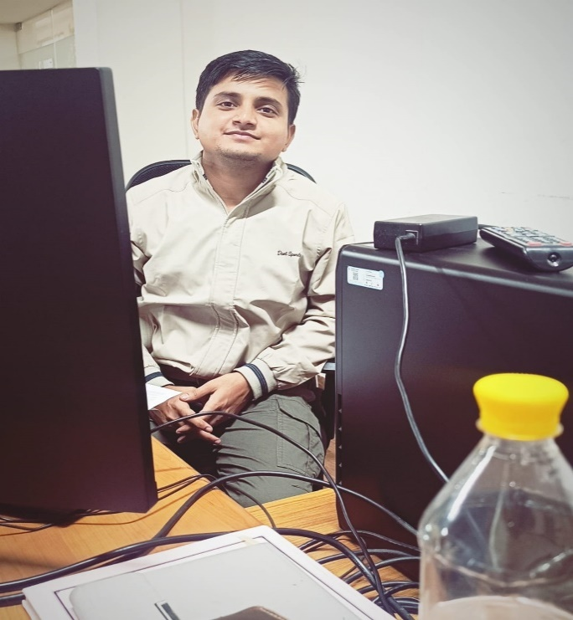
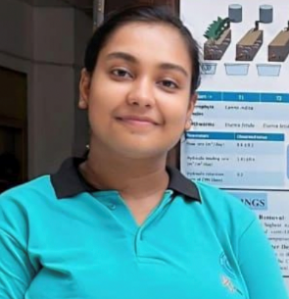






Acknowledgments-Funding Agency & Research Group
PhD Students
Project Staff
Ms. Shruti Singh (MSc Env Science)
Jointly Supervised
Junior Research fellow (August 2023-Till date)
Project: Vermifiltration with MFC for Cattle wastewater treatment and energy generation
Mr. Ankit Kumar (MSc Geology)
Jointly Supervised
Junior research fellow (August 2024- till date)
Project: Enhanced nutrient removal & reduced GHG emission from vermifilters
Rahul Bisht (M. Tech. Env Engg)
Project assoc. (April 2026-Till date)
Project: Tire derived aggregate based biofiltration system for urban runoff
Former group members
Dr. Suneel Yadav (PhD Env. Engg)
Project assoc. (Jan 2024 - March 2024)
Rimsha Hasan (MSc Env. Sci.)
Project assoc. (Jan 2024 - July 2024)
Rahul Kumar (MSc Geol.)
Project assoc. (Nov 2024- Dec 2025)
Pallavi Priya (B Tech Civil Engg)
SPARK Intern (May 2024-Jul 2024)

Slide 12
Patents, Grants, and Awards/Honors
Grants:
Singh, R. (2025). Wastewater treatment for agricultural reuse in rural communities. Funding agency- SERB-Department of Science and Technology (PI). Amount ₹ 1.19 Crore (119 lakhs). (Funded-Ongoing)
Yadav, B.K., & Singh, R. (2023). Comprehensive Assessment of Co-Transport of Microplastics and Heavy Metals during Groundwater-Surface Water Interactions. Funding agency- ERDP, MOEF&CC (Co-PI). Amount ₹ 48.5 lakhs. (Approved)
Patents:
Singh, R., Yadav, A., Garg, M. & Mandal, S., (2024). Integrated biological filter cum aquaponics system. (Granted). Journal number 03/2025 (Publication date:17/01/2025) (IN)
Awards and Honors (selected):
Ramanujan Fellowship for Faculty-Fellow position at IIT Roorkee by ANRF - GoI (February 2023)
Research project “Application of tire waste for urban runoff management” was covered by an Emmy award winning kids educational show “Into the Outdoors” (Weblink) (February 2023)
Research project relating to “estimation of gaseous emission from vermifiltration” was covered by a Pulitzer prize winning news agency “Insider Climate News” (Weblink) (July 2022)
Research project relating to “estimation of gaseous emission from vermifiltration” was covered in American news agency “farms.com” (Weblink) (July 2022)

