Slide 1



2026
State of the Aquifer
WERI-GLE GHS Workshop
September 25, 2026

Slide 2
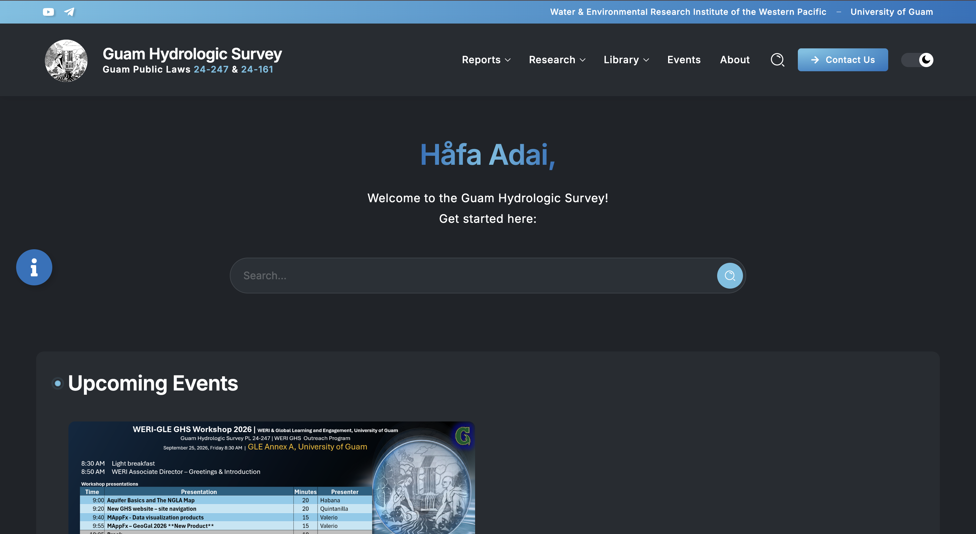

Slide 4
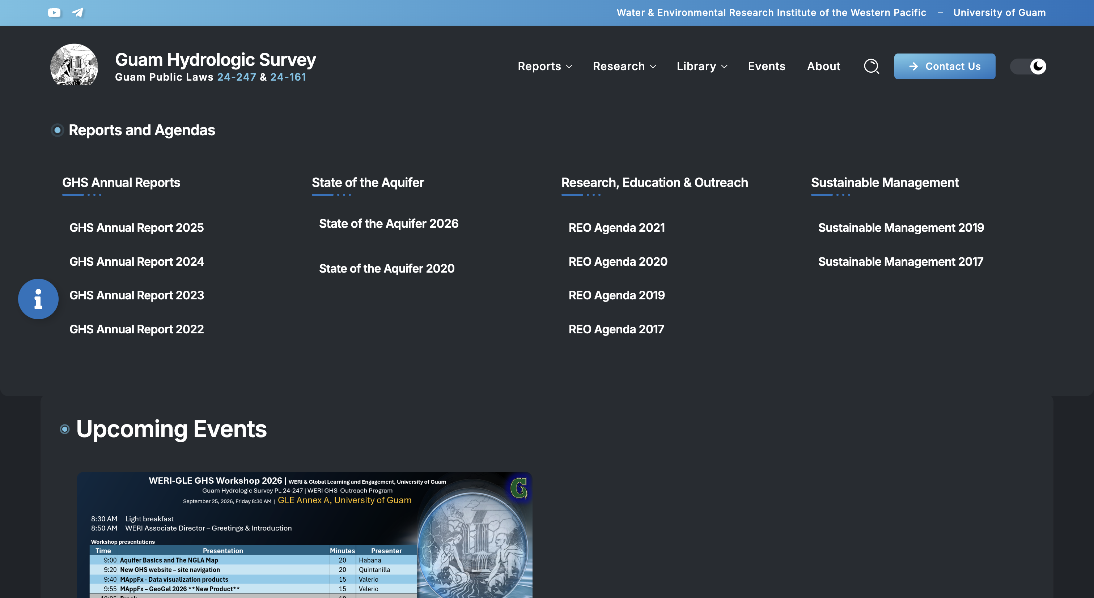

Slide 5


Slide 6

WATER QUALITY
Dieldrin
Notes:
First, I’ll be discussing water quality, with a focus on dieldrin and its current presence in the NGLA

Slide 7
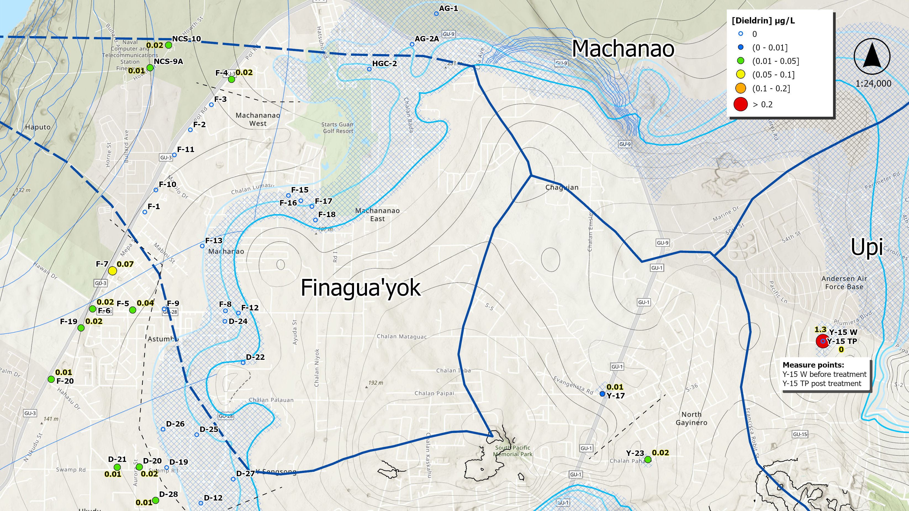
Notes:
Before I discuss the map, I’ll briefly explain what the colors represent.

Slide 8
Notes:
The wells are color-coded based on their dieldrin concentration ranges in micrograms per liter, or parts per billion.
Each color represents a different concentration range.
For example, orange represents concentrations greater than 0.10 but less than or equal to 0.20 micrograms per liter, while red represents concentrations above 0.20 micrograms per liter.
I also want to note that 0.20 micrograms per liter is the Interim Action Level established by Guam EPA for dieldrin here on Guam.

Slide 9
Notes:
Looking at the Finagua’yok and Machanao Basins, a lot of the wells show no detectable dieldrin, especially in the parabasal zone. And for the wells where dieldrin was detected, the concentrations are still below the IAL.

Slide 10
Notes:
Y-15 is important to note in the Upi Basin. Before treatment, it had a dieldrin concentration of 1.3 micrograms per liter, which is well above the IAL. After the GAC system was activated, the concentration is zero.

Slide 11
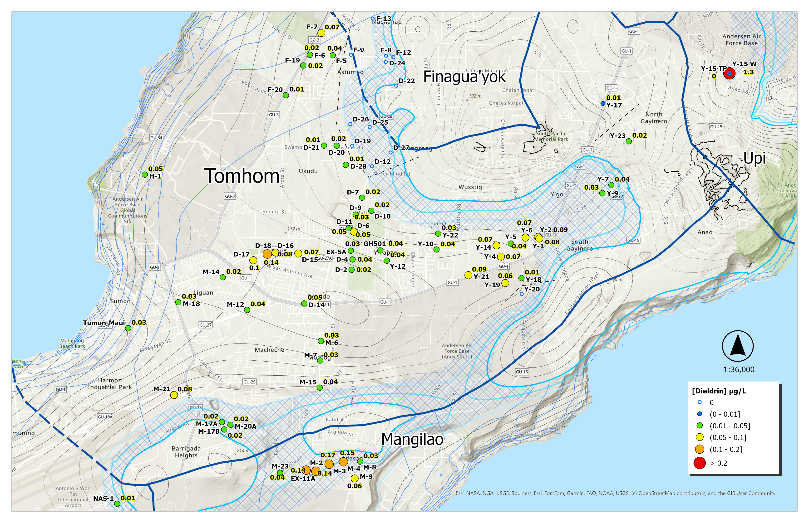
Notes:
Moving on to the next basins, we have Tomhom and Mangilao.

Slide 12
Notes:
In the trough of the Tomhom Basin, we do we that majority of the wells do have a concentration of dieldrin, typically within the green and yellow ranges.

Slide 13
Notes:
As we move closer to the coast, we still see mostly concentrations within the green and yellow ranges. One well that stands out is D-18, with a dieldrin concentration of 0.14 micrograms per liter.

Slide 14
Notes:
Then, as we move down to the Mangilao Basin, four wells—EX-11, M-2, M-3, and M-4—fall within the orange range, with concentrations approaching the IAL. Because of this, these wells warrant continued monitoring.

Slide 15
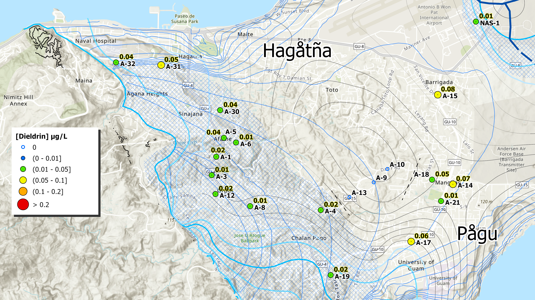
Notes:
Lastly, we have the Hagåtña and Pågu Basins. All of the wells are below the IAL, but there is one section of the Hagåtña Basin, where no dieldrin was detected in A-9, A-10, and A-13.

Slide 16
WATER QUALITY
PFAS
Notes:
Moving on to another contaminant of concern, we have PFAS. The PFAS data used in this report were collected under the Unregulated Contaminant Monitoring Rule 5, or UCMR 5, which tested for 29 PFAS between 2023 and 2025. For this presentation, we’ll be looking at the most recent PFAS data available.

Slide 17
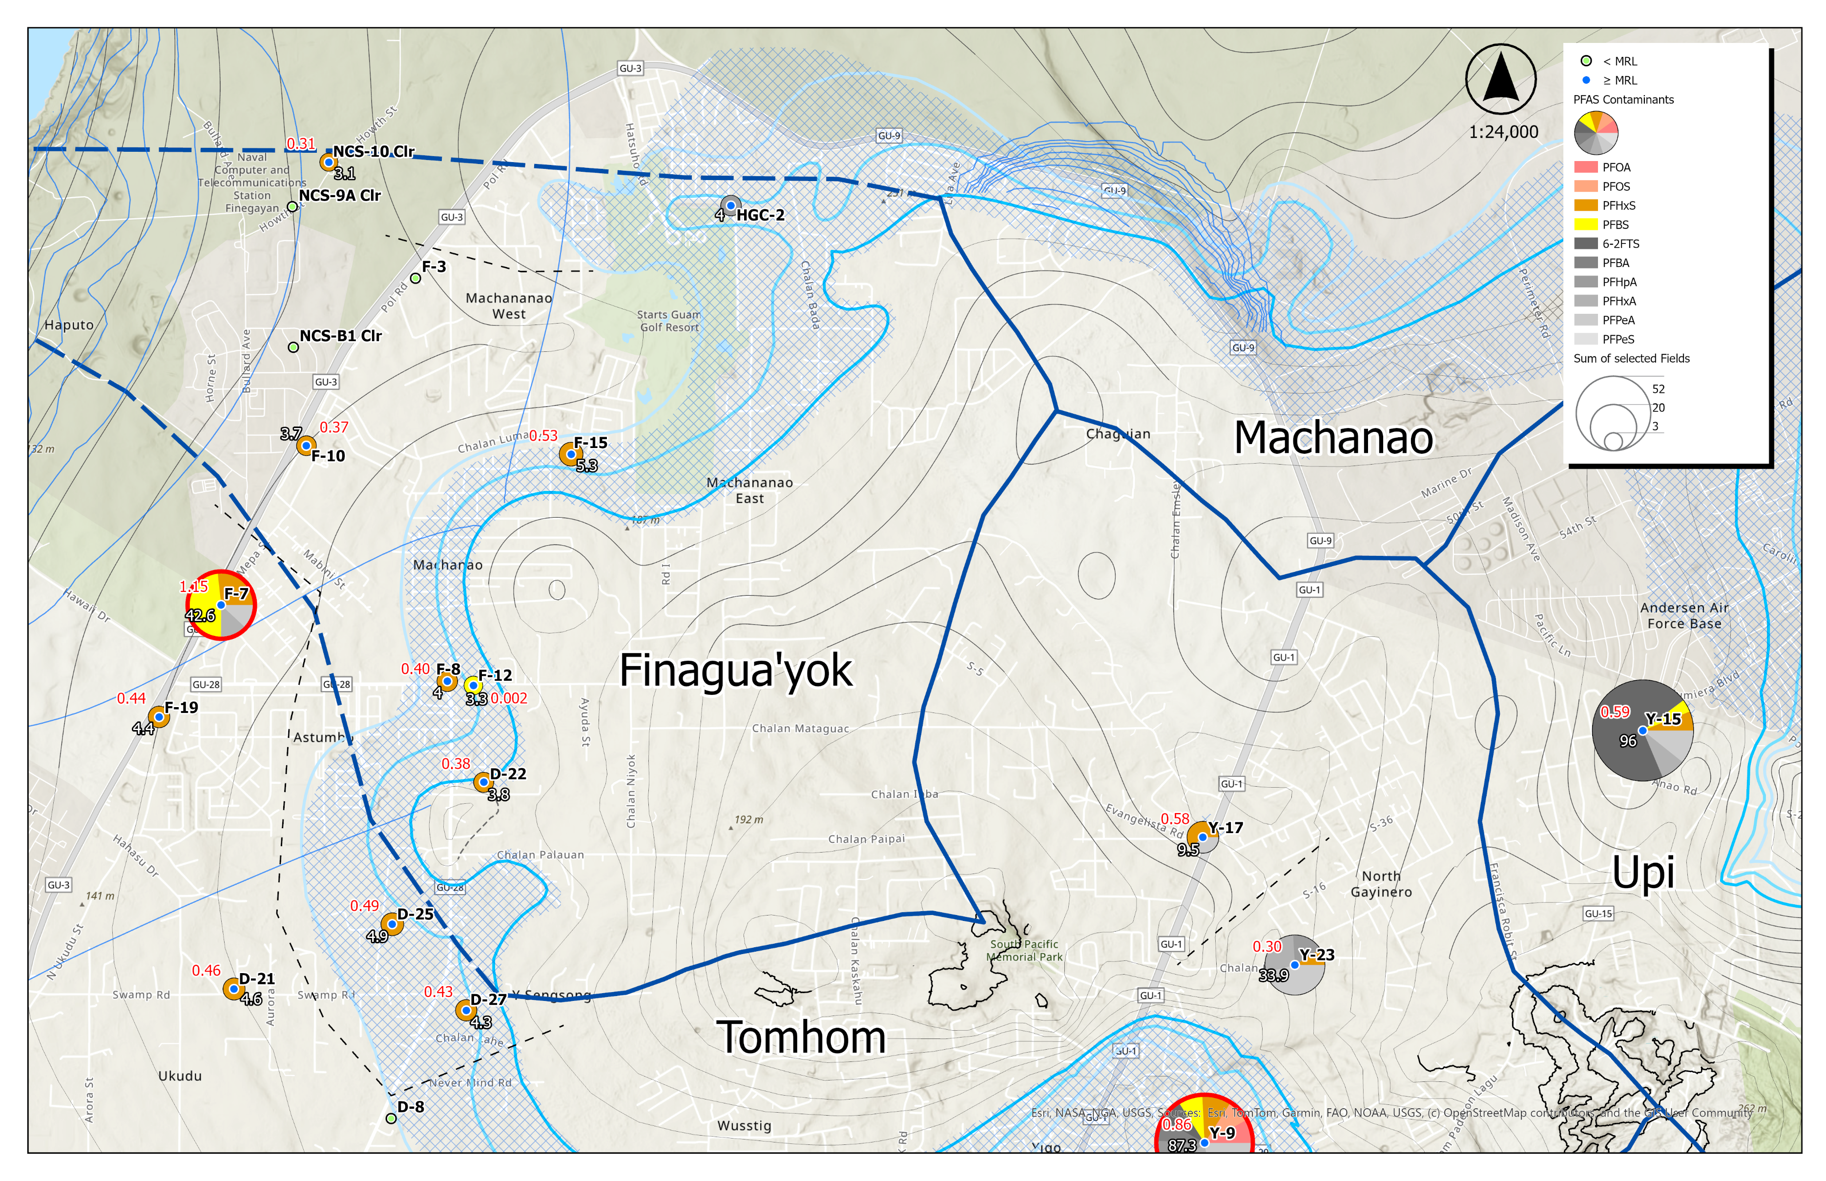
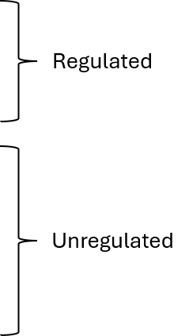
Hazard Index
∑ PFAS
> MCL
Notes:
Before I go over the map, I’ll briefly explain what’s shown in the legend.

Slide 18
Hazard Index
∑ PFAS
> MCL
Notes:
The wells are shown in either green or blue.
Green means that all 29 PFAS tested were below their respective minimum reporting levels, or MRLs, while blue means that at least one PFAS was detected at or above its MRL.
For wells with detections, the pie charts show which PFAS were present, with each color representing a different PFAS compound. The first four colors represent the regulated PFAS, while the gray shades represent the unregulated PFAS detected in the dataset.
If a pie chart has a red outline, that means at least one PFAS is above its respective maximum contaminant level, or MCL. The size of the pie chart represents the total PFAS concentration.
We also show the Hazard Index, or HI, which looks at the combined contribution of PFHxS, PFNA, HFPO-DA, and PFBS. An HI greater than 1 means that their combined contribution exceeds EPA’s health-based benchmark for the mixture.
And all concentrations shown here are reported in nanograms per liter, or parts per trillion.

Slide 19
Hazard Index
∑ PFAS
> MCL
Notes:
Starting with Machanao, no PFAS were detected above the reporting limits.
In Finagua’yok, we see a few detections, mostly PFHxS (highlighted in orange), while several wells remain below their reporting limits.
In Upi, Y-15 stands out because it contains a mixture of PFAS, with 6:2 FTS making up a large portion of the total concentration.

Slide 20
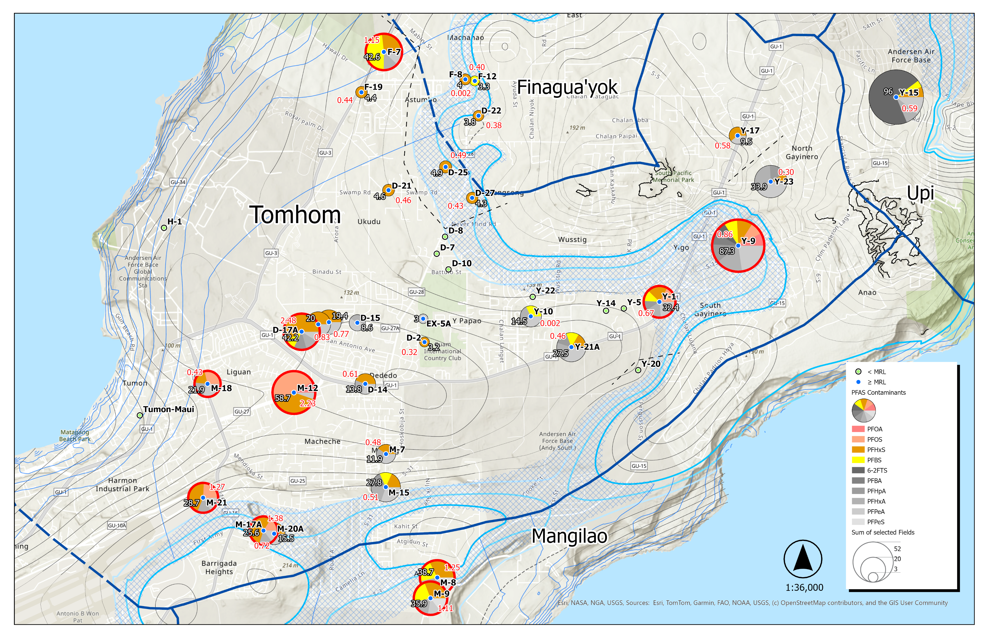
Notes:
Moving onto the Tomhom and Mangilao aquifer basins.

Slide 21
Notes:
Starting in the trough of the Tomhom Basin, we see a wide variety of PFAS, with PFHxS again being one of the more commonly detected compounds.
We also see several wells with at least one PFAS above its MCL, including Y-1, Y-9, and M-12.
Interestingly, some wells still remain below the reporting limits, including some of the D and Y wells

Slide 22
Notes:
As we move closer to the coast, we still see PFHxS showing up in many of the wells, along with some PFBS and PFOS.
We also see several wells where at least one PFAS exceeds its MCL, including D-17, M-12, M-18, M-21, and M-17.
Some of those wells also have Hazard Index values above 1.

Slide 23
Notes:
In the Mangilao Basin, M-8 and M-9 stand out. Both show detections of PFHxS and PFBS, with at least one PFAS above its MCL. Their Hazard Index values are also above 1.

Slide 24
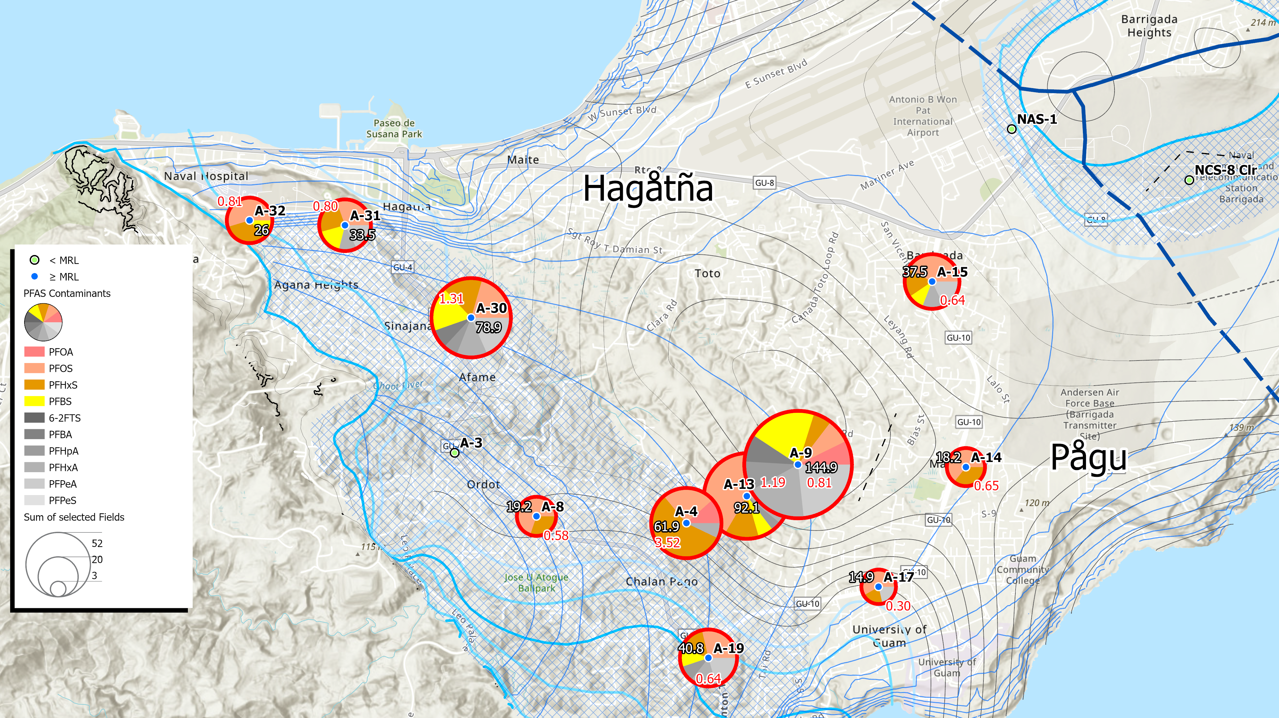
Hazard Index
∑ PFAS
> MCL
Notes:
Lastly, we have the Hagåtña and Pågu Basins. Aside from A-3 and NAS-1, most wells show a mixture of PFAS detections, with regulated PFAS making up much of what was detected. Several wells also have at least one PFAS above its MCL. A-4, A-13, and A-30 stand out because their Hazard Index values are also greater than 1.

Slide 25
WATER QUALITY
Nitrates
Notes:
Next, we’ll look at nitrates.

Slide 26
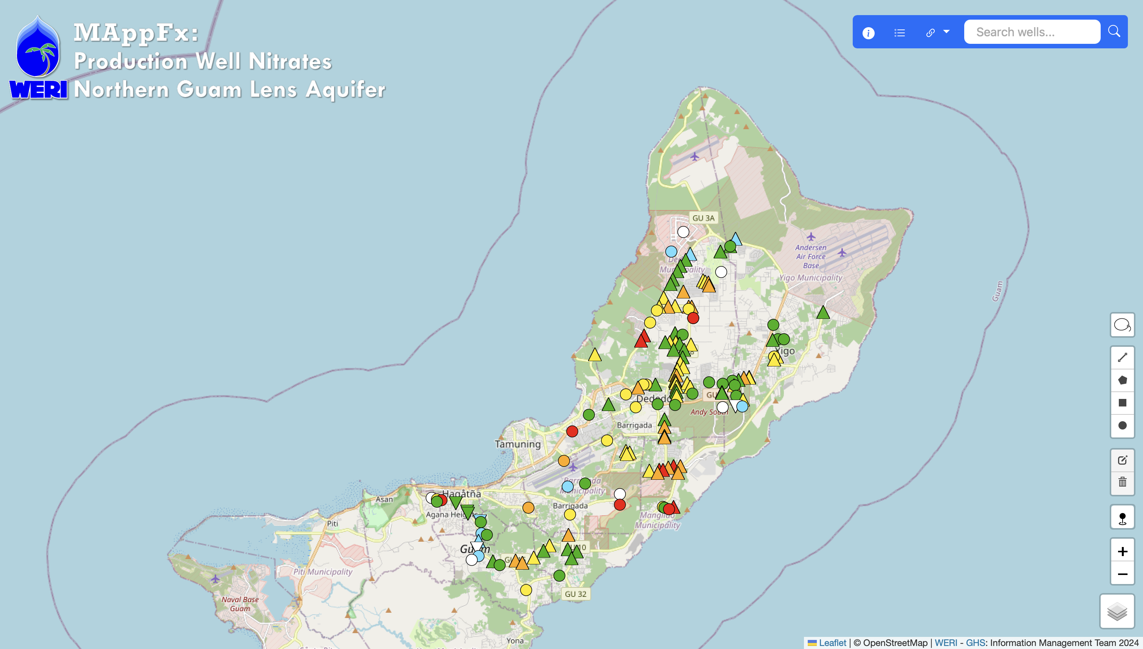

Notes:
Here we have the MAppFx for Production Well Nitrates, which you can access by scanning the QR code. The app is currently updated through June 2026 and combines nitrate time-series data with statistical and trend analyses. It allows us to see which wells have increasing, decreasing, or no significant nitrate trends.

Slide 27
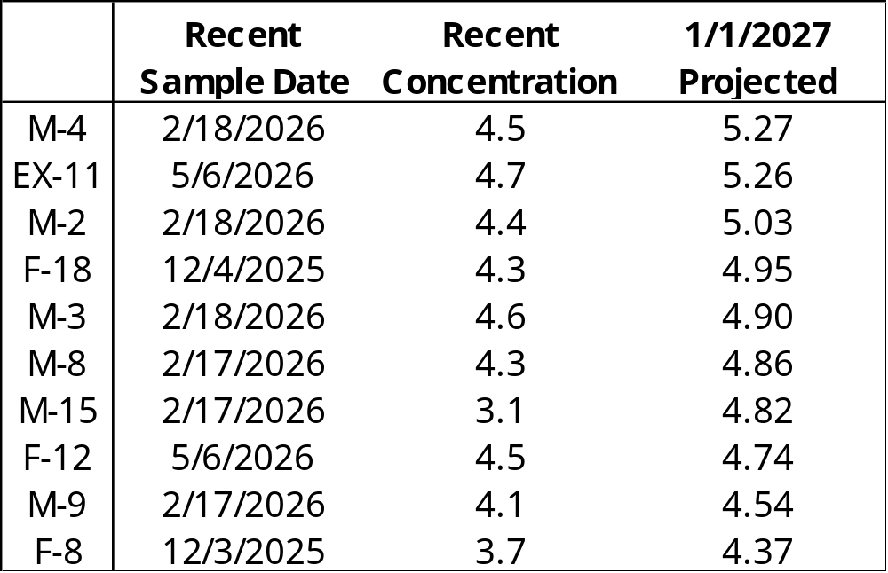
Notes:
Focusing on the increasing trends, the table shows ten production wells that warrant continued monitoring, most of which are in the Mangilao and Tomhom Basins. In the Adacao area of the Mangilao Basin, M-2, M-4, and EX-11 are projected to reach or exceed 5 milligrams per liter, or 50% of the MCL.

Slide 28
WATER QUALITY
Chloride & Production
Notes:
Next, we’ll look at chloride and production.

Slide 29
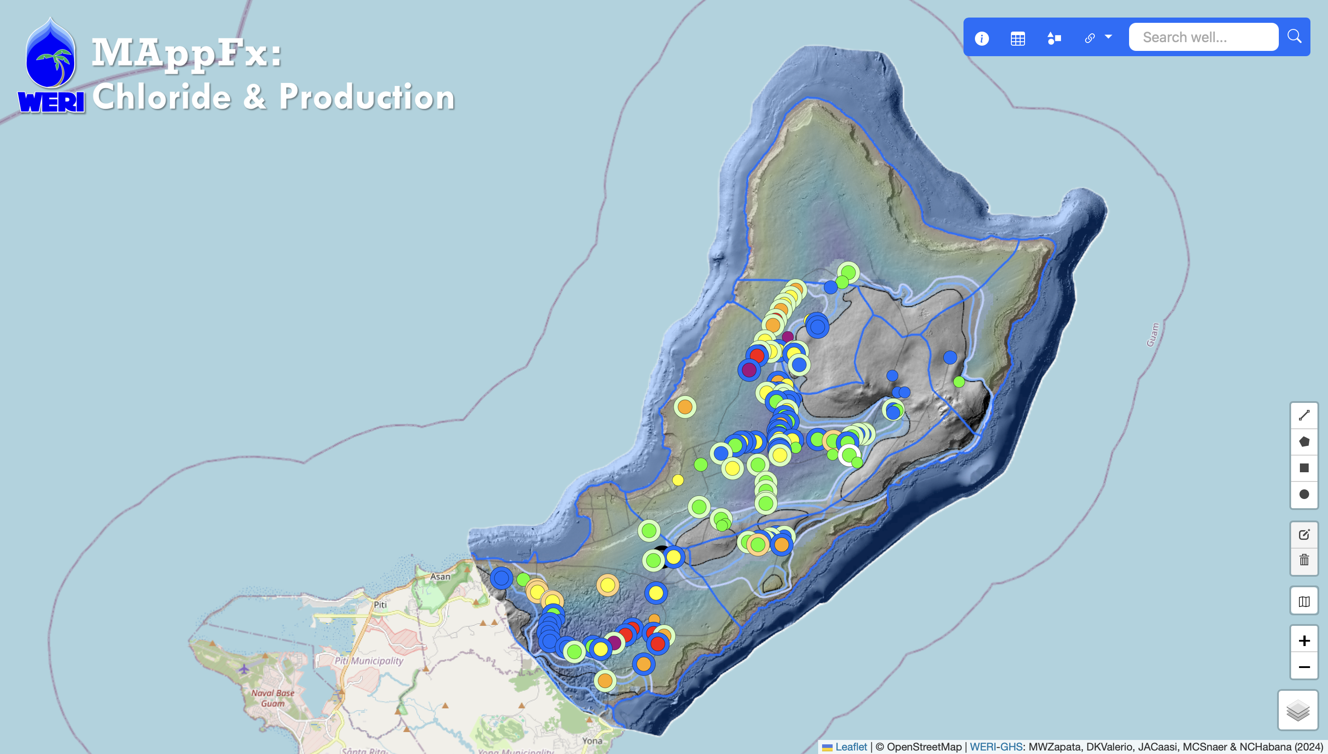

Notes:
For chloride and production, this MAppFx gives an interactive view of the latest available data through June 2026. You can access it using the QR code.

Slide 30
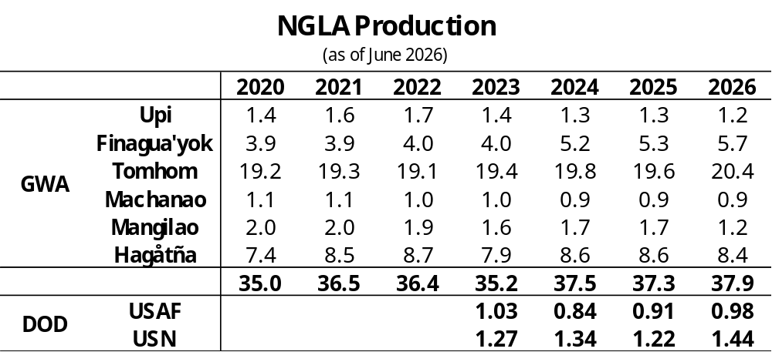
Notes:
Looking at groundwater production, GWA has produced about 38 MGD over the last two years. Tomhom continues to account for the largest portion at around 20 MGD, followed by Hagåtña and Finagua’yok. For military production, the Air Force produces about 1 MGD, while the Navy produces around 1.4 MGD.

Slide 31
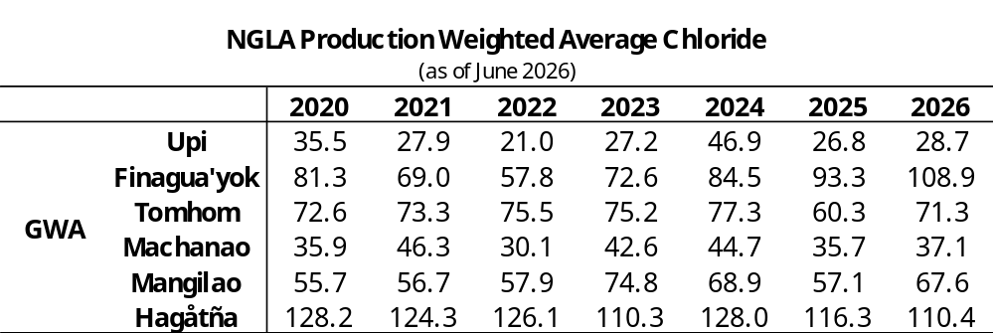
Notes:
Looking at the production-weighted average chloride, Hagåtña and Finagua’yok have the higher values. As of June 2026, Hagåtña is about 110 mg/L, followed closely by Finagua’yok at about 109. Even with these higher values, all basin averages remain below the local 150 mg/L guideline.

Slide 32
WATER QUANTITY
Deep Observation Wells
Notes:
Last but not least, we have the Deep Observation Wells, or DOWs

Slide 33
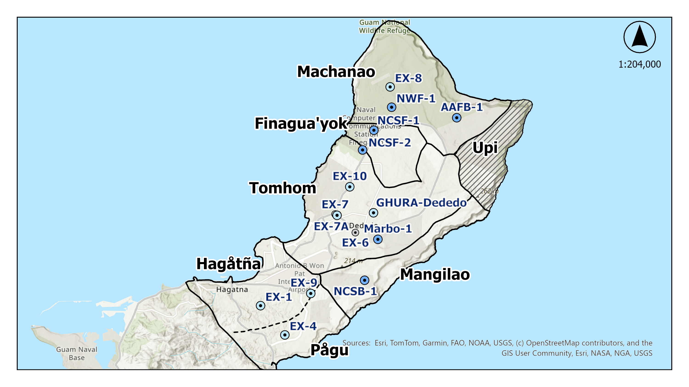
Notes:
In addition to what Mary presented, six new military DOWs have been installed since 2023, expanding observation across the Machanao, Finagua’yok, and Mangilao Basins. These are shown on the map as the darker blue dots.

Slide 34
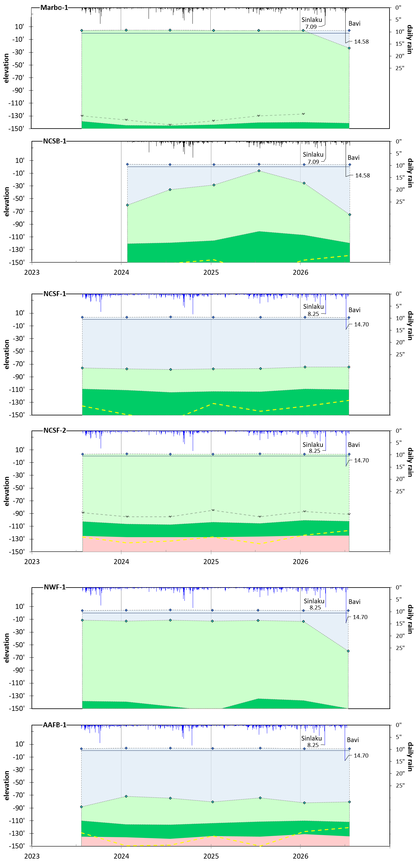
Notes:
Marbo-1 is located farther inland in the Tomhom Basin and shows a thick brackish lens extending to about 140 feet below mean sea level. After Typhoons Sinlaku and Bavi, which brought about 23 inches of combined rainfall, a thin freshwater layer of about 30 feet developed. This suggests that the heavy rainfall may have temporarily diluted the brackish lens.
NCSB-1, located in the Mangilao Basin, shows a clearer response to seasonal rainfall. During the wet season, the freshwater lens thickens, while after a period of dry conditions, it becomes thinner. Following Typhoon Bavi, the lens reached its greatest observed thickness, extending to about 80 feet below mean sea level.

Slide 35
Notes:
NCSF-1 and NCSF-2 are both located in the Finagua’yok Basin, where the area is heavily fractured, and we can see how they respond differently.
NCSF-1 has a fairly stable freshwater lens at about 80 feet, with not much change from seasonal rainfall or the typhoons.
NCSF-2 has a brackish lens of about 100 feet, and we also don’t see much of a response after the two typhoons.

Slide 36
Notes:
NWF-1 and AAFB-1 are both located in the Machanao Basin.
NWF-1 typically has a thin freshwater lens over a much thicker brackish lens. After the two typhoons, though, the freshwater lens thickened to about 60 feet.
AAFB-1 usually has a freshwater lens around 70 to 80 feet thick and doesn’t show much response to seasonal rainfall. Compared with the previous sampling date, the lens decreased slightly by about 2 feet.

Slide 37

Thank You

Slide 38
