Slide 1
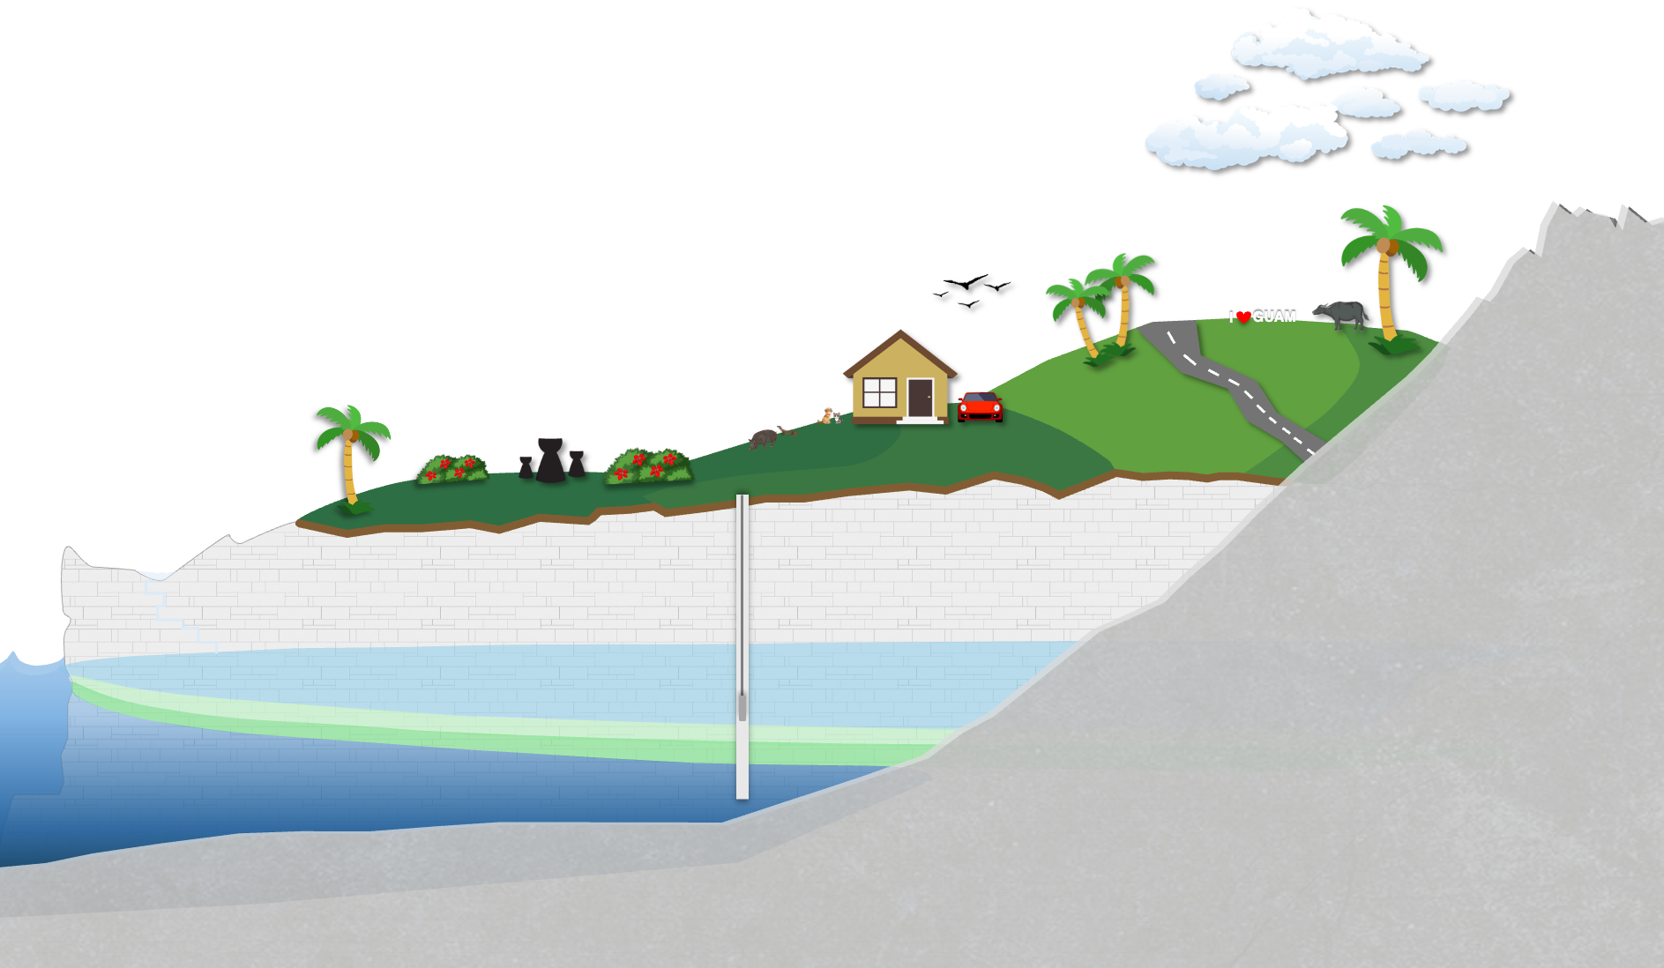
Deep Observation Wells
in the Northern Guam Lens Aquifer
Technical Report 189 | WERI-GLE GHS Workshop 2026
Mary Clare Snaer
DOWs
in the
Northern Guam Lens Aquifer
Technical Report 189
WERI-GLE GHS Workshop 2026
Mary Clare Snaer
Technical Report 189 | WERI-GLE GHS Workshop 2026
Mary Clare Snaer

Slide 2
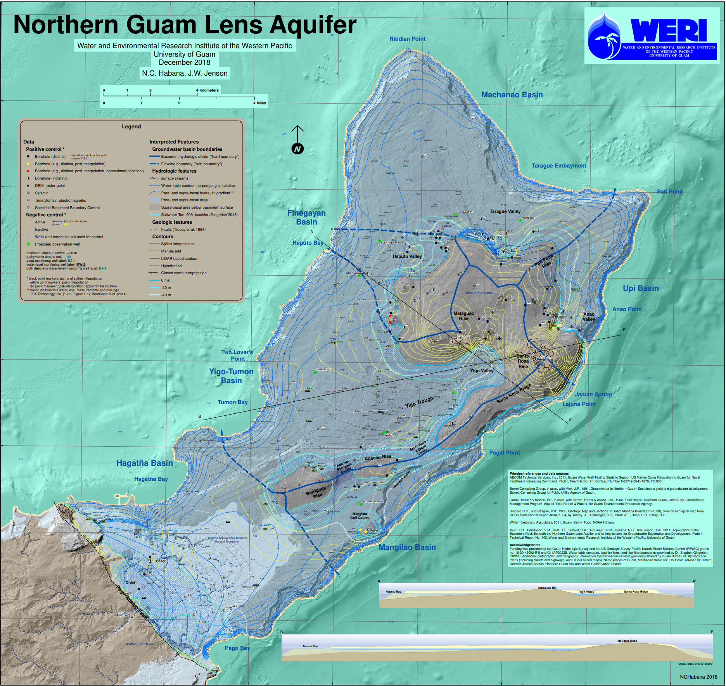

Slide 3
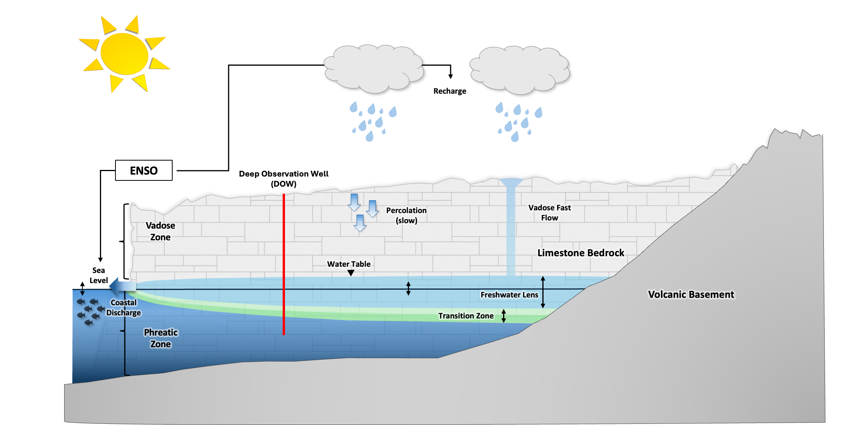

Slide 4
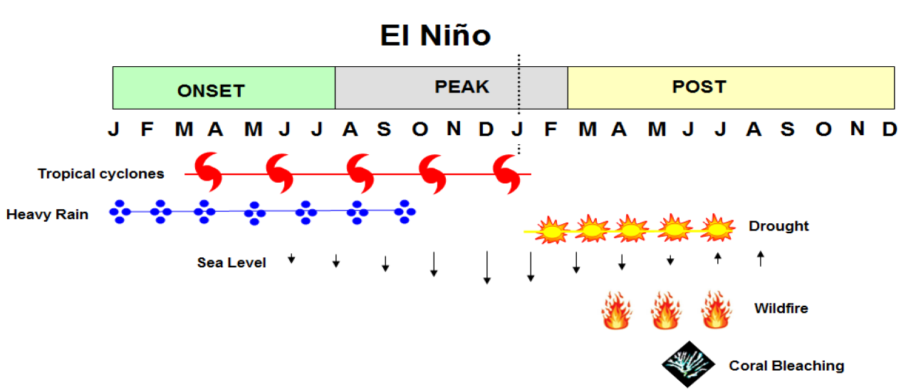
Timing of climatic hazards associated with El Niño
Pacific ENSO Applications Climate Center (PEAC)
Lander (2016)
Notes:
Enso

Slide 5
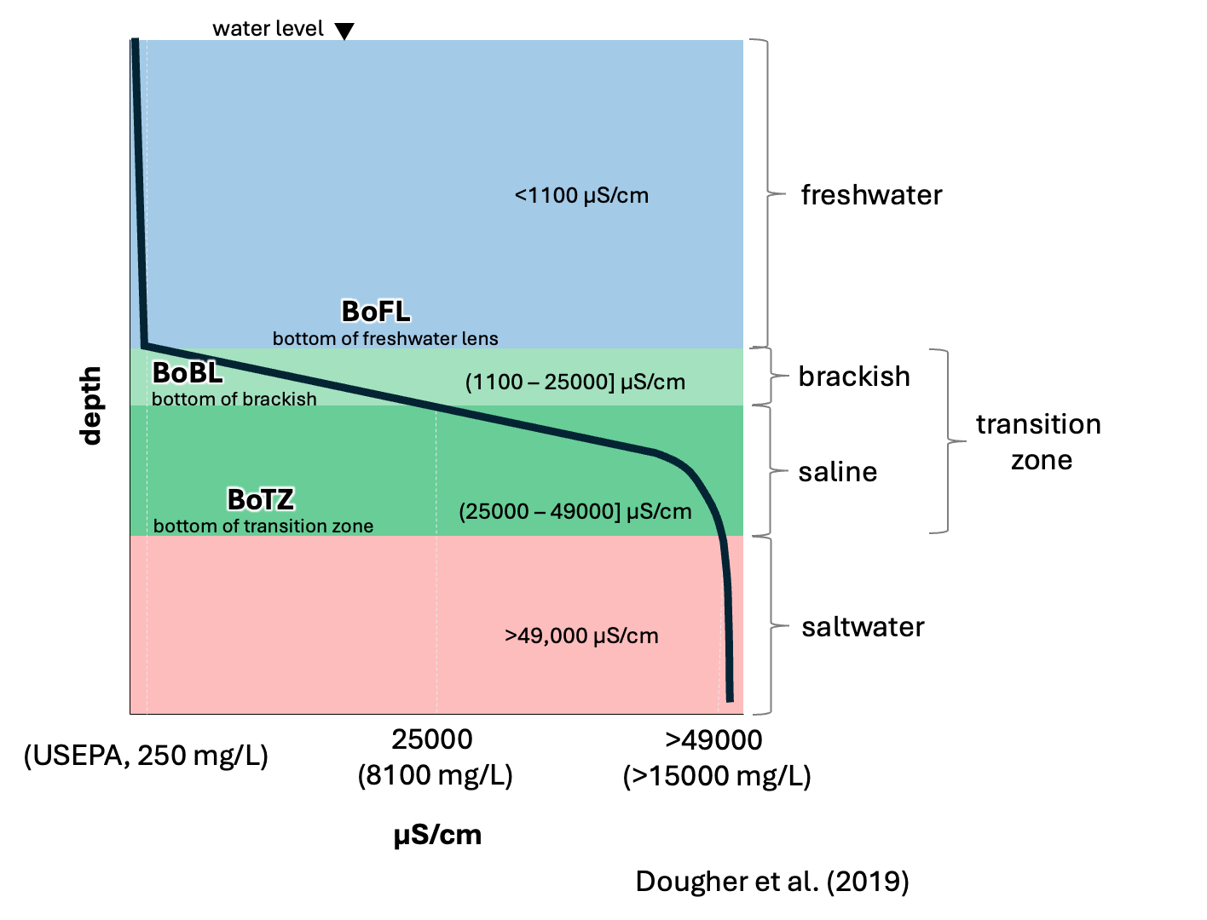
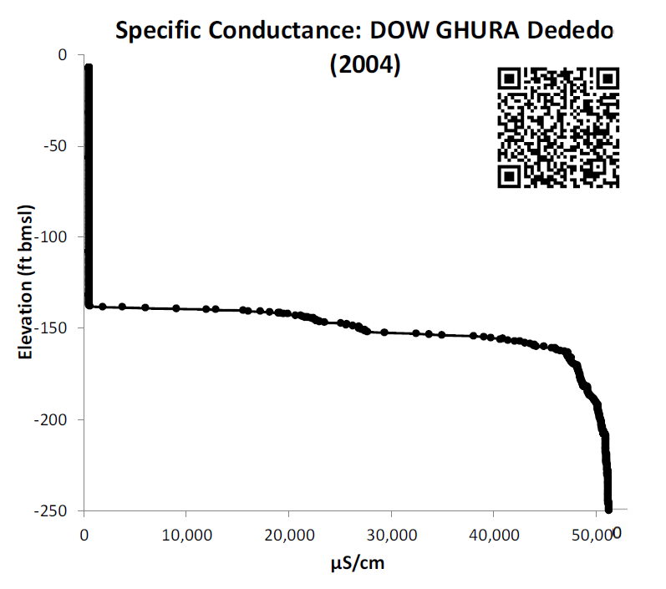
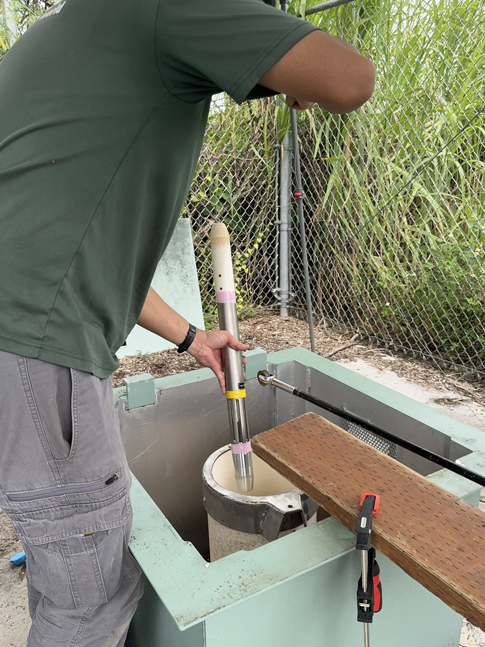
CTD probe
DOW
5
Notes:
DOW explain

Slide 6
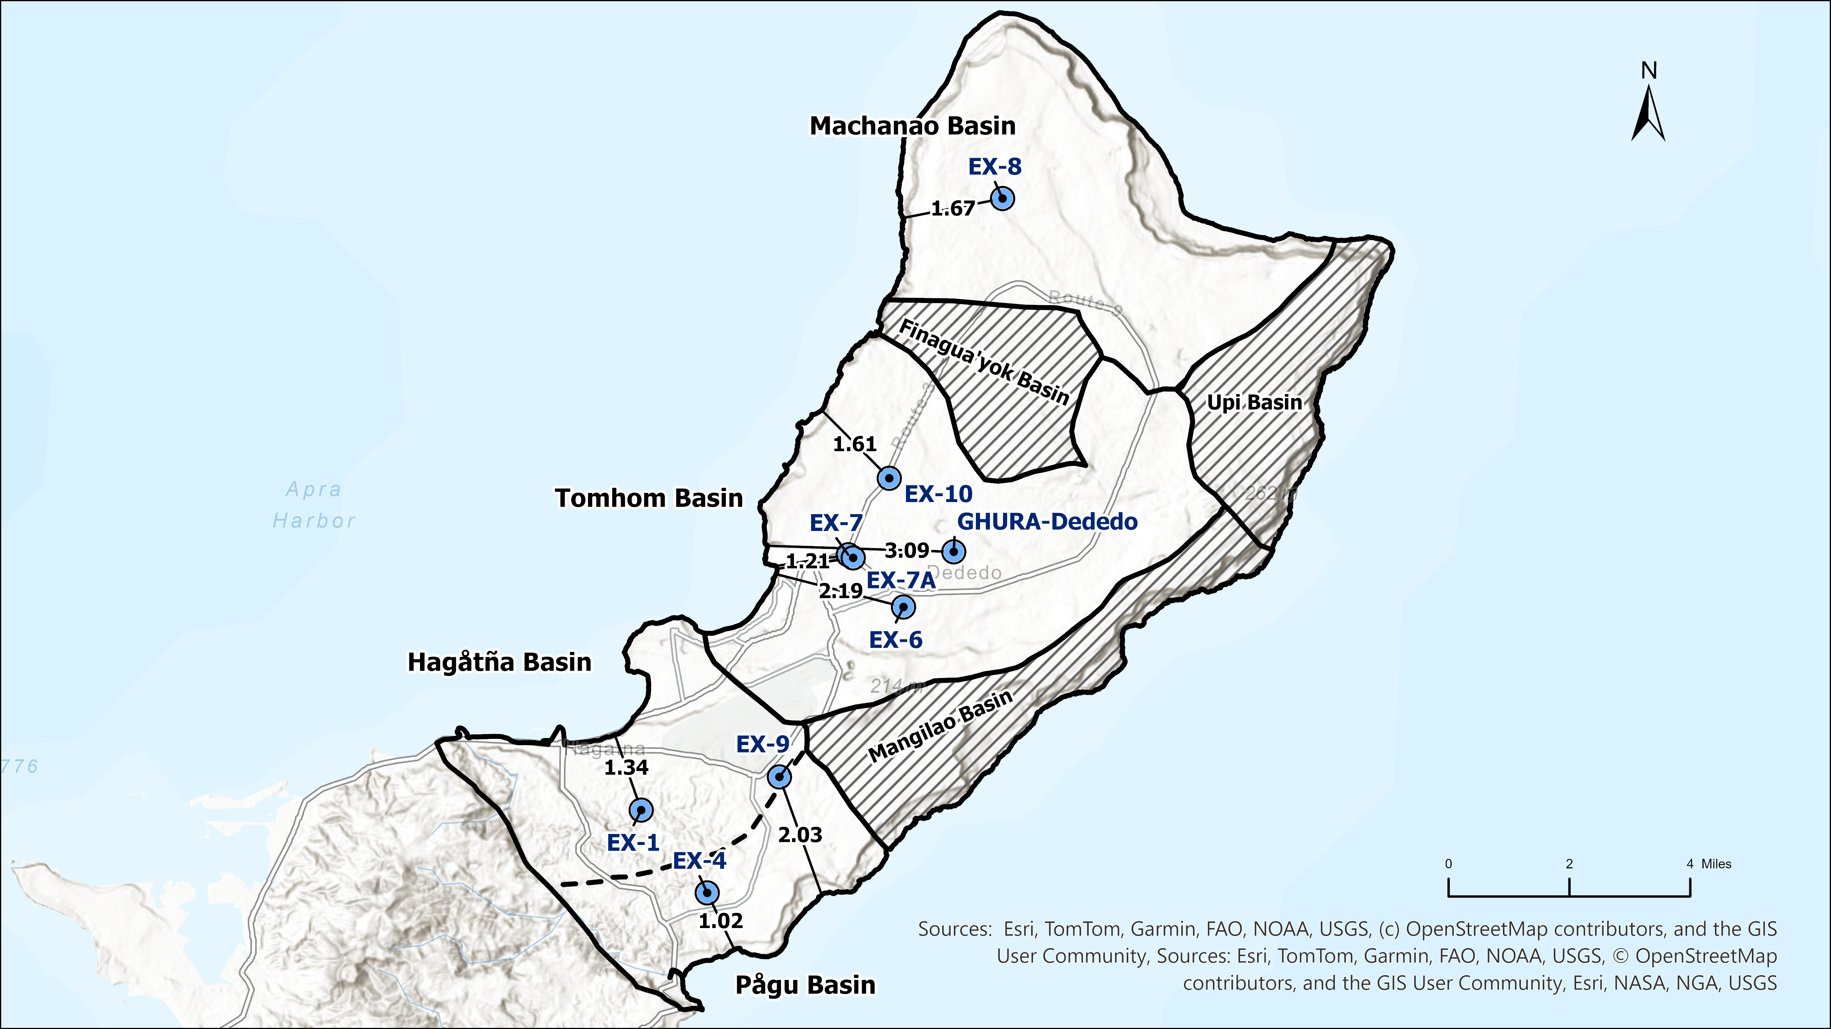
nearest distance to shore, miles
Notes:
Dows again
With distance to shore – ex 4 being closest and ghura dededo being most inland

Slide 7
nearest distance to shore, miles
Notes:
Dows again
With distance to shore – ex 4 being closest and ghura dededo being most inland

Slide 8
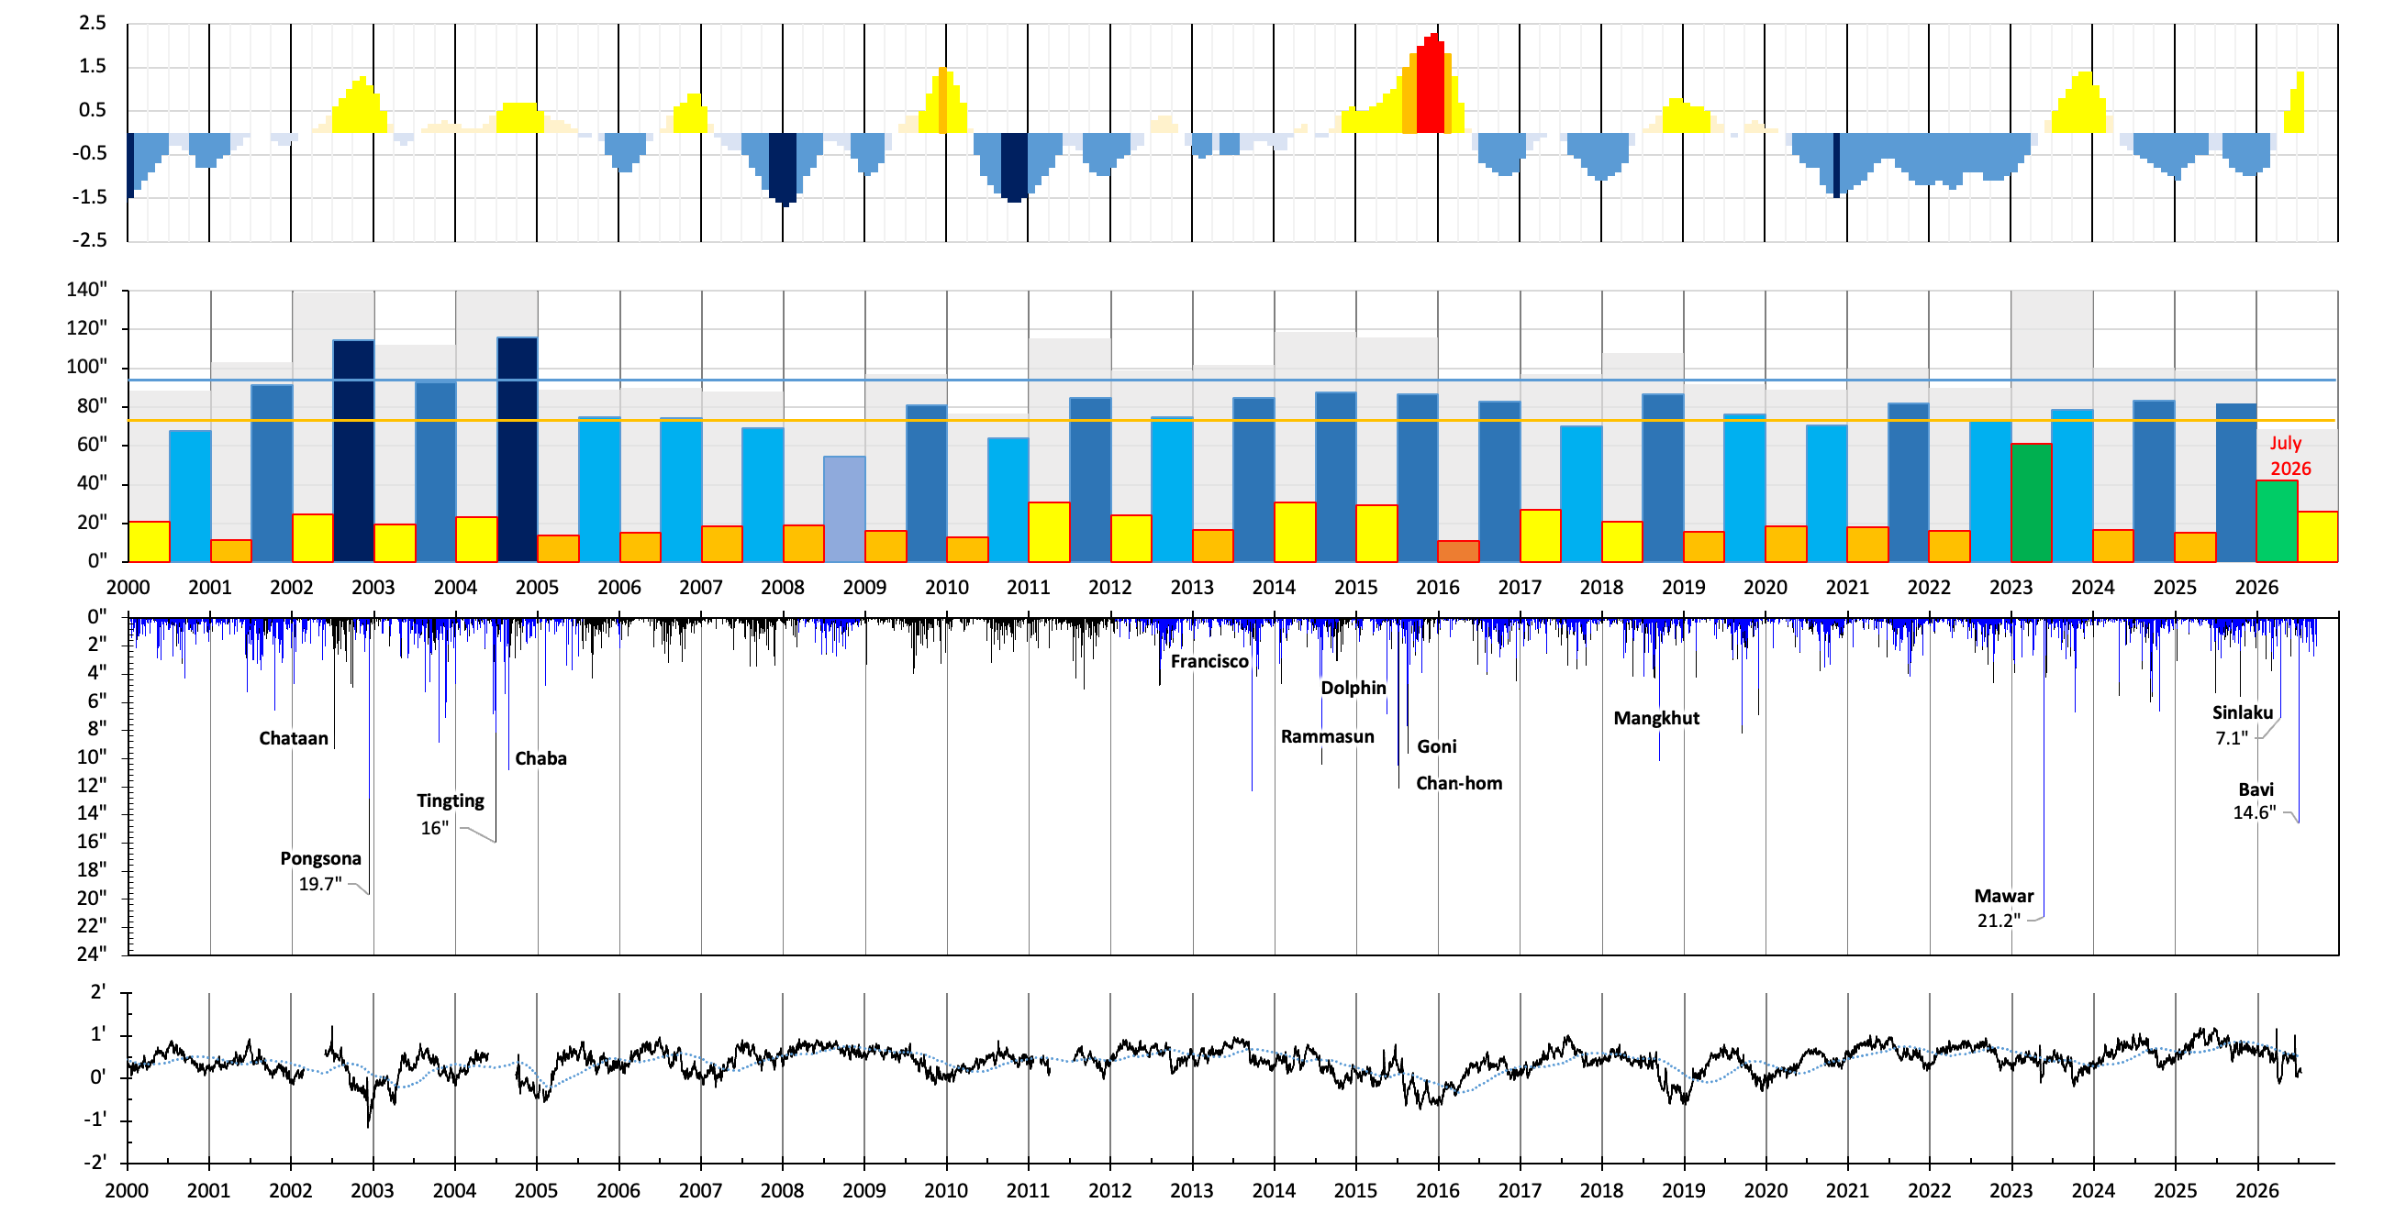
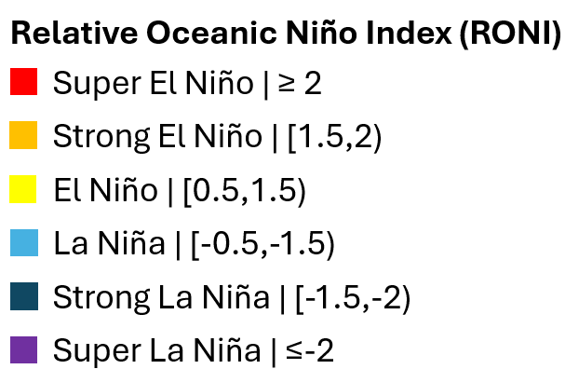
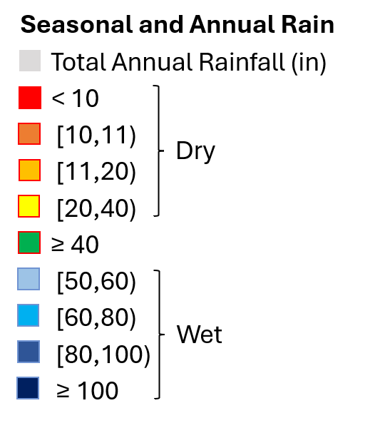
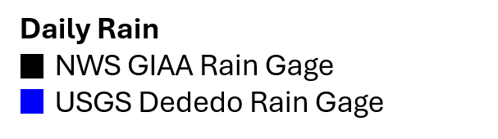
Legend
ENSO RONI
seasonal and annual rain
daily rain
sea level
Notes:
phreatic hydrograph contains these Hydrologic factors - go down the line eexplain
Annual rain greater than 100, greater than 140
usually brought by Typhoons – mention typhoons,
El nino coinciding with high rain especially during onset and peak
Sea level drop el nino
Prolonged drought period 2005 – 2011 The BIG NOTHING mark lander 6 years
Less than 100, more are less than 90 in – 2008 and 2010, less than 80 in
No typhoons
Double dip la nina – associated with less rainfall
Strong la nina following regular and strong el ninos
La nina sea level higher than 0
Drought post peak 2009-2010, 2016 – 2017, 2024
2016 drought, less than 11 inch in dry season
20 year running average – the 0
sea level may influence lens position
Following phreatic hydrographs discuss the response of the DOWs to these hydrologic factors

Slide 9
Timing of climatic hazards associated with El Niño
Pacific ENSO Applications Climate Center (PEAC)
Lander (2016)
Notes:
Enso

Slide 10
ENSO RONI
Legend
seasonal and annual rain
daily rain
sea level
Notes:
phreatic hydrograph contains these Hydrologic factors - go down the line eexplain
Annual rain greater than 100, greater than 140
usually brought by Typhoons – mention typhoons,
El nino coinciding with high rain especially during onset and peak
Sea level drop el nino
Prolonged drought period 2005 – 2011 The BIG NOTHING mark lander 6 years
Less than 100, more are less than 90 in – 2008 and 2010, less than 80 in
No typhoons
Double dip la nina – associated with less rainfall
Strong la nina following regular and strong el ninos
La nina sea level higher than 0
Drought post peak 2009-2010, 2016 – 2017, 2024
2016 drought, less than 11 inch in dry season
20 year running average – the 0
sea level may influence lens position
Following phreatic hydrographs discuss the response of the DOWs to these hydrologic factors

Slide 11
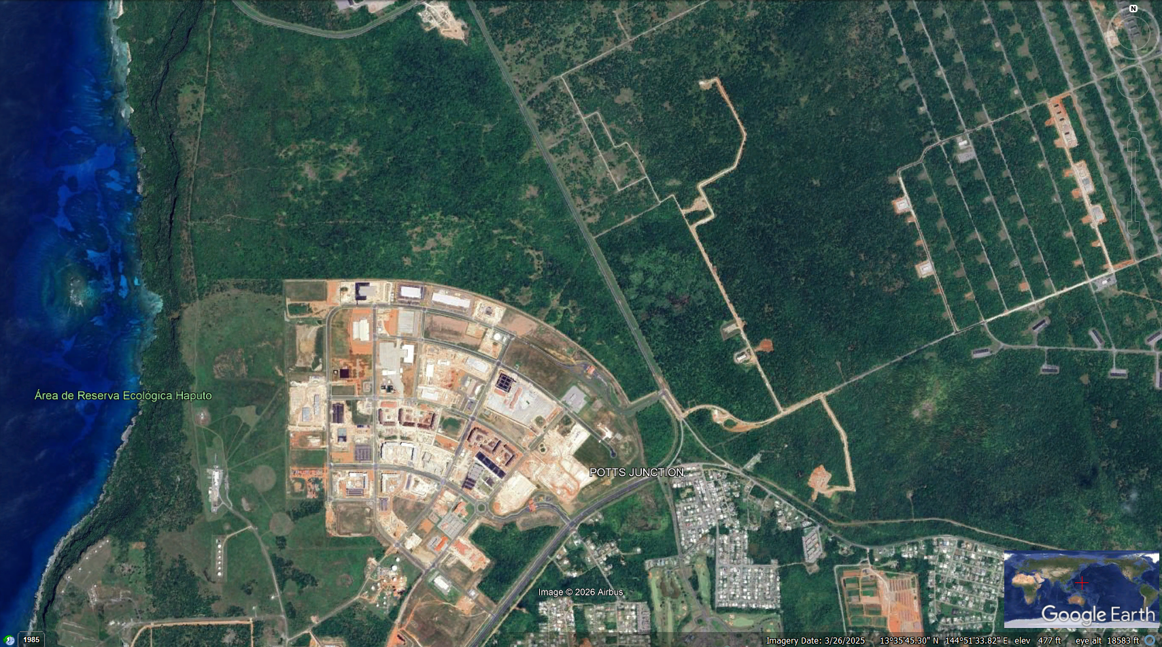
EX-8 location
EX-8
Camp Blaz
Rt. 3

Slide 12
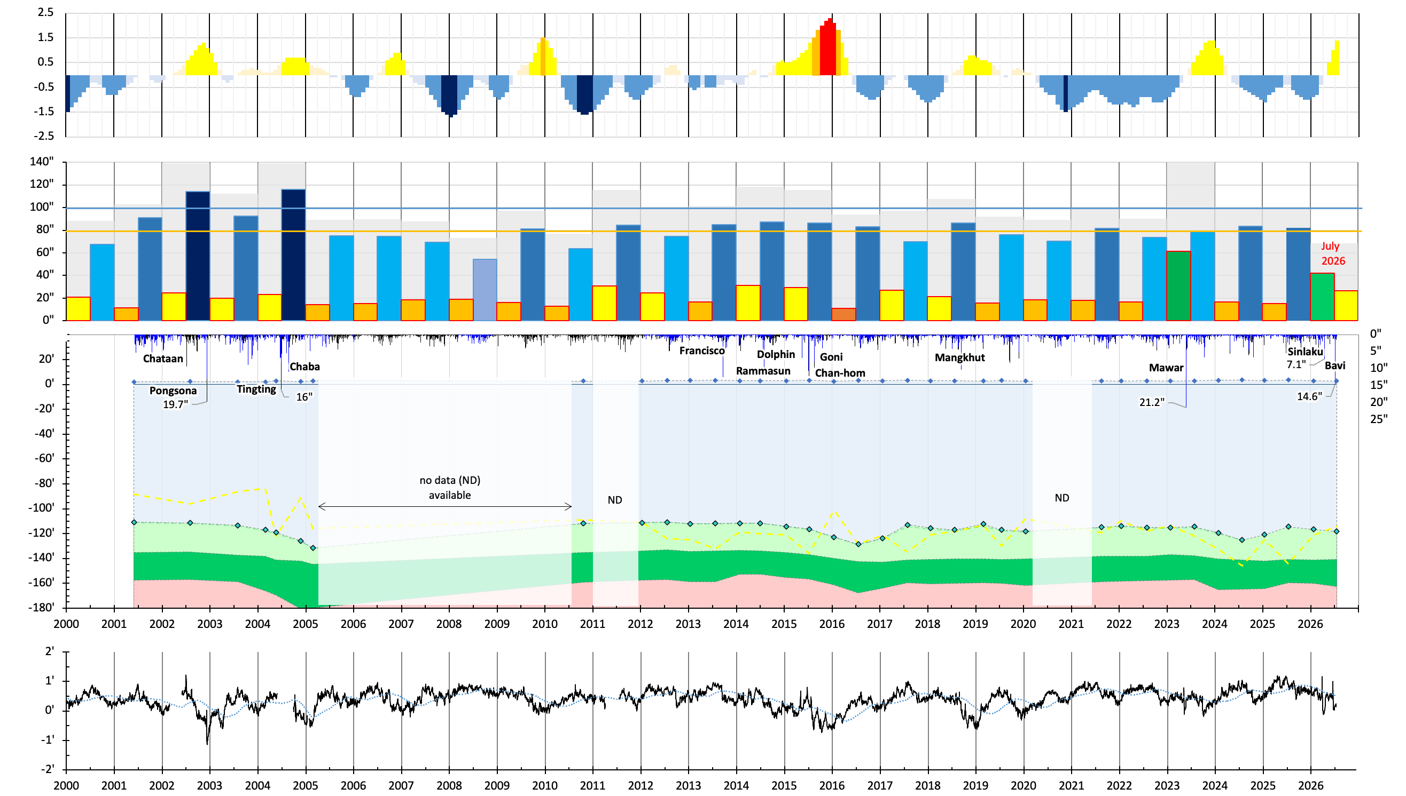
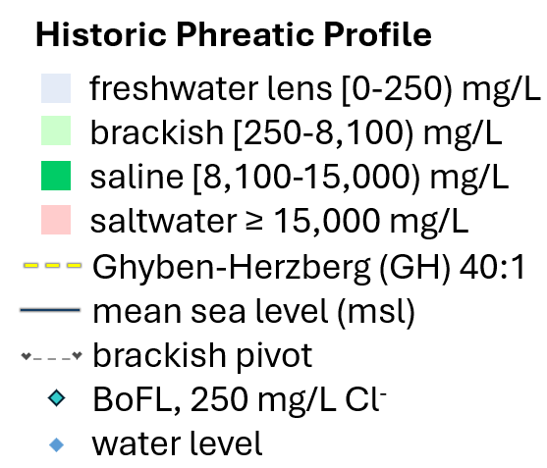
EX-8
daily rain
elevation

Slide 13
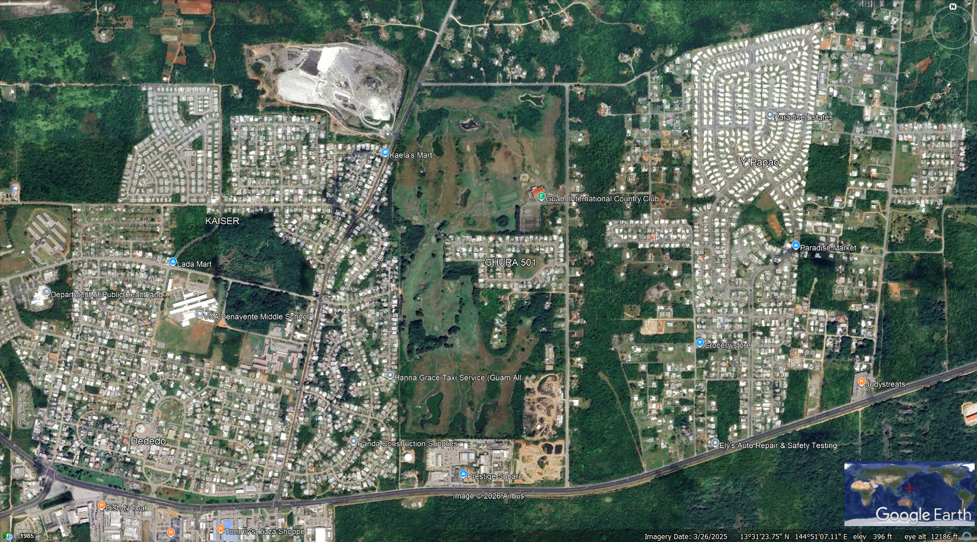
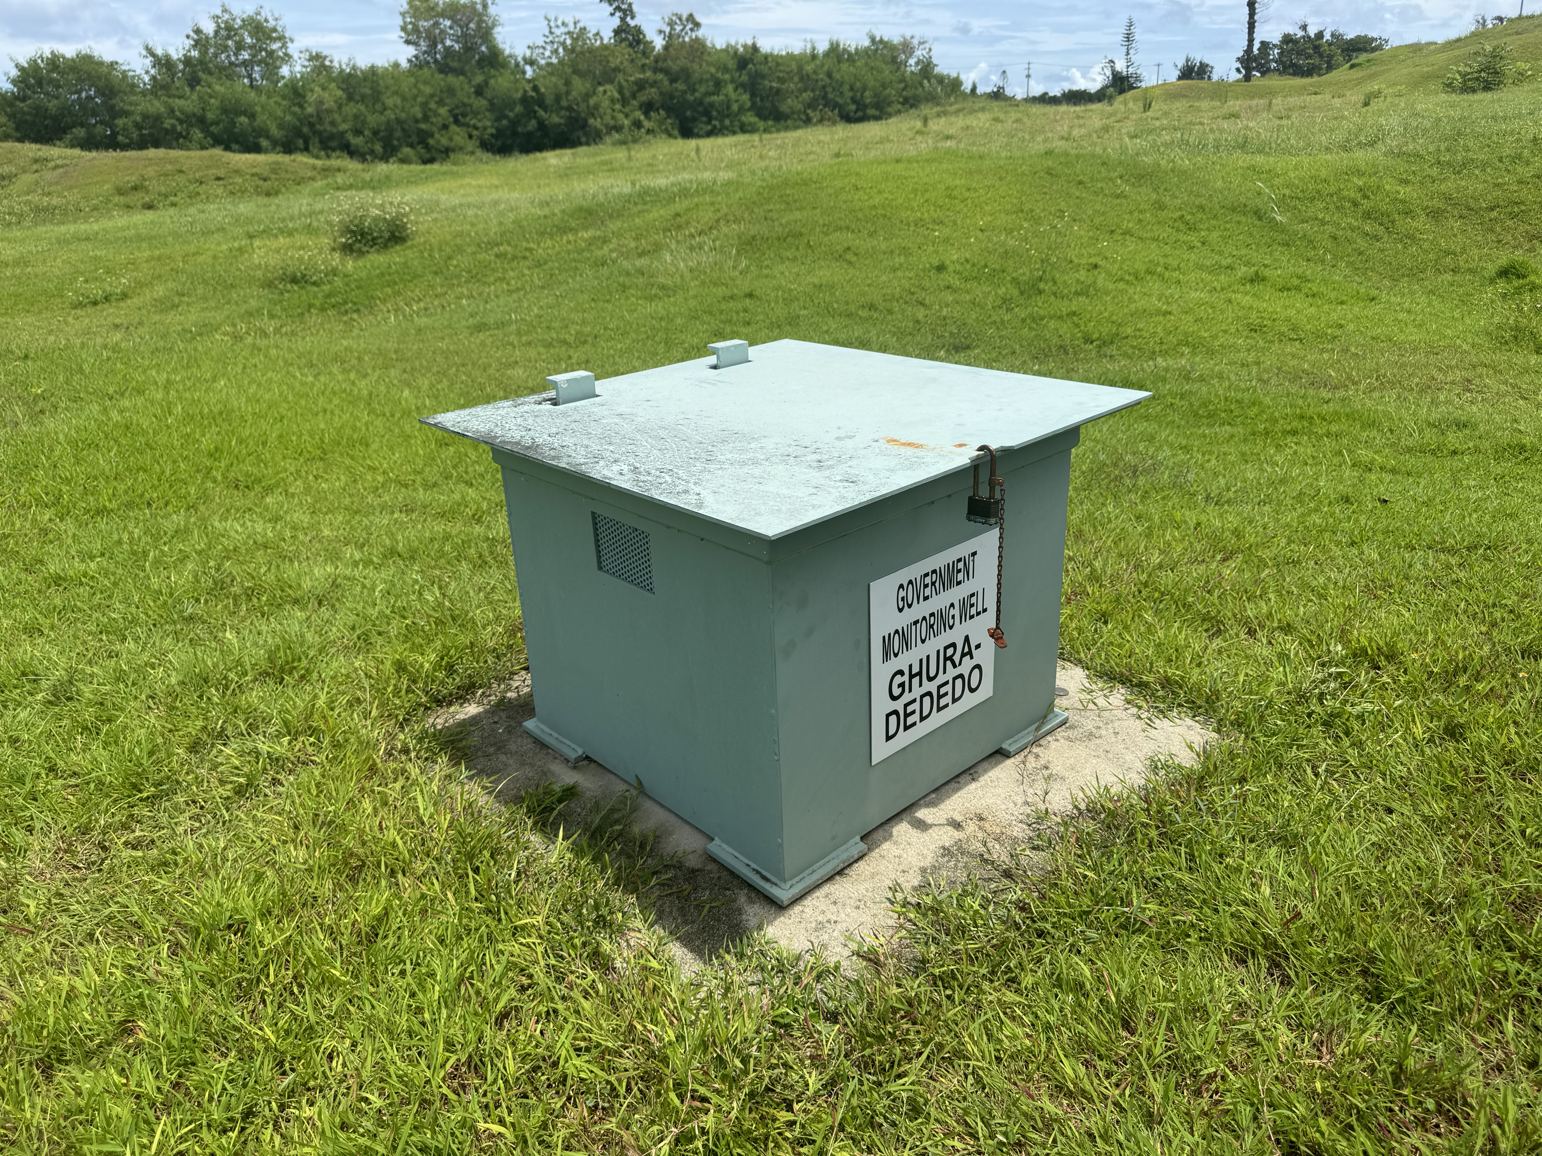
GHURA-Dededo location
GICC
GHURA-Dededo
Ysengsong Road
Rt. 1

Slide 14
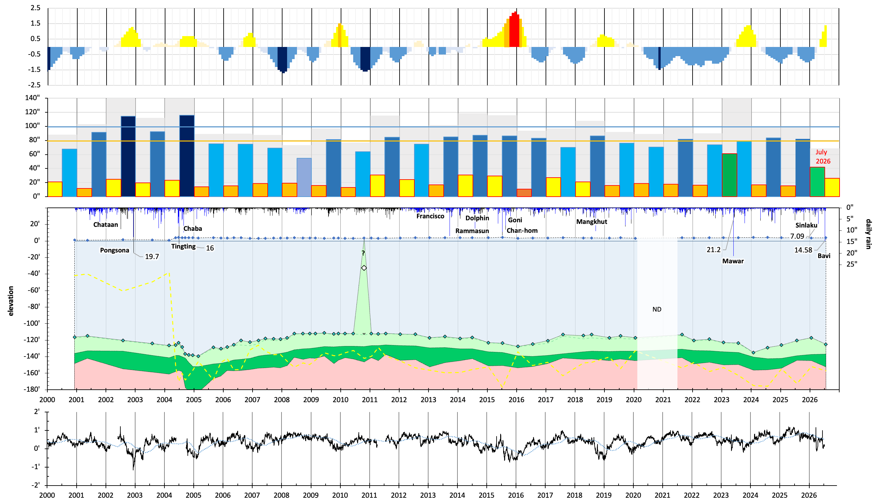
GHURA-Dededo

Slide 15
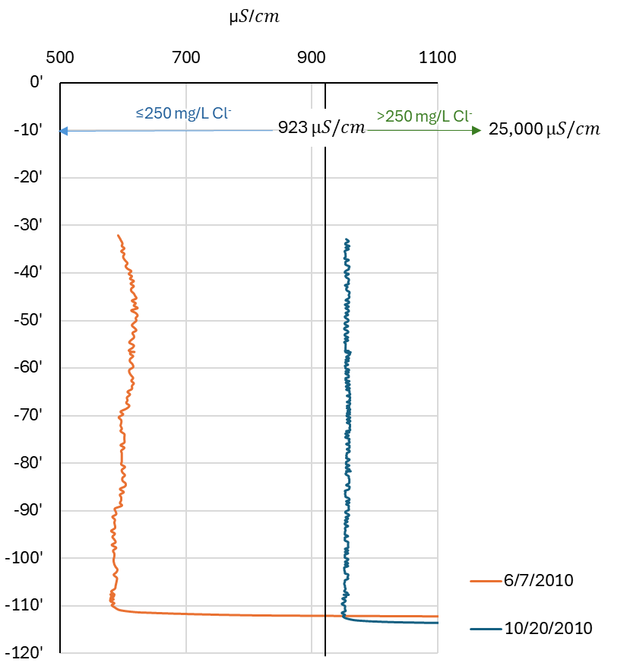
GHURA-Dededo conductivity profiles

Slide 16
GHURA-Dededo

Slide 17
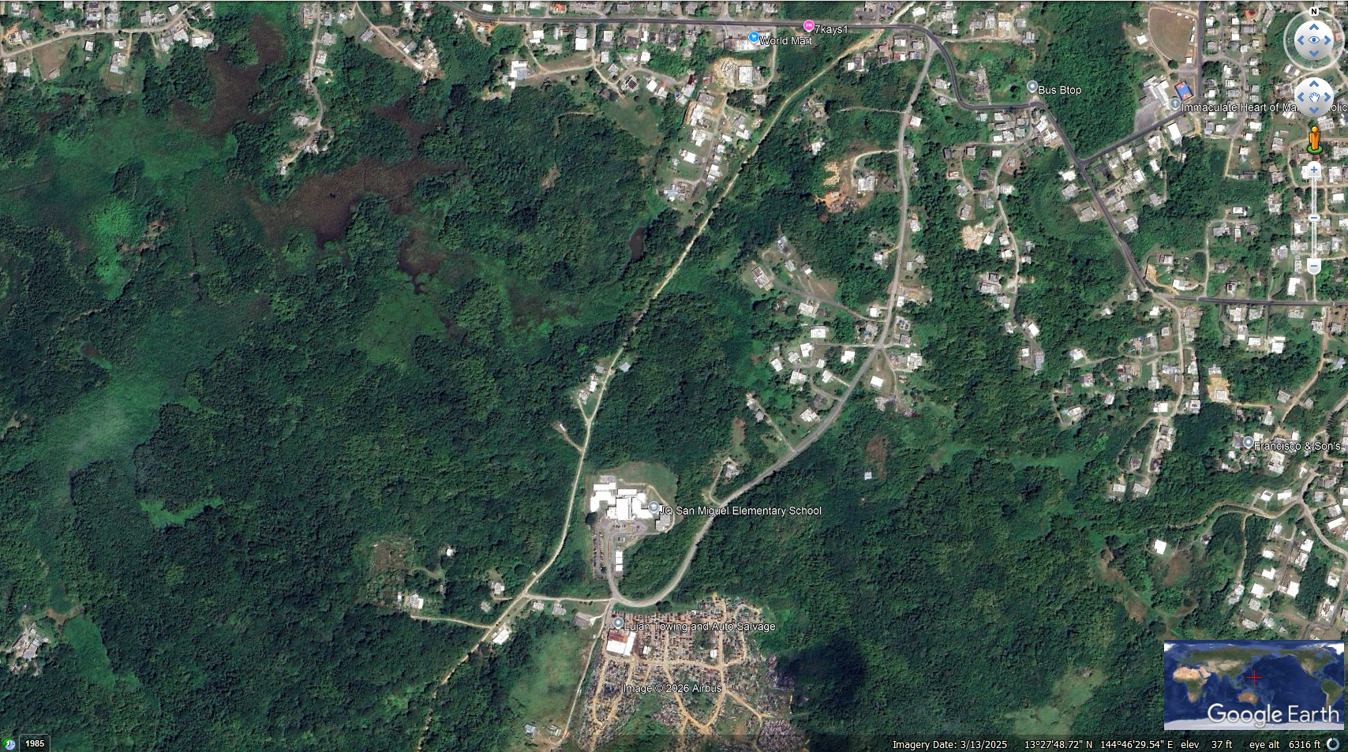
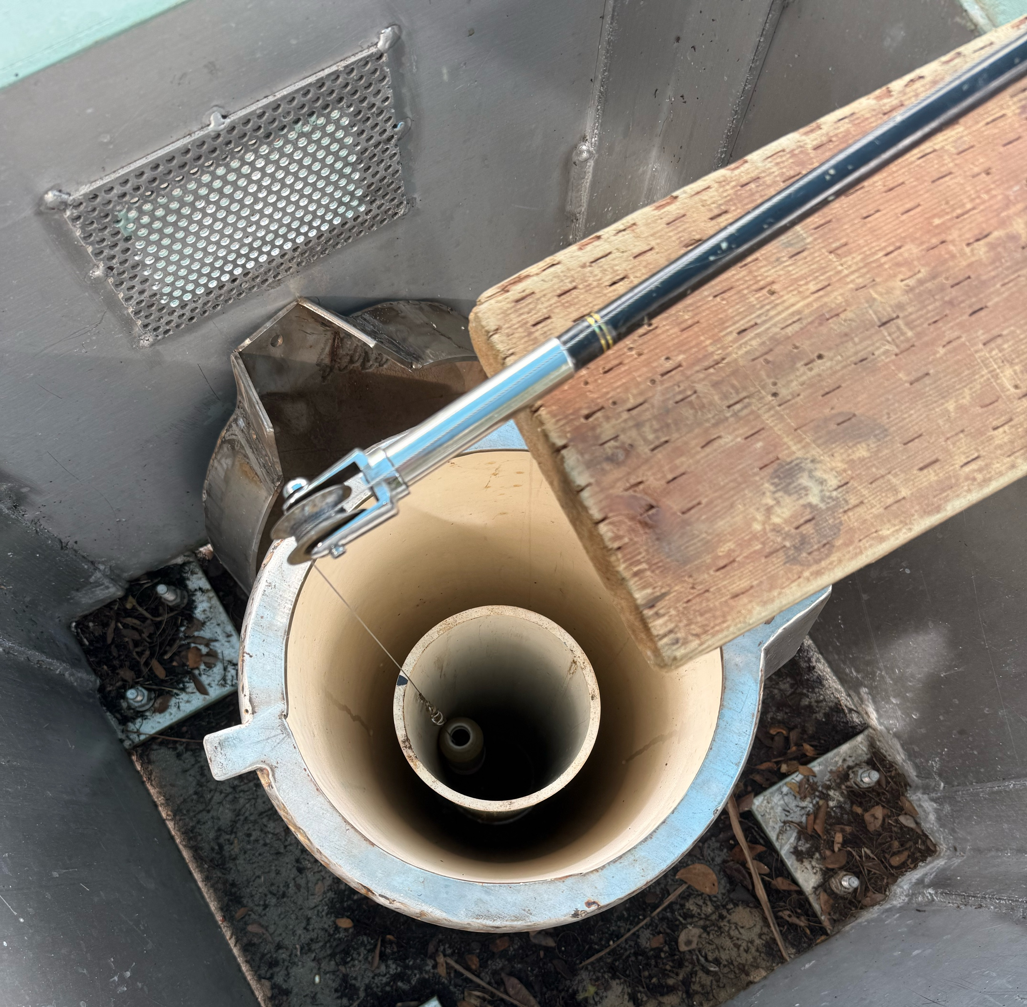
EX-1 location
Rt. 33
Immaculate Heart of Mary Church
Clara Rd
EX-1
J.Q. San Miguel
Elementary School
Lujan Towing

Slide 18
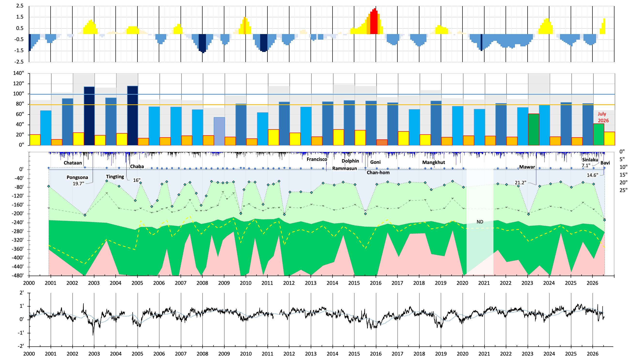
EX-1
daily rain
elevation

Slide 19
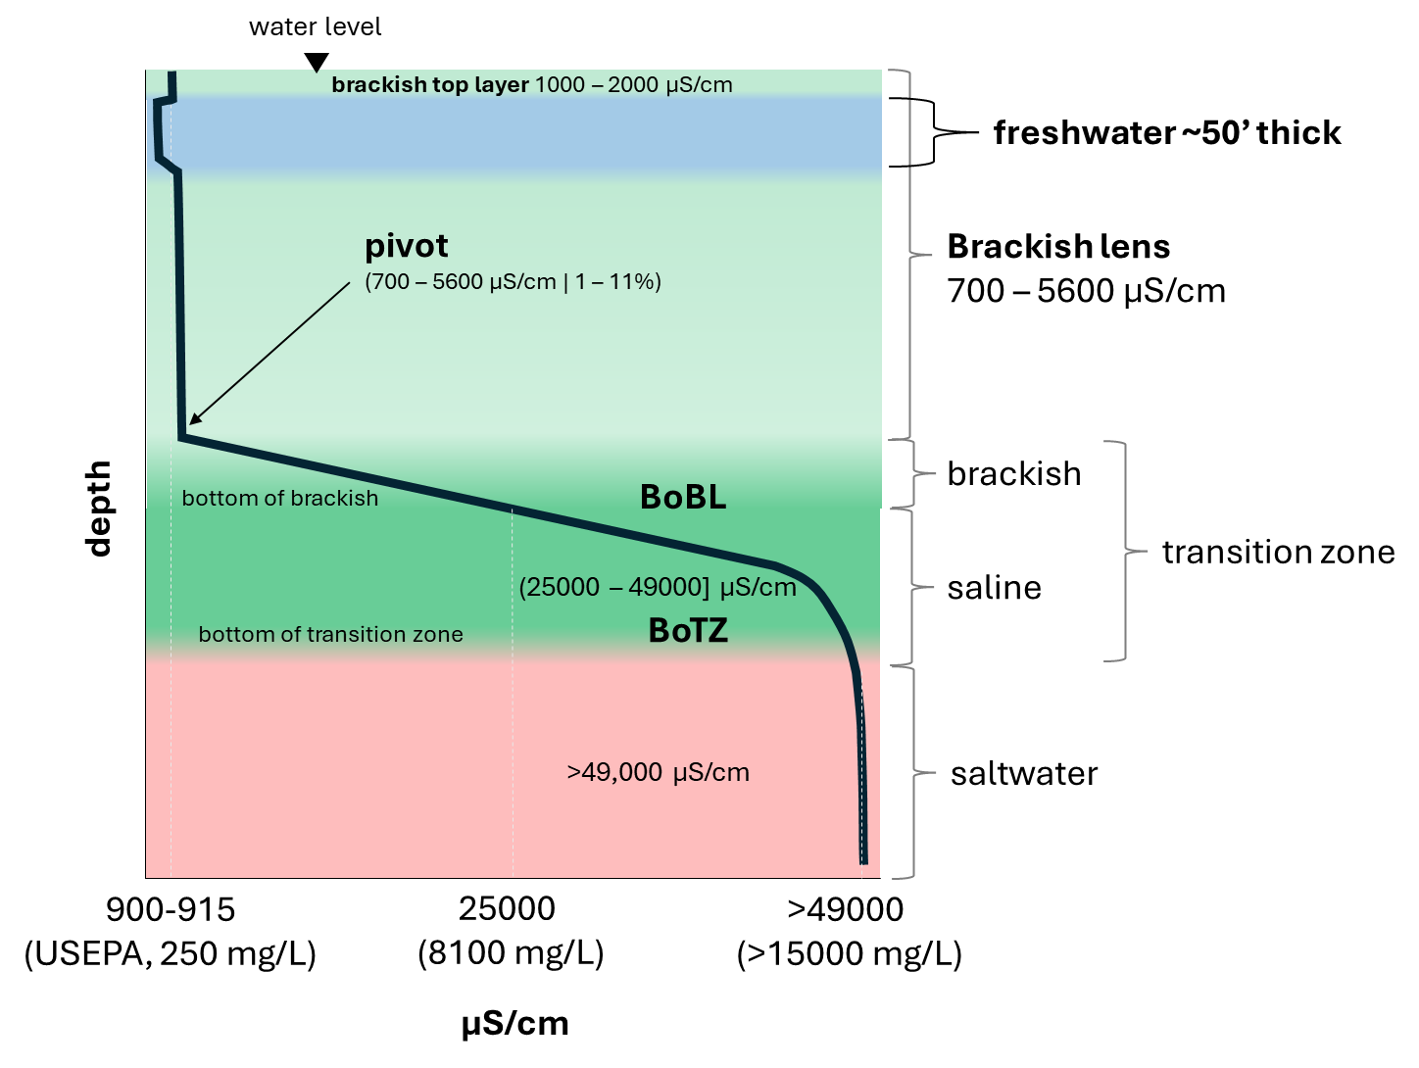
EX-1 generalized profile

Slide 20
EX-1
daily rain
elevation

Slide 21
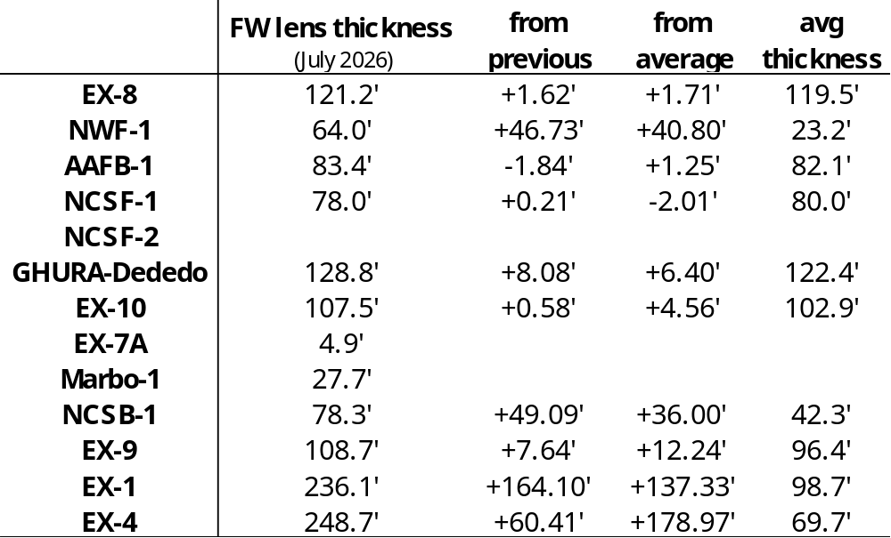

Slide 22
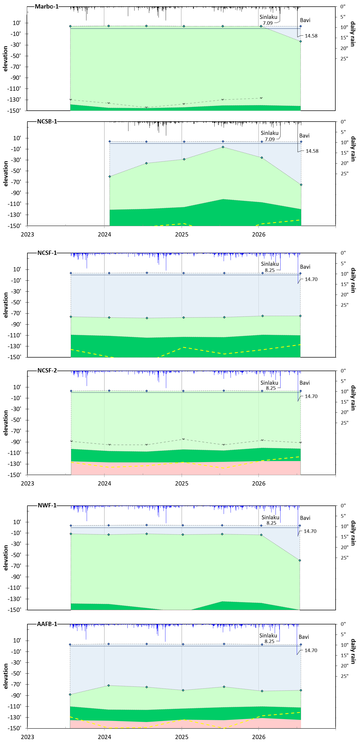
to be continued…
SOTAR 2026

Slide 23
to be continued…
SOTAR 2026

Slide 24

`
Technical Report 189
Thank you!

